Slide 1

Welcome back to school, and our Summer Term!

Slide 2

Strange times!
I know how strange it is saying ‘Welcome Back’ when most of us are stuck at home.
But the new term has started, and we should all be looking like this…

Slide 3
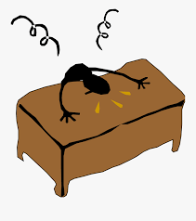
The truth is that we might be feeling like this…

Slide 4
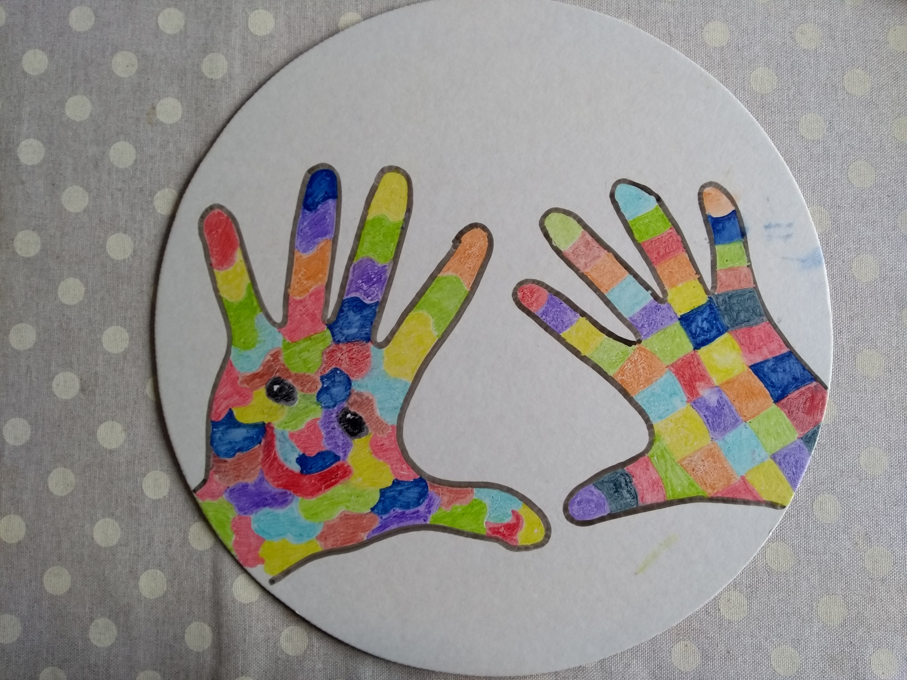
All of our emotions are confused at the moment.
I know how much I am missing seeing you all every day, and having the pleasure of watching you grow and learn.

Slide 5

Keeping busy!
But you have all been superstars!

Slide 6
Thank you for…
Your amazing home learning.
The wonderful photos you have sent in.
Keeping in touch, and for all of the great messages.
For making us smile, and for sharing the laughter.
For being the best school children in the world.

Slide 7
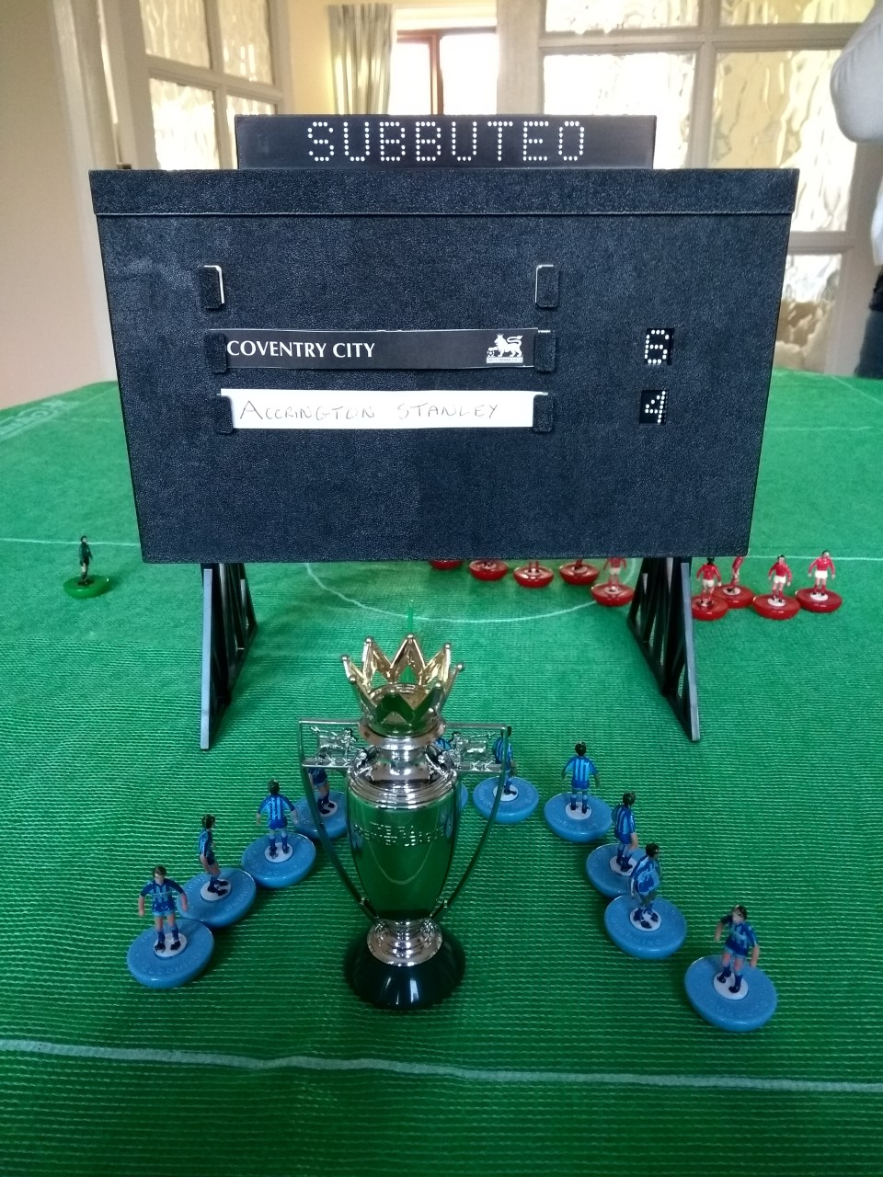
Thank you for keeping busy.
We have been playing out all of the remaining League One fixtures in Subbuteo! Guess who is winning!

Slide 8

Thank you for looking after each other.

Slide 9
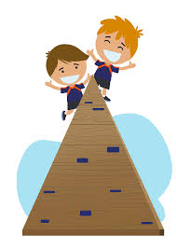
Now we have to keep going…!

Slide 10
This comes from the Bible.
Perserverance.
Let us not become weary in doing good, for at the proper time we will reap a harvest if we do not give up.
Galations 6:9

Slide 11
We have a very unusual few weeks ahead.
It is really important that we persevere, be amazing, be kind, be respectful, be safe, be creative and be focused.

Slide 12
I am sure that you will remember these photos of real patience and perseverance.

Slide 13
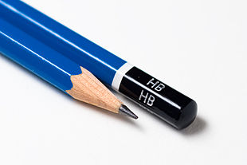
Notes:
Who has had a new one of these this year?
I love stationary. Is a pencil amazing or beautiful? How could it be? To draw something beautiful. Actually you need to think laterally (what is lateral thinking?)

Slide 14
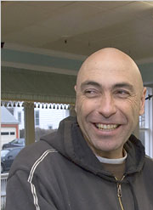
Dalton Ghetti
Dalton carves shapes out of pencil leads.

Slide 15
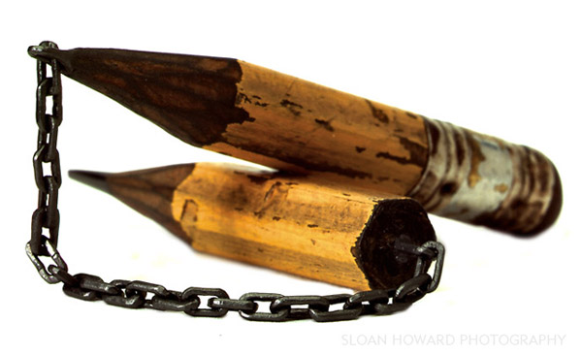

Slide 16
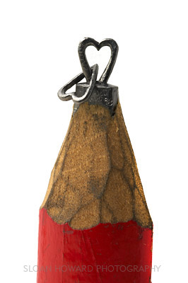

Slide 17
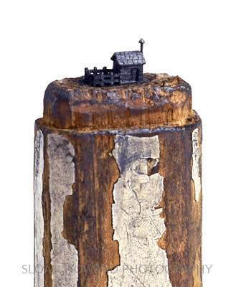

Slide 18
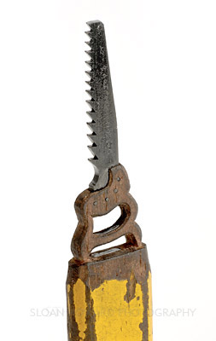

Slide 19
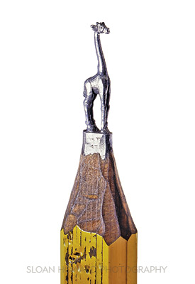

Slide 20
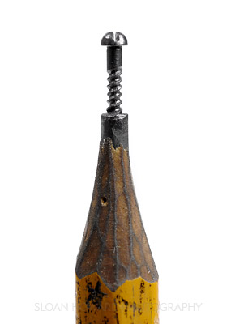

Slide 21
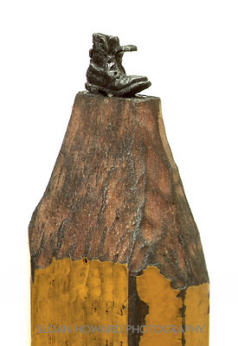

Slide 22
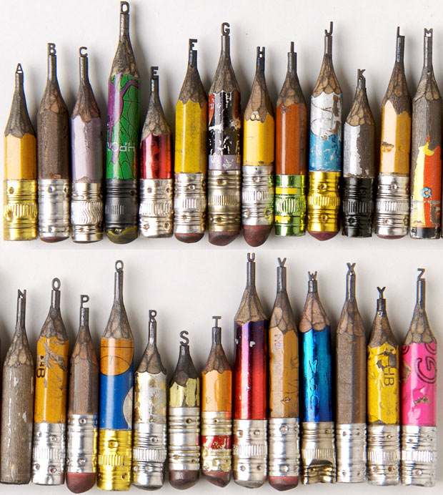
Notes:
Dalton began learning how to handle tools at the young age of 6 when at school in Brazil, he and the other students used either a razor blade or a pocket knife to sharpen their pencils for drawing and writing.
Also, his mother was a seamstress. When Dalton was 8 years old, she taught him how to use a sewing needle to help her with simple projects like hemming and sewing buttons. At the age of 9, his parents gave him a set of metal tools for children, which he used to make his own boxes, toys and go-carts. This is also the age when he began sculpting with knives, chisels and a hammer. Ever since, he has created many objects out of all kinds of materials.
At first, he carved large objects; but in 1986, as a challenge to himself and because of his interest in small living things, like plants (moss) and insects (spiders and ants), he decided to create the smallest possible carvings that he could see with his naked eyes. One day, he picked up a working pencil and started carving it.
His idea is to bring people’s attention to small things. Small is beautiful. Most of the pencils he uses are found on the streets and sidewalks. Dalton’s work is a recycling process. He turns discarded objects into art.
To create his sculpture, he holds the pencil in his hand under a strong light source (table lamp or sunlight) and carves it mostly with a sewing needle and a very sharp, triangular, small, metal blade. He works at very small intervals: 1 to 2 hours maximum per day whenever he gets inspired. He works very slowly by removing specks of graphite at a time. It therefore takes months or sometimes years to complete a sculpture.
For Dalton, sculpting pencils is a hobby and a form of meditation, which requires a lot of patience. His pencil carvings are not for sale. He doesn’t do it for money. He sculpts pencils mostly for himself and his art comes from his heart. He wants to keep it that way.

Slide 23
What can we learn from Dalton and his pencils?
We all need patience to succeed
Doing things for personal satisfaction
Sticking to something is very rewarding
Amazement at the little things, small is beautiful. Stop and notice
Things which might seem impossible can be achieved

Slide 24
So, what have we learnt today?
Never give up.
Always try your hardest.
When the going gets tough remember that everyone is here to support you.
Be an amazing team.
Be positive.
Be safe.
Be caring.
Be proud.
Notes:
The Pencil Maker took the pencil aside, just before putting him into the box.
"There are 5 things you need to know," he told the pencil, "Before I send you out into the world. Always remember them and never forget, and you will become the best pencil you can be."
"One: You will be able to do many great things, but only if you allow yourself to be held in Someone's hand."
"Two: You will experience a painful sharpening from time to time, but you'll need it to become a better pencil."
"Three: You will be able to correct any mistakes you might make."
"Four: The most important part of you will always be what's inside."
"And Five: On every surface you are used on, you must leave your mark. No matter what the condition, you must continue to write."
The pencil understood and promised to remember, and went into the box with purpose in its heart.
Now replacing the place of the pencil with you. Always remember them and never forget, and you will become the best person you can be.
One: You will be able to do many great things, but only if you allow yourself to be held in God's hand. And allow other human beings to access you for the many gifts you possess.
Two: You will experience a painful sharpening from time to time, by going through various problems in life, but you'll need it to become a stronger person.
Three: You will be able to correct any mistakes you might make.
Four: The most important part of you will always be what's on the inside.
And Five: On every surface you walk through, you must leave your mark. No matter what the situation, you must continue to do your duties.
Allow this parable on the pencil to encourage you to know that you are a special person and only you can fulfill the purpose to which you were born to accomplish.
Never allow yourself to get discouraged and think that your life is insignificant and cannot make a change

Slide 25
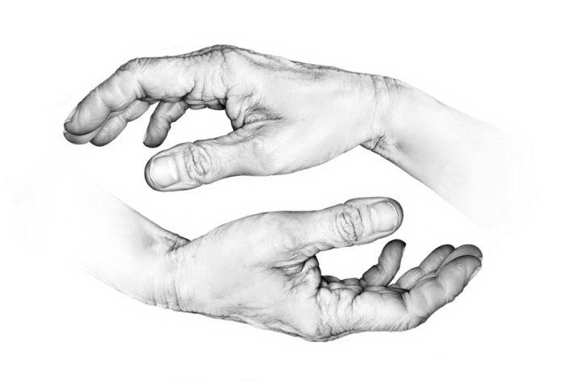
Dear Lord,
Help us to be patient. Help us to be kind. Help us to persevere and never give up. Help us through these difficult times. Amen.
Notes:
I think of you as my pencils. Lots of different shaped and sizes, but all have the potential to achieve something amazing. You will make mistakes, but hopefully nothing a little bit of corrections and guidance from us – you are here to learn, you can’t learn unless you make mistakes. You need to try and make an impression

Slide 26
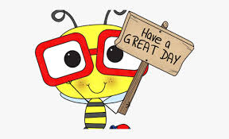
Have a great day!

