Slide 1

Good morning everyone.
Welcome to our Monday assembly for 27th April 2020

Slide 2

I hope that you are all safe and well.
Thank you to everyone who has sent me a picture of themselves with their special certificate> It is always great to hear from you!

Slide 3
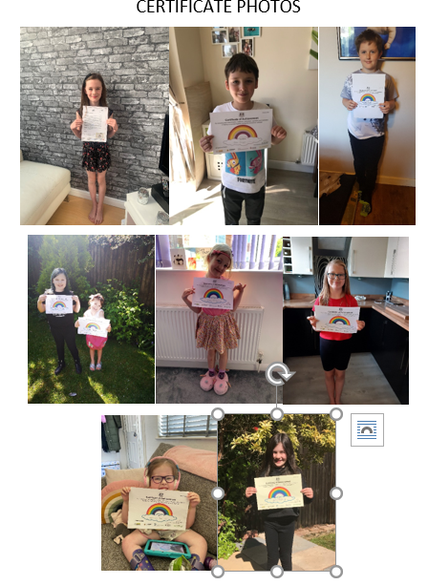
This is just a selection…

Slide 4

Today have a close look at our school logo…

Slide 5
We held a competition in school and this was the winning design.

Slide 6
That was about 15 years ago.
I wonder if you can guess what each part of the design means?

Slide 7

Why are there hands?

Slide 8
The hands are all in different skin colours, showing how we are all equal, and the circle of hands show how we are a team.
In these difficult times it is more important than ever that we stay as a team – TEAM ALL HALLOWS!

Slide 9

Why is there a church?

Slide 10
This is pretty obvious.
We are a church school, and we need to always remember that special connection.

Slide 11

So why are there these two children, sitting, reading?

Slide 12
This shows how we come to school to learn, and reading is just one of the skills that we teach you to do.

Slide 13

And finally, why are there scales?

Slide 14
Well on the scales are people and they are equally balanced. This shows how much we value equality, patience, kindness, and thoughtfulness.
‘We are all equal in the eyes of God,’ is a phrase from the Bible, and this symbol shows this.

Slide 15
I wonder how different our school logo would be if we designed a new one today? Maybe you could even have a go and send it to me, although I can’t promise that we could change the one we use.

Slide 16
Whatever you are doing today, just remember that our school logo teaches us some key values, and shows us that we are a team.
EVEN THOUGH WE ARE APART WE ARE STILL
TEAM ALL HALLOWS!

Slide 17
A prayer
Dear Lord,
Help us always to remember that we are part of a team. Help us to be kind and considerate.
Amen

