Slide 1
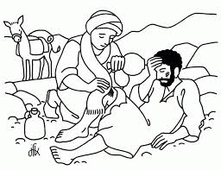
The story of jesus.
ThE PARABLE OF THE GOOD SAMARITAN.
(read it in LUKE’S GOSPEL, CHAPTER 10)

Slide 2

Monday assembly for 6th may 2020
Welcome and good morning everyone!

Slide 3
Monday notices
Thank you for your amazing home learning!
Thank you for your lovely letters and photos!
Well done to everyone for keeping going and smiling.

Slide 4
Don’t forget…
As you know Friday 8th May is VE day, I will putting a special service on line that day.
Sunday 10th May the theme is Helpers and Heroes. Which will tie in with VE day and the present situation.
Rev Mic says, ‘If you have time could get the children to do pictures of people who are their heroes and helpers. I’m going to include them in a song video for the service. Thank you and keep safe God bless. Mic.’
You can send me copies/photos to Mic at michael.johnsons@hotmail.com

Slide 5
Name some people who help us? At the moment there are loads of people…!

Slide 6
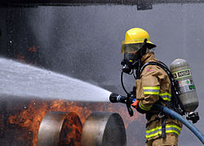
Here are some…

Slide 7
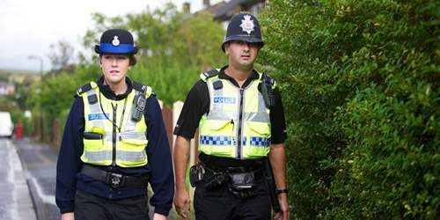

Slide 8
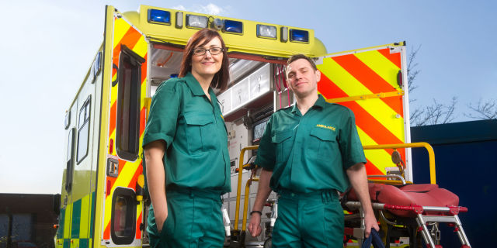

Slide 9
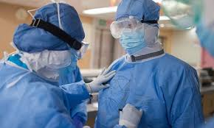

Slide 10
Jesus tells us :
‘Love God with all of your heart; and love other people as yourself.’

Slide 11

More than ever it is important that we look after each other!

Slide 12
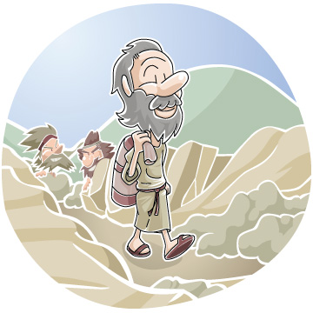
The good samaritan

Slide 13
I know that you know the next story, but it is more important than ever now.

Slide 14
There once was a Jewish man walking along a road. He was coming from Jerusalem and was heading to Jericho, which was a full day or two of walking.
The road was rocky and there were small hills all around. The man was just humming to himself and enjoying the nice day when suddenly a group of men jumped out from behind a hill. They took all his belongings and tore off most of his clothes. They didn't want him to follow them so they beat him up very badly, and left him lying and bleeding on the side of the road.

Slide 15
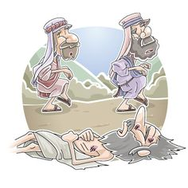

Slide 16
A few minutes later, a priest was walking down the same path and noticed the man lying on the side of the road. Do you know what he did? You'd think he would run over and help the man. Instead he crossed the road and walked on the other side and acted like he didn't see the man.
About an hour or so later, another man, called a Levite, was walking down the road. Levites were people who assisted priests with their work. He would probably help the man. But you know what he did? He slowed down and walked a little closer to the man, but then kept walking without helping him at all.
You might be thinking that maybe the man lying by the side of the road looked like he was resting or something and that is why the priest and the Levite didn't stop to help. The trouble is, it was easy to tell he was badly hurt. The man was bleeding, had most of his clothes ripped off him, and he was bruised and hardly breathing.

Slide 17
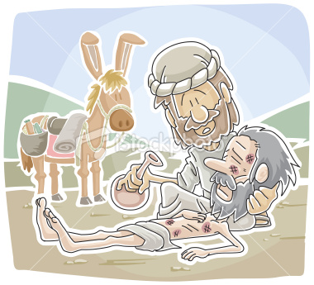

Slide 18
Just a few minutes later, another man came walking. He was a Samaritan. One thing you should know about Samaritans is that Jews didn't like them. Jews usually didn't treat Samaritans very well, so they never got along. The man who was dying on the road was a Jew. So what do you think the Samaritan did? You would think he would walk by and maybe even laugh at the man.
But as soon as he saw the man, he went over to him and felt compassion for him. He put bandages on his sores and poured oil and wine (which were quite expensive) on the sores to prevent them from getting worse. Then he lifted the man on his own donkey and took him to a hotel to take care of him.
The next day the Samaritan took out enough money so the man could stay at the hotel until he was well enough to leave. He paid the man at the front desk and asked him to take care of the man. If he wasn't better after about two months the Samaritan would come back and pay for any extra cost."

Slide 19
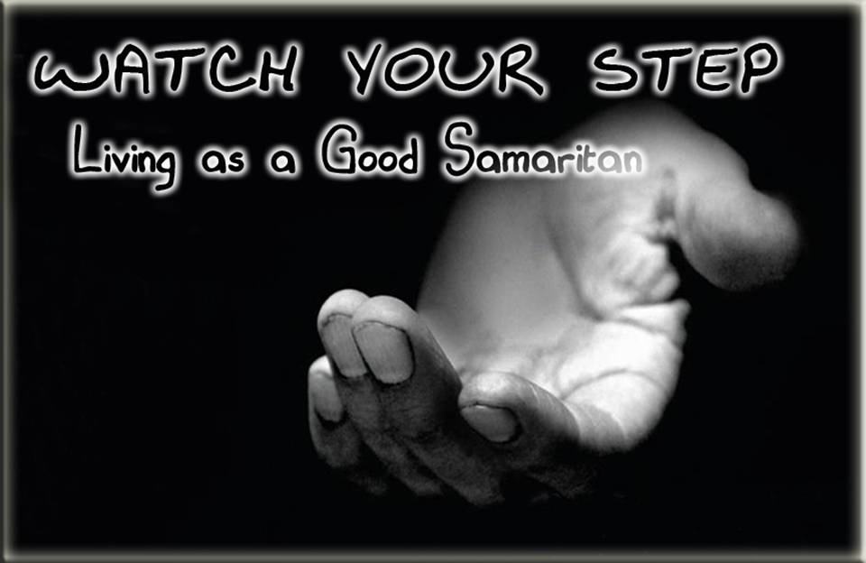
It is more important than ever that we help each other, and do not walk by on the other side.

Slide 20
Dear Lord,
Thank you for the story of the Good Samaritan.
Help us to be kind and helpful, and not to walk by on the other side.
We thank you for all of the key workers who are looking after us. They are our Good Samaritans.
Amen

Slide 21

Reflection time.

Slide 22
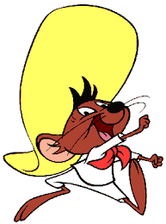
HAVE A GREAT DAY EVERYONE!

