Slide 1
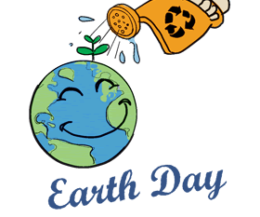
Earth day 2020
Taking action

Slide 2

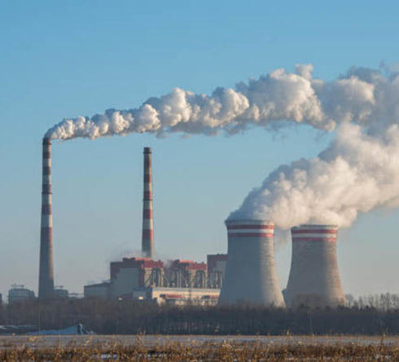
What to do
To make a difference you can do lots of things. like: planting trees, using less plastic and don’t use your car as much.

Slide 3




When does it takes place
Earth day takes place every year 22 of April

Slide 4
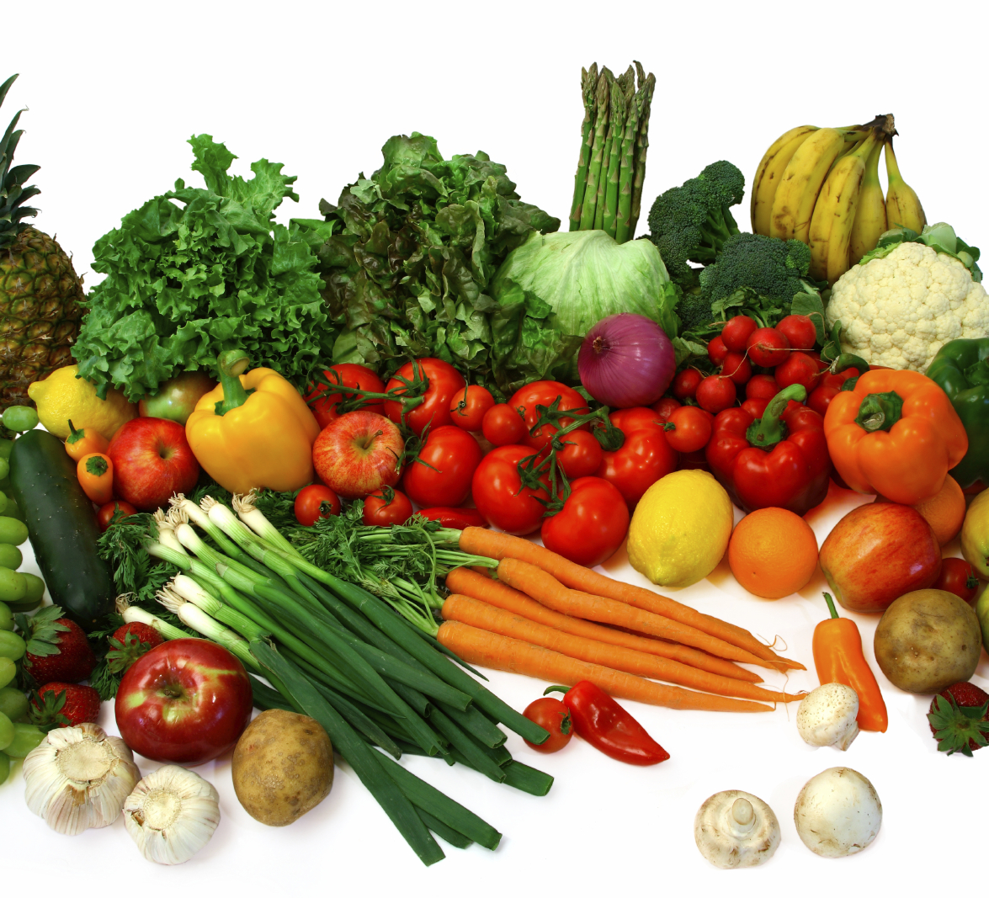
Meat, meat and more meat!
A lot of the worlds pollution comes from meat and it adds to green house gasses. So please try and eat more veg.

Slide 5
Green house gases
Green house gas is a harmful type of gas which is harmful to wild life it is made with pollution.

