Slide 1
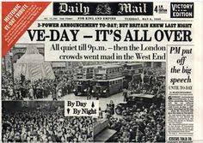
Our VE Day assembly

Slide 2

Good morning everybody!
Welcome to our special VE Day assembly.
I hope that you are all safe and well.
Thank you for your amazing learning, your wonderful photos, and for simply being the best you can be!

Slide 3
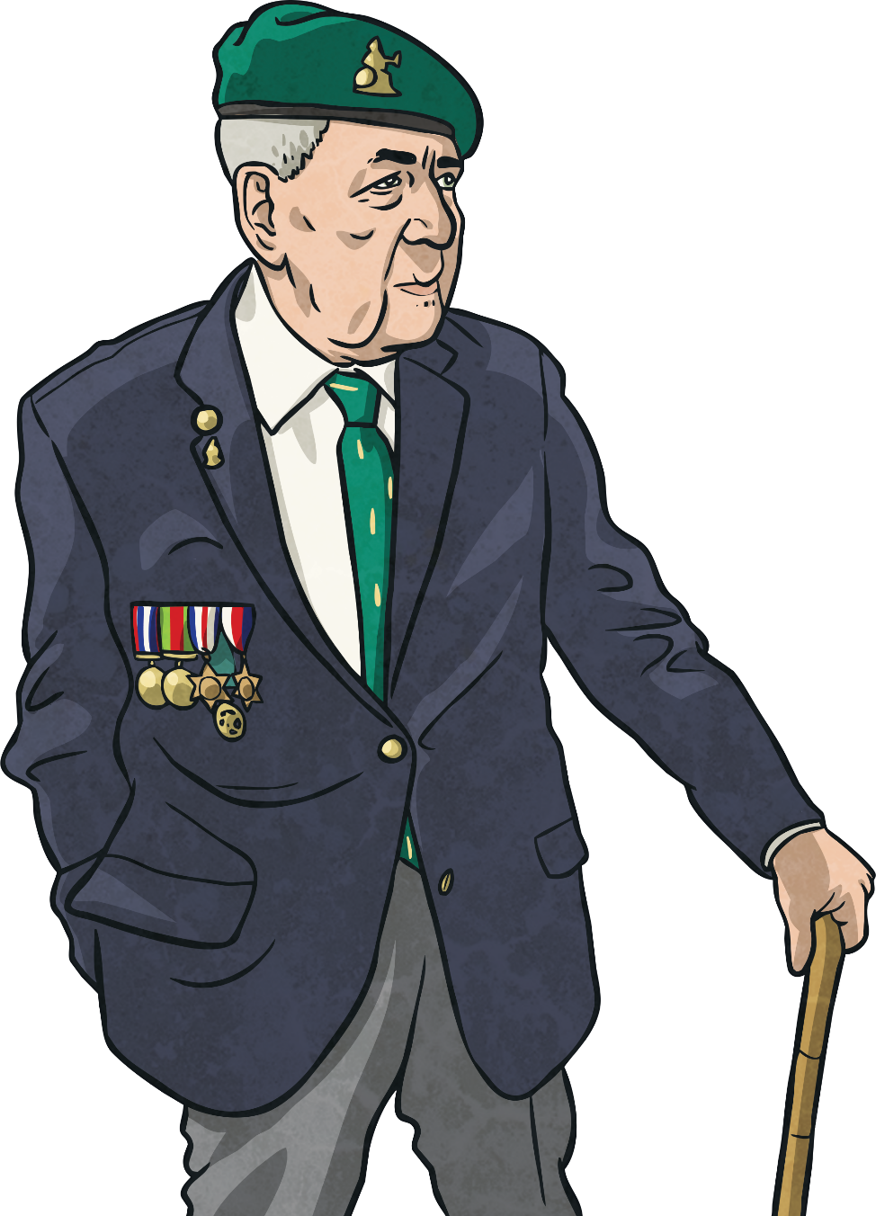
So what is VE Day?
Victory in Europe Day
VE Day
Victory in Europe Day

Slide 4
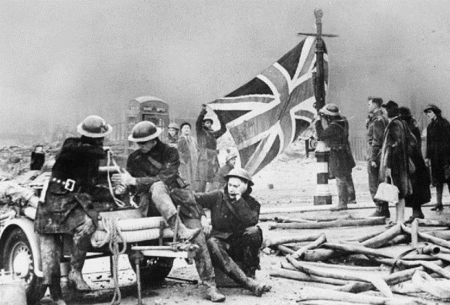
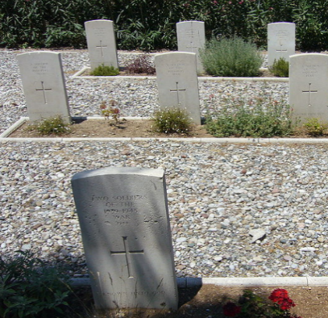
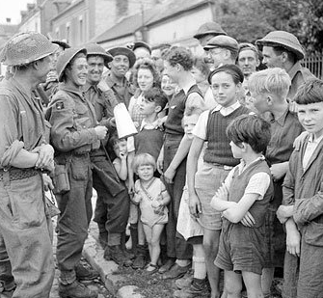
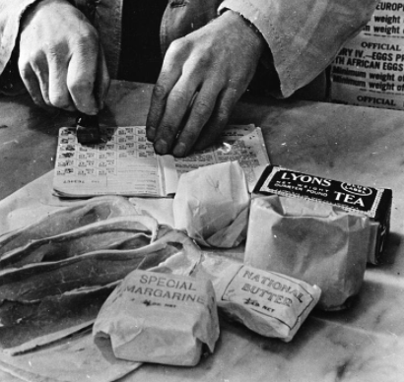
Second World War
Britain had been at war since September 1939.
The war had caused great hardships for the entire country.
Cities, such as Coventry, London and Plymouth were badly bombed and many were killed. Buildings were destroyed and people were left homeless.
384,000 British soldiers were killed and many more
were wounded.
It was usually impossible for soldiers to visit home due to
the war.
Food was rationed; before the war, Britain imported lots of its food from abroad. With German submarines manning the seas, importing food was too risky.

Slide 5
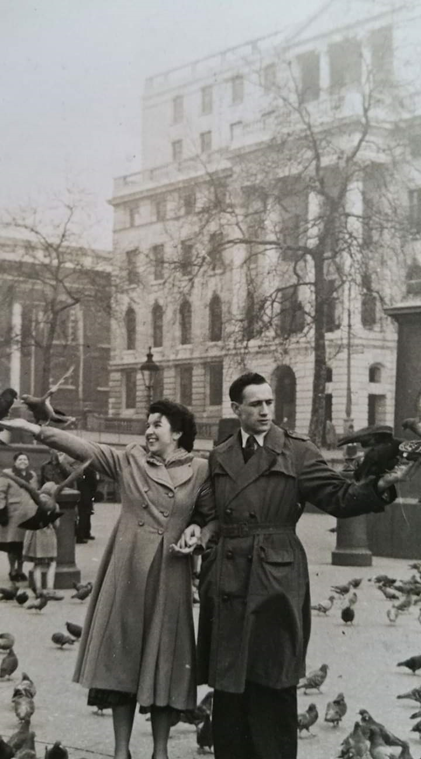
This is my mum and dad, on their honeymoon in London.

Slide 6
On the night of the blitz in Coventry she was just 14.
On that night the Luftwaffe dropped 500 tons of high explosive, 30,000 incendiaries and 50 landmines. It was also trying out a new weapon, the exploding incendiary.

Slide 7
On the 14th November 1940 my mum was in bed. She was one of seven children, and shared a room with her younger brother. When the air raid siren went off, instead of going to the Anderson Shelter in the back yard she and her brother stayed in bed. They had heard lots of sirens before.

Slide 8
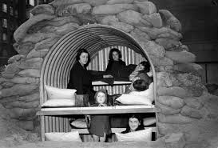
This is an Anderson shelter, and you were meant to go into it when the sirens signalled an air raid.

Slide 9

My mum was very lucky. A bomb came through the roof, and right through the bedroom ceiling, and through to the kitchen below. It was a fire bomb, but it did not explode!

Slide 10
She told us this story MANY TIMES, and how they ran down stairs, and were pulled into the pantry by their distraught mother (my Nan). They stayed there all night, and when they emerged the next morning, they saw this…

Slide 11
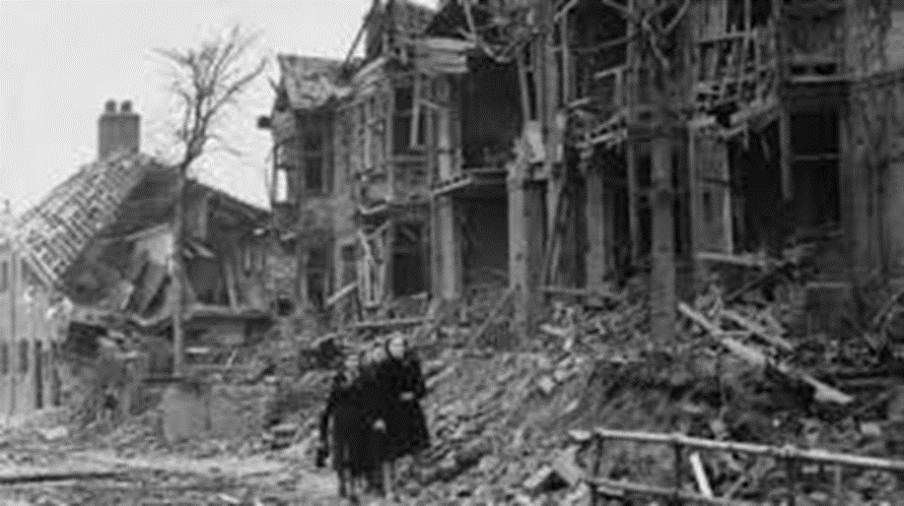

Slide 12
Their house had been badly damaged, but they were alive and realised how lucky they were.
How different the story could have been.

Slide 13
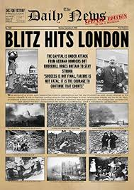
The war carried on for nearly five more years, and many cities suffered the same fate.

Slide 14
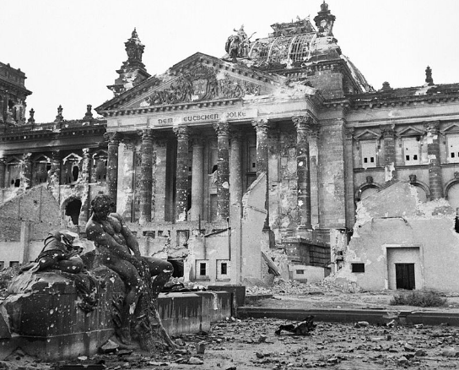
The End
By the end of April 1945, the leader of Italy, Benito Mussolini and the leader of Germany, Adolf Hitler, were dead. Germany was in ruins.

Slide 15
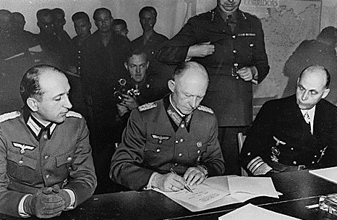
The End
On 7th May, at 2.41 a.m., in Reims in France, Germany surrendered.
This meant that the war in Europe was over.

Slide 16
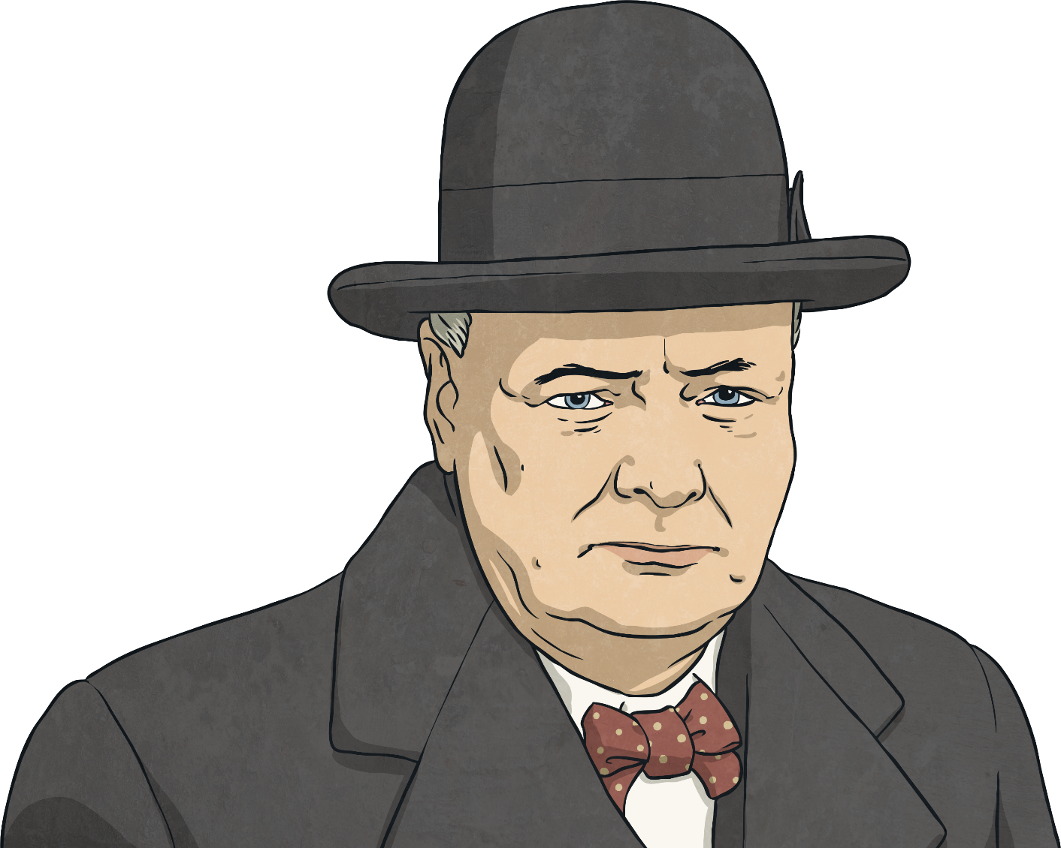
The News Spreads
Before long, the exciting news spread that the war in Europe was over. People ran out on the streets to celebrate and church bells were rung to spread the news.
In accordance with arrangements between the three great powers, tomorrow, Tuesday, will be treated as Victory in Europe Day and will be regarded as a holiday.

Slide 17
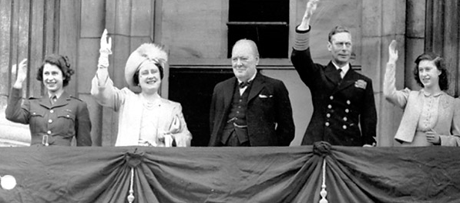
VE Day
The following day was one of great celebration. Churchill made a speech in which he said: ‘My dear friends, this is your hour. This is not victory of a party or of any class. It's a victory of the great British nation as a whole.’
Communities had street parties and churches held services of thanksgiving.

Slide 18
Celebrations!
My mum fondly remembered the celebrations of VE day.
They had been through so much!

Slide 19
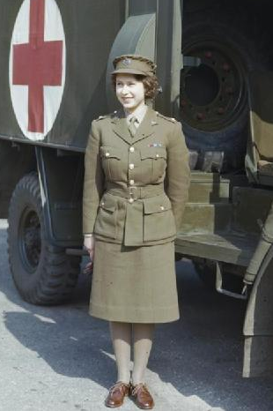
Sneaking out to Celebrate
When she appeared on the balcony of Buckingham Palace, Princess Elizabeth was wearing her ATS uniform.
Overjoyed at the people’s celebrations, the Princess asked her parents if she and her sister might join. The King and Queen agreed on the condition that they went in a large group of people, who would look after them. No one in the crowd realised that two princesses were in their midst!

Slide 20
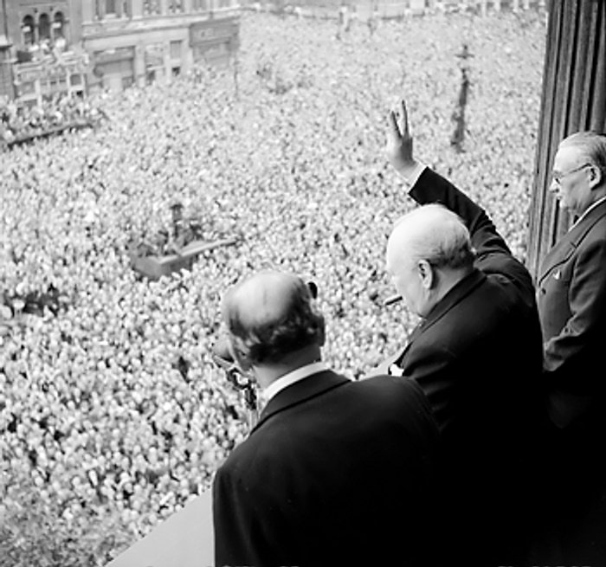
The Ongoing Battle
During the celebrations, Churchill reminded people that there were still problems to be faced when he said, “We may allow ourselves a brief period of rejoicing; but let us not forget for a moment the toil and efforts that lie ahead.”

Slide 21
Today, we had planned a big street party in school.
We were going to decorate the school, and have a celebration afternoon tea on the playground!
It is so sad that we are not together to be able to do this.

Slide 22
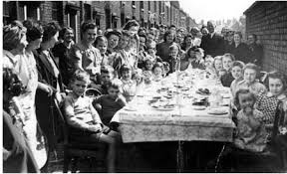
I hope that we can get back together soon.
In the meantime, I hope that you can have your own VE Day garden party. Send me your photos if you do!

Slide 23
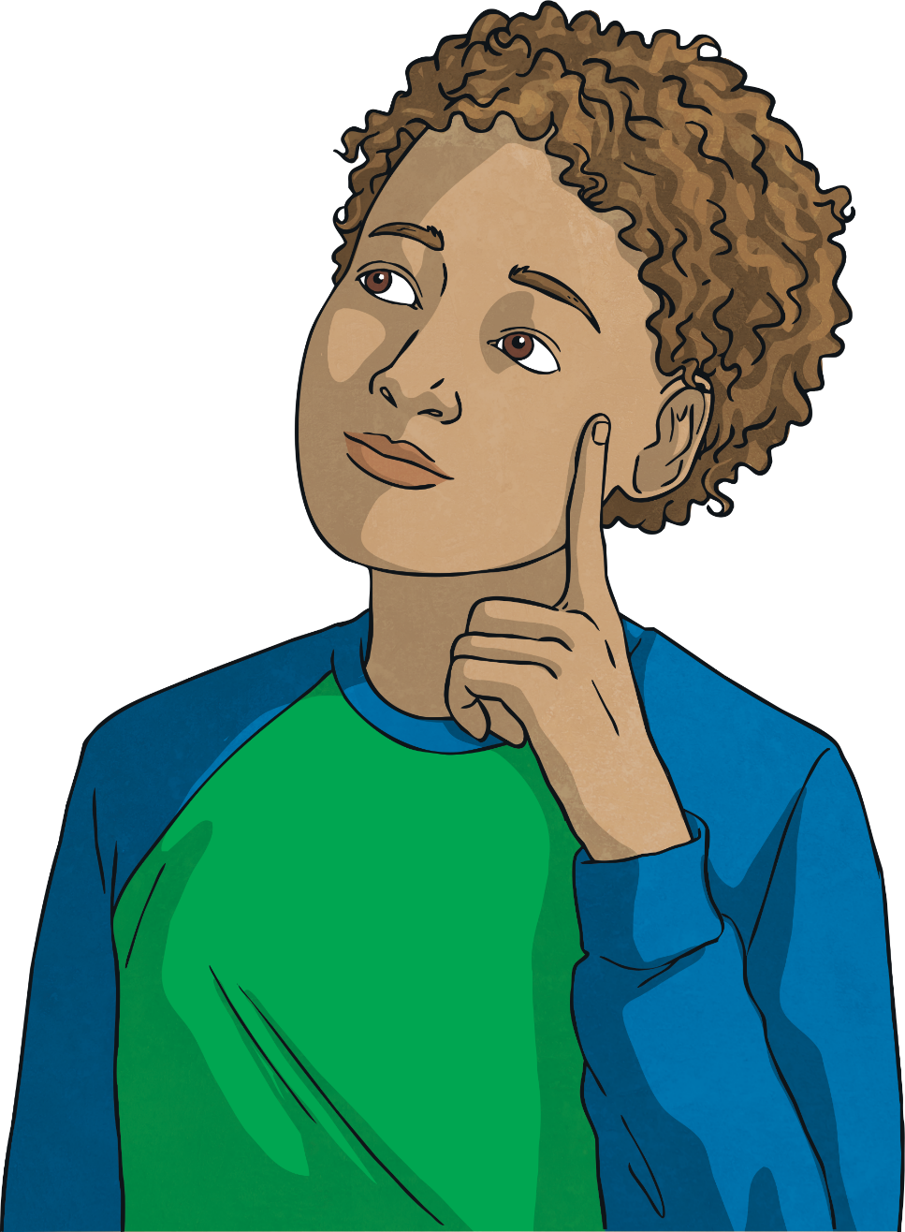
Time to Reflect
In his VE Day speech, Winston Churchill said, “Do not despair, do not yield to violence and tyranny, march straight forward.”
We are facing our own difficult times at the moment. So in your thoughts and prayers today remember the past, reflect on the present, and look forward to the future.

Slide 24

Song

Slide 25
Have a great VE Day.
Look after yourselves, keep smiling and I hope to see you all soon.

