Slide 1
Good morning everyone.
Assembly for Monday 11th May
Hello everyone. I hope that you are well, and had a great weekend.
Did you do anything special for VE Day?
We had street party, with everyone sitting on their own lawns eating cake!
We all sang ‘We’ll meet again’ and we even had a dance on our own driveways. It was good fun.

Slide 2
Happy birthday and thank you.
If it is your birthday this week, I hope that you have a good day.
Thank you to everyone who has sent me a message or a photo. It is always great to hear from you.

Slide 3
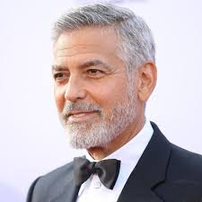
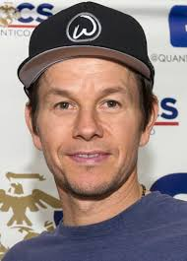
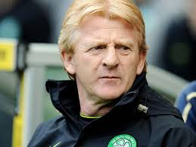

Have you ever met someone famous?
I am lucky to have a good friend who works in the film industry and he sometimes asks me to go to film premieres with him. So I have met …
And best of all…….

Slide 4
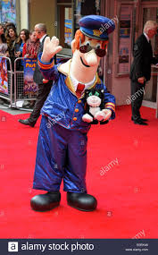
POSTMAN PAT!

Slide 5
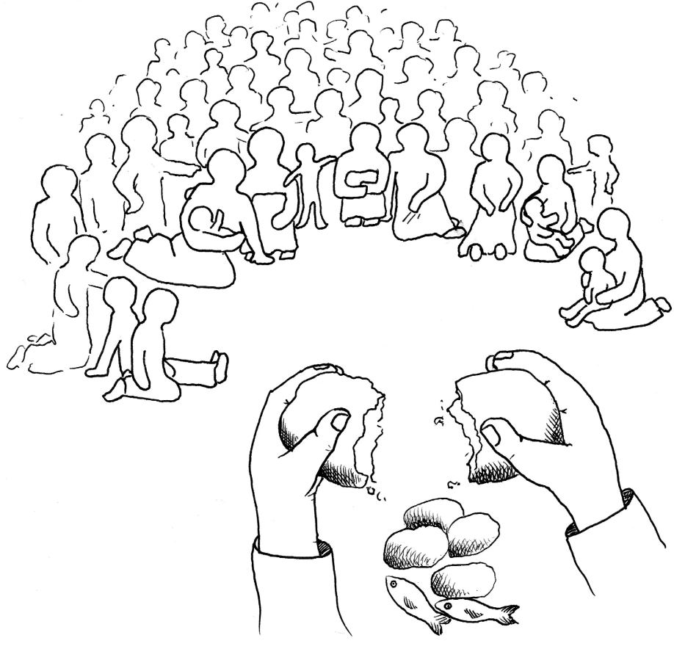
The story of
Jesus – Meeting John.

Slide 6
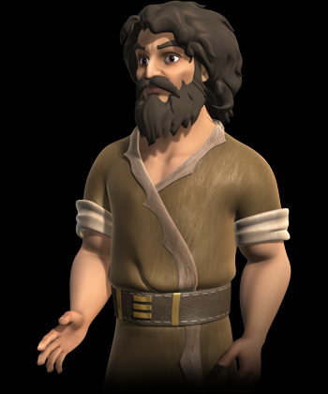
Who was John the Baptist?
He was pretty famous when Jesus was alive.

Slide 7
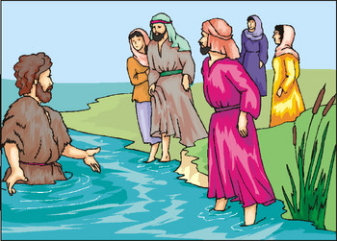
John was telling people about God long before Jesus.
When Jesus met John, he was baptised by him in the river.

Slide 8
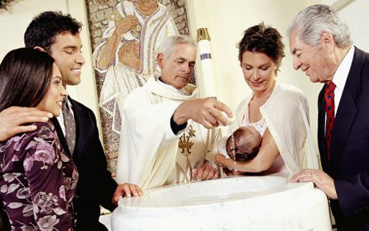
Who has been baptised or christened?

Slide 9
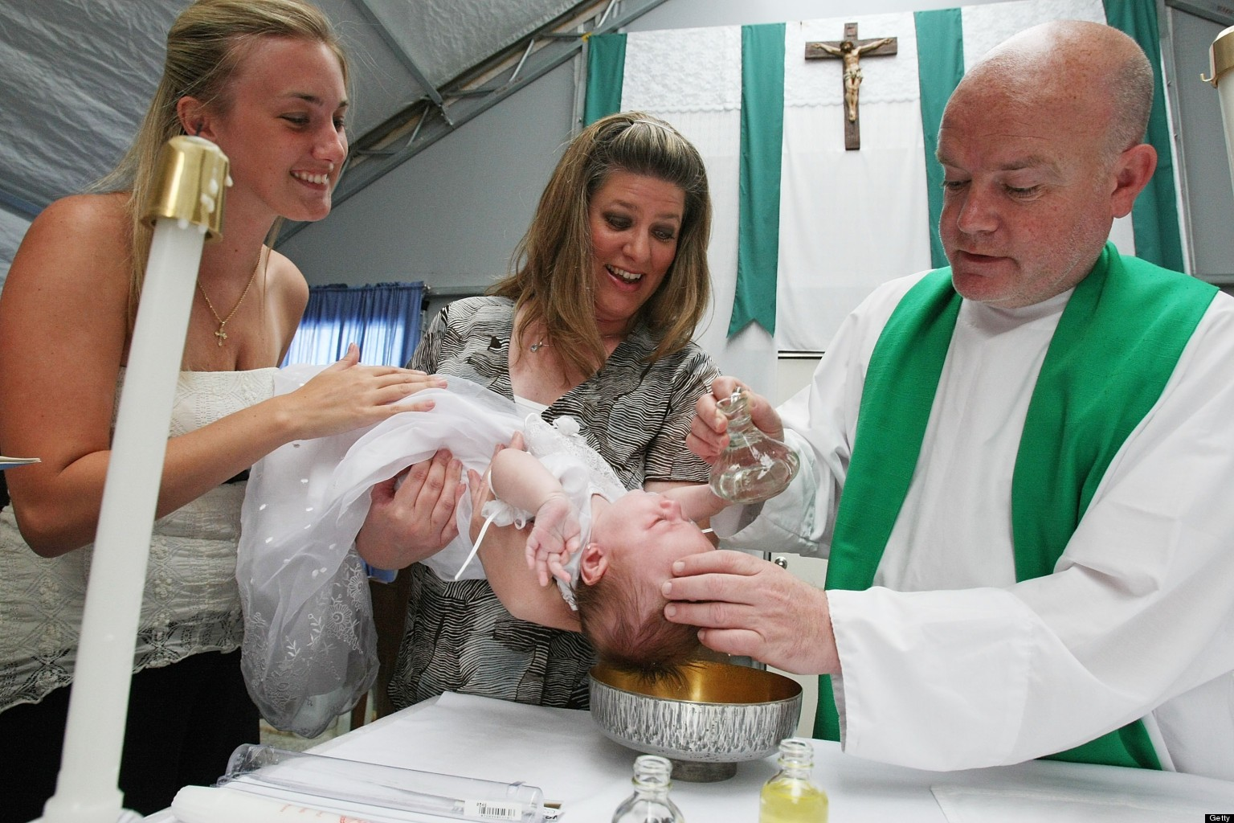

Slide 10
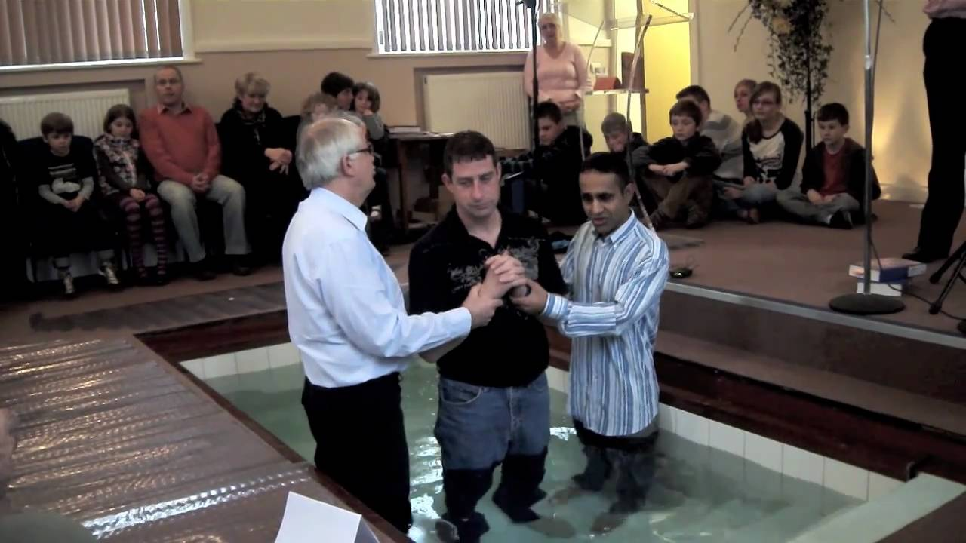
Jesus was baptised in the river. Some churches have a pool in them. This is called full immersion baptism.

Slide 11
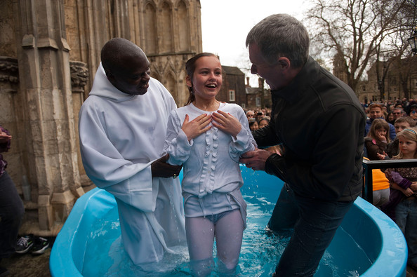
Or even a pool outside!

Slide 12
So, a baptism or christening marks the start of a journey with God.
It is a service which welcomes you into the Christian community.
Watch this clip https://www.bbc.co.uk/bitesize/clips/zm87tfr

Slide 13
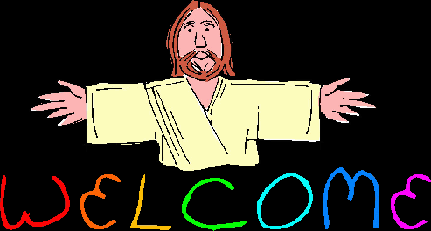
It is a bit like adding your name to God’s register.

Slide 14
The longest recorded personal name is (try saying this) …
Adolph Blaine Charles David Earl Frederick Gerald Hubert Irvin John Kenneth Lloyd Martin Nero Oliver Paul Quincy Randolph Sherman Thomas Uncas Victor William Xerxes Yancy Zeus Wolfeschlegel­steinhausen­bergerdorff­welche­vor­altern­waren­gewissenhaft­schafers­wessen­schafe­waren­wohl­gepflege­und­sorgfaltigkeit­beschutzen­vor­angreifen­durch­ihr­raubgierig­feinde­welche­vor­altern­zwolfhundert­tausend­jahres­voran­die­erscheinen­von­der­erste­erdemensch­der­raumschiff­genacht­mit­tungstein­und­sieben­iridium­elektrisch­motors­gebrauch­licht­als­sein­ursprung­von­kraft­gestart­sein­lange­fahrt­hinzwischen­sternartig­raum­auf­der­suchen­nachbarschaft­der­stern­welche­gehabt­bewohnbar­planeten­kreise­drehen­sich­und­wohin­der­neue­rasse­von­verstandig­menschlichkeit­konnte­fortpflanzen­und­sich­erfreuen­an­lebenslanglich­freude­und­ruhe­mit­nicht­ein­furcht­vor­angreifen­vor­anderer­intelligent­geschopfs­von­hinzwischen­sternartig­raum Sr.
Just call him ‘Ad.’ I bet his baptism went on forever!

Slide 15
Names also have meanings.
Apparently my name means
‘God is gracious.’

Slide 16

Why not try to find out what your name means?

Slide 17
A prayer for today
Dear Lord,
Thank you for the story of John the Baptist.
At this difficult time we think of all of our family and friends.
Keep us all safe.
Amen

Slide 18
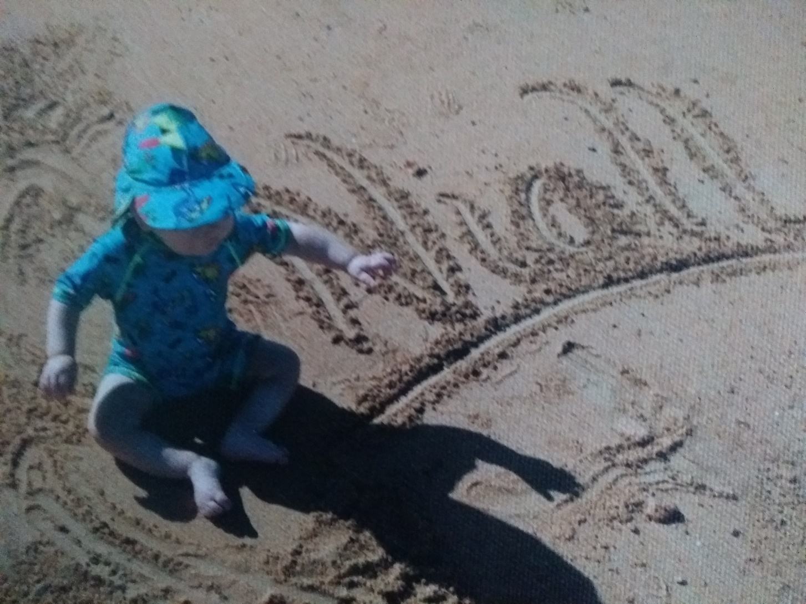
Have a great day everyone.
Thank you for all of your learning!

