Slide 1
AFRICAN ELEPHANT

Slide 2
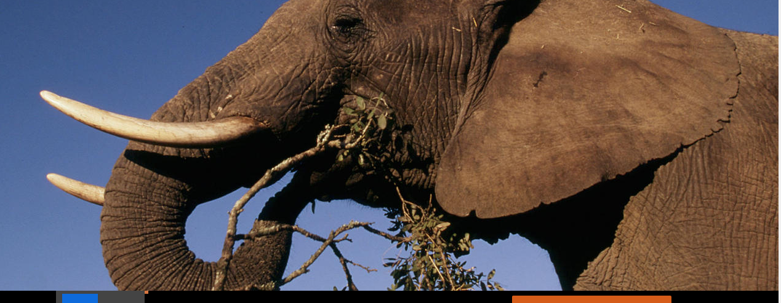
FACTS
  HHHHHHHHHHHH
objects.

Slide 3
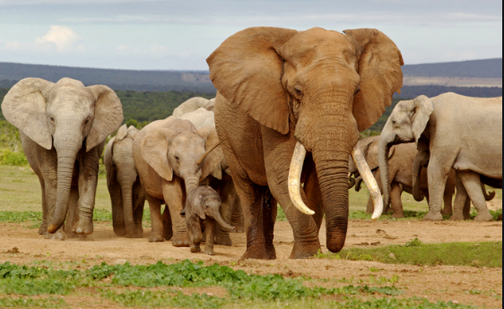

Slide 4
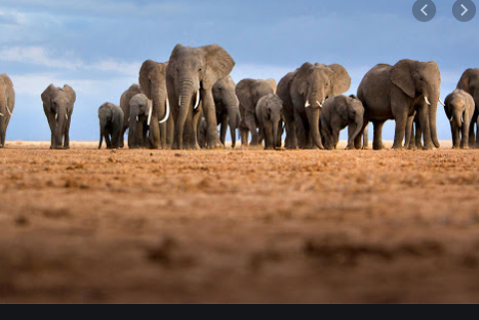

Slide 5


