Slide 1
African wild dogs

Slide 2
African wild dogs. will typically live around 11 years in the wild . They are some of the most successful hunters bringing down around 80% of their targeted prey. They are some of the most successful hunters bringing down around 80% of their targeted prey. Other names for these animals include the African hunting dog, the painted hunting dog, and the ornate wolf.

Slide 3
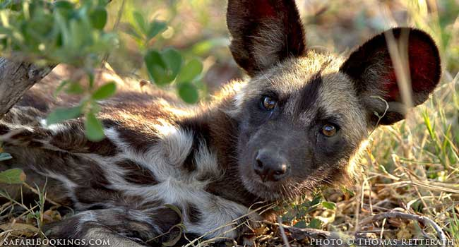

Slide 4
The
African wild dog is one of the world’s most endangered mammals. The largest populations remain in southern Africa and the southern part of East Africa (especially Tanzania and northern Mozambique). Wild dogs are social and gather in packs of around ten individuals, but some packs number more than 40. They are opportunistic predators that hunt medium-sized ruminants, such as gazelles. In a sprint, African wild dogs can reach speeds of more than 44 miles per hour.

Slide 5


