Slide 1
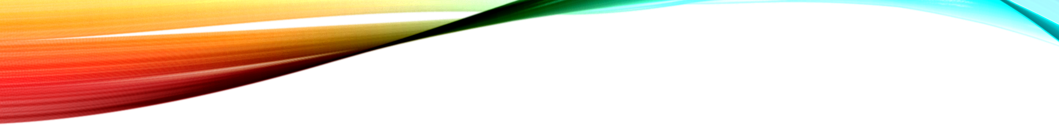
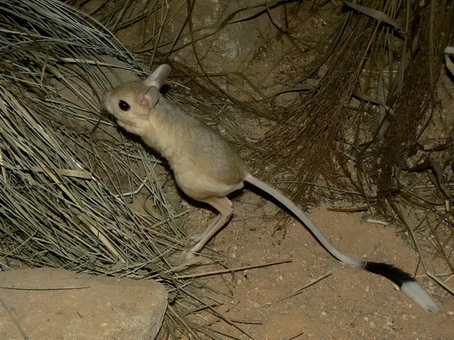
Desert jerboa

Slide 2
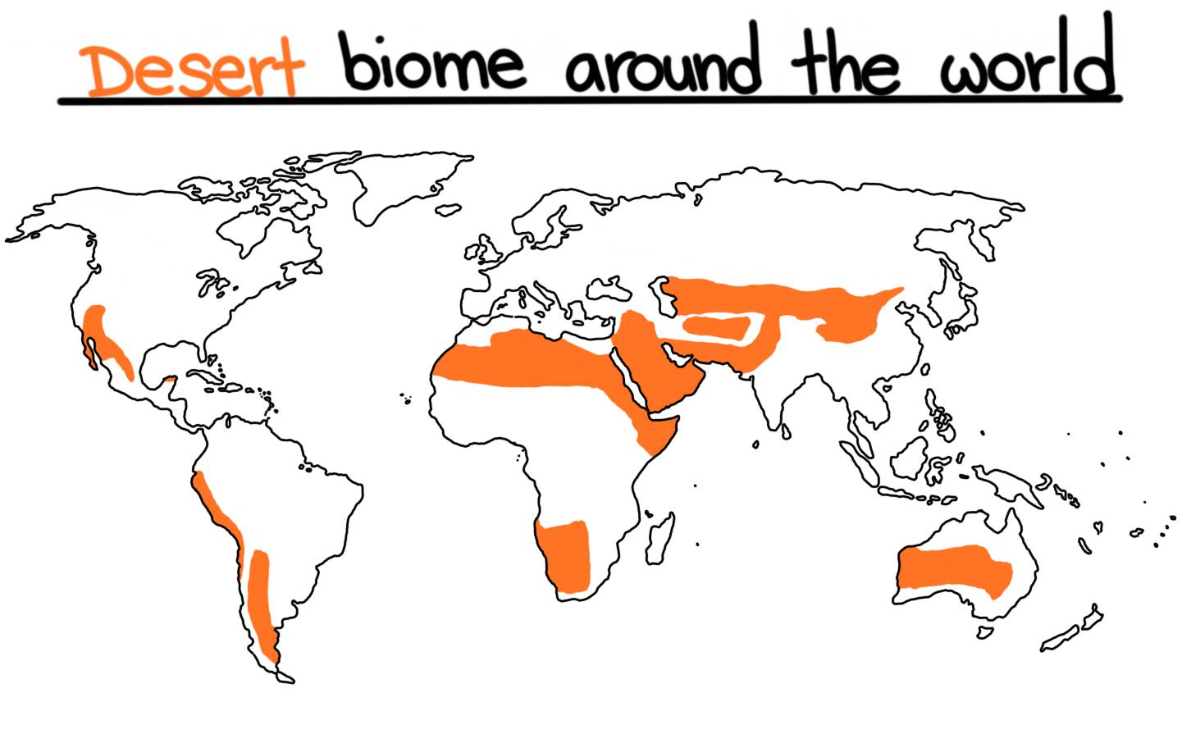
habitat
The Desert Jerboa lives in hot deserts of Northern Africa ,Asia and Manchuria.

Slide 3
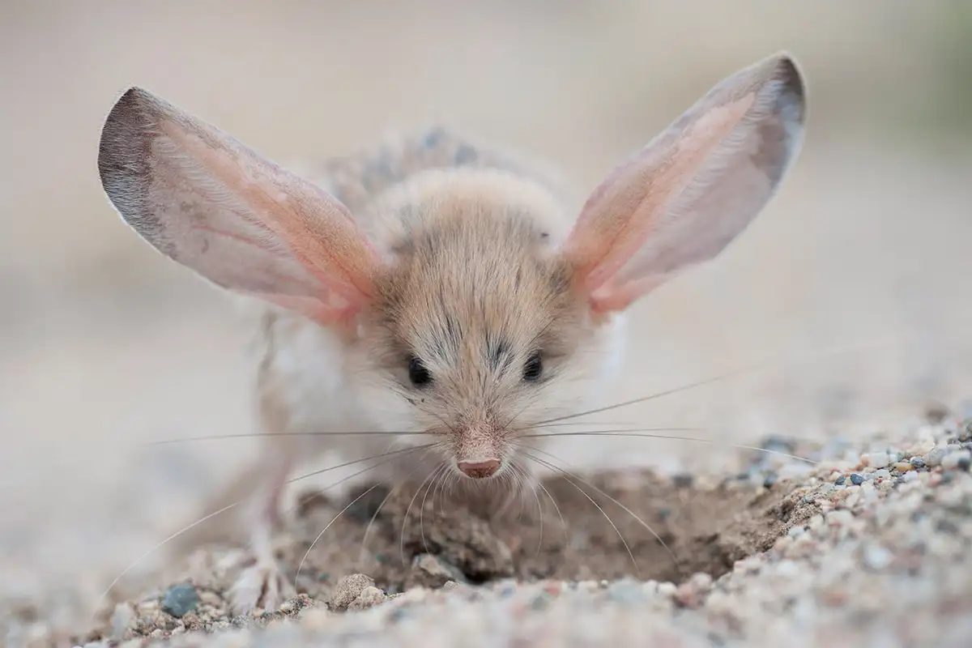
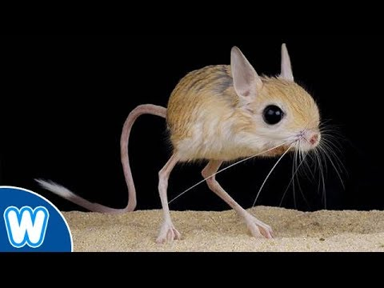
Adaptations
The Jerboa’s large ears release heat to keep its body cool.
It can survive without water because it gets its water from its food! In the desert.
Its back legs are like a kangaroo because it springs like one too.
When chased it can run up to 24 kilometres per hour(about 15 mph)
Most jerboas rely on plant material as the main part of their diet ,but cannot eat hard seeds. Some species will eat beetles and other insects they come across.
The Jerboa's feet has fur on them to stop them from sinking.

Slide 4
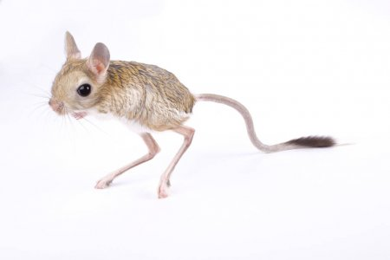
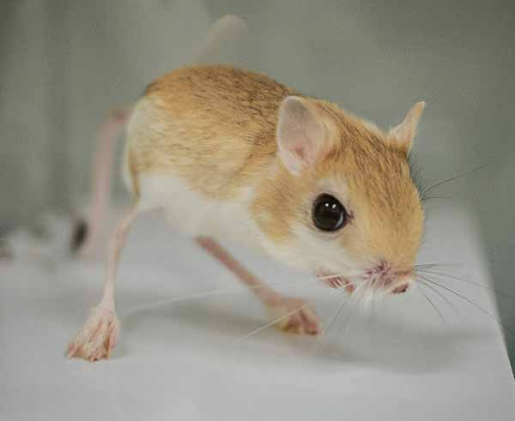
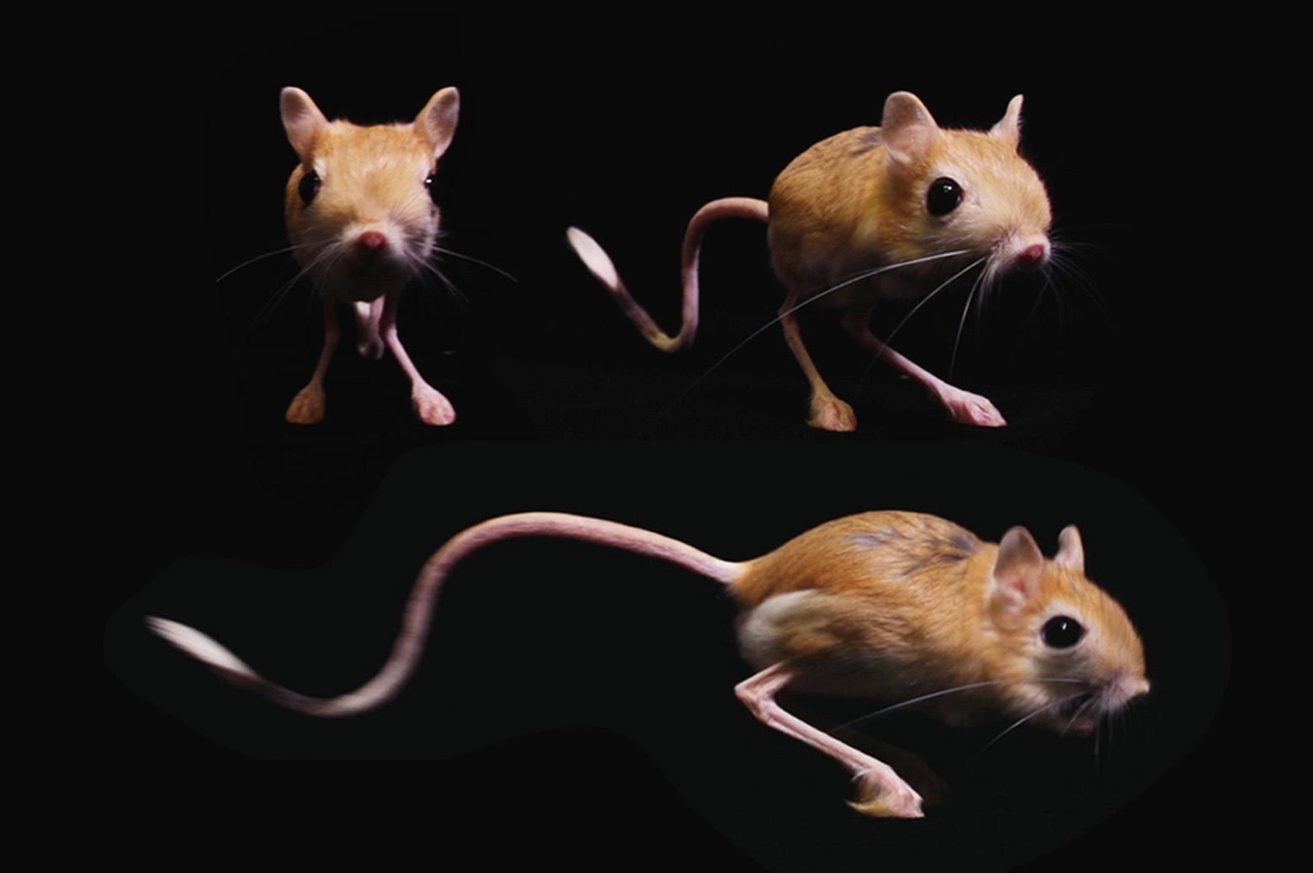
pictures

