Slide 1
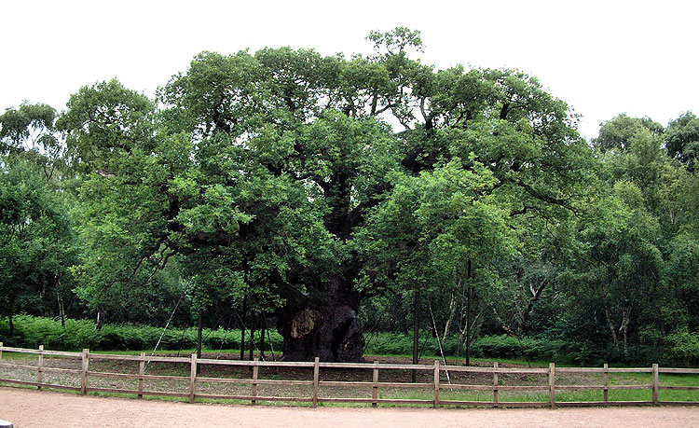
Welcome to Class Sherwood

Slide 2
Overview
Classroom Organisation
Curriculum Maps (particularly the overview of the Autumn Term)
Maths: Year 4 objective ladders, key instant recall facts (KIRFs) , times tables expectations (MTC) and written calculation methods.
English: Year 4 writing objectives, Reading, SPaG content and statutory spellings.
Home Learning
Trips for the Autumn Term and others
Questions

Slide 3
Class Organisation
Mr. Gillett
Mrs. King, Mrs. Somerville and Miss. Clark
Organisation/daily routine virtually identical to Year 3
Assessment: MTC plus beg – mid - end.
Water and snacks (nut free)
Milk : online registration (office for details)
Communication links – class page and texts

Slide 4
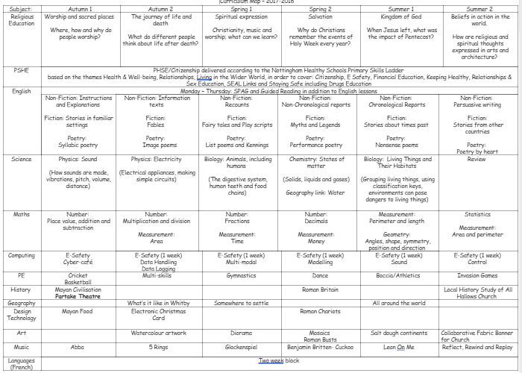
Curriculum Map

Slide 5
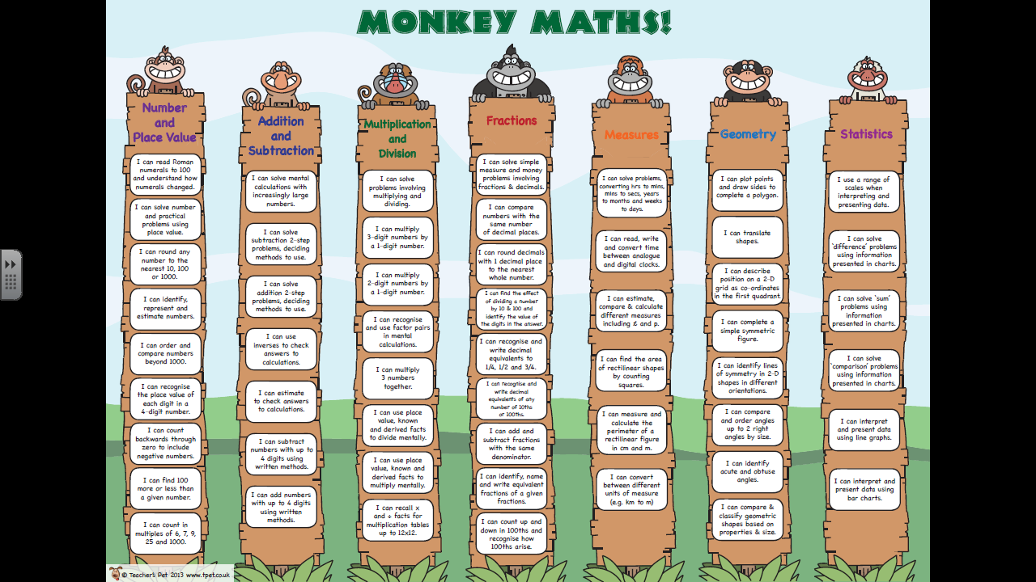
Maths
Arithmetic and reasoning

Slide 6
KIRFs (Key Instant Recall Facts)
To help develop children’s fluency in mathematics, we ask them to learn Key Instant Recall Facts each half term. We expect children to practise their KIRFs at least 3 times a week.
Top tip: Little and often

Slide 7

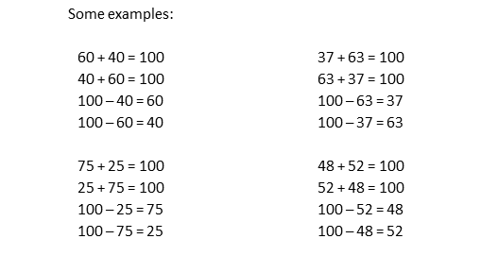
Year 4 – Autumn 1
I know number bonds to 100.
Key Vocabulary
What do I add to 65 to make 100?
What is 100 take away 6?
What is 13 less than 100?
How many more than 98 is 100?
What is the difference between 89 and 100?
This list includes some examples of facts that children should know. They should be able to answer questions including missing number questions e.g. 49 + ⃝ = 100 or 100 – ⃝ = 72.
Top Tips
The secret to success is practising little and often. Use time wisely. Can you practise these KIRFs while walking to school or during a car journey? You don’t need to practise them all at once: perhaps you could have a fact of the day. If you would like more ideas, please speak to your child’s teacher.
Buy one get three free - If your child knows one fact (e.g. 8 + 5 = 13), can they tell you the other three facts in the same fact family?
Use number bonds to 10 - How can number bonds to 10 help you work out number bonds to 100?
Play games – There are missing number questions at www.conkermaths.com . See how many questions you can answer in just 90 seconds. There is also a number bond pair game to play.

Slide 8
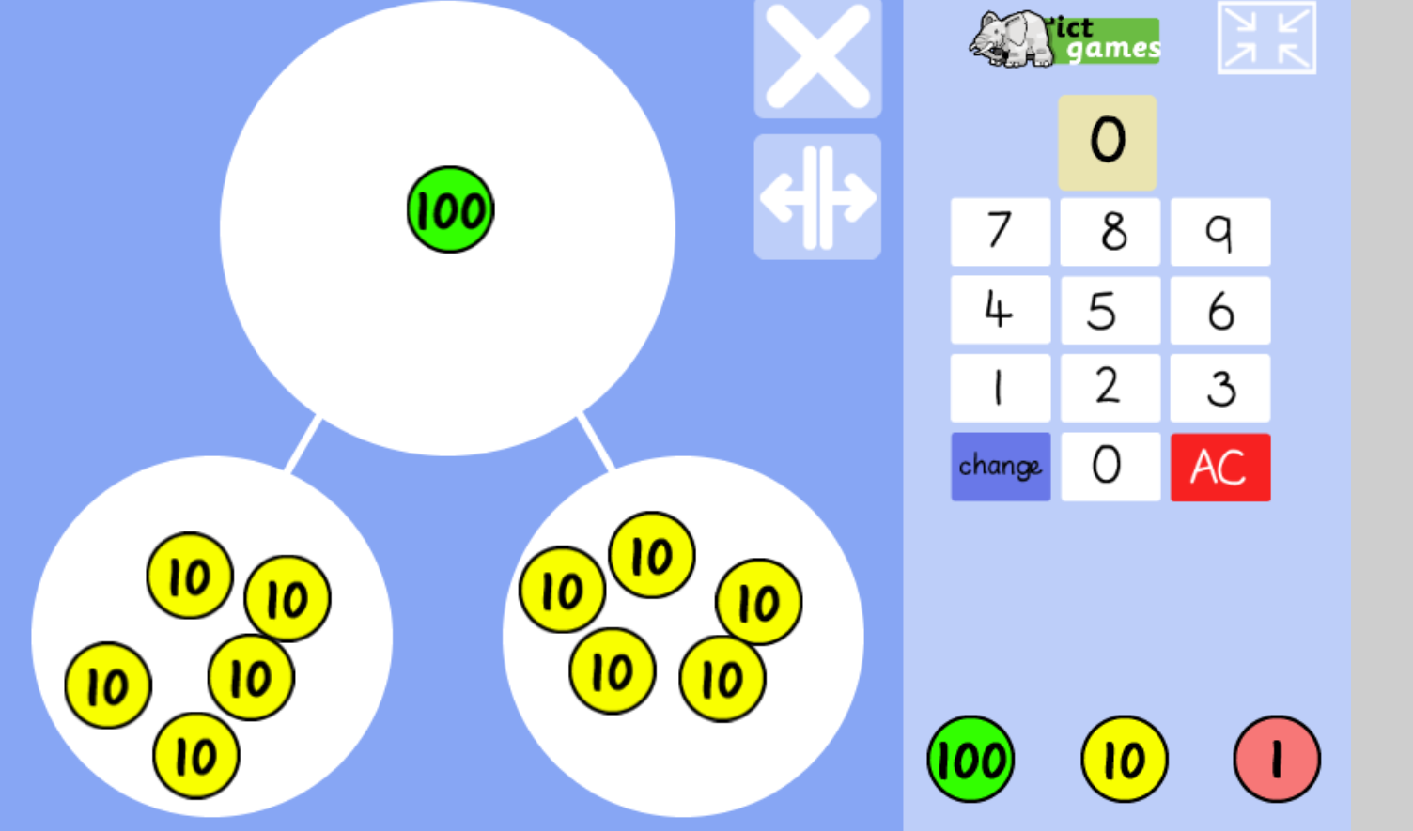
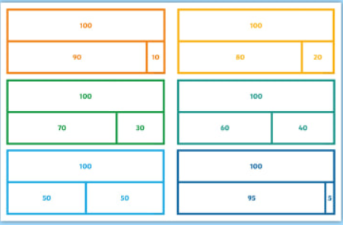
Part part whole model
A link to this is on the class page
Bar model

Slide 9
Maths
New KIRF every half term (number bonds to 100, times table facts, decimal and fraction equivalents and multiplying and dividing by 10 and 100).
Times tables expectation up to 12 x 12 = 144.
Multiplication Tables Checker (MTC) assessment during June (3 week window).
Rockstar correlation - Av 21/25
Written methods (algorithms are more efficient than previous)

Slide 10
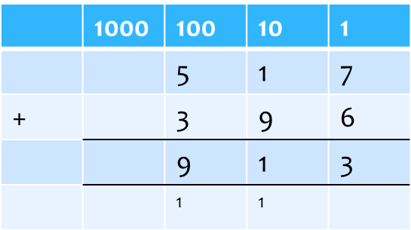
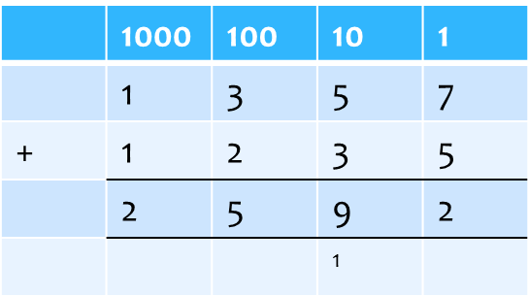

Add numbers with up to 4 digits
Link to place value addition
Key points:
Largest number at the top
Add the 1’s first (least significant number)
Regroup numbers underneath the bottom line
Reinforce correct place value i.e. 5 hundreds add 3 hundreds and not 5 add 3
Broaden :
Use and apply method to money and measurement values.

Slide 11
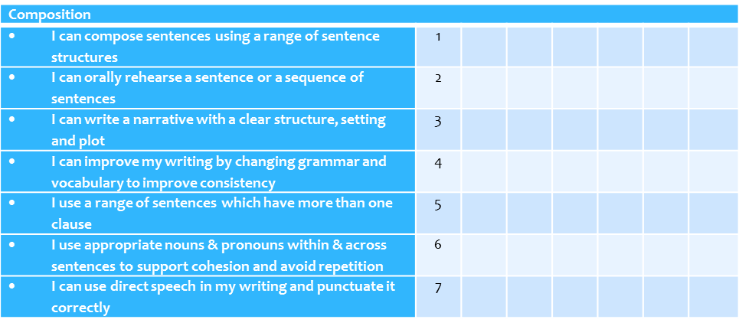
English: Writing
New set of writing criteria for Year 4.
Assessment of writing skills focuses on 3 areas, composition, grammar (expanded noun phrases and fronted adverbials) and transcription (SPaG).

Slide 12
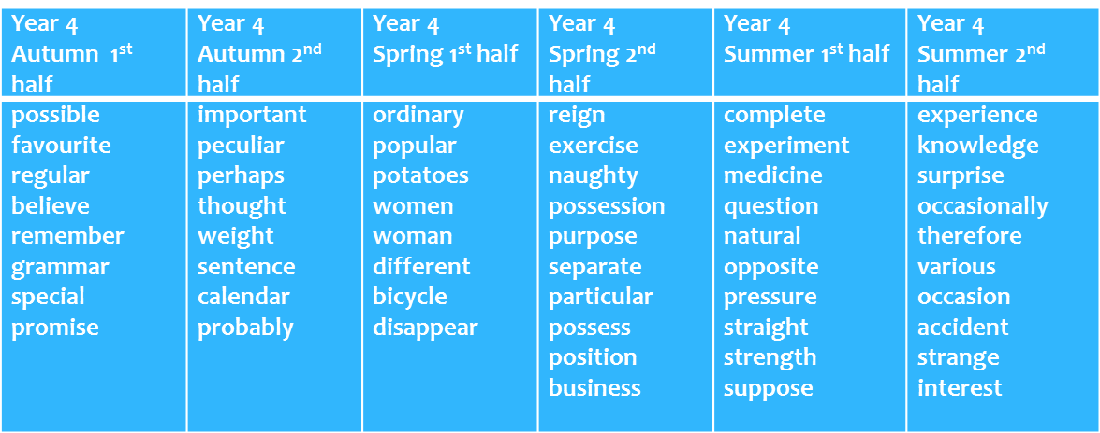
Spellings
Class and Statutory

Slide 13
Reading
Reading is the rocket fuel for improving vocab.
Fluency, rate and understanding.
Reading in school takes the form of guided sessions, one to one and whole class.
Outside of school is so important.
Particularly important to discuss texts.
Library Cards – Bronze, Silver and Gold.
Range of text types – having discussions about how to ensure this.

Slide 14
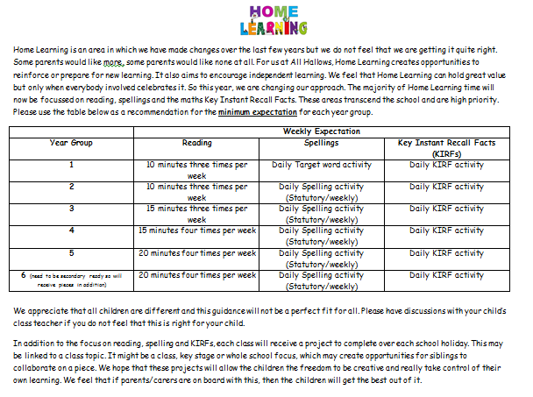
Home Learning –
Practise makes permanent

Slide 15
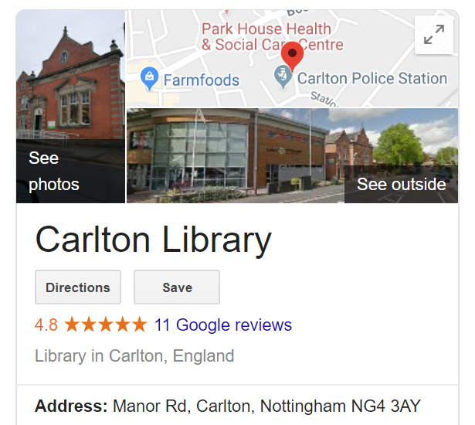




Trips
We are unable to subsidise these as much as previous years unfortunately although some are free.

Slide 16
Any questions?

