Slide 1
My school year 3 overview
By Reuben Wheeldon

Slide 2

Obviously learning

Slide 3

Xmas play

Slide 4
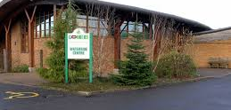
Our class went to conkers

Slide 5

then we had to start lockdown

Slide 6

Now it’s the summer holidays!
I’m excited to see my friends in year 4
Have a great summer everyone

