Slide 1
Welcome
This all about class Rufford by Jessica Oliver

Slide 2
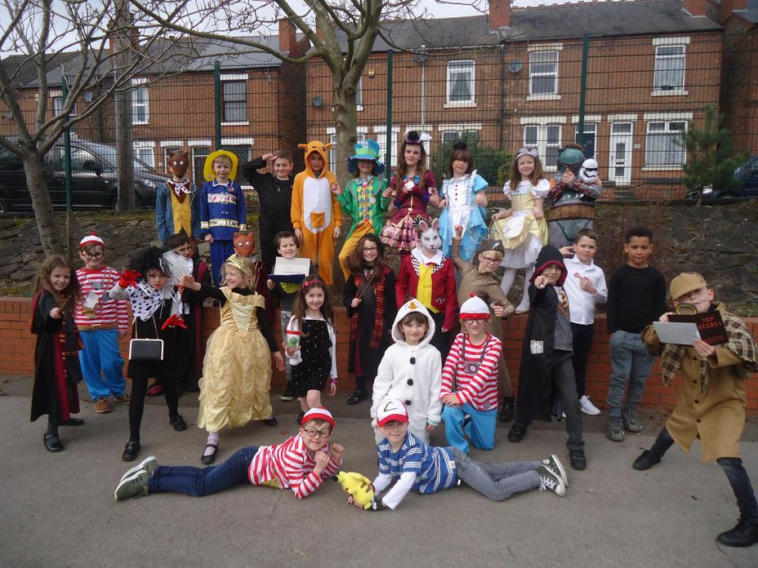
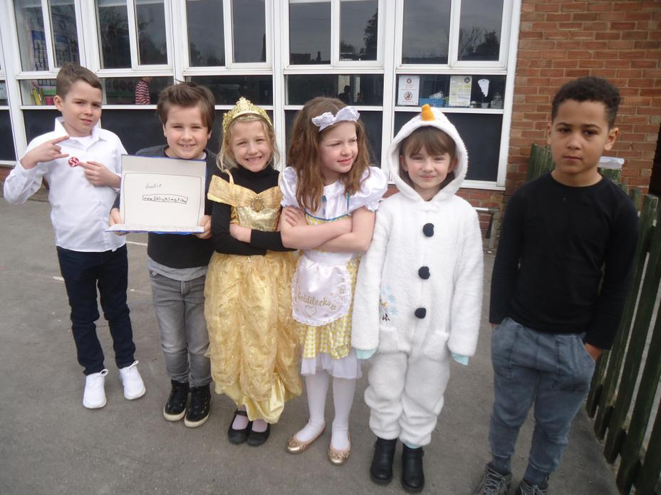
World Book Day
World Book Day
6 / 8
I remember I was Goldilocks, Belle was Belle, Elenor was a tree from Harry Potter and Sienna was Alice
I remember we made bookmarks
I remember we read our books for dear time

Slide 3
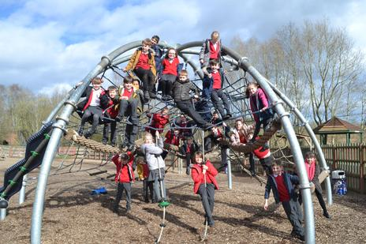
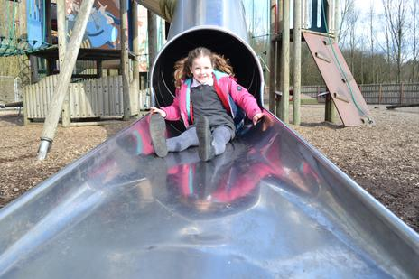
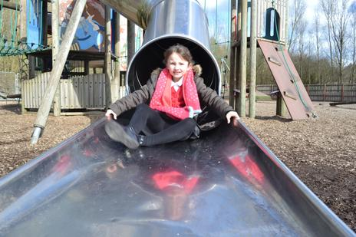
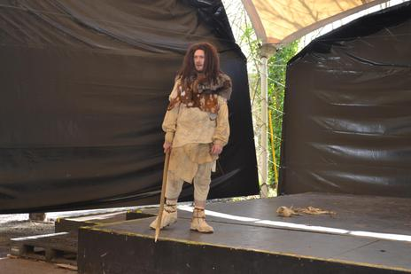
Stoneage day at Conkers
I liked being called pig by a cave man
I remember people were scared and ran away from the cave man.

Slide 4
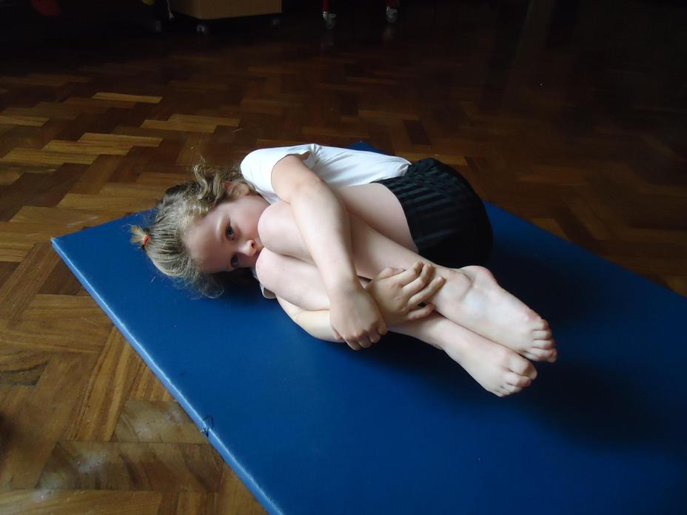
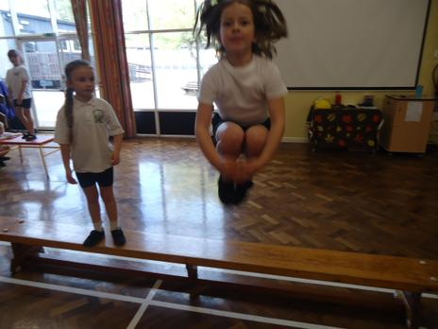

Gymnastics
I liked jumping off benches and I got outstanding for
PE in my report. I am proud of myself

Slide 5
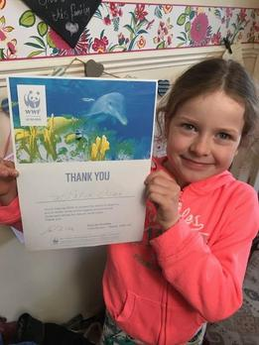
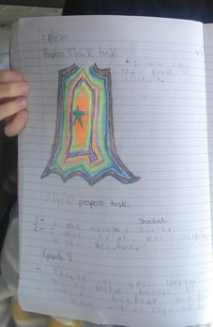
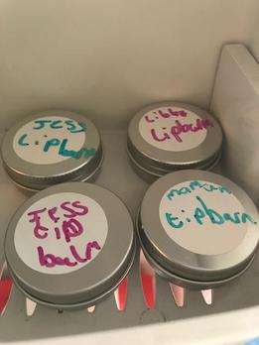
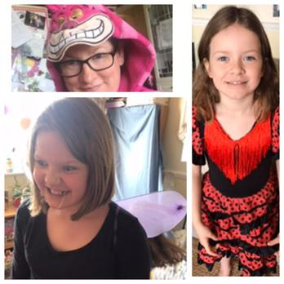
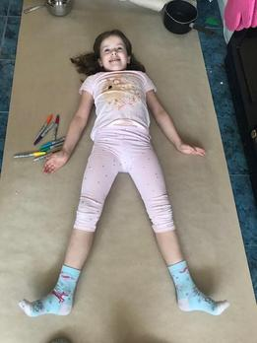
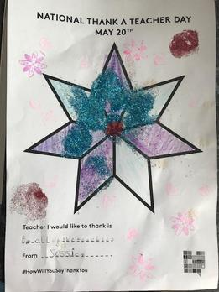
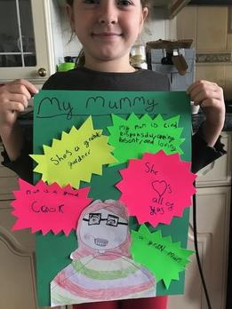
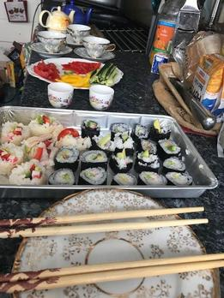
At home
We had lots of fun making bread , lipbalm, having a water balloon fight, made stop motion movies, baked cakes, went for lots of walks and sponsered a dolphin

Slide 6
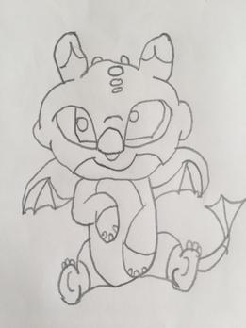
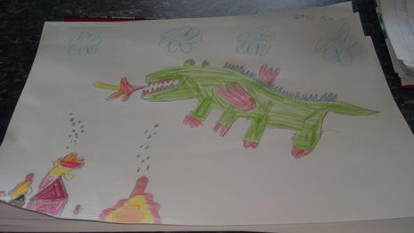
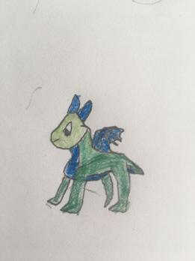
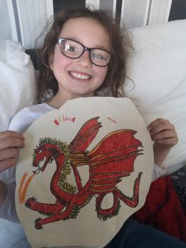
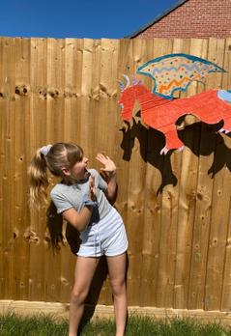
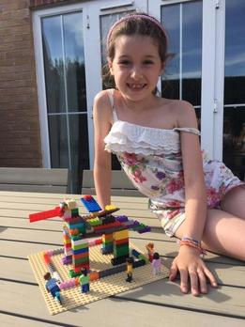
St George`s day
I loved seeing all the pictures in the gallery

Slide 7
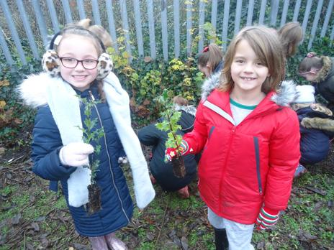
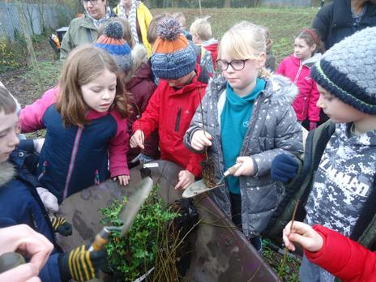
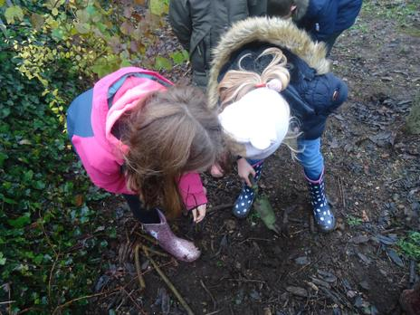
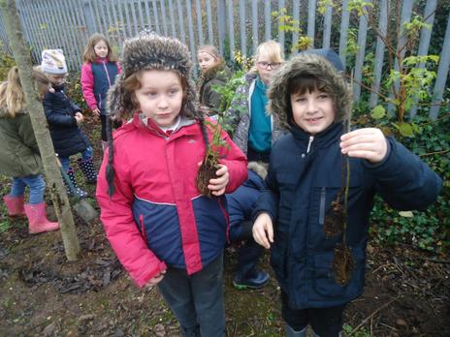
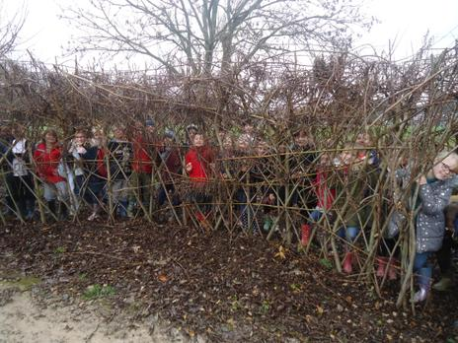
Tree Planting Day
I rememeber we did a big picture in a bamboo loop

Slide 8




Thank you for watching my slideshow
see you in year 4 every body

