Slide 1
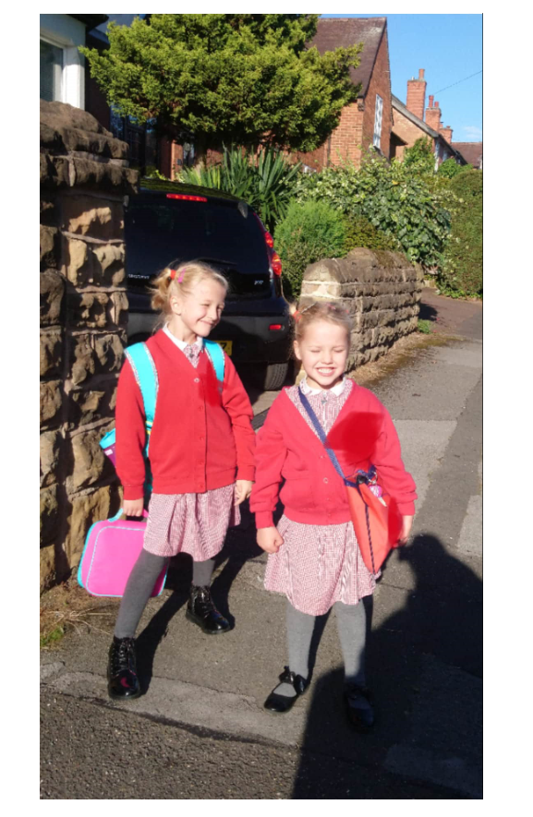
Belle’s year 3 adventure
Favourite bits

Slide 2
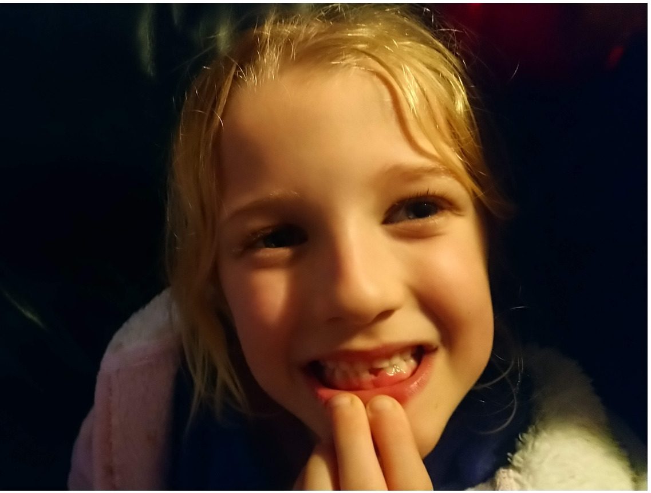
Loosing my first tooth!!!!

Slide 3
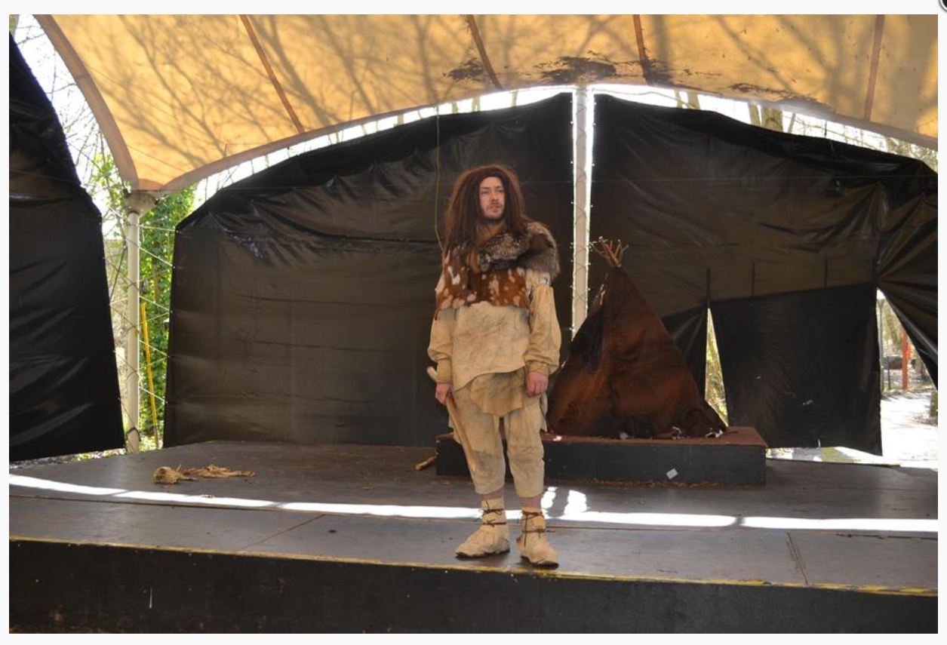
The Stoneage man called me ‘Toenail’.

Slide 4
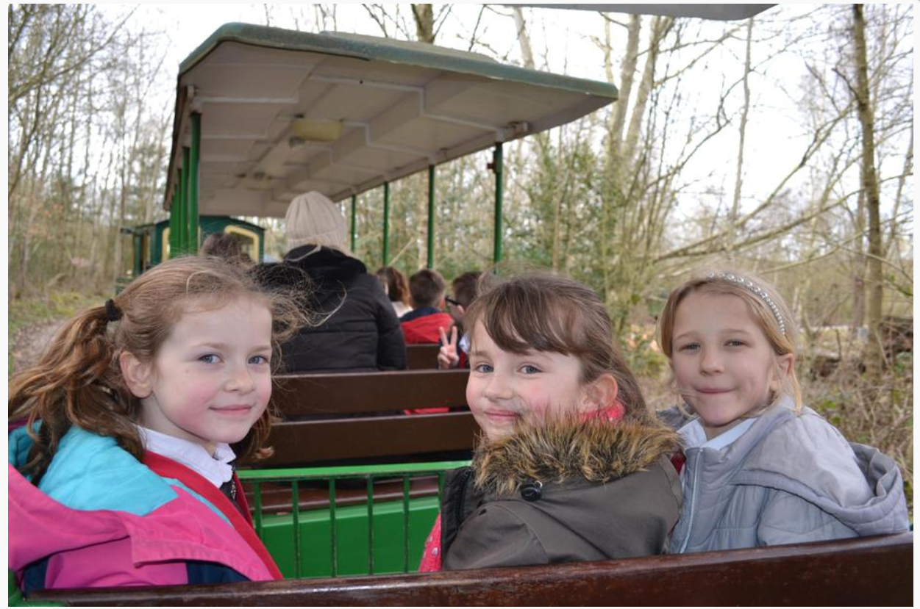
It was super fun because I was sitting with my best friends.

Slide 5
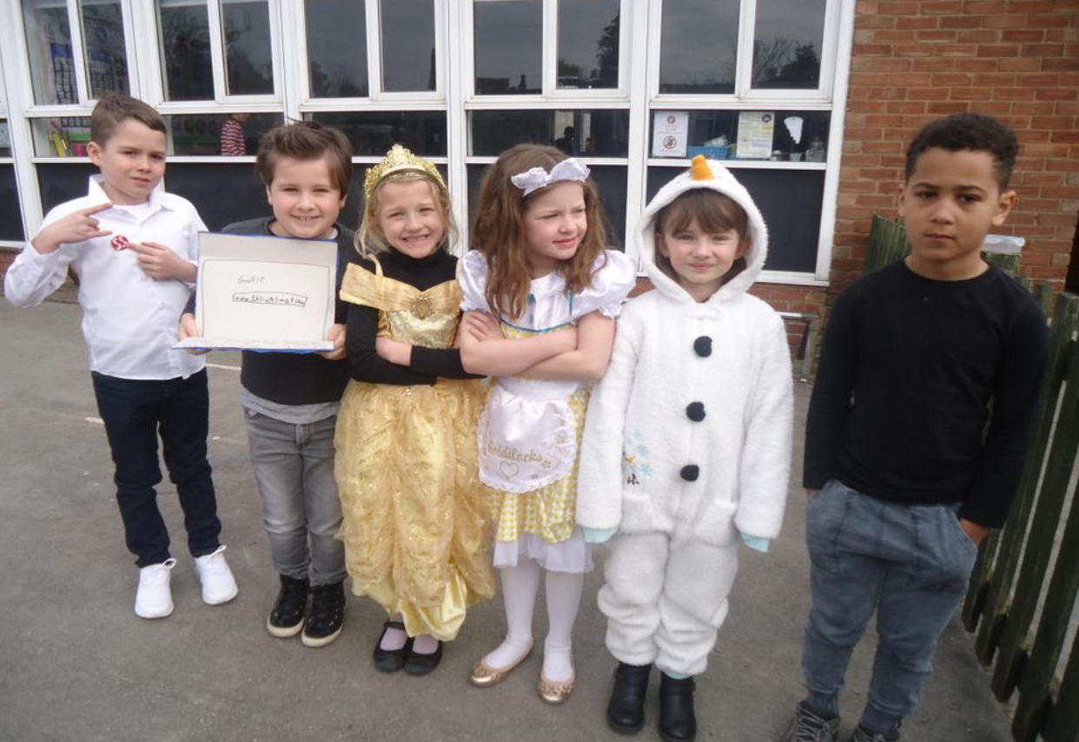
I enjoyed dressing up as Belle. I liked seeing the other costumes too.

Slide 6
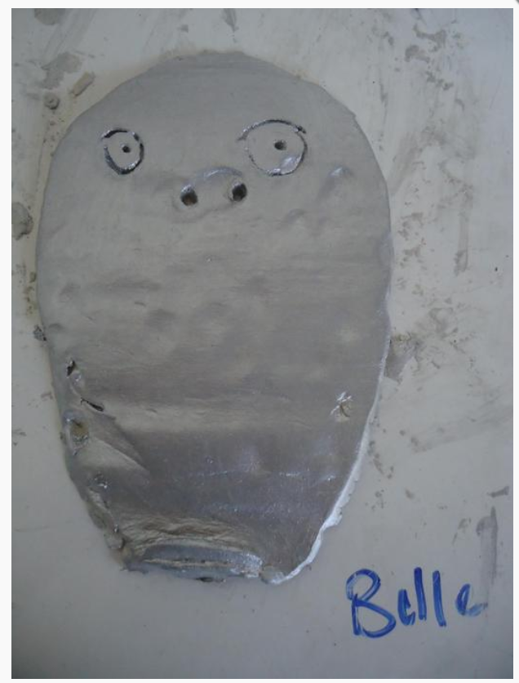
I liked making my ancient Greek mask.

Slide 7
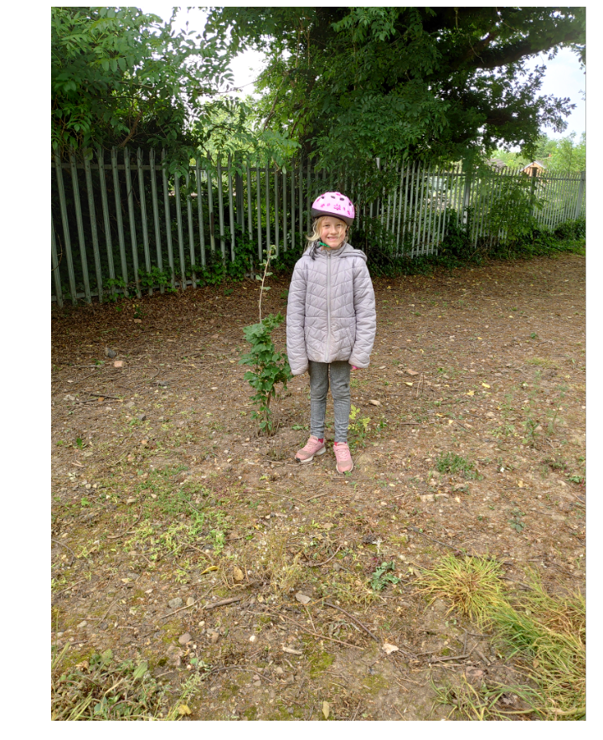
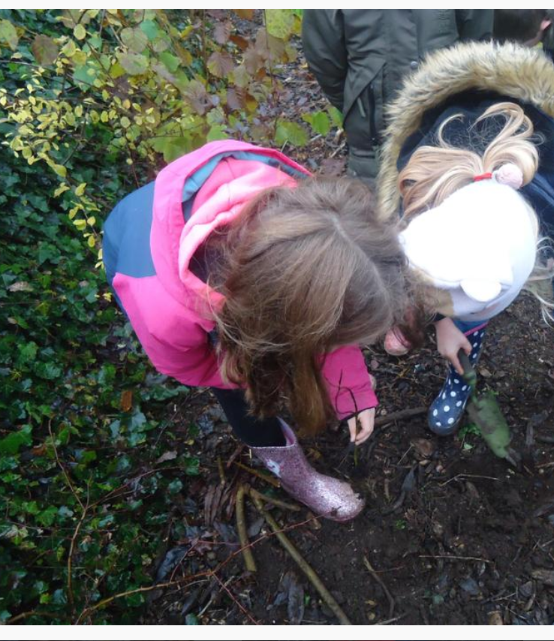
I enjoyed planting trees.
I cycled past the trees in the lockdown and was surprised how big they had grown.

Slide 8
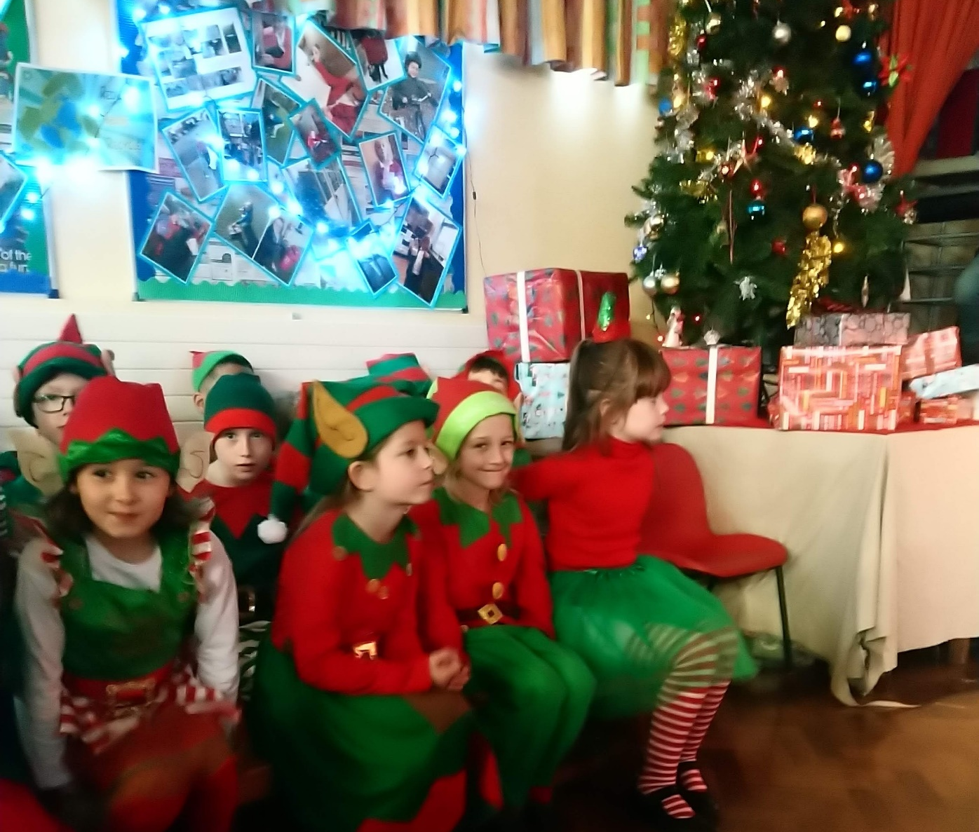
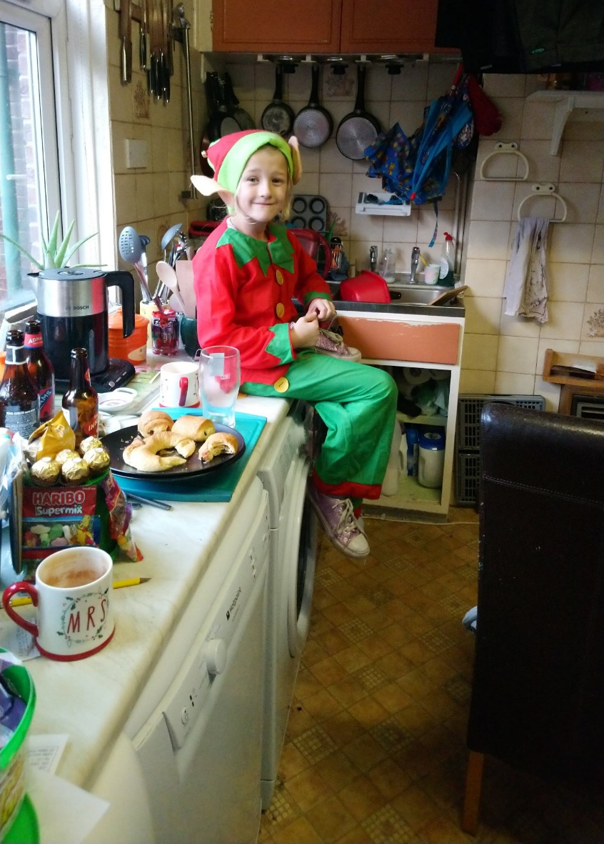
I enjoyed dressing up as an elf for the Christmas production.
Belle, the elf on the shelf.

Slide 9

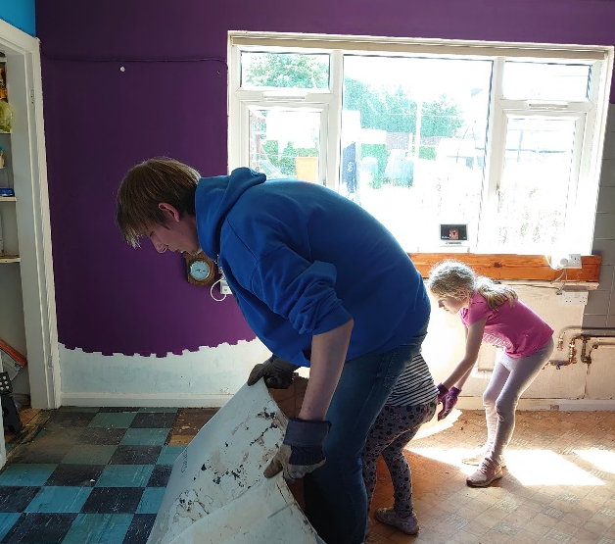
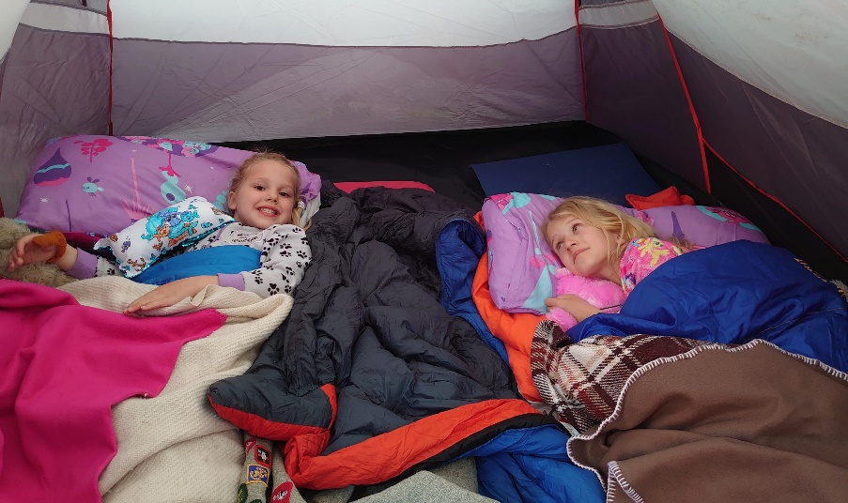
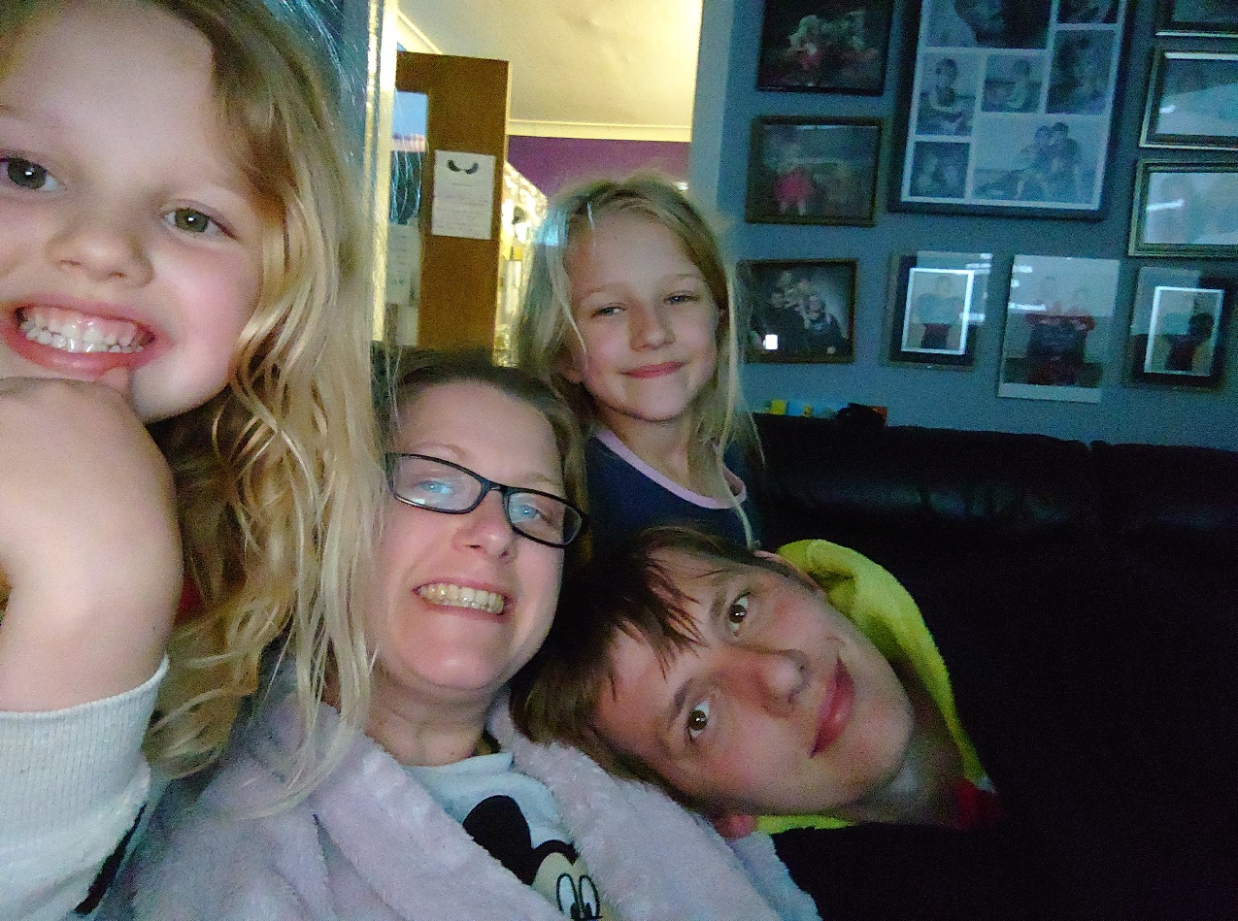
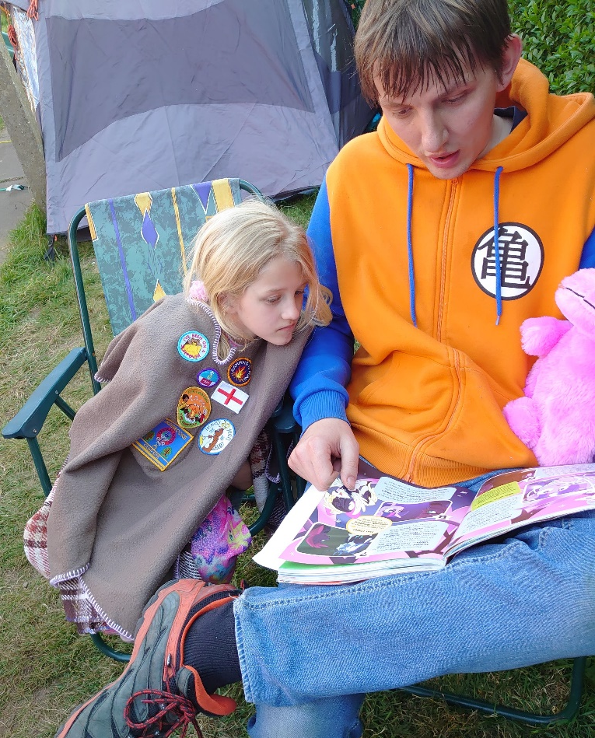
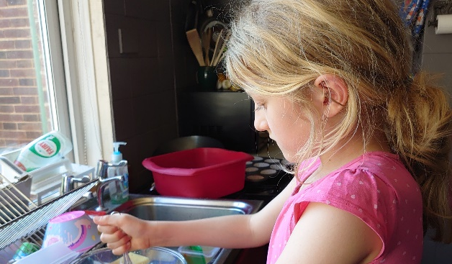
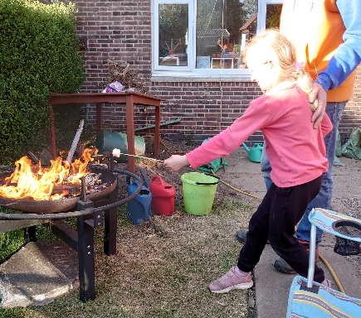
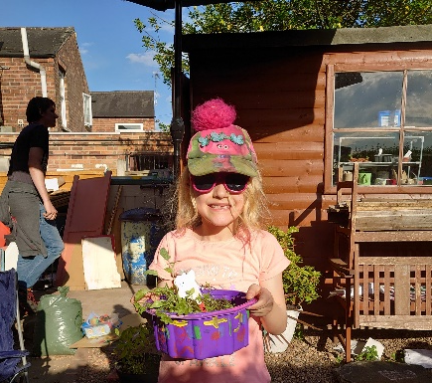
I have enjoyed the lock down. Being with my family.

