Slide 1


YEAR 3
Made by Alex Harrison

Slide 2




I have enjoyed reading on Epic. My favourite book was Diary of a Wimpy Kid.

Slide 3
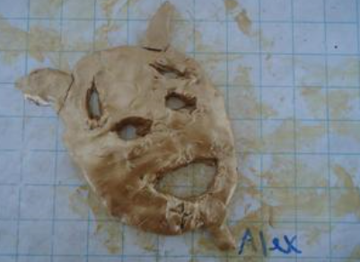
I loved making Greek theatre masks.

Slide 4
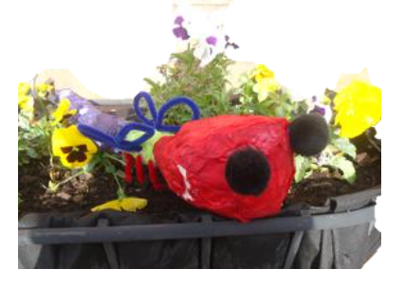
The bugs we did looked good and were fun to make. I made mine with Oliver.

Slide 5
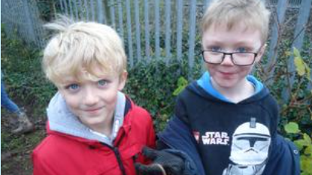
I liked planting trees and I especially liked holding worms.

Slide 6
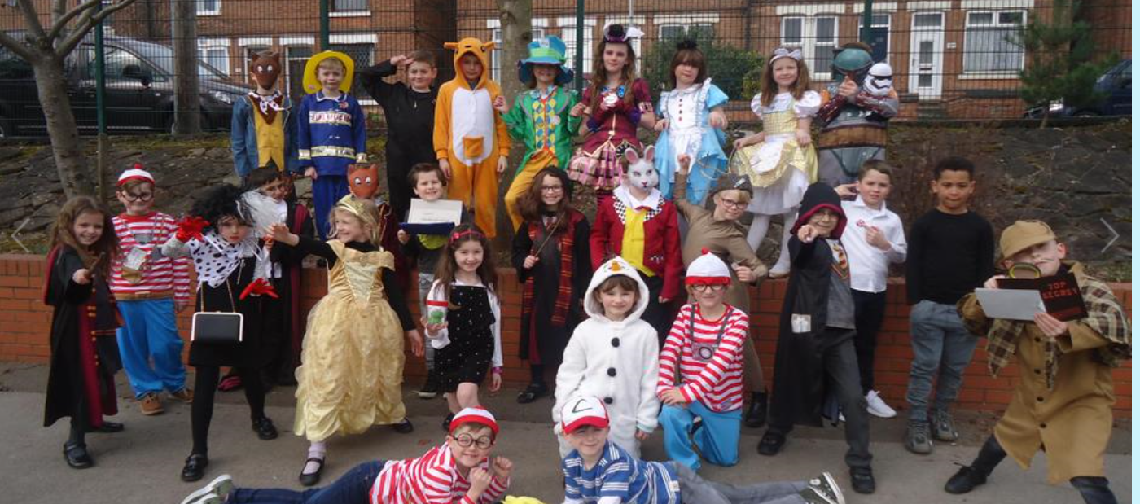
World Book Day- I dressed as Fantastic Mr. Fox.

Slide 7
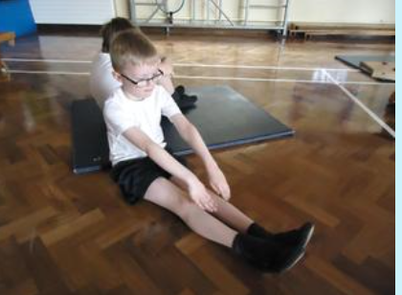
I like P.E. I enjoyed Hockey and Handball the most.

Slide 8
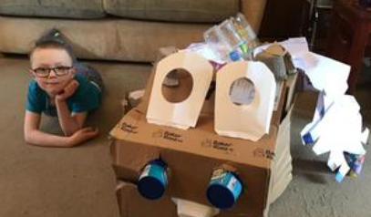
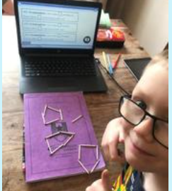
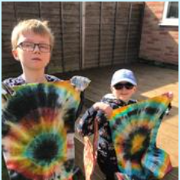
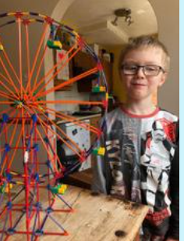
March – July 2020. Home Schooling.
Mummy as a teacher- Arrrrgh!

Slide 9

Thank you Mrs Hally.
Thank you for watching.
☺

