Slide 1
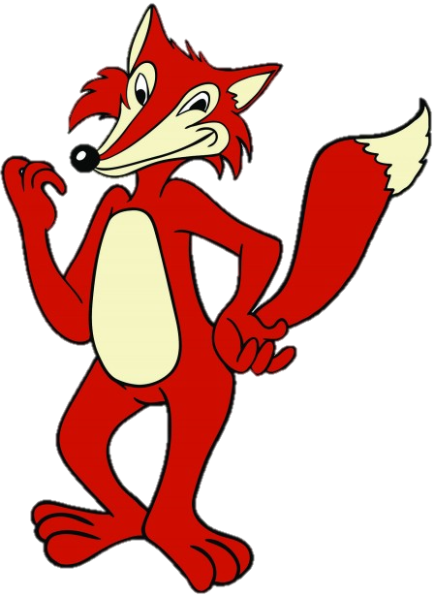

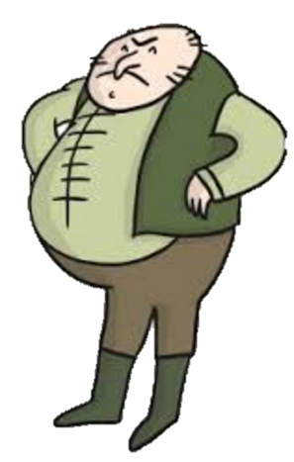
Roald Dahl’s
FANTASTIC
MR FOX
BOGGIS, BUNCE AND BEAN!
LEARNING OBJECTIVE
Understand and explore language in a text.
Use descriptive techniques to create characters.

Slide 2
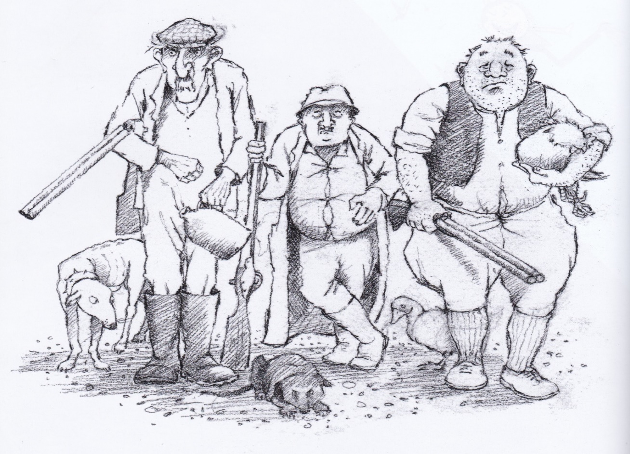
INTRODUCTION
THE THREE FARMERS
Boggis, Bunce, and Bean, are the three farmers who have farms near Fantastic Mr Fox’s hole.
They are each disgusting men in their own way, and they hate Mr Fox! Today we will be learning all about them!

Slide 3
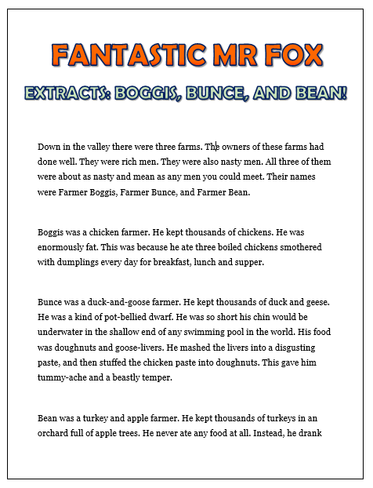
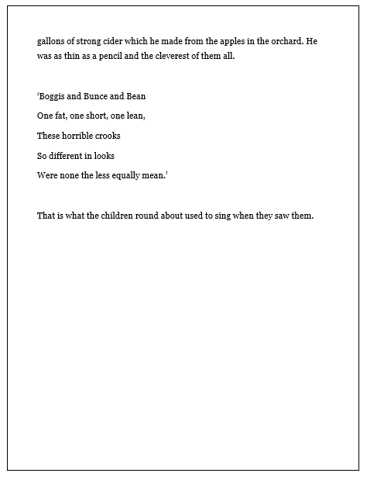
INTRODUCTION
READING
Now read the extract from ‘Fantastic Mr Fox.’ It is from the very beginning of the book.
In this extract, we learn all about the three farmers: Boggis, Bunce, and Bean!

Slide 4
INTRODUCTION
COMPREHENSION
What type of farms do Boggis, Bunce, and Bean have?
How do each of the farmers look different?
What do the three farmers eat?
What do the local children think of the three farmers?

Slide 5
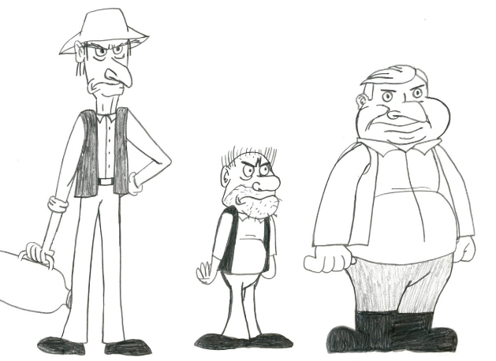
INTRODUCTION
COMPREHENSION –
ANSWERS
Boggis owns a chicken farm. Bunce owns a duck and goose farm. Bean is a turkey and apple farmer.
Boggis is extremely fat. Bunce is very, very short, and also quite far. Bean is extraordinarily thin.

Slide 6
INTRODUCTION
COMPREHENSION –ANSWERS
3. Boggis eats three boiled chickens a day smothered with dumplings. Bunce eats mashed livers in doughnuts. Bean doesn’t eat at all, he just drinks strong cider!
4. The children in the local area all think that the farmers are very mean.

Slide 7
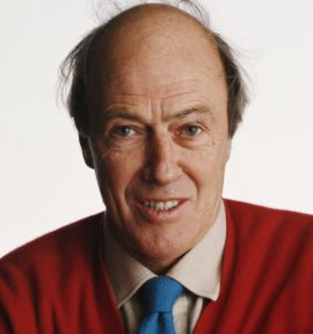
DEVELOPMENT
DAHL’S LANGUAGE
Roald Dahl (who wrote Fantastic Mr Fox) is considered one of the greatest writers of all time!
He is famous for his use of descriptive language in his stories; his descriptions help to create a picture in the mind of the reader.
We will be thinking about how Roald Dahl uses language to describe Boggis, Bunce, and Bean!

Slide 8
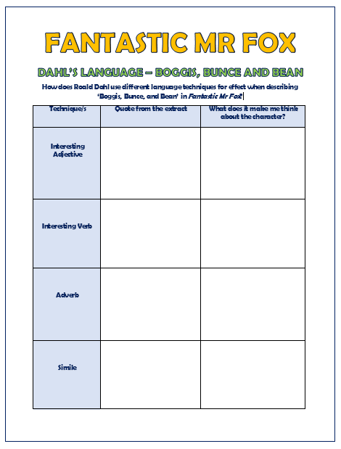
DEVELOPMENT
DAHL’S LANGUAGE
There is a sheet like this one for you complete. If you can’t print it don’t worry, just write your ideas in your book.
This will help you to think about the language that Roald Dahl uses to describe Boggis, Bunce and Bean.
Firstly (in the middle column) you need to find an example of each language technique – verbs, adjectives, adverbs and similes. I know you have been recapping over these over the past few weeks. Then (in the column on the right), explain how each language technique makes you think about the character.

Slide 9
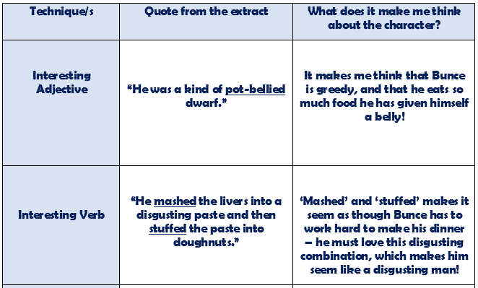
DEVELOPMENT
ANSWERS

Slide 10
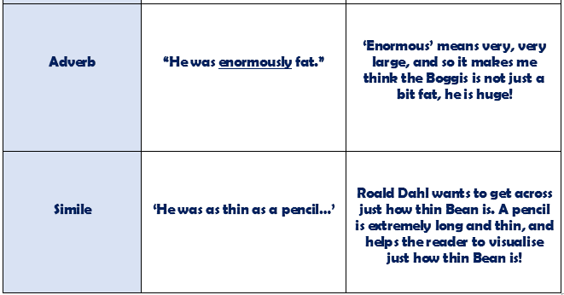
DEVELOPMENT
ANSWERS

