Slide 1
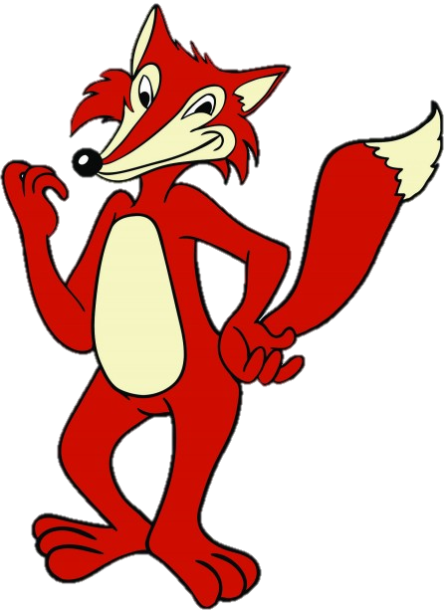
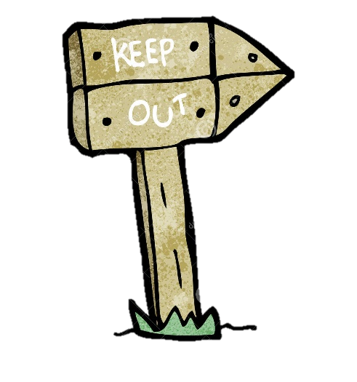
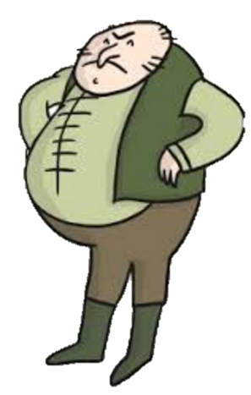
Roald Dahl’s
FANTASTIC
MR FOX
BOGGIS, BUNCE AND BEAN!
LEARNING OBJECTIVE
Understand and explore language in a text.
Use descriptive techniques to create characters.

Slide 2
Reading
Today you’re first task it to read the first 2 chapters of Fantastic Mr Fox. Don’t worry, they are very short! The part of the story you used yesterday is actually the first chapter of the book, so you’ve already read some of this.
Continue to the next slide for the story.
Once you have finished reading have a look at the last slide which has your task for today on it.

Slide 3
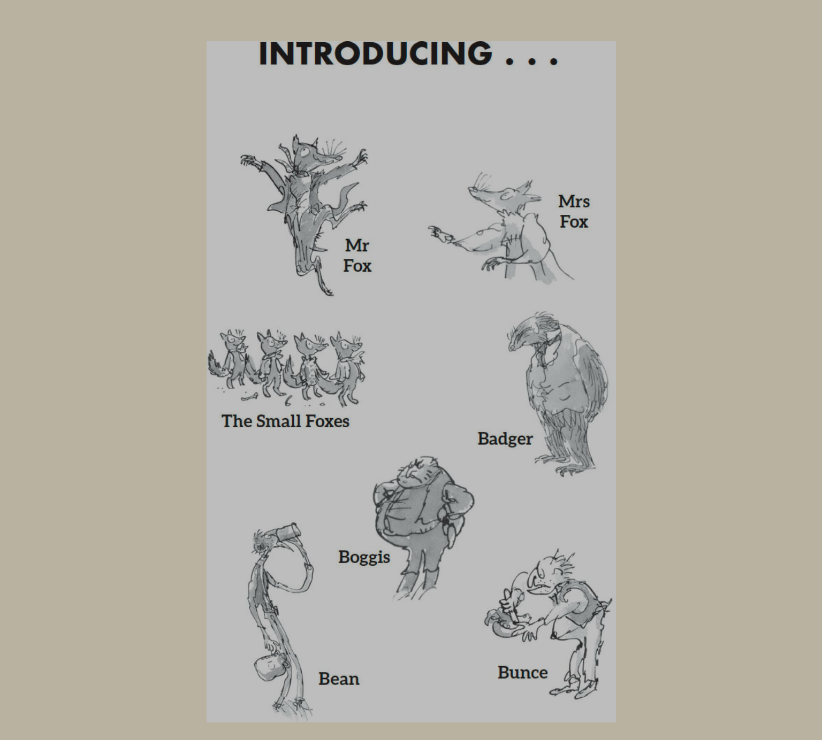

Slide 4
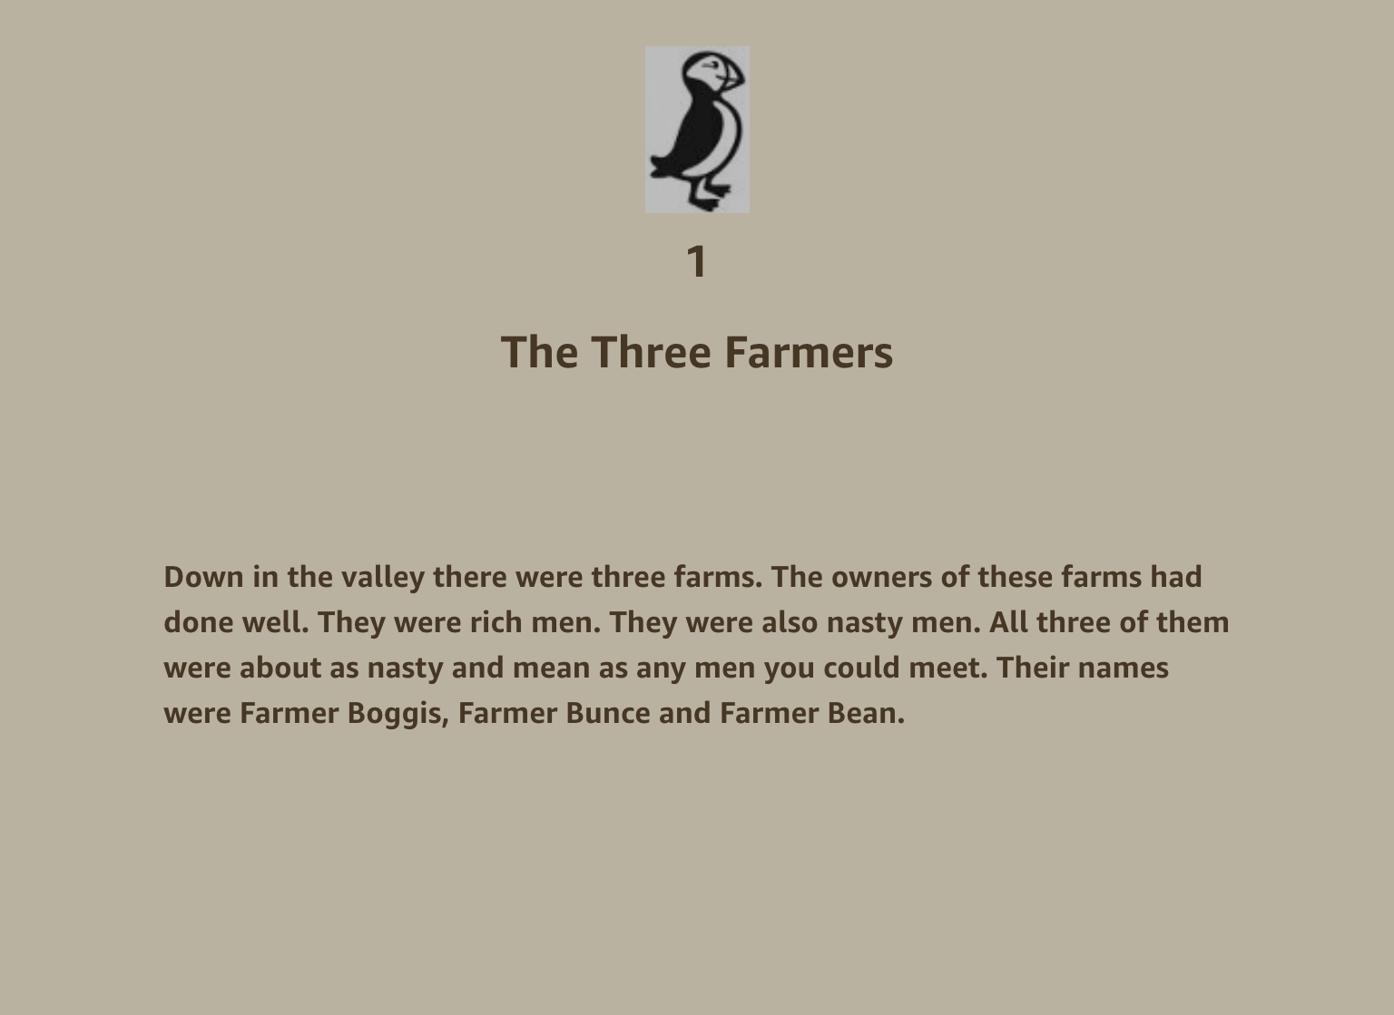

Slide 5
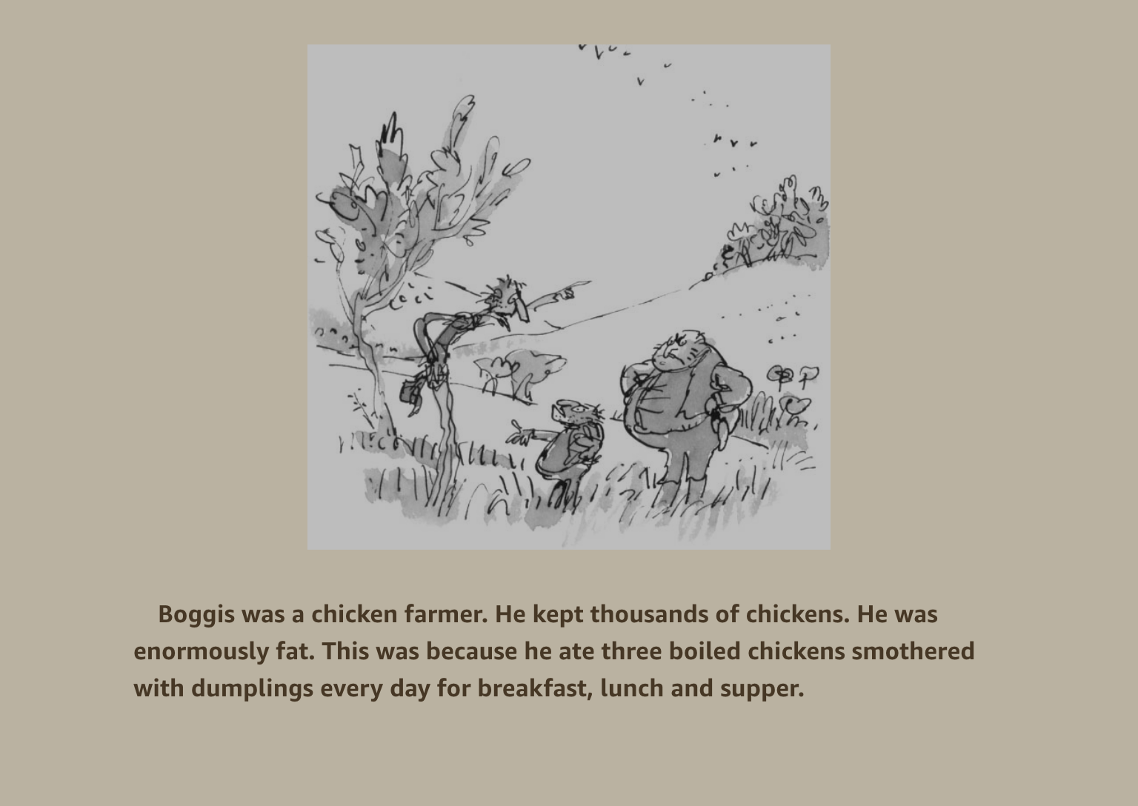

Slide 6
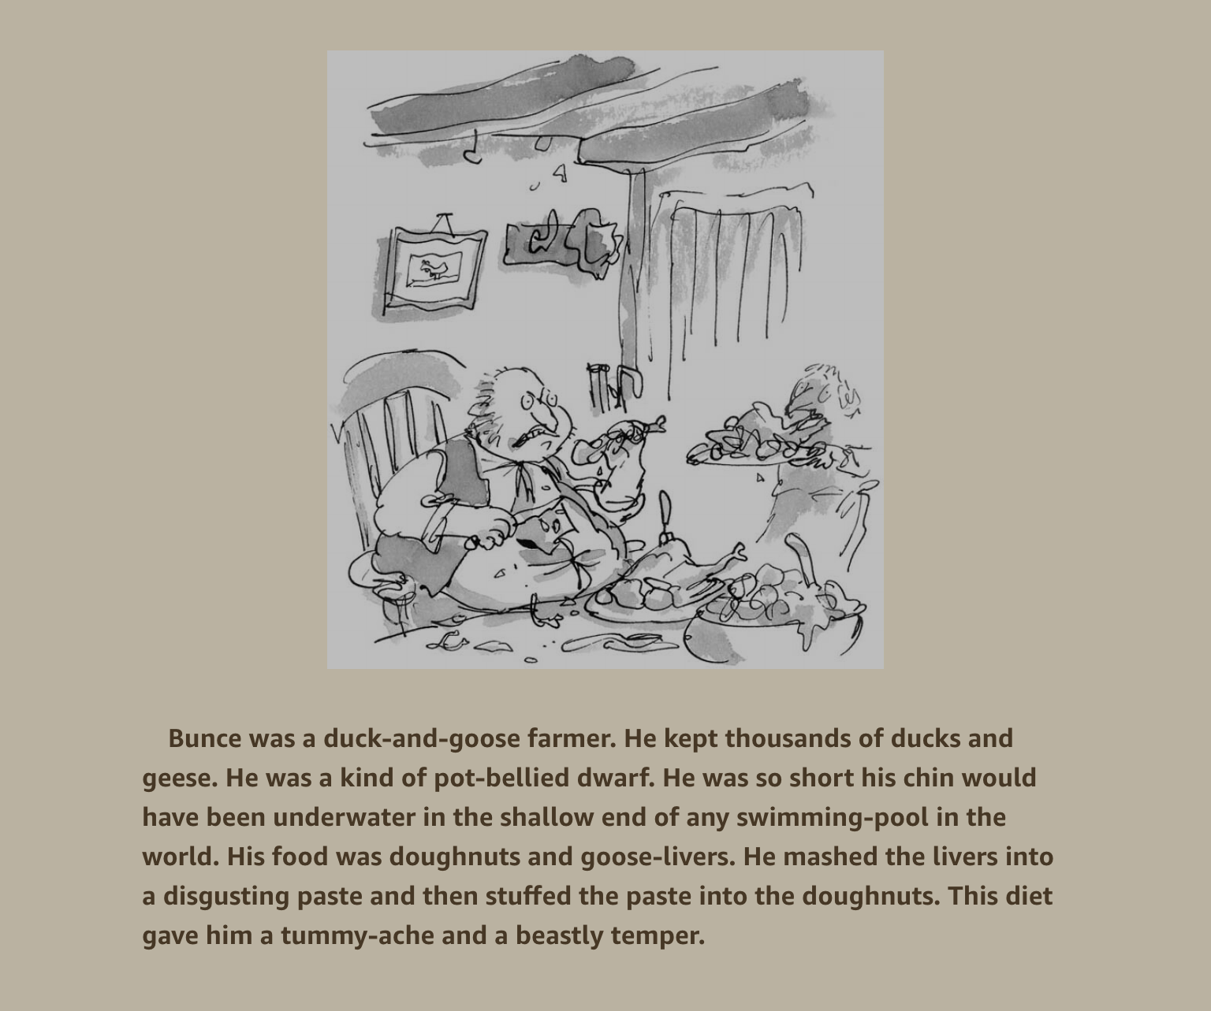

Slide 7
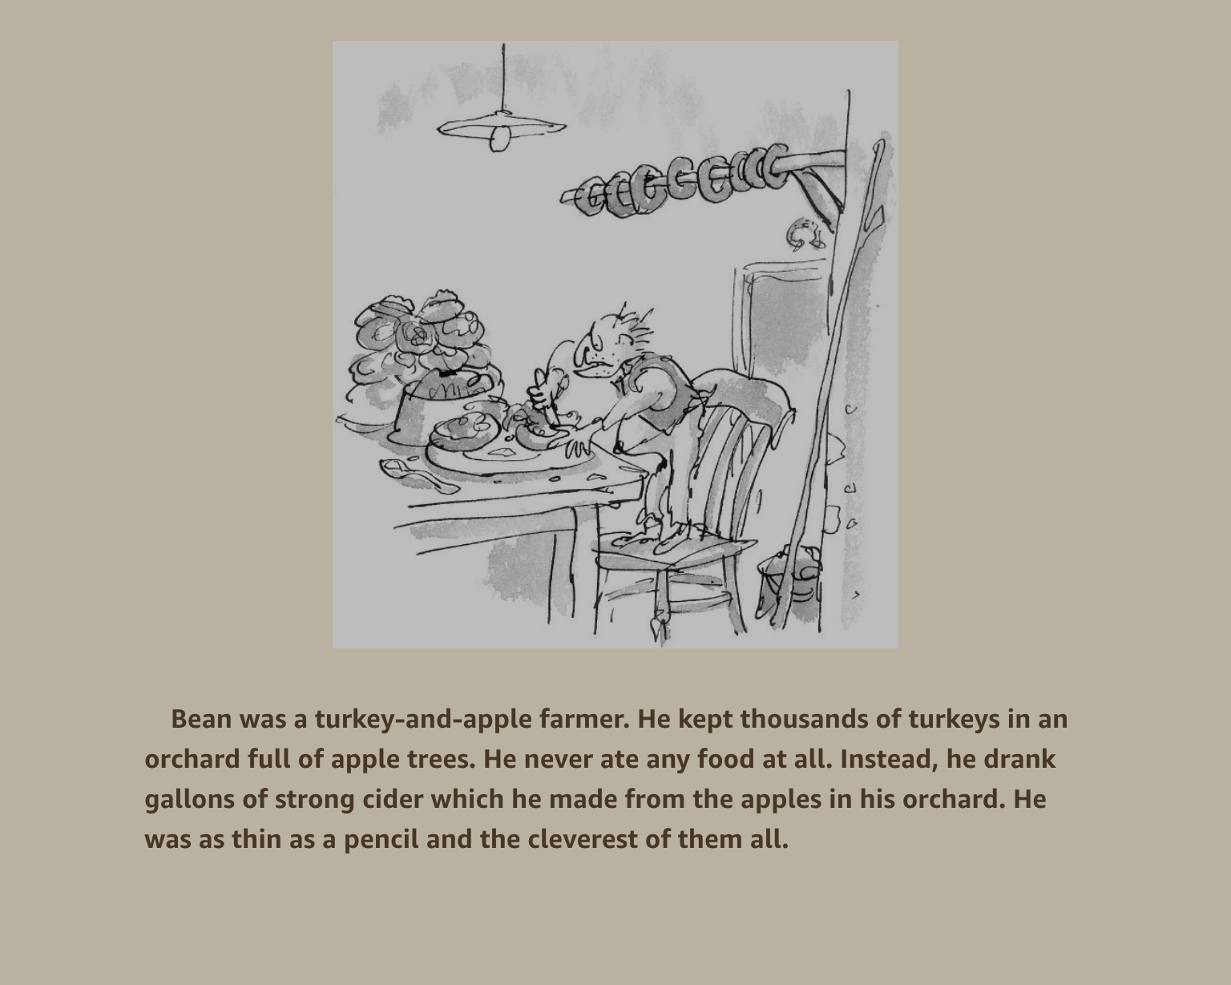

Slide 8
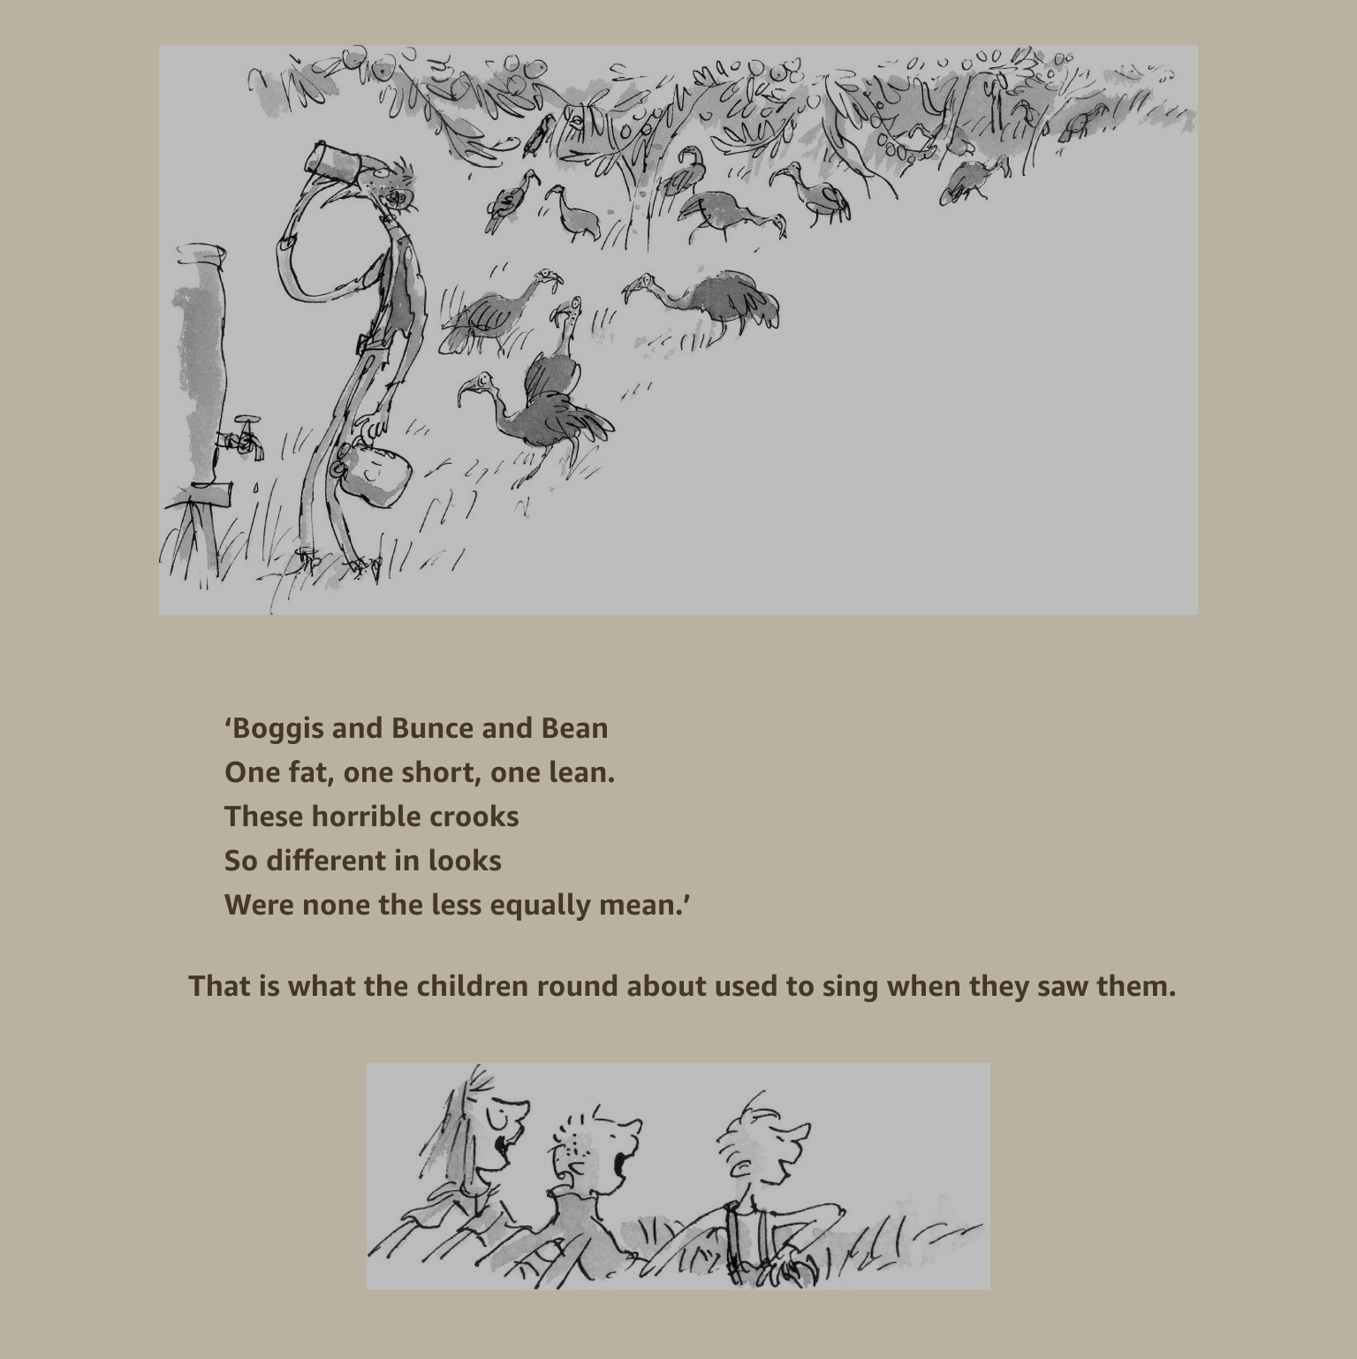

Slide 9
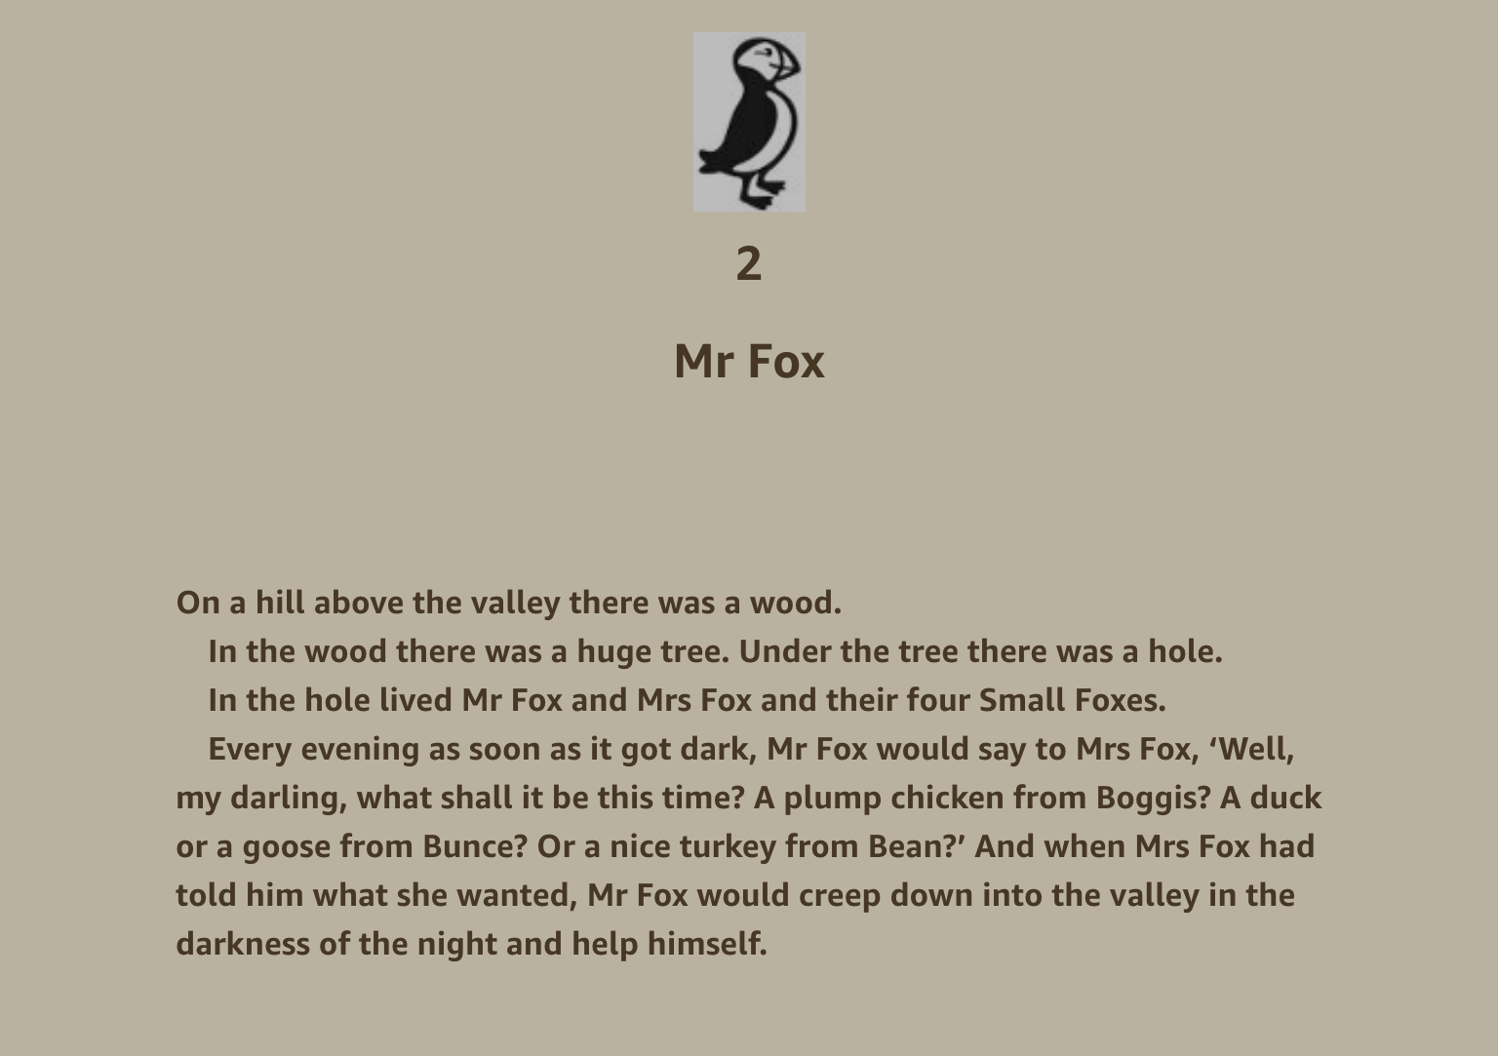

Slide 10
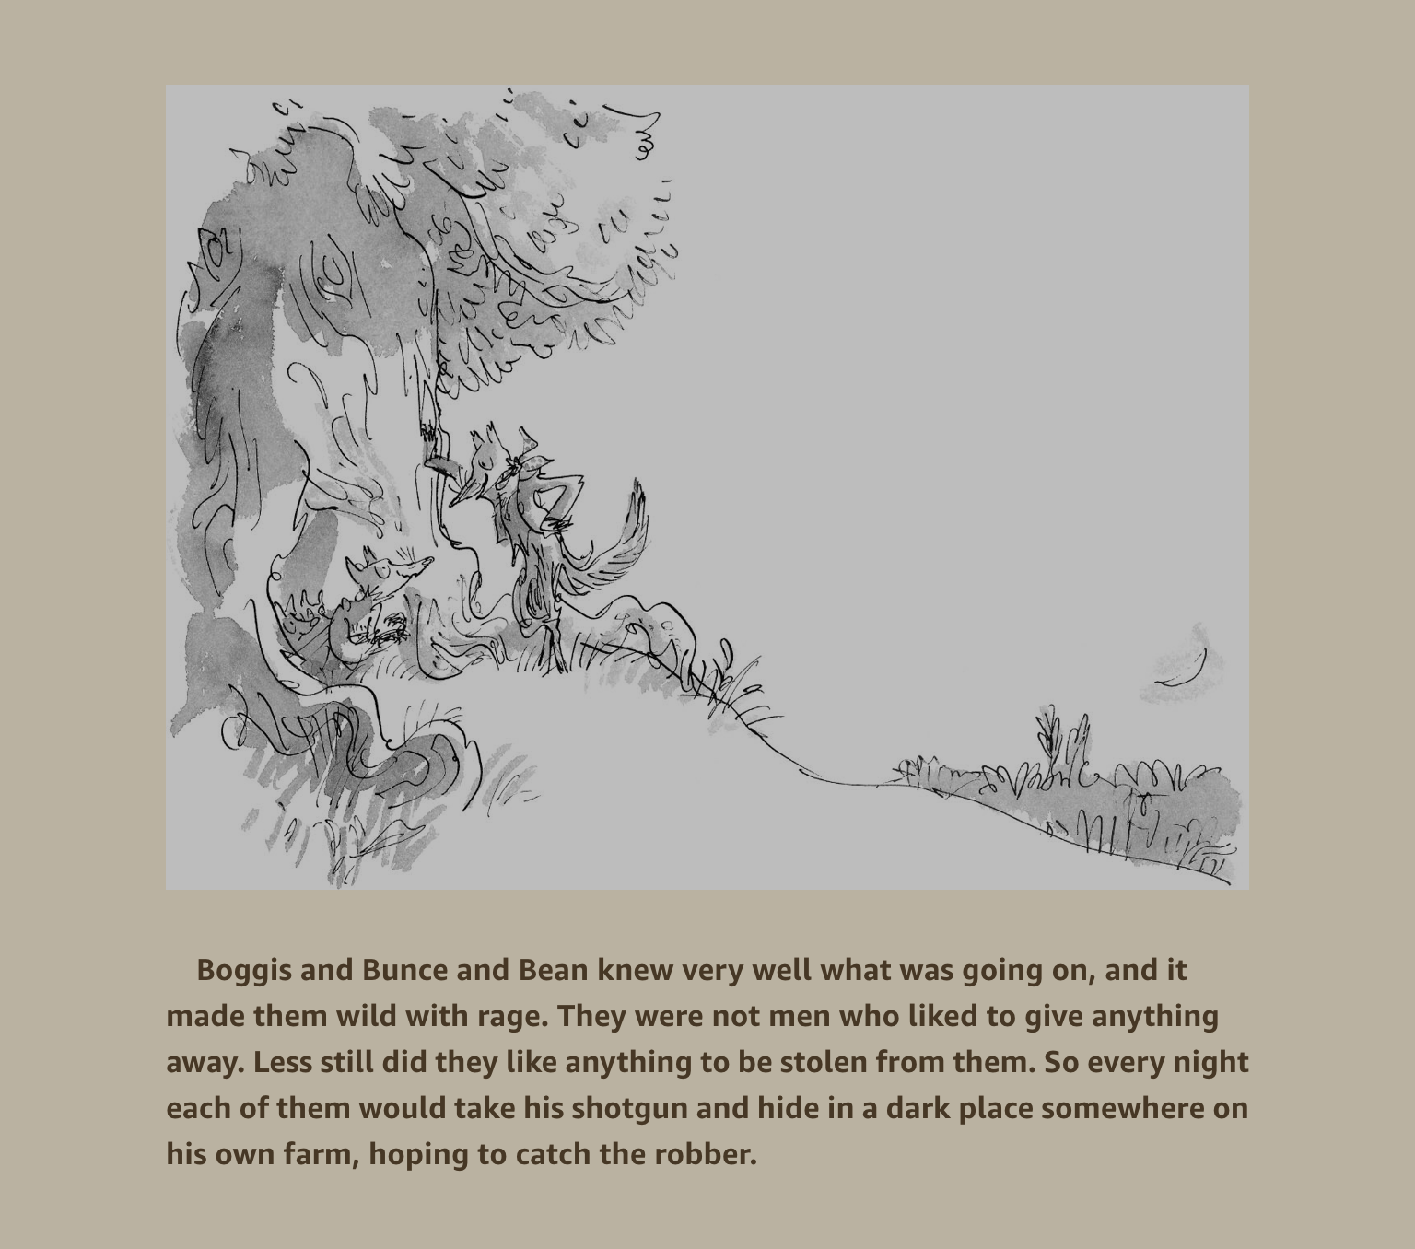

Slide 11
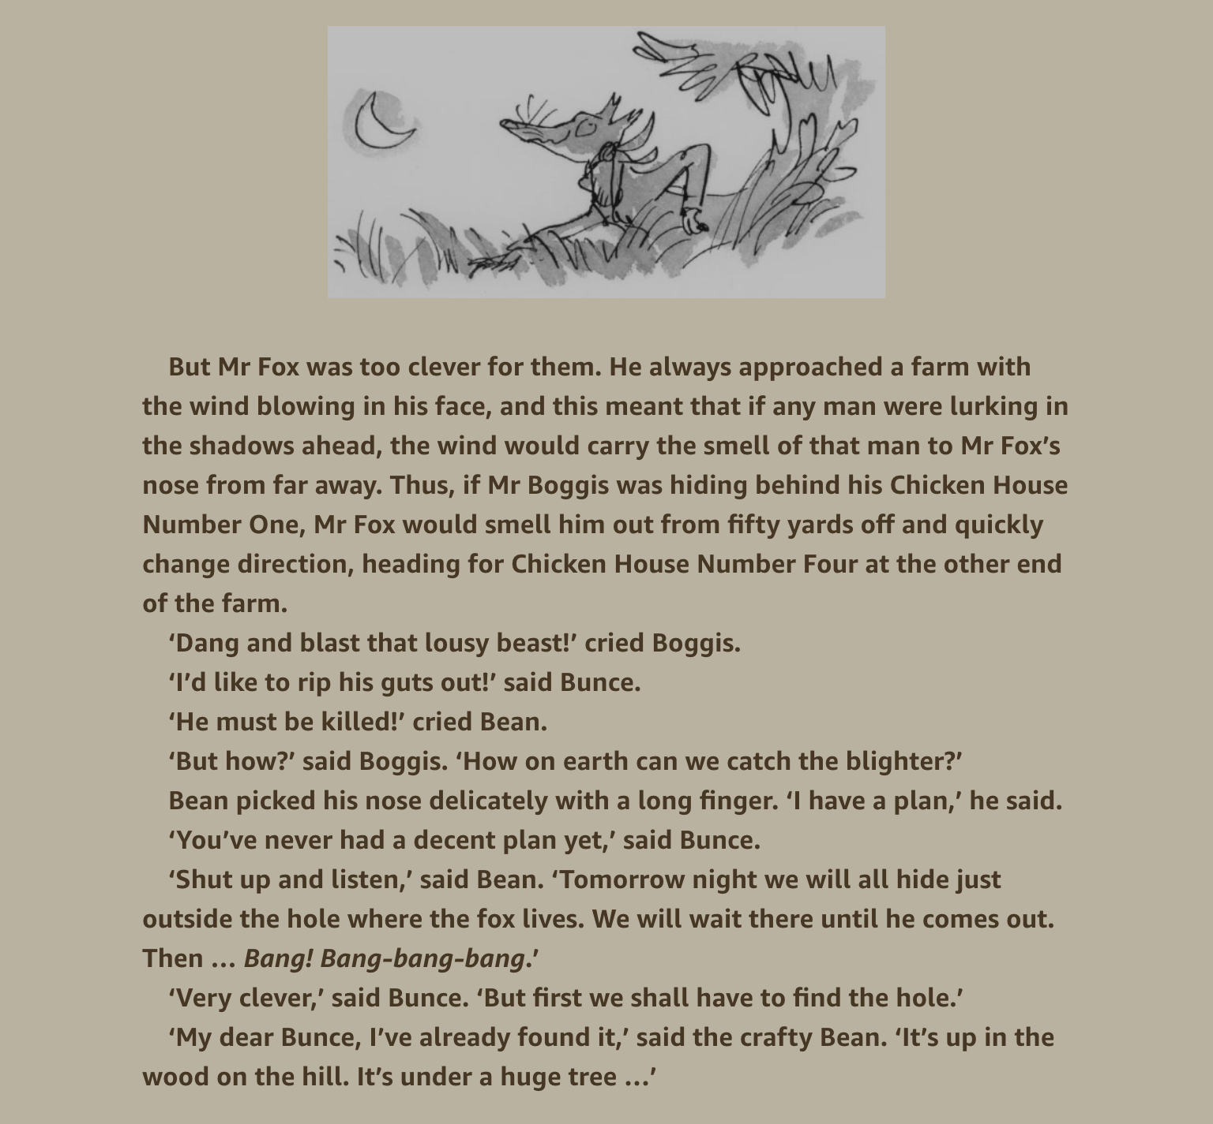

Slide 12
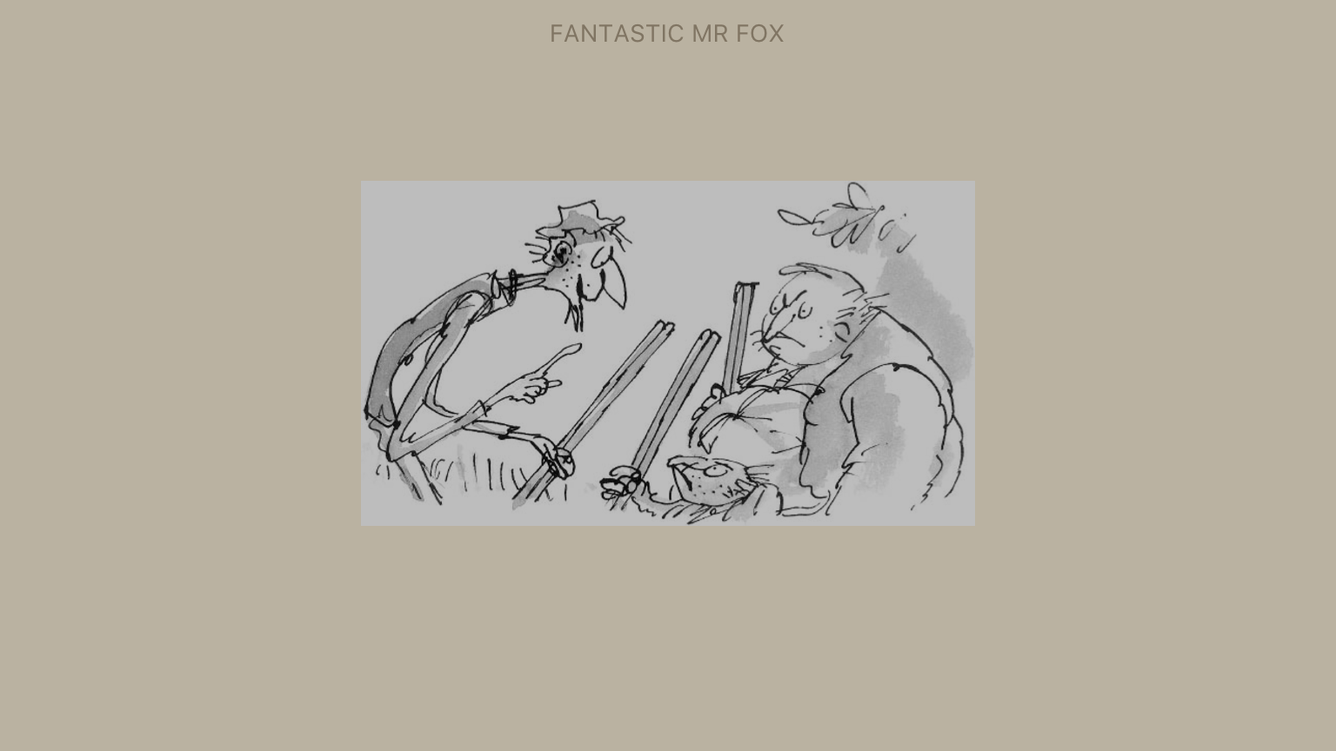

Slide 13
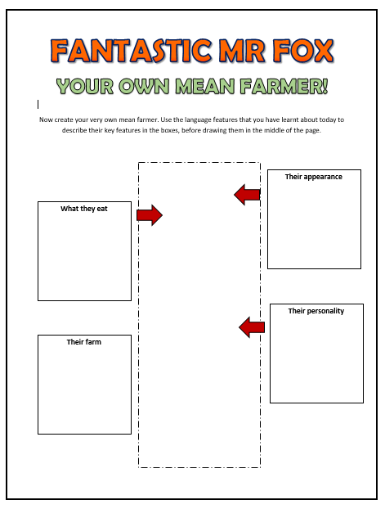
MAIN TASK
YOUR OWN MEAN FARMER!
Now it’s your turn to show that you can use language like Roald Dahl!
Create your own mean farmer, describing their appearance, personality, favourite foods, and their farm.
Use a range of language techniques, just like Roald Dahl. Then, draw your farmer!

