Slide 1


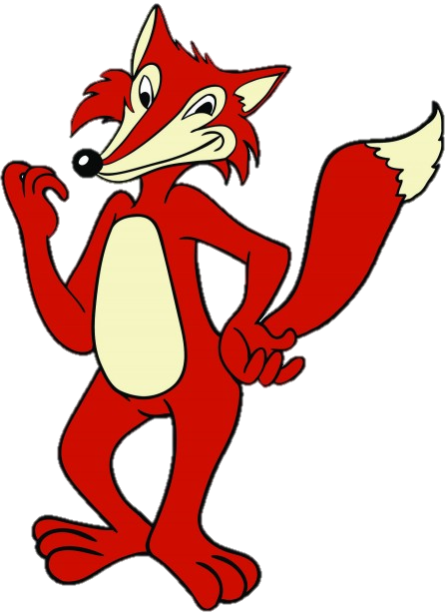
Roald Dahl’s
FANTASTIC
MR FOX
THE VERY CLEVER MR FOX!
ACTIVITY
What do you know about foxes? Write your ideas around a spider diagram, with the word ‘FOXES’ in the middle. I’ve done an example on the next page in case you get stuck.

Slide 2
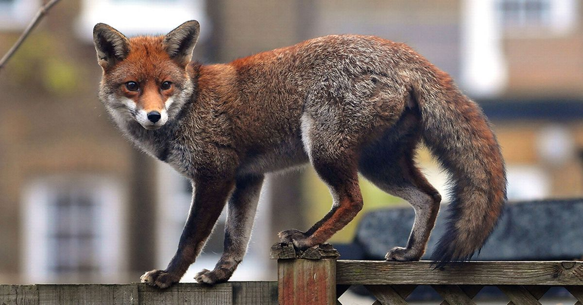
Example
There are many different types of foxes, which live all over the world. Mr Fox is most likely a red fox, as these are common across the UK.
Foxes are members of the dog family. Male foxes are called ‘dog foxes’ and female foxes are called ‘vixens.’ Baby foxes are called ‘Pups’ or ‘Cubs.’
FOXES
Foxes are seen as smart. People use the phrase “wily like a fox” or “sly as a fox” for a reason. Foxes are smart at finding food, outwitting predators and protecting their young. They're proven to be smarter than most dog breeds.
Chicken and poultry farmers are very wary of foxes. They are exceptionally good at finding ways to get food. They can chew through wire. They can jump 3 foot, or scramble over 6 foot fences, and can dig under fences also!

Slide 3
Roald Dahl’s
FANTASTIC
MR FOX
THE VERY CLEVER MR FOX!
Reading
Today you’re going to read Chapter 3 – The shooting where we find out more about our clever main character.

Slide 4
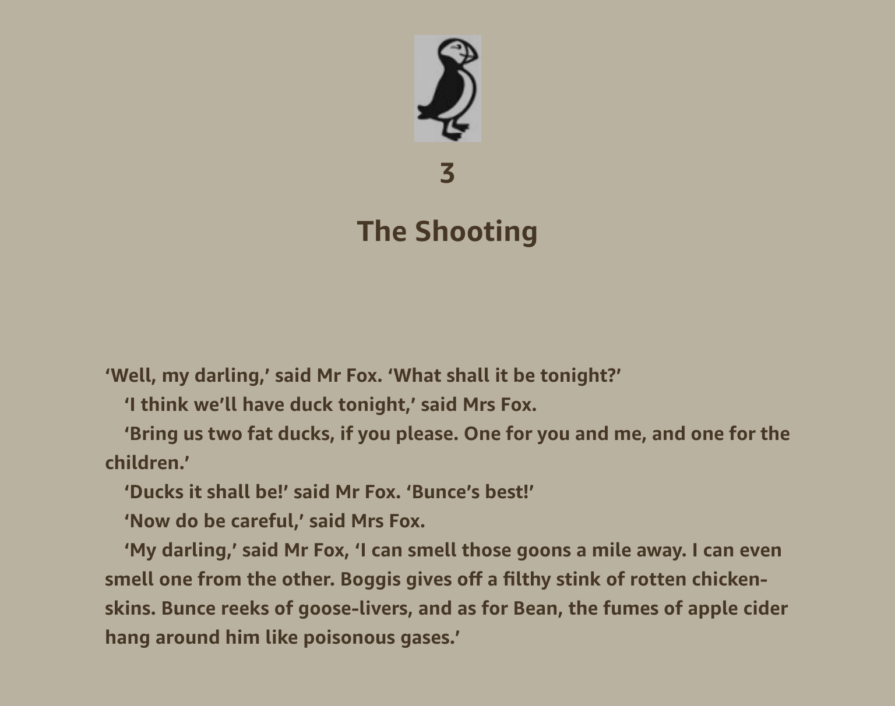

Slide 5
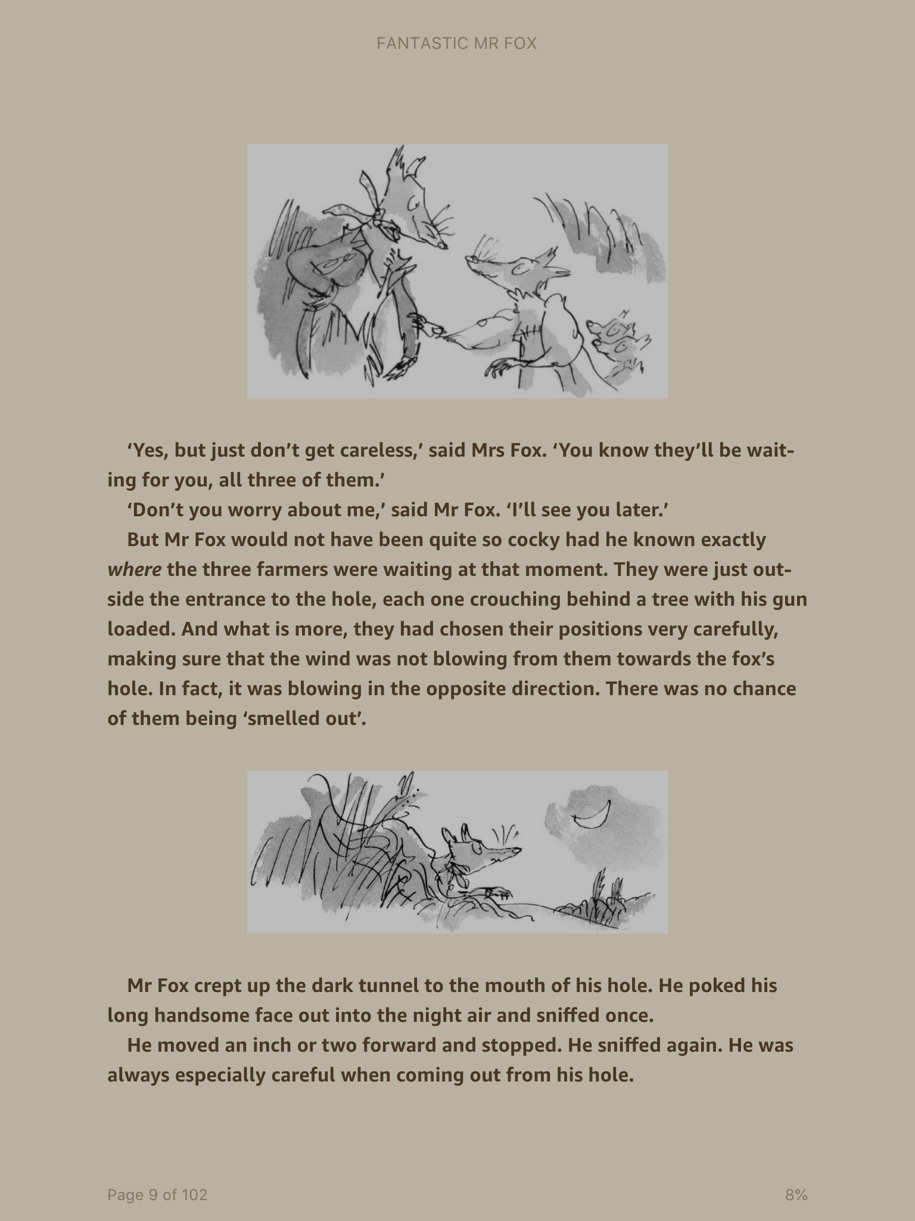

Slide 6
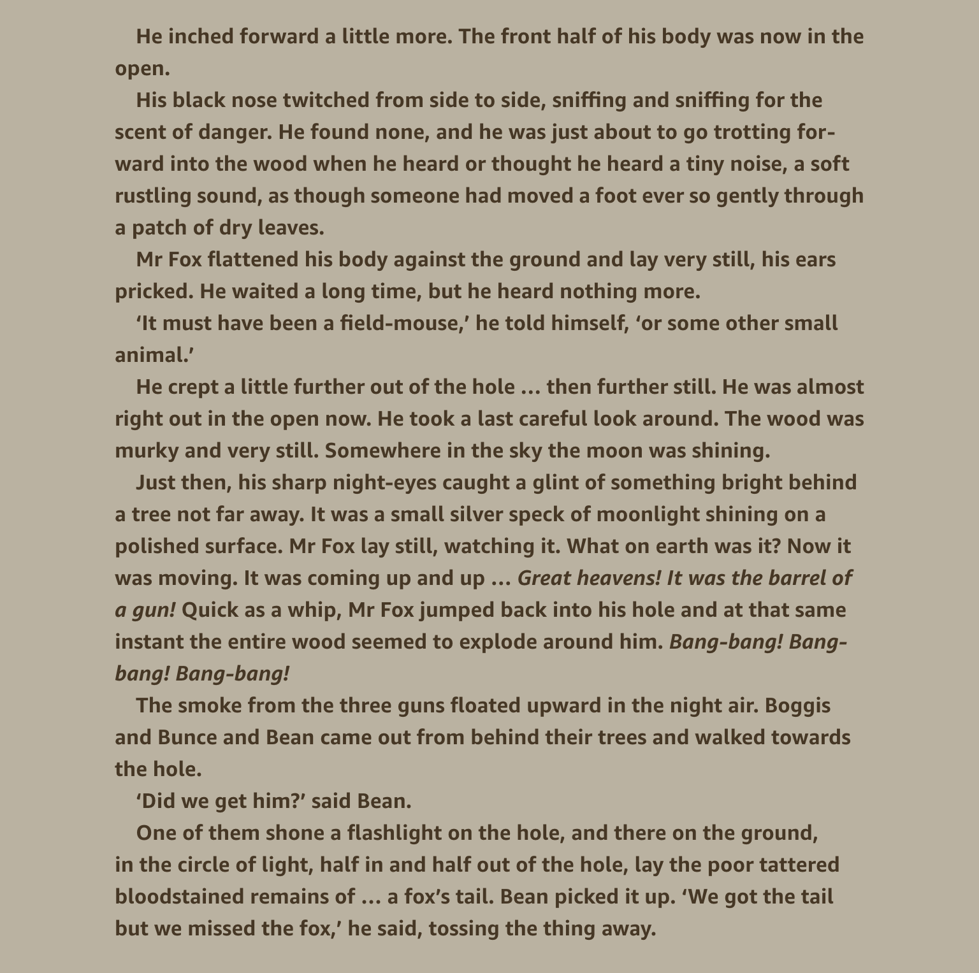

Slide 7
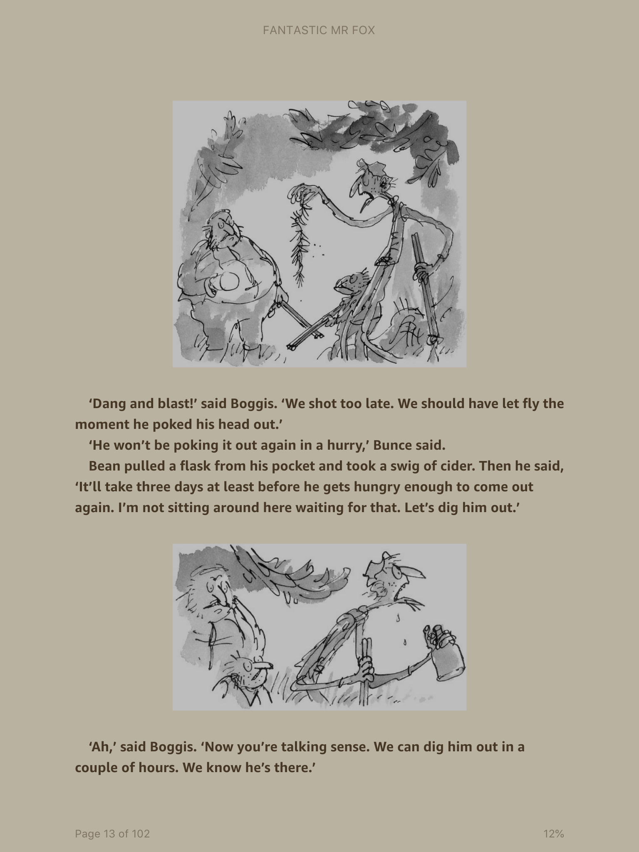

Slide 8


