Slide 1
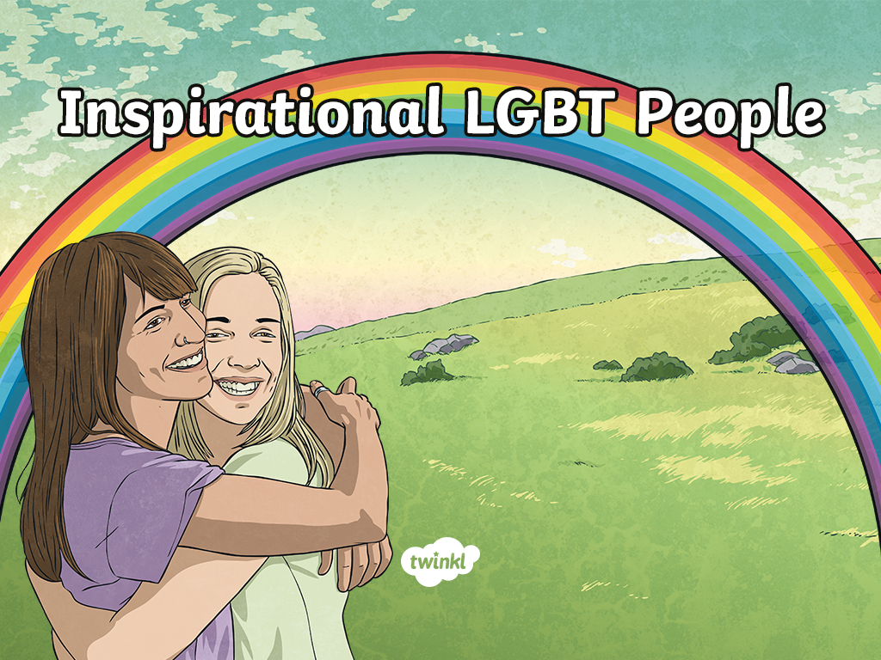

Slide 2
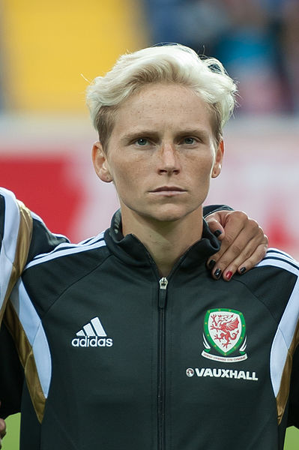
Jess Fishlock
Jess Fishlock is a Welsh midfielder who is openly gay. On 5 April 2017, Fishlock became the first Welsh football player to earn 100 caps for the national team. For four years running, Fishlock was named as the female Welsh Footballer of the Year.
“Ultimately everyone has an opinion about you, on what you do and how you do it. It’ll be positive and negative but the truth is you probably see 80 percent negative and 20 percent positive. It’s not easy, you just have to be able to deal with the good and the bad the same.” – Fishlock.

Slide 3
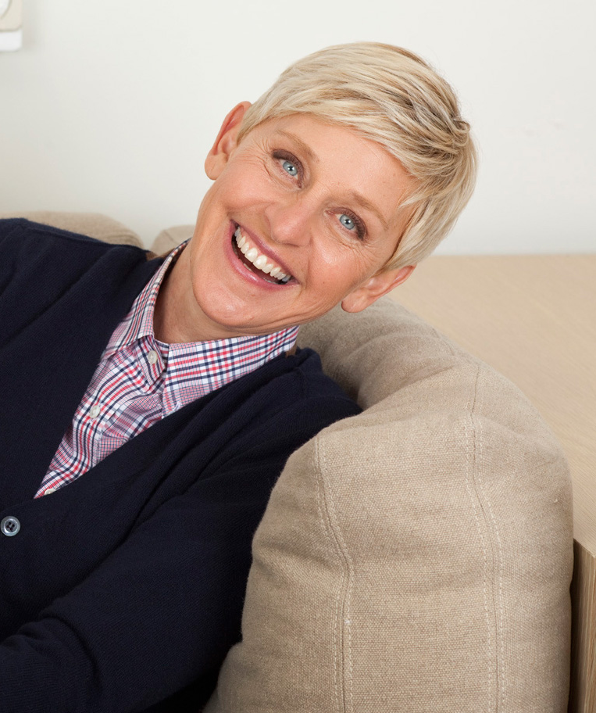
Ellen DeGeneres
Ellen DeGeneres is an American actor, writer, producer, comedian and LGBT activist. She has been the host of the comedy talk show ‘The Ellen DeGeneres Show’ since 2003.
“I think beauty comes from actually knowing who you are. That’s real beauty to me.”
– Ellen DeGeneres

Slide 4
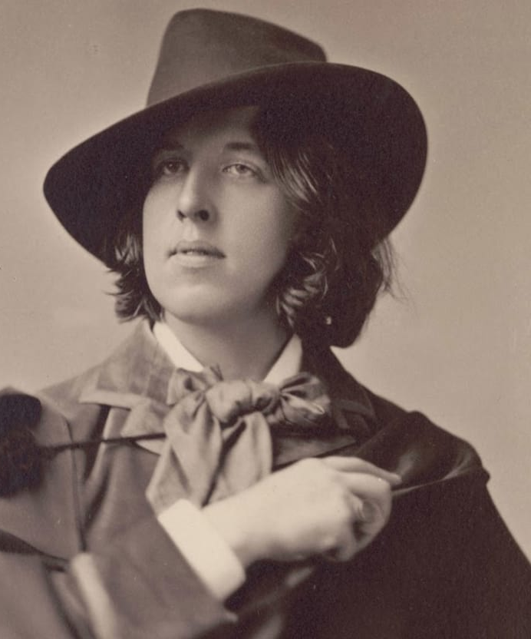
Oscar Wilde
Author Oscar Wilde was known for his flamboyant style and marvellous wit. He won accolades for his works including ‘The Importance of Being Earnest’ and ‘The Picture of Dorian Gray’. He was imprisoned because of his sexuality in 1895 for two years.
“You don’t love someone for their looks, or their clothes, or for their fancy car, but because they sing a song only you can hear.” – Oscar Wilde

Slide 5
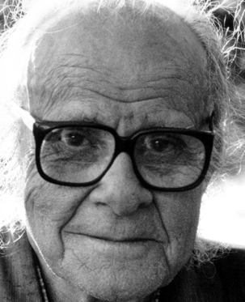
Harry Hay
Henry ‘Harry’ Hay began his activist life in the 1930s in which he was fighting for workers’ rights during the labour movement. With this experience, he became part of the communist party and started America’s first successful homosexual liberation organisation.
“I knew that I was gay in every bone of my body. So I did the only thing I could do. I started the movement.” – Harry Hay

Slide 6
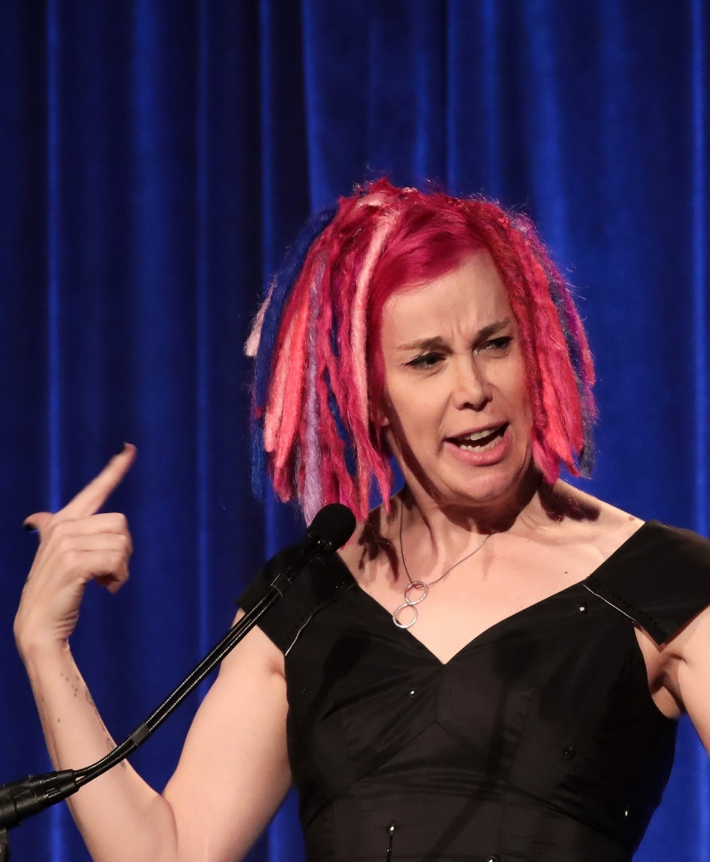
Lana Wachowski
Lana Wachowski is an American film director, screenwriter and producer. Lana is a transgender woman. She has had success with films ‘The Matrix’ and ‘Cloud Atlas’ which she produced with her sister Lilly. Lilly is also a transgender woman.
“Art is an invitation to abandon your perspective. Art always says: come with me and look at life in a different way.”
– Lana Wachowski

Slide 7
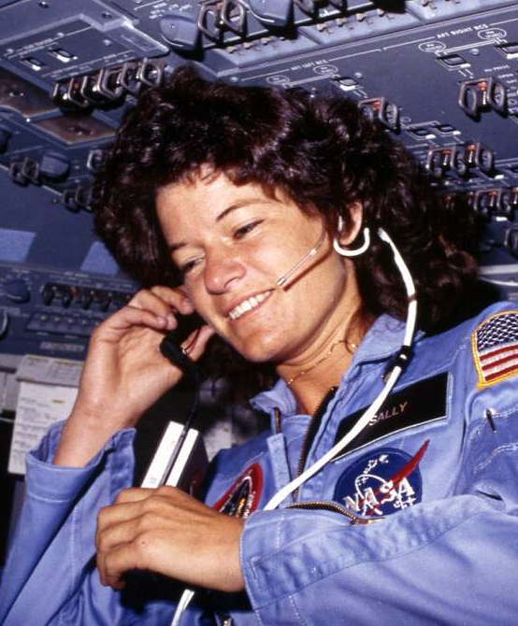
Sally Ride
Sally Ride joined NASA in 1978 and was the first American woman in space in 1983. She was inducted into the National Women’s Hall of Fame and the Astronaut Hall of Fame in recognition of her work as an American physicist and astronaut. Sally wrote a number of science books for children.
“All adventures, especially into new territory, are scary.” – Sally Ride

Slide 8
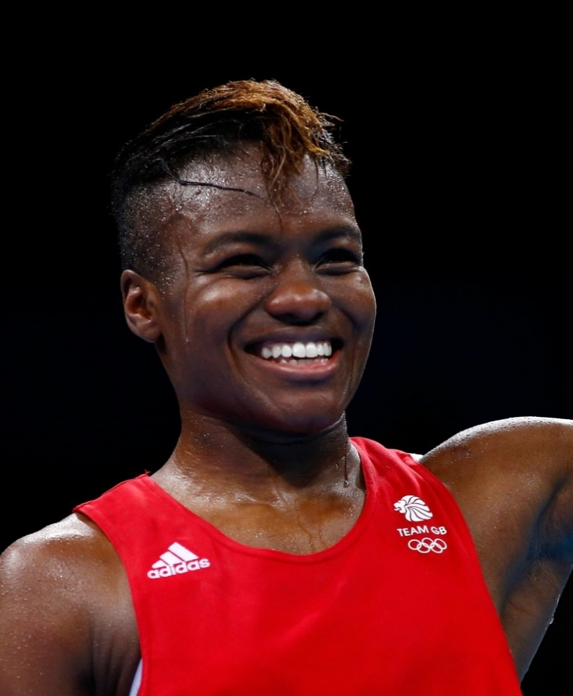
Nicola Adams
Nicola Adams is a British professional boxer. She was the first woman to win an Olympic boxing title. She is the 2012 and 2016 Olympic gold medallist in the woman’s flyweight division. Nicola is openly bisexual and was named the most influential LGBT person in Britain in 2012.
“I always look back on the hard times. It’s what gives me the drive and ambition to keep moving forward.”
– Nicola Adams

Slide 9
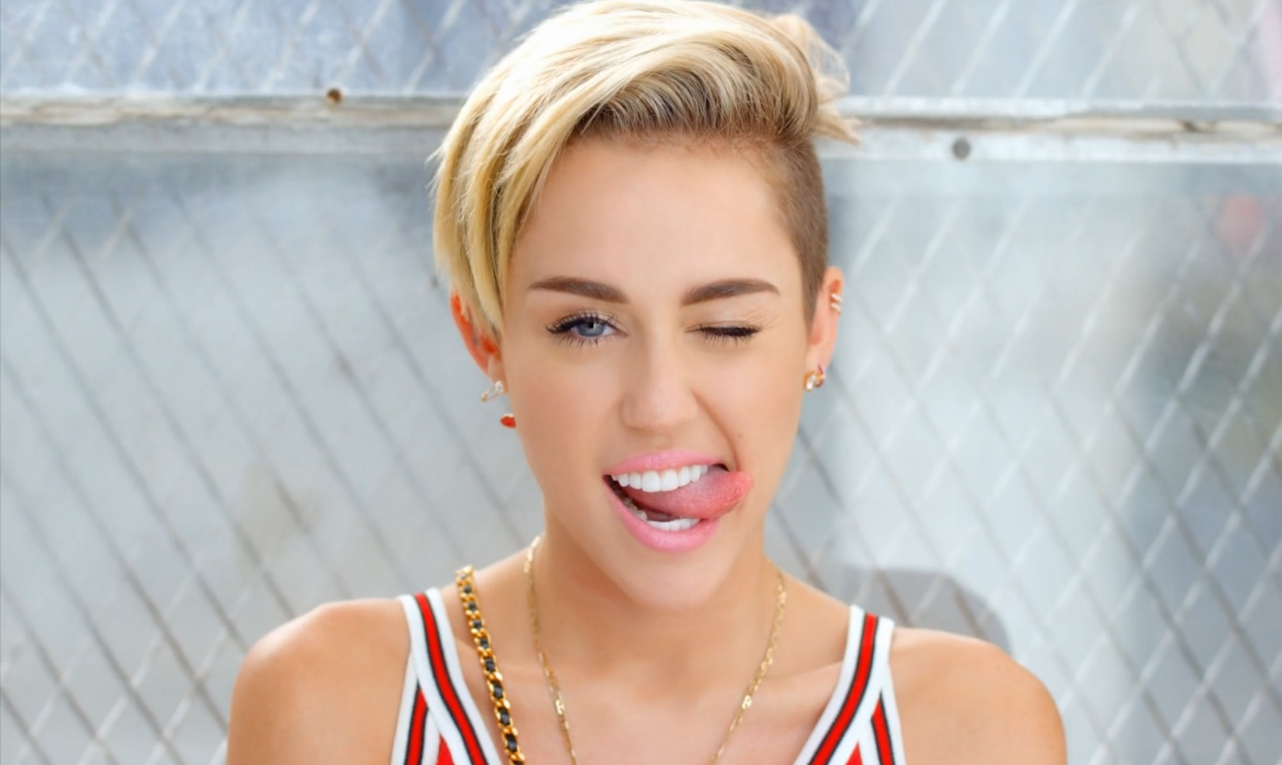
Miley Cyrus
Miley Cyrus is an American singer, songwriter and actor. She was a teen idol starring in the Disney television series Hannah Montana. Miley has achieved five number-one singles and eleven top-ten albums. She is a huge supporter of the LGBT community and set up a foundation ‘The Happy Hippie’ which focusses on youth, homelessness and the LGBT community.
“Don’t be anything you don’t want to be, always be yourself.” – Miley Cyrus

Slide 10
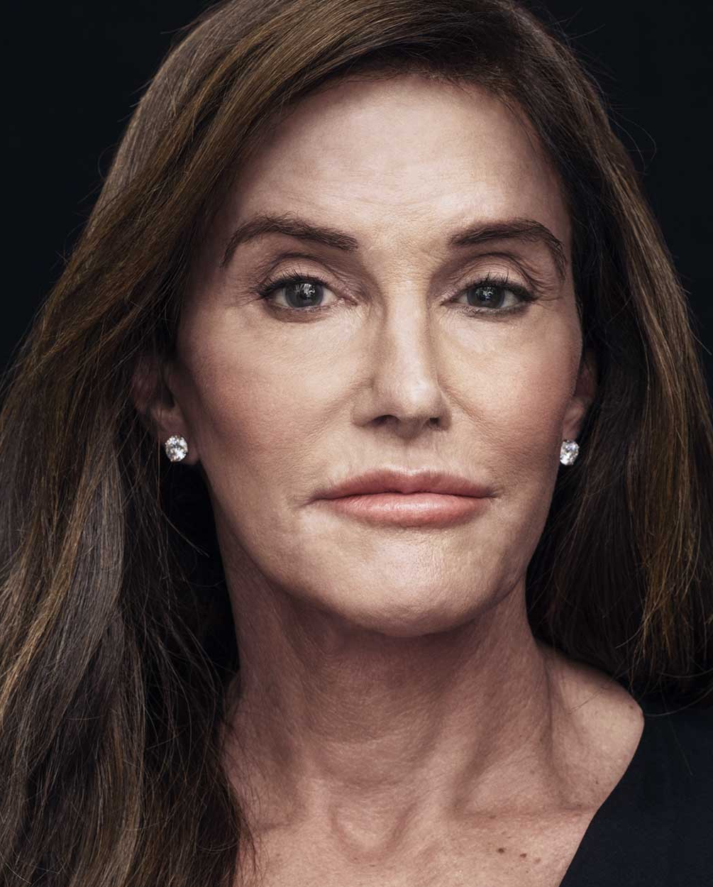
Caitlyn Jenner
Caitlyn Marie Jenner is an American television personality and retired Olympic gold medal winning decathlete. Caitlyn publicly revealed her identity as a transgender woman in a Vanity Fair cover story.
“We’re all different. That’s not a bad thing.” – Caitlyn Jenner

Slide 11
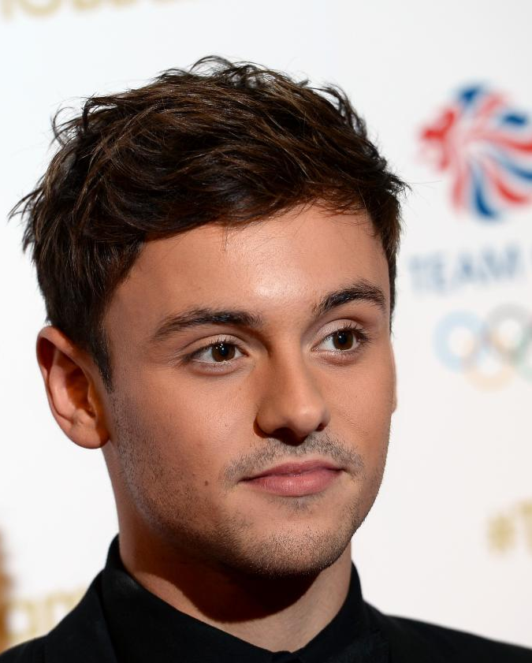
Tom Daley
Tom Daley is a British diver. His event is the 10m platform and he competes in the synchronised and team events. He was the world champion for diving in 2009 and 2017. He has created a YouTube channel that features vlogs and fitness videos. It was through this medium that, in 2013, he announced that he was in a relationship with a man. He won the title of Independent Influencer Award at the British LBGT awards in 2017.
“In an ideal world I wouldn’t be doing this video because it shouldn’t matter.” – Tom Daley

Slide 12
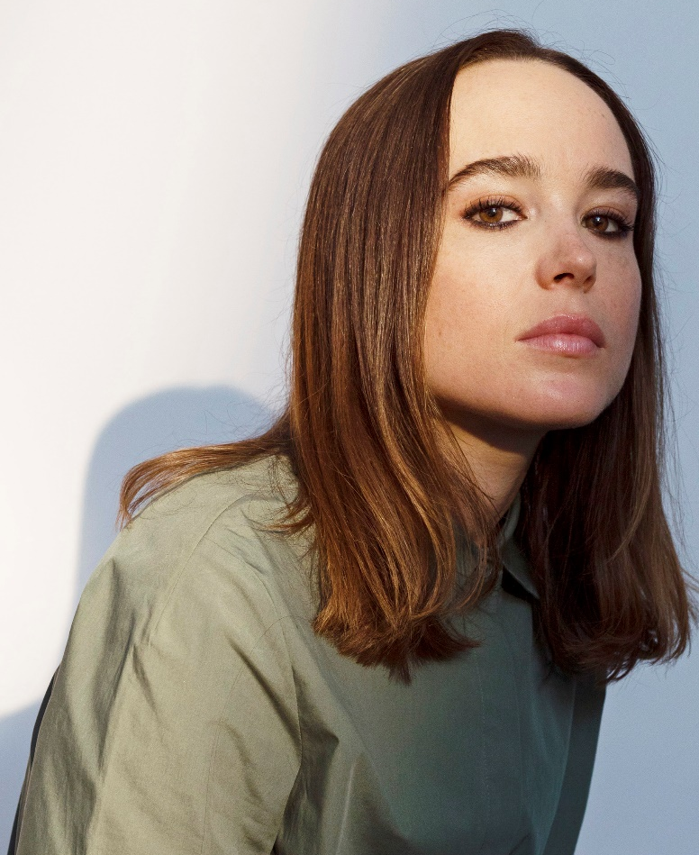
Ellen Page
Ellen is a Canadian actor who began her career on Canadian television. She starred in the 2005 drama ‘Hard Candy’ in which she won the best actor award for her role at the Austin Film Critics. In 2007, she played the lead character in the movie Juno and she was nominated for an Academy Award. In 2014, during a speech at the Human Rights Campaign’s ‘Time to Thrive’ conference, she revealed that she was gay.
“This world would be a whole lot better if we just made an effort to be less horrible to one another.” – Ellen Page

Slide 13
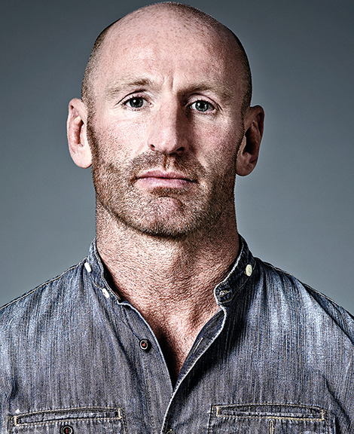
Gareth Thomas
Gareth ‘Alfie’ Thomas is a professional rugby player. He has represented Wales in both Rugby Union and Rugby League. He has played in over 100 test matches and is currently ranked 13th among international try scorers. Gareth announced that he was gay in 2009 and the following year he was voted the most influential gay person in the United Kingdom IoS Pink List and received the Stonewall’s Hero of the Year award.
“I don’t want to be known as a gay rugby player. I am a rugby player, first and foremost I am a man.” – Gareth Thomas.

Slide 14
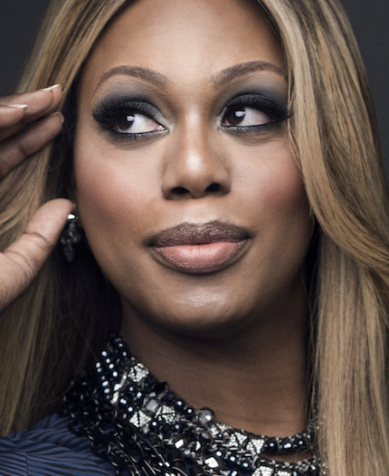
Laverne Cox
Laverne Cox is an actor and LGBT advocate. She has an identical twin brother and was raised in Alabama by her mother and grandmother. Laverne was nominated for a Primetime Emmy Award in the acting category and is the first transgender woman to be nominated since 1990.
“You are worthy… simply because of who you are.” – Laverne Cox

Slide 15
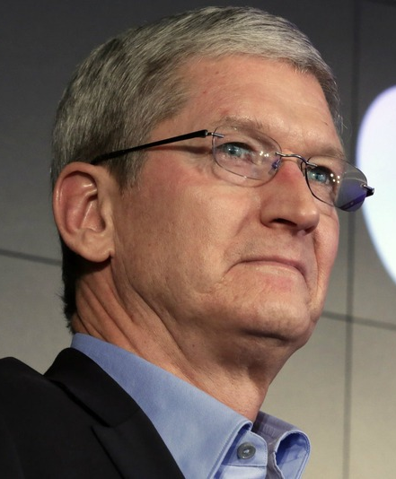
Tim Cook
Tim Cook is an American business executive, industrial engineer and developer. He is currently the Chief Executive Officer of Apple Inc. Tim is known for keeping his private life private and he did not confirm that he was gay until 2014. He publicly supports LGBT rights. He is the first openly gay CEO on the Fortune 500 list.
“Let your joy be in your journey, not in some distant goal.” – Tim Cook

Slide 16
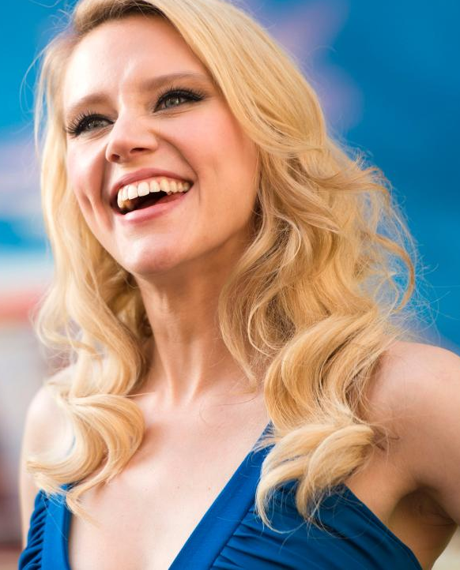
Kate McKinnon
Kathryn ‘Kate’ McKinnon is an American comedian, actor and model. She is best known as a regular cast member on Saturday Night Live and The Big Gay Sketch Show. Kate is also known for doing impressions. She has received five nominations for Primetime Emmy awards and four for Outstanding Supporting Actress in a comedy series, winning in 2016 and 2017.
“Why punish yourself by trying to be extraordinary or even good or normal. Because the sight of a person who has decided to make their own music is breathtaking.” – Kate McKinnon

Slide 17
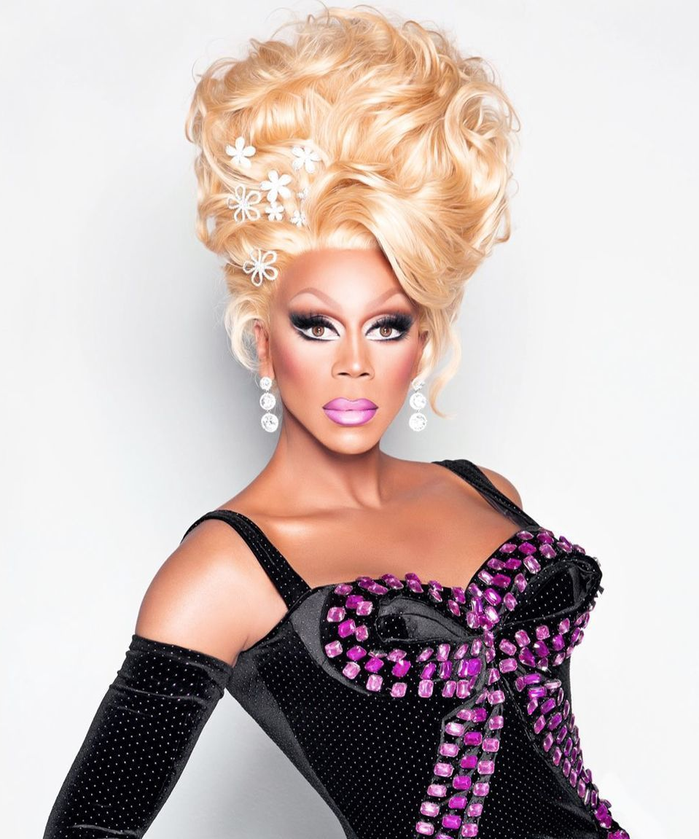
RuPaul
RuPaul Andre Charles is an American drag queen and is thought to be the most successful drag queen of all time. He is an actor, model, singer, songwriter, television personality and author. He has produced and hosted the reality show RuPaul’s Drag Race on the LGBT network. RuPaul has played men in a number of roles and makes public appearances both in and out of drag.
"You can call me he. You can call me she. You can call me Regis and Kathie Lee; I don't care! Just as long as you call me." – RuPaul

