Slide 1


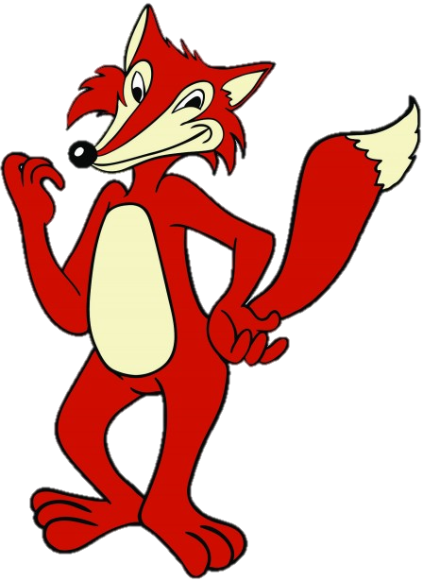
Roald Dahl’s
FANTASTIC
MR FOX
THE VERY CLEVER MR FOX!
LEARNING OBJECTIVE
-Understand and explore characters in a text.
-Infer and deduce the hidden meanings in texts.

Slide 2
Roald Dahl’s
FANTASTIC
MR FOX
THE VERY CLEVER MR FOX!
In the next part of the story we meet another character. I’m not going to give you the next part of the story to read…just yet. Instead I want you to think who this new character could be.

Slide 3
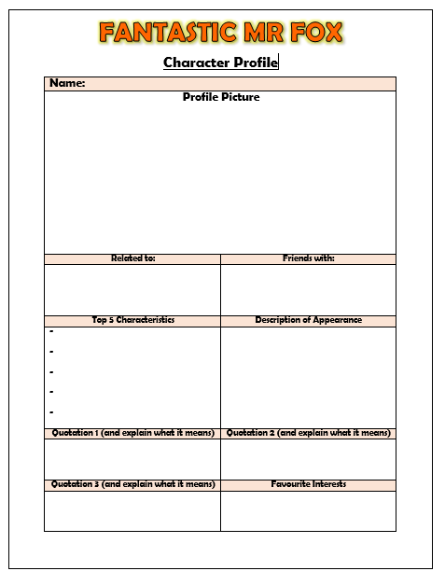
EXTENSION
YOUR OWN CHARACTER!
Now that you have completed your character profile of Mr Fox, it’s time for you to create your own character!
Think of another character that you could add into the story of Fantastic Mr Fox. Reveal their key information by completing the character profile.

Slide 4
I really hope you’ve enjoyed our study of Fantastic Mr Fox.
If you wish to find out what happens in the rest of our story, click on the fox below. (You need to be in presentation mode for it to work.) It will take you to an audio clip so you can listen and follow along with the story right to the end. You can listen to the whole thing or jump to 31 mins in to pick up roughly where we left it.

