Slide 1


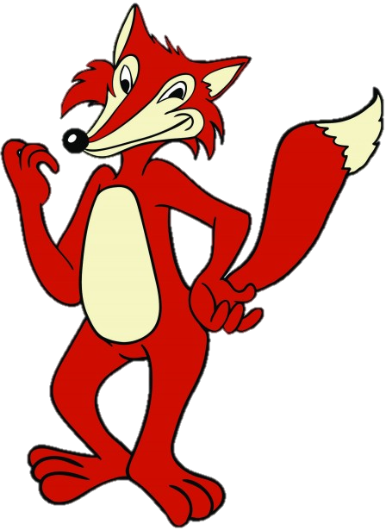
Roald Dahl’s
FANTASTIC
MR FOX
THE VERY CLEVER MR FOX!
LEARNING OBJECTIVE
-Understand and explore characters in a text.
-Infer and deduce the hidden meanings in texts.
STARTER ACTIVITY
We’ll start today by reading the next chapter, which is very short but I’m sure, like me, you want to know what happens next.

Slide 2
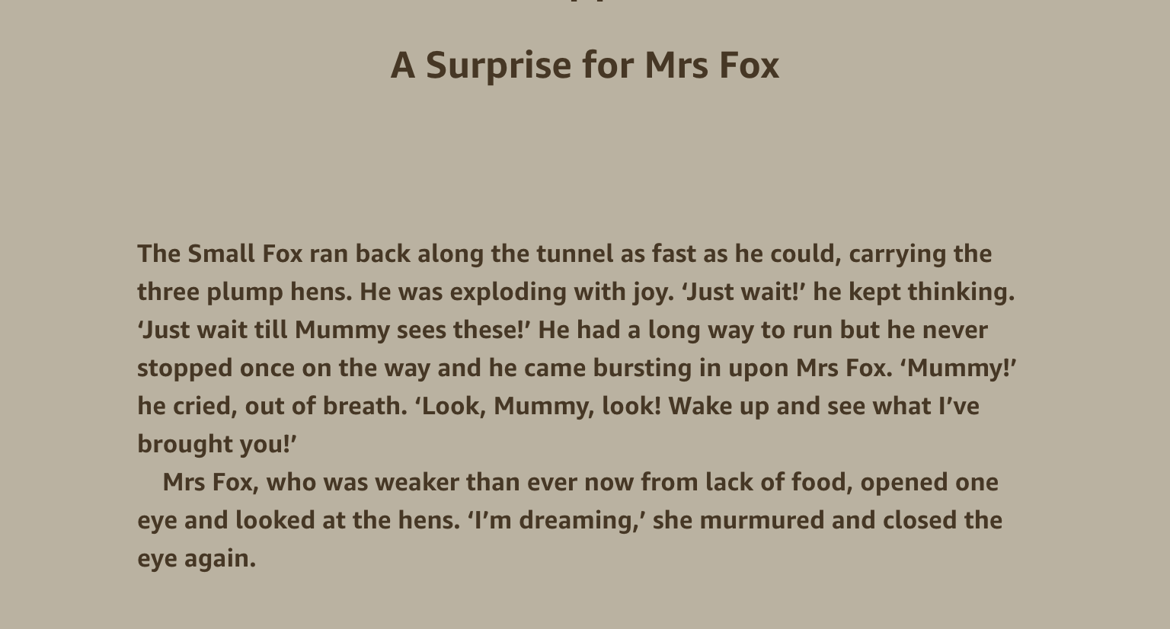

Slide 3
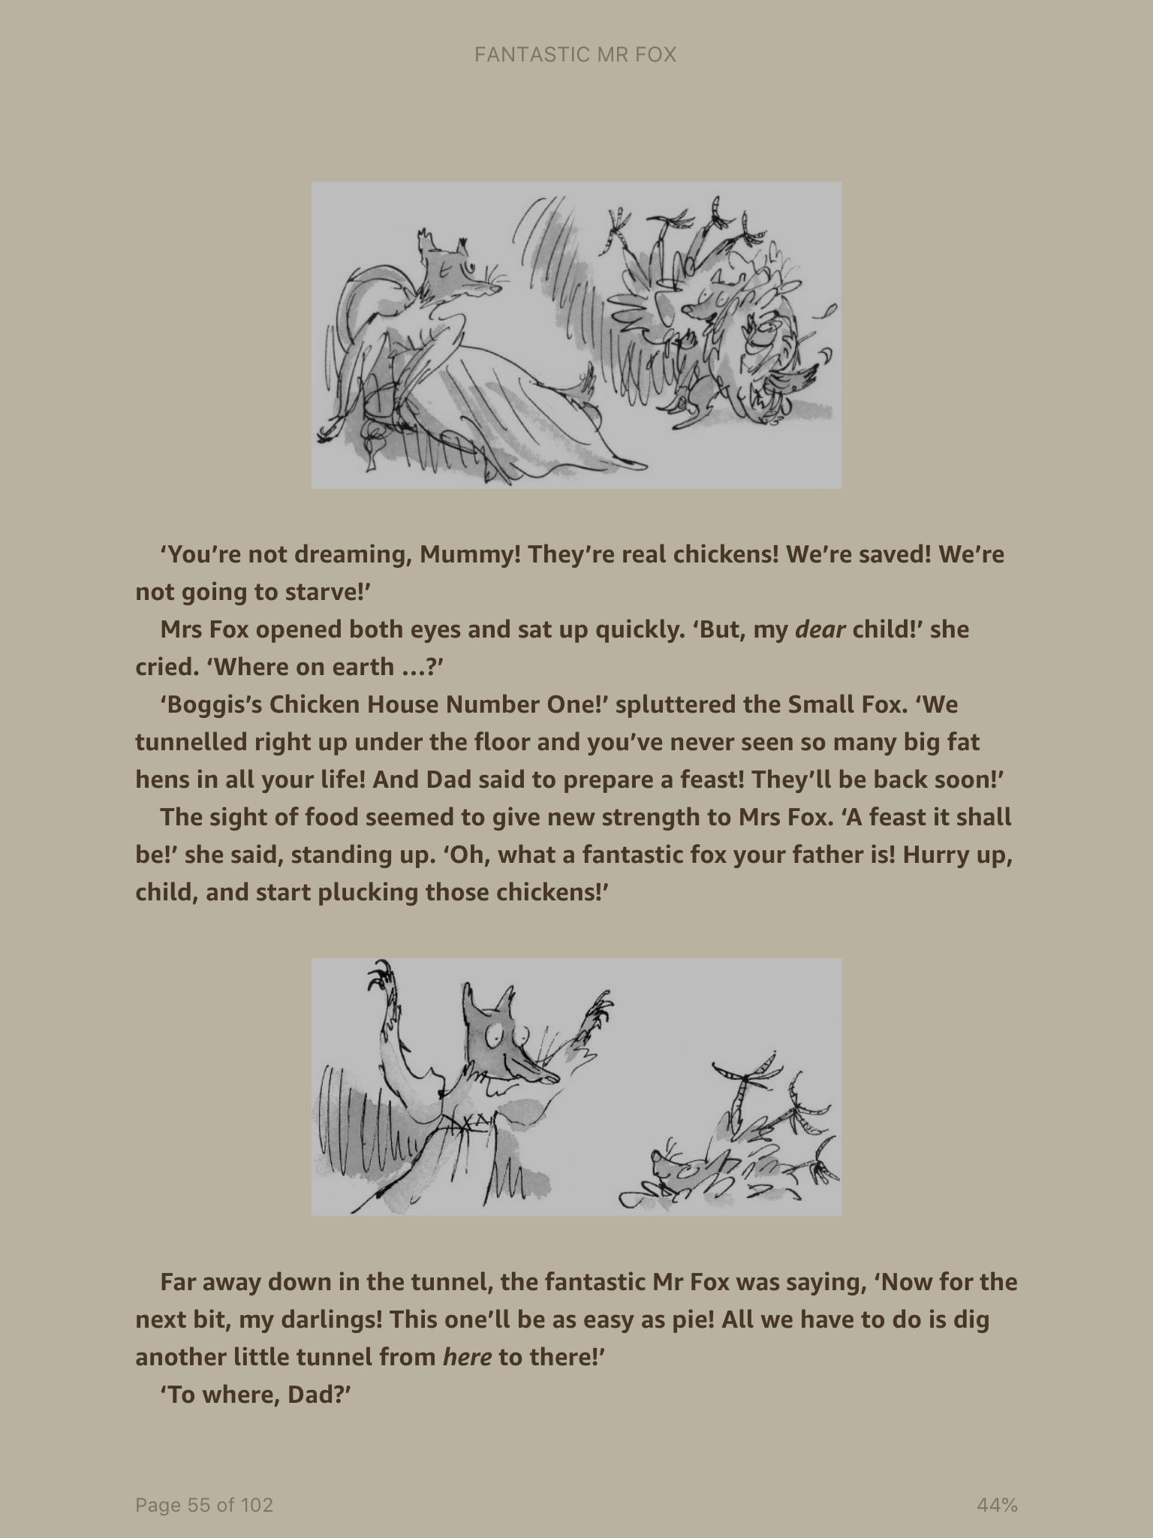

Slide 4


Slide 5
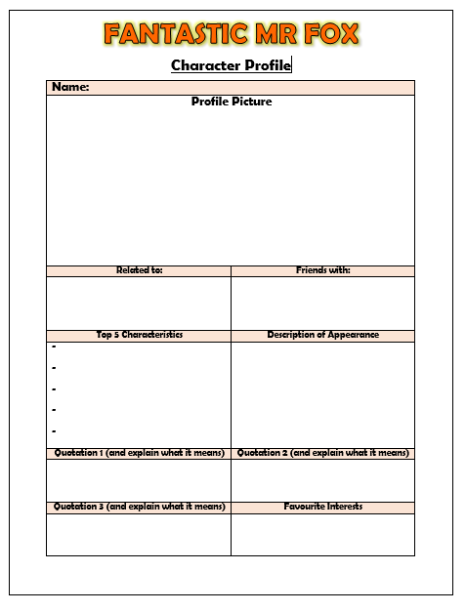
MAIN TASK
MR FOX’S PROFILE!
You are now going to use all of the information that you have gathered about Mr Fox’s character to create his character profile!
Use the document provided to help you to share all of your knowledge about the very clever Mr Fox!

