Slide 1



Roald Dahl’s
FANTASTIC
MR FOX
THE VERY CLEVER MR FOX!
LEARNING OBJECTIVE
-Understand and explore characters in a text.
-Infer and deduce the hidden meanings in texts.

Slide 2
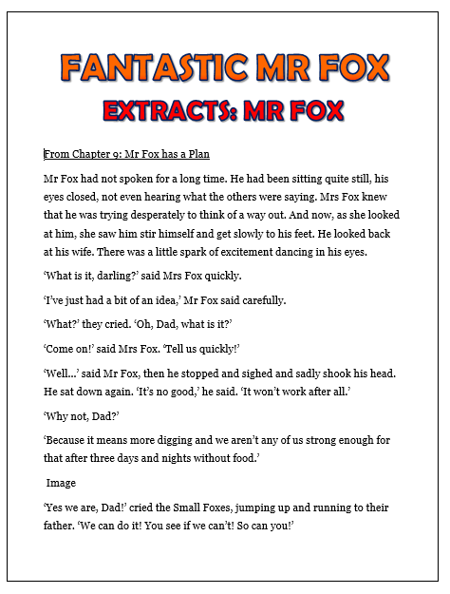
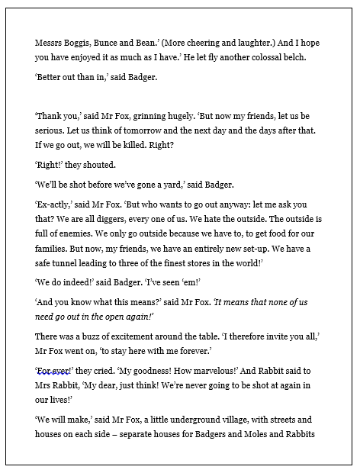
INTRODUCTION
MR FOX
Read the extracts from ‘Fantastic Mr Fox.’ (See the documents along with this PowerPoint.)These show what a clever fox Mr Fox is!
As you read, THINK: What are the other characteristics of Mr Fox?

Slide 3
INTRODUCTION
COMPREHENSION
How does Mr Fox’s appearance change when he has an idea?
Why is Mr Fox proud of his children?
What is Mr Fox’s plan?
Why does he not tell the small foxes his plan?
Why does Mr Fox take great care when leaving the chicken house?

Slide 4
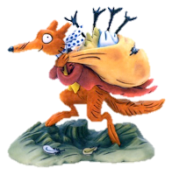
INTRODUCTION
COMPREHENSION –
ANSWERS
It is clear when Mr Fox has an idea because something in his face changes. He is described as having ‘a little spark of excitement dancing in his eyes.’
Mr Fox is proud of his children because of how resilient they are. Although they have not had a drink for three days, they are ‘undefeated.’

Slide 5
INTRODUCTION
COMPREHENSION –
ANSWERS
3. Mr Fox’s plan is to dig and dig and dig until they are underneath the storehouses of the farmers. Then, they will be able to steal the food!
4. He doesn’t tell the young foxes where they are going because he fears that they will ‘die with disappointment’ if they don’t make it there.

Slide 6
INTRODUCTION
COMPREHENSION –
ANSWERS
5. Mr Fox takes great care when leaving the chicken house because he doesn’t want the farmers to know that anyone has been there. That way, he can keep returning when he needs to. This shows his ability to forward plan.

Slide 7
DEVELOPMENT
MR FOX’S CHARACTER
As we have seen from our reading extract today, Mr Fox is a very clever character.
However, he also has many other strings to his bow!
In this section of the lesson, we will find out a bit more about the main character of the story.

Slide 8
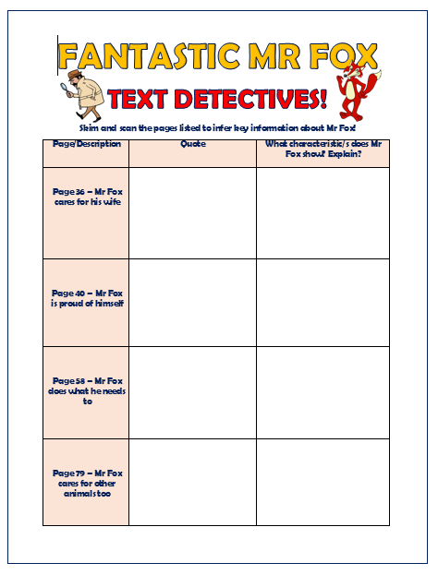

DEVELOPMENT
TEXT DETECTIVES!
You are now going to need the worksheet on the right, which will enable you to find out a little more information about Mr Fox.
The next two slides are for you to check what you have discovered so don’t look at them until you’ve filled in your sheet.

Slide 9
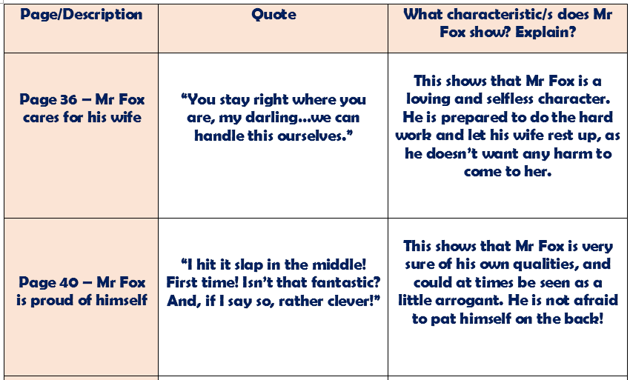
DEVELOPMENT
ANSWERS

Slide 10
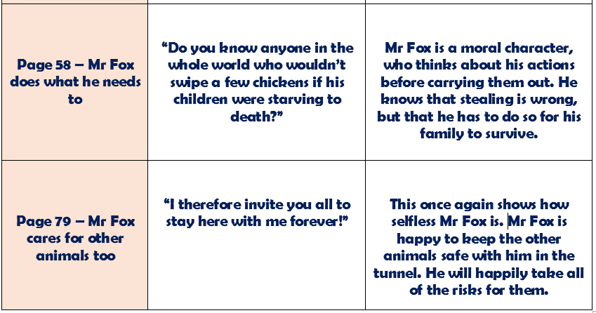
DEVELOPMENT
ANSWERS

