Slide 1

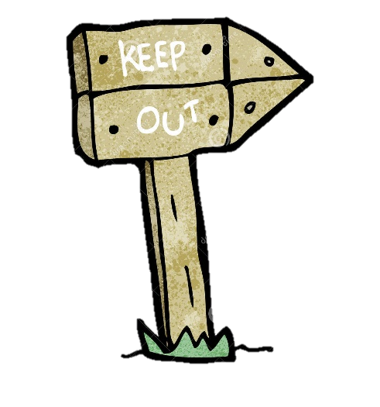
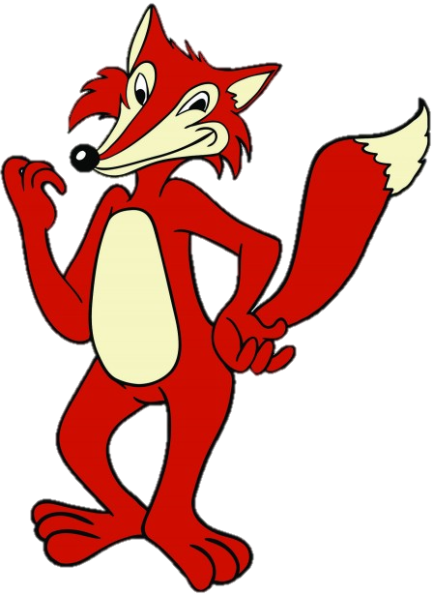
Roald Dahl’s
FANTASTIC
MR FOX
THE VERY CLEVER MR FOX!
Reading
Today we’re going to find out what happens to our fox family.
Our 3 farmers are determined to use whatever it takes to catch them…I wonder if they can escape?

Slide 2
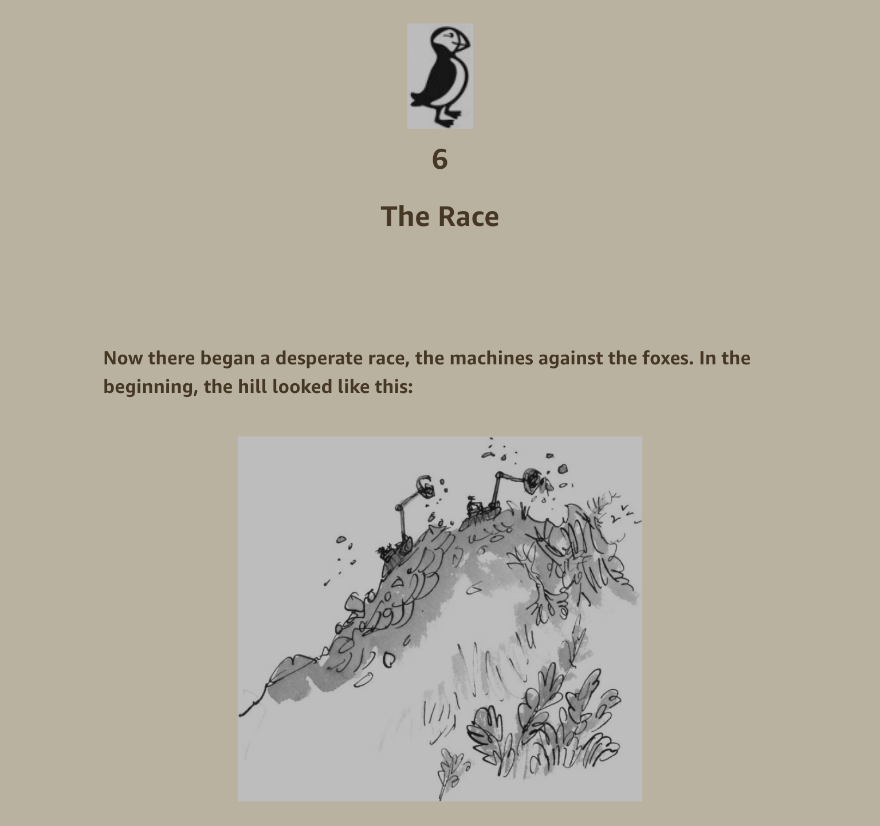

Slide 3
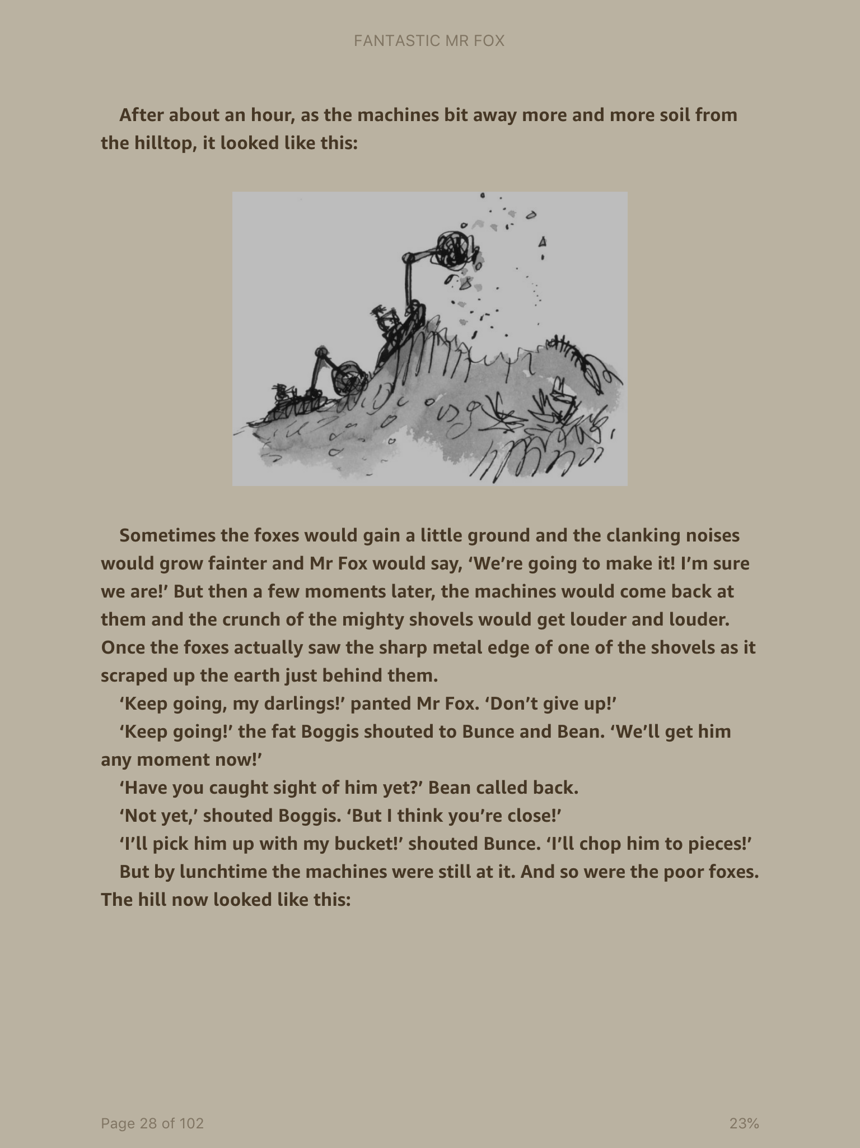

Slide 4
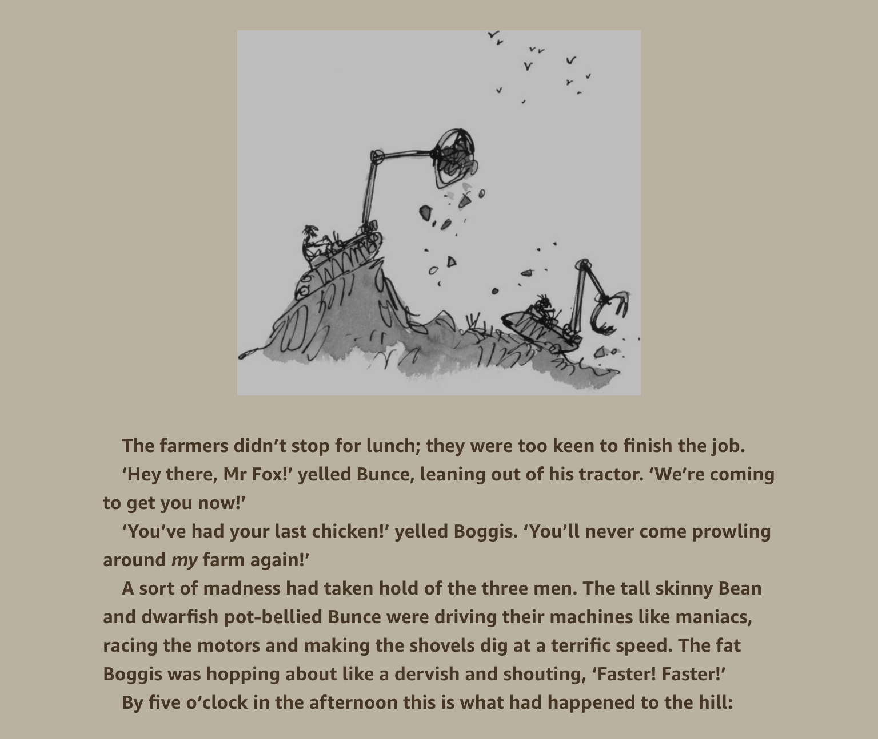

Slide 5
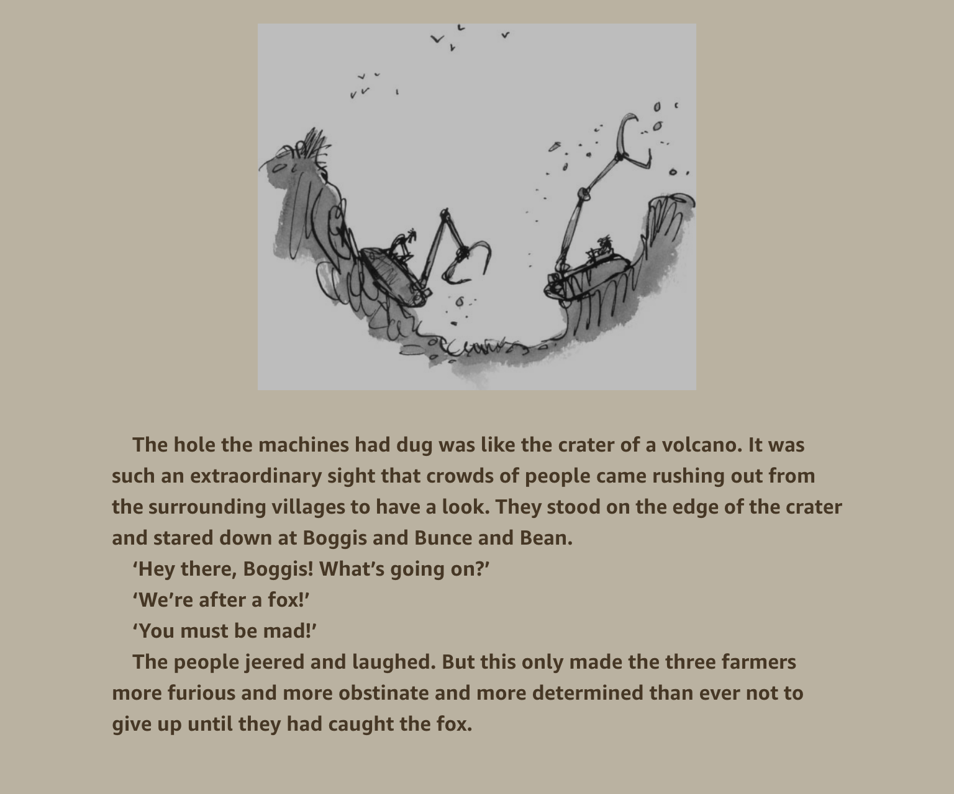

Slide 6
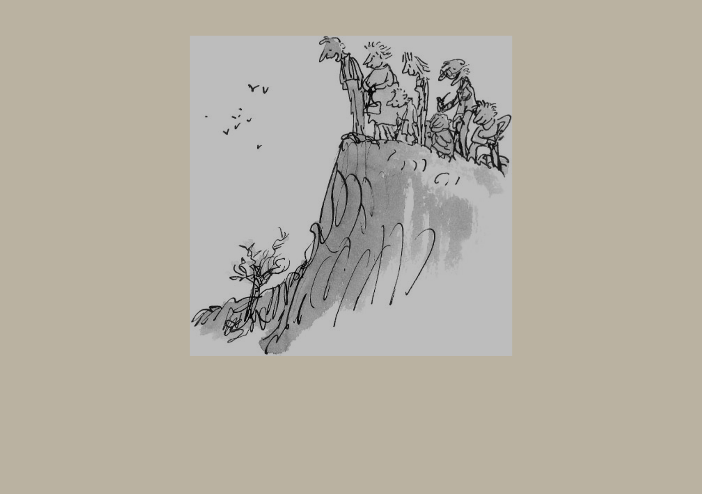

Slide 7
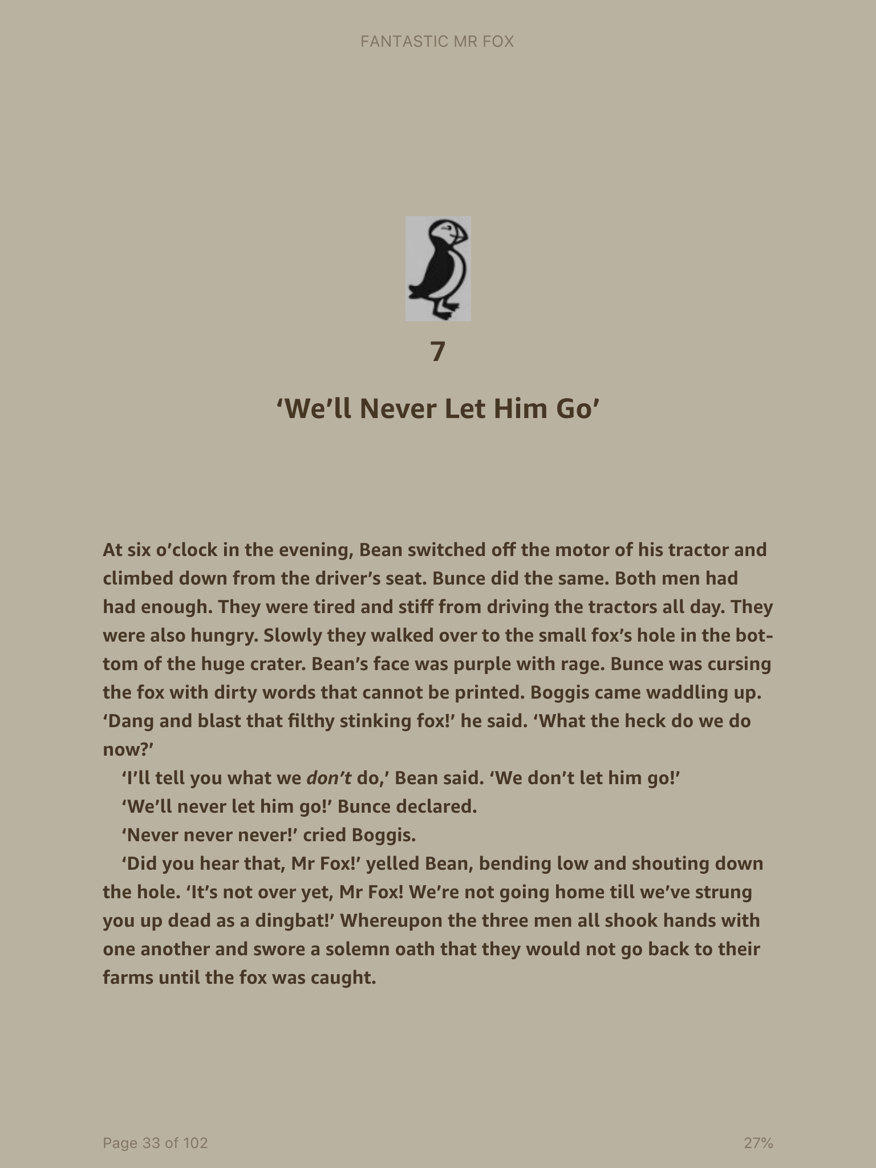

Slide 8
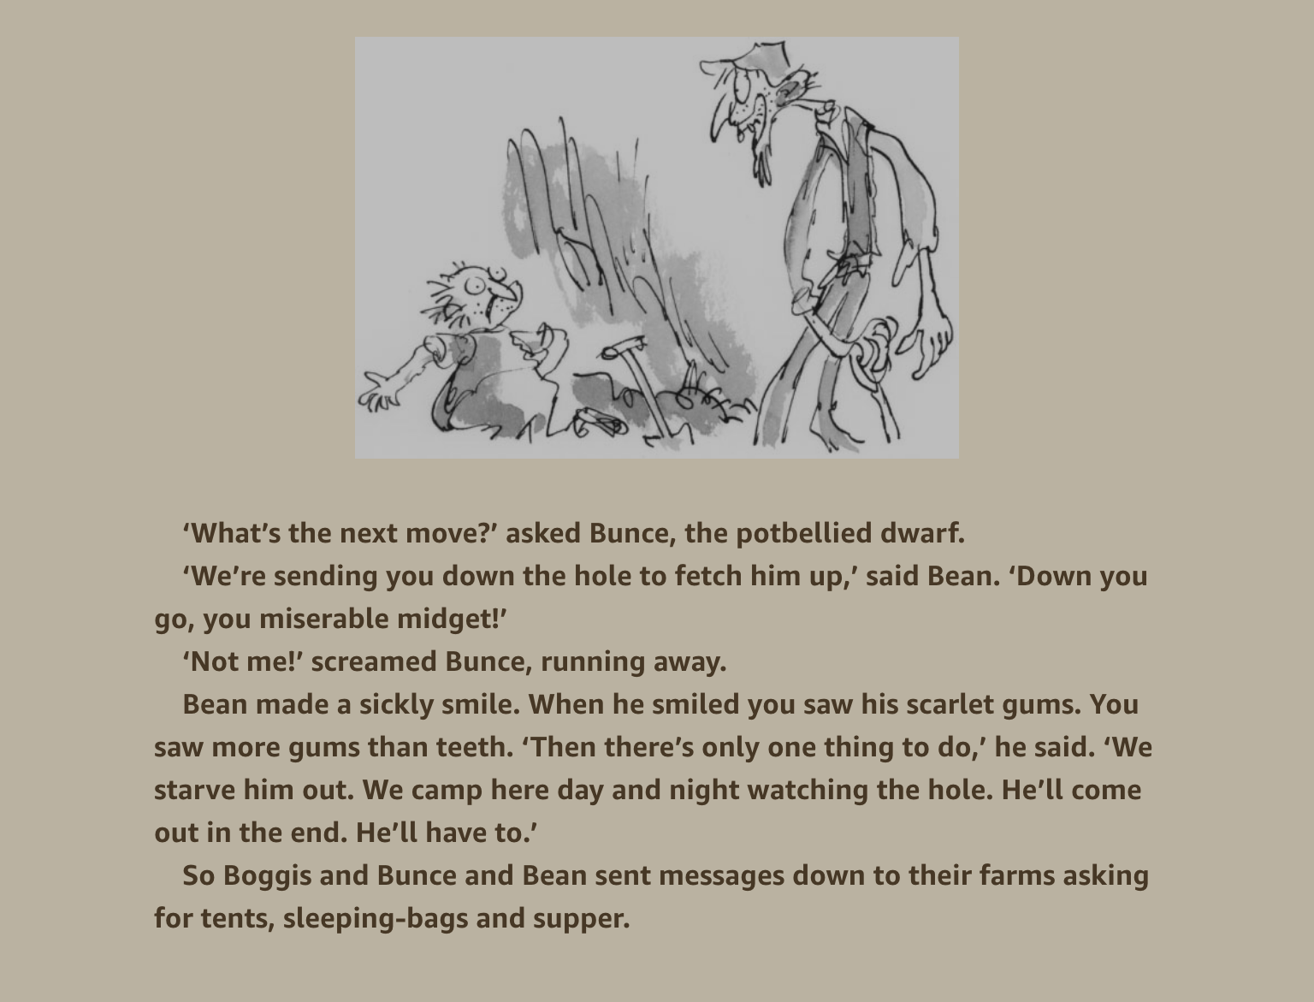

Slide 9
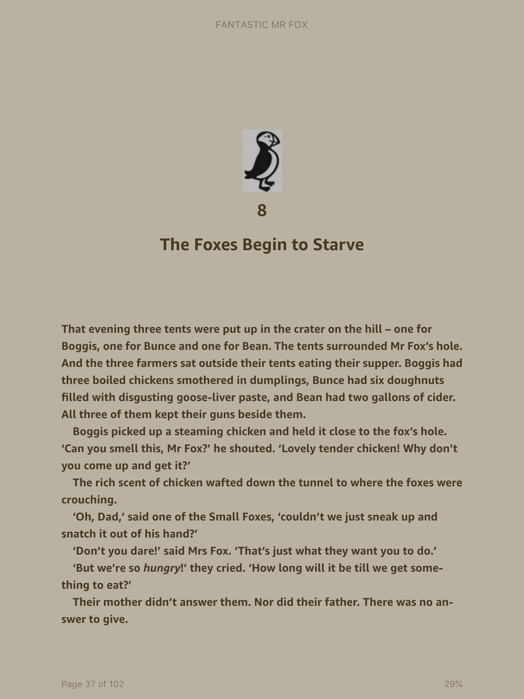

Slide 10
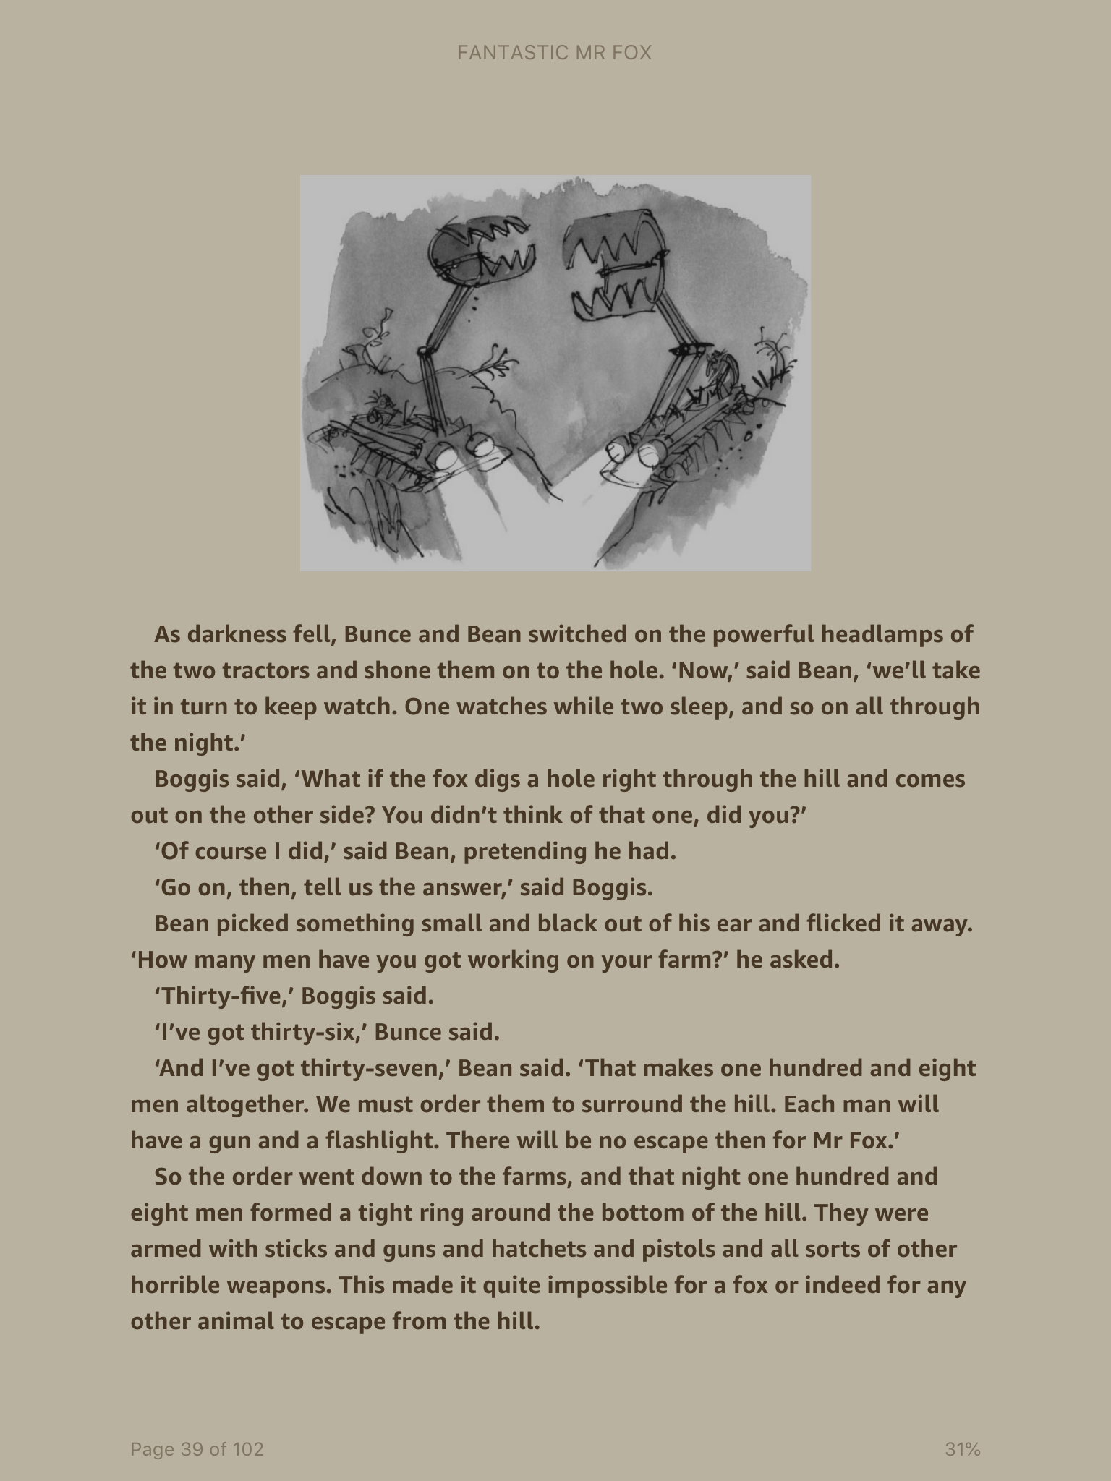

Slide 11
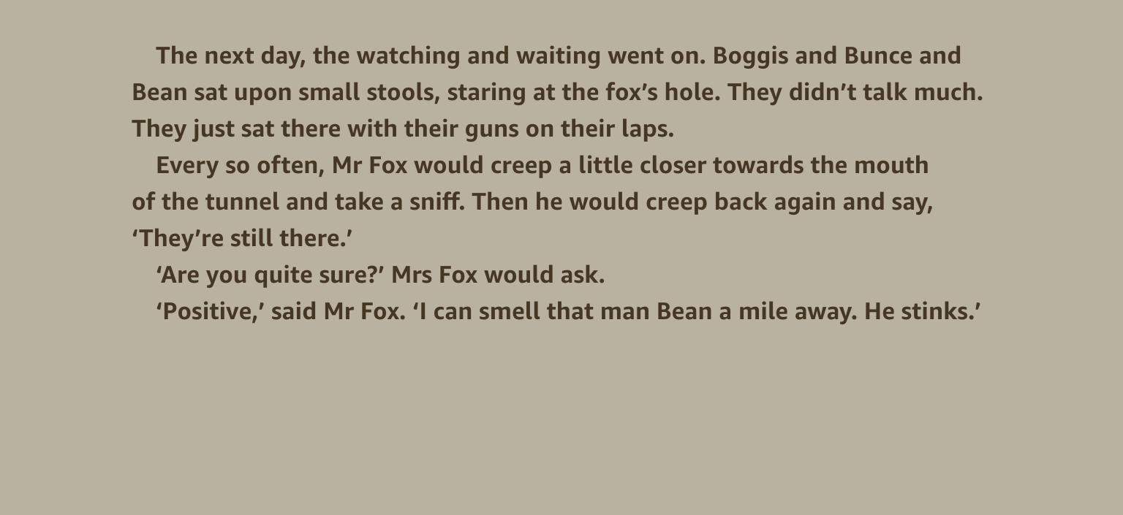

Slide 12
Roald Dahl’s
FANTASTIC
MR FOX
THE VERY CLEVER MR FOX!
Task for today
When the farmers are trying to get the foxes they shout to each. See if you spot the speech in the text and record it in the speech bubbles provided. There is a separate sheet to work on or record them in your book. (I’ve given you an example one on the next slide to look at of the speech between the foxes so you get the idea.)

