Slide 1

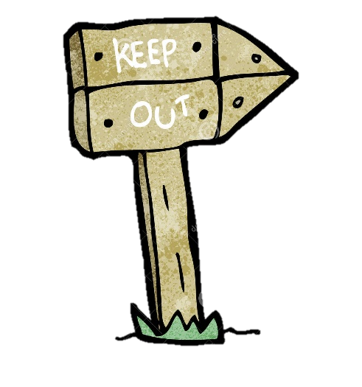
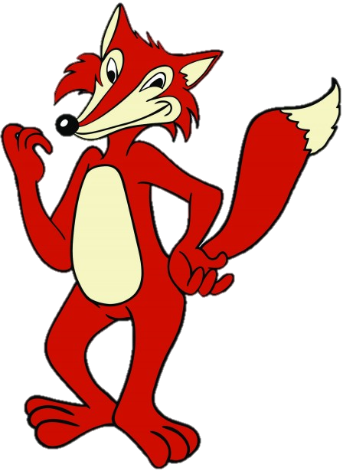
Roald Dahl’s
FANTASTIC
MR FOX
THE VERY CLEVER MR FOX!
Reading
Today you’re going to read another 2 chapters from our story. Both chapters have terrible in the title…I wonder what that makes you think about what could happen next?

Slide 2
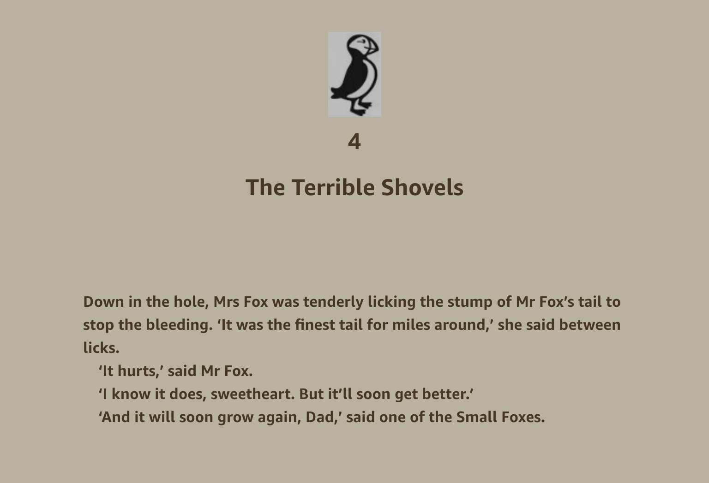

Slide 3
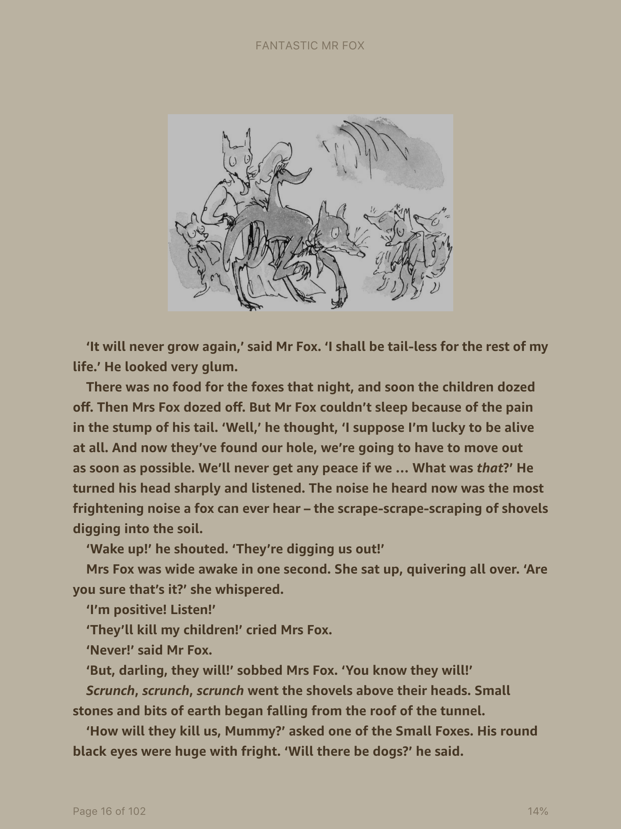

Slide 4
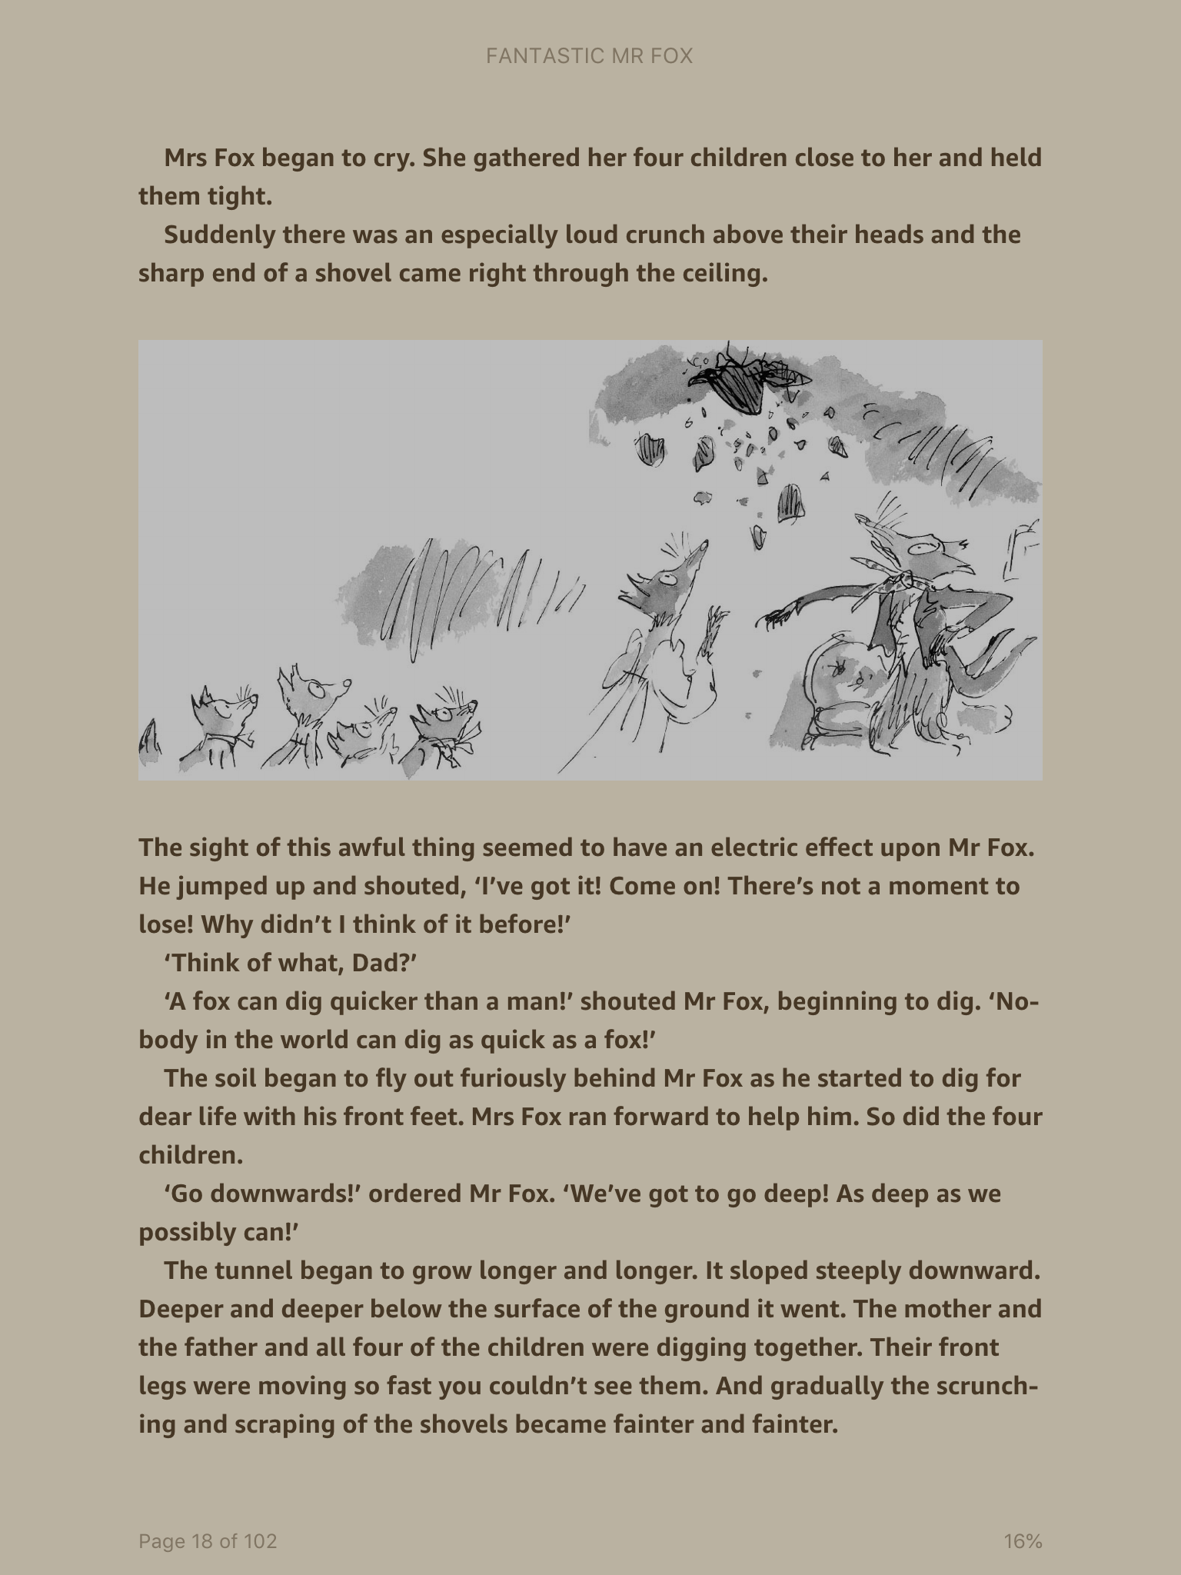

Slide 5
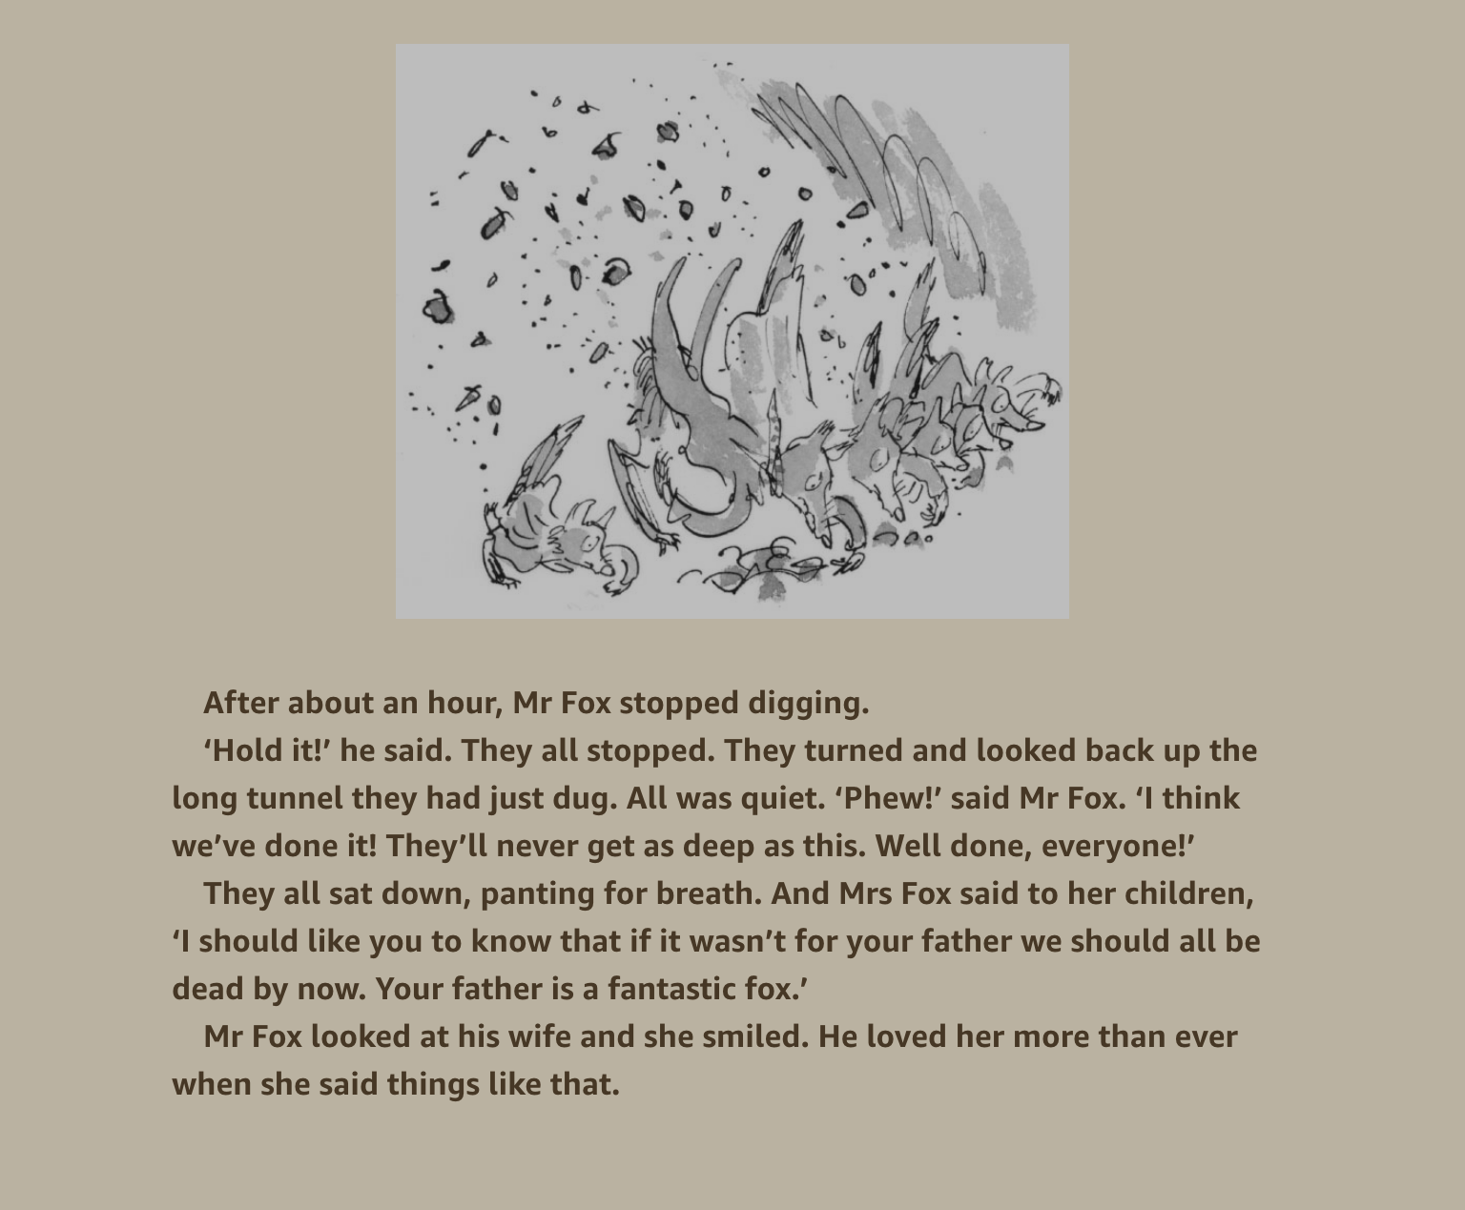

Slide 6
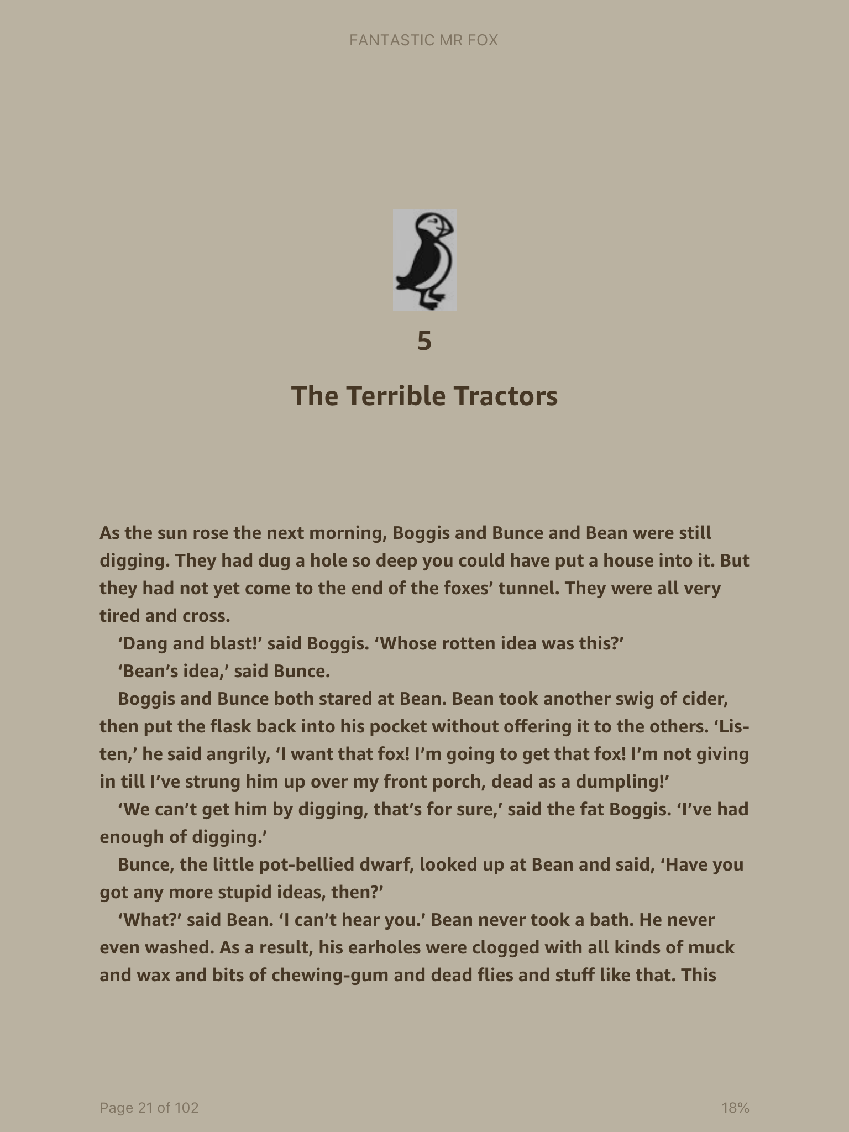

Slide 7
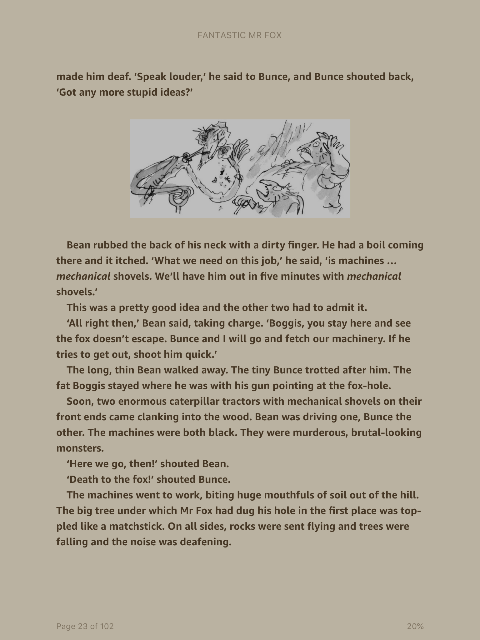

Slide 8
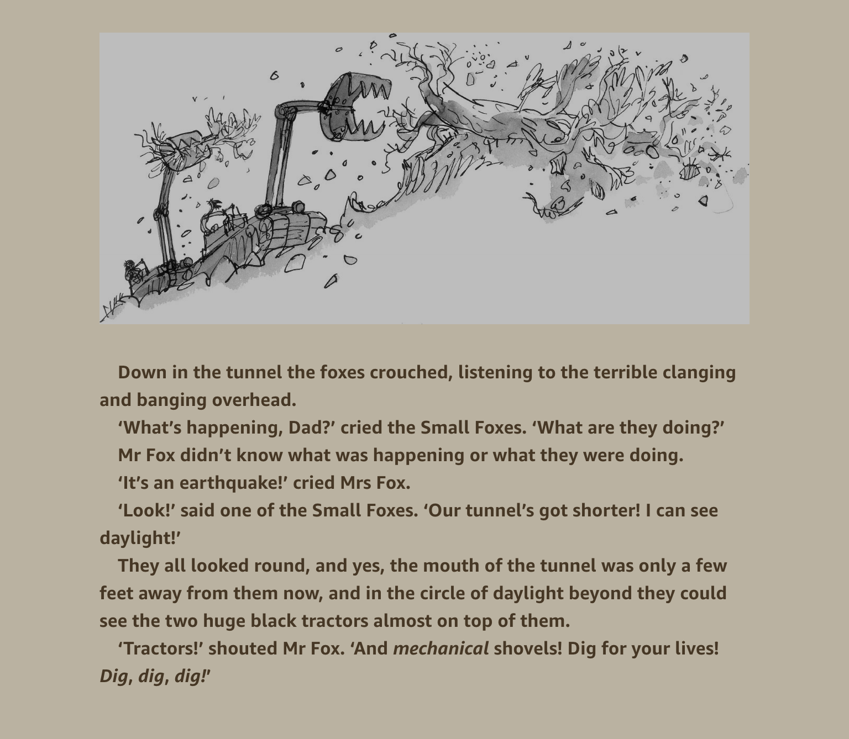

Slide 9
Roald Dahl’s
FANTASTIC
MR FOX
THE VERY CLEVER MR FOX!
What happens next?
One thing I love about Roald Dahl’s books are the illustrations by the illustrator Quentin Blake.
For your last task today, decide what you think happens next. Rather than writing I want you to draw the illustrations that would go with it. Even if you know what’s next, you can invent a completely different idea if you like.

