Slide 2
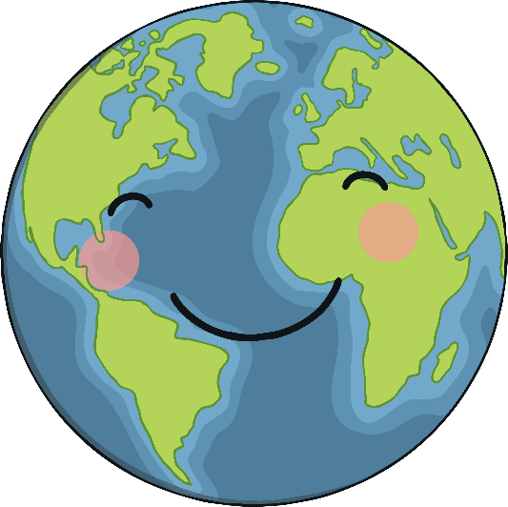
What Is Earth Day?
The first Earth Day was held on April 22, 1970. Earth Day was founded to help people consider their actions and how they affect the Earth and our world. The purpose of Earth Day is to continue helping people think about how to protect and care for our Earth.

Slide 3
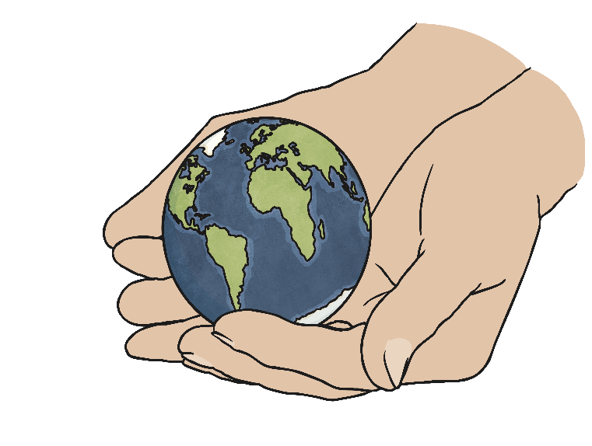
How Has Earth Day Helped Us?
Giving people a chance to talk about how to take care of our Earth and be more aware of our actions has led to:
The formation of the Environmental Protection Agency
The Clean Air Act
The Clean Water Act
The Endangered Species Act
The Resource Conservation and Recovery Act

Slide 4
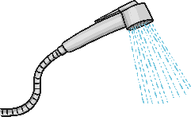



What Can I Do?
Earth Day is especially important for kids! What happens to the Earth today determines what type of world kids will have when they grow up. Conservation is very important. Kids like you can help by encouraging your parents to purchase eco-friendly goods, by turning off the lights when you leave a room, and by using less water.
Here are some other ideas for how you can help look after the Earth.
Write letters to your state and national representatives telling them that you think conservation is important.
Take shorter showers.
Use LED or CFL lightbulbs.
Recycle.

Slide 5
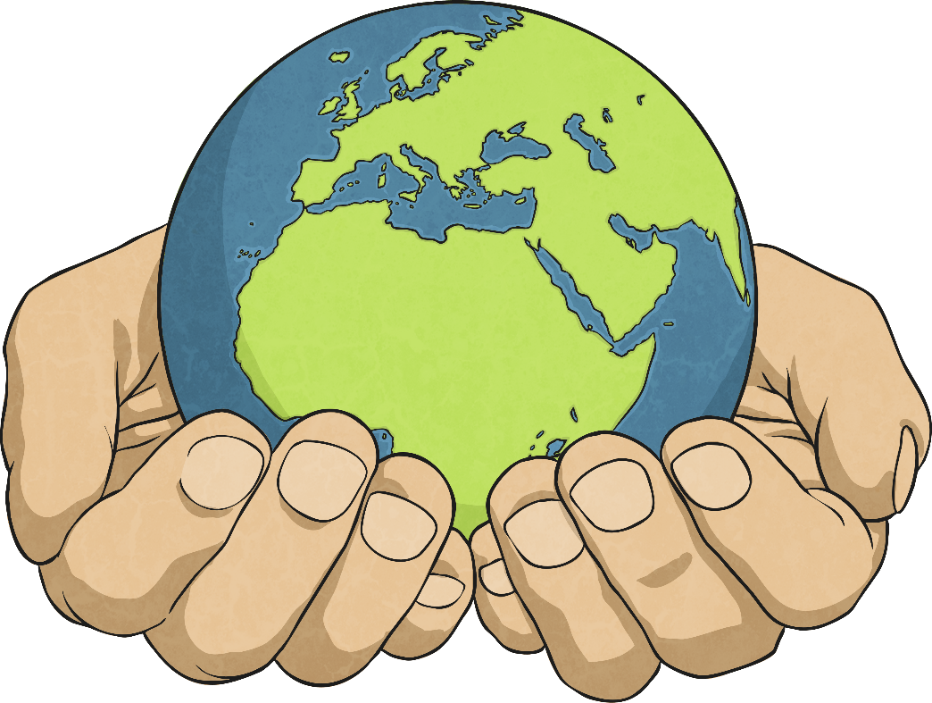
We only have one Earth! Let’s take care of it!

