Slide 1
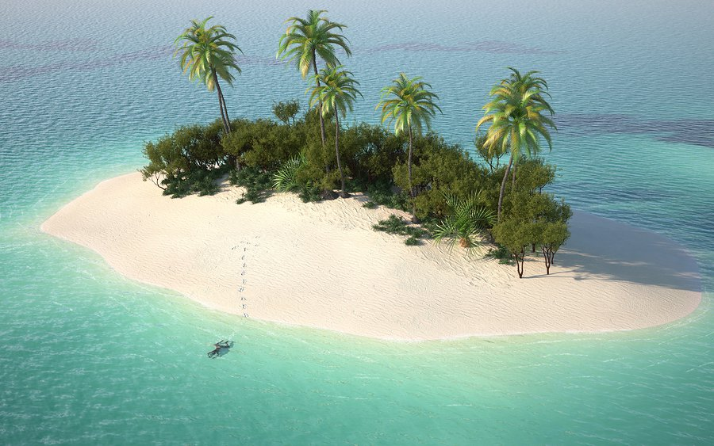
Monday 29th June 2020
Desert Island Description
Have look at this desert island.
What can you see?
What words could you use to
describe it?

Slide 2
Your task:
I want you to write a SETTING DESCRIPTION of
this island.
REMEMBER: a setting description is a set of
sentences describing a place, it is not a story, but
sometimes it can be part of one.
I am looking for adjectives and adverbs in your
Sentences.
Can you spot them in this sentence?
The warm, yellow sun beamed brightly down onto the tall palm trees swaying gently in the breeze.
adjective
adjectives
adverb
adverb

