Slide 1
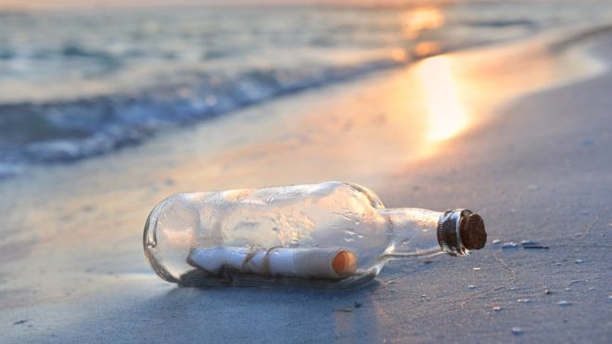
Tuesday 30th June 2020
I have received an urgent message!
In a bottle!

Slide 2

Dear Class Attenborough,
Help!
I have been trapped on a desert island for 13 days!
My beard is now so long that it reaches my knees!
My island is long and thin, with green palm trees on one side.
Please come and rescue me!
Joe King

Slide 3
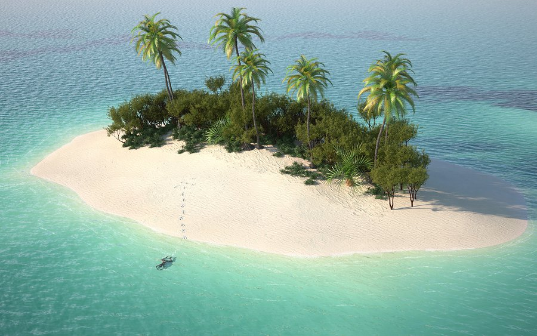
Hmm. I don’t think we’ll be able to rescue Joe.
His note didn’t have any detail!
Can you do better?
I would like you to write your own rescue note, as if you were trapped on yesterday’s island.
Remember to describe the island!
It looked like this!

