Slide 1
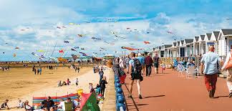
Seaside Poem Planning

Slide 2
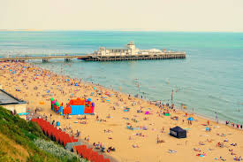
Hello class Attenborough!
I have been thinking about the seaside a lot lately, watching videos of it and looking up pictures, and as we are looking at poems for the next few weeks, I thought we would combine the two!

Slide 3
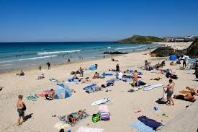
This poem is called Seaside things and is by Maureen Warner
Ice Cream and lollipops
Beads and Books in seaside shops
Trumpets in the village band
Crabs and seaweed on the sand
Rippling waves, the cliffs and rocks
Bare feet, walking without socks
Sandy hands and flying kite
Punch and Judy Red and White
This is a rhyming poem, the end of every line rhymes with the
one before.

Slide 4
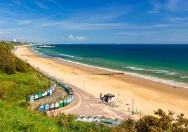
Today I want you to make a list of all the things you like about the seaside, then I want you to try and find as many
Words as you can that RHYME with each of your words.

