Slide 1
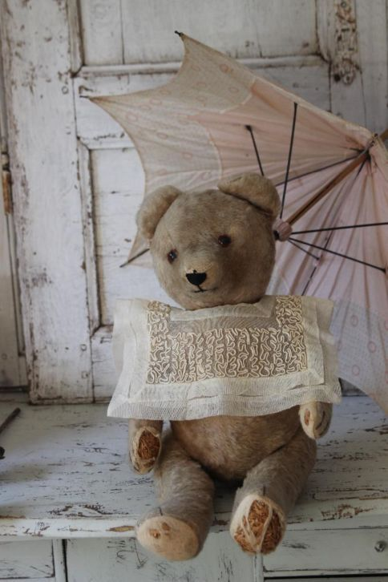
Old Bear’s Umbrella
By Mr Higgins

Slide 2
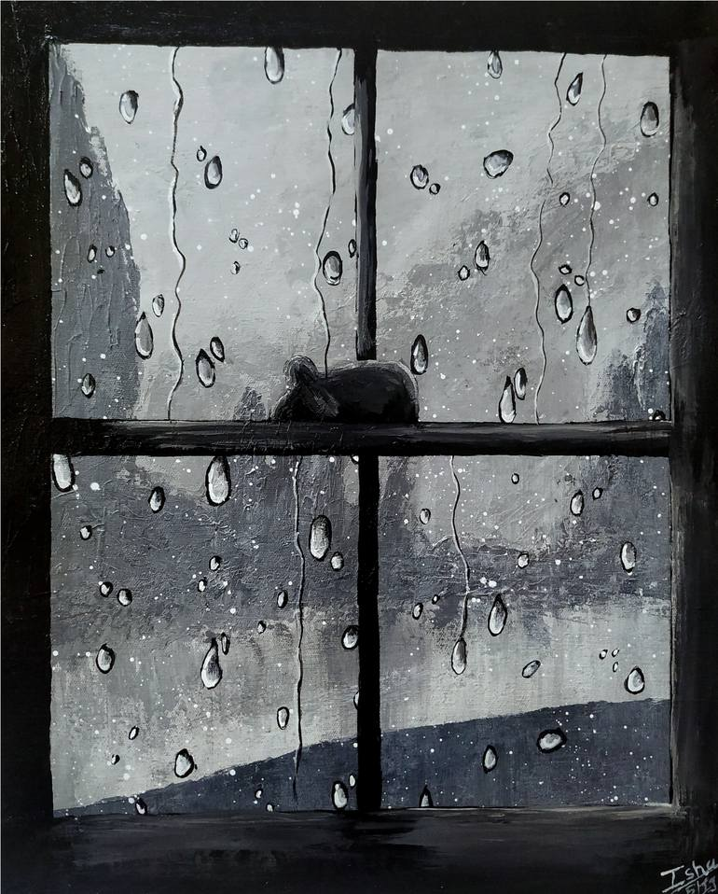
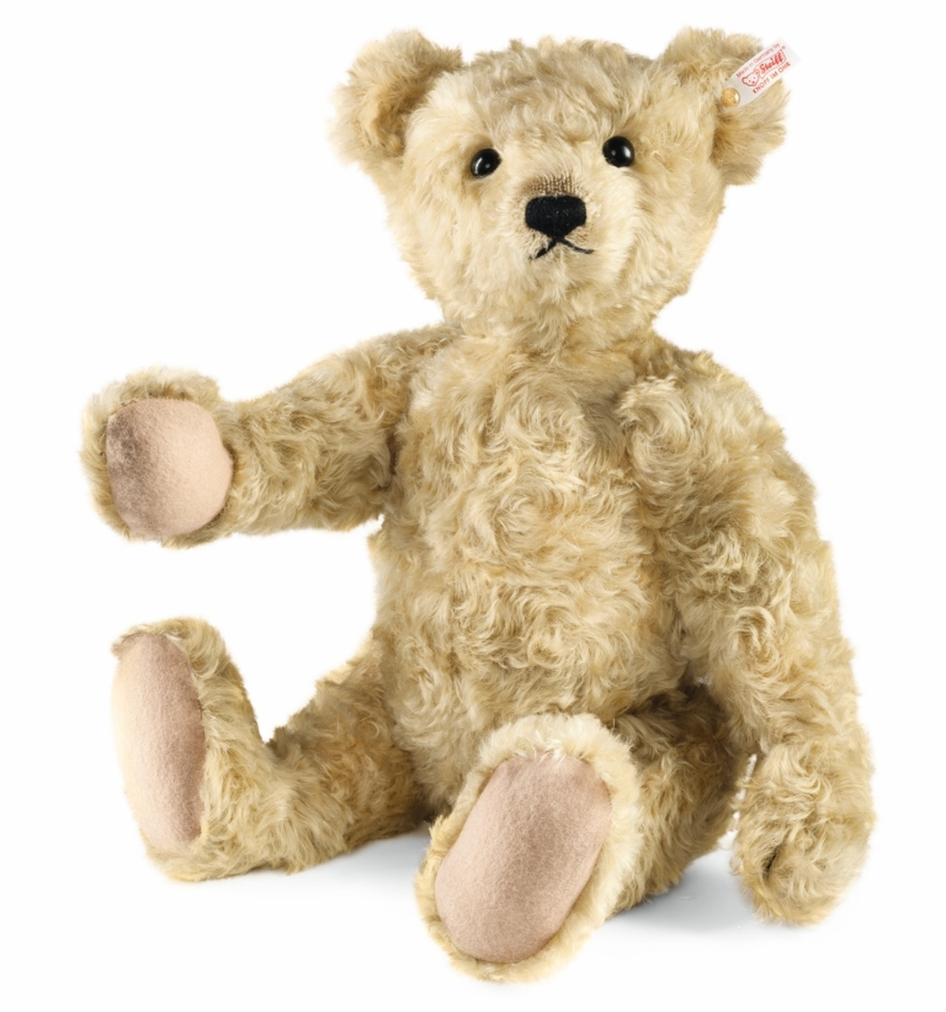
What is wrong Old Bear?
You look very sad today,
With all the rain that’s pouring down,
You can’t go out and play.

Slide 3
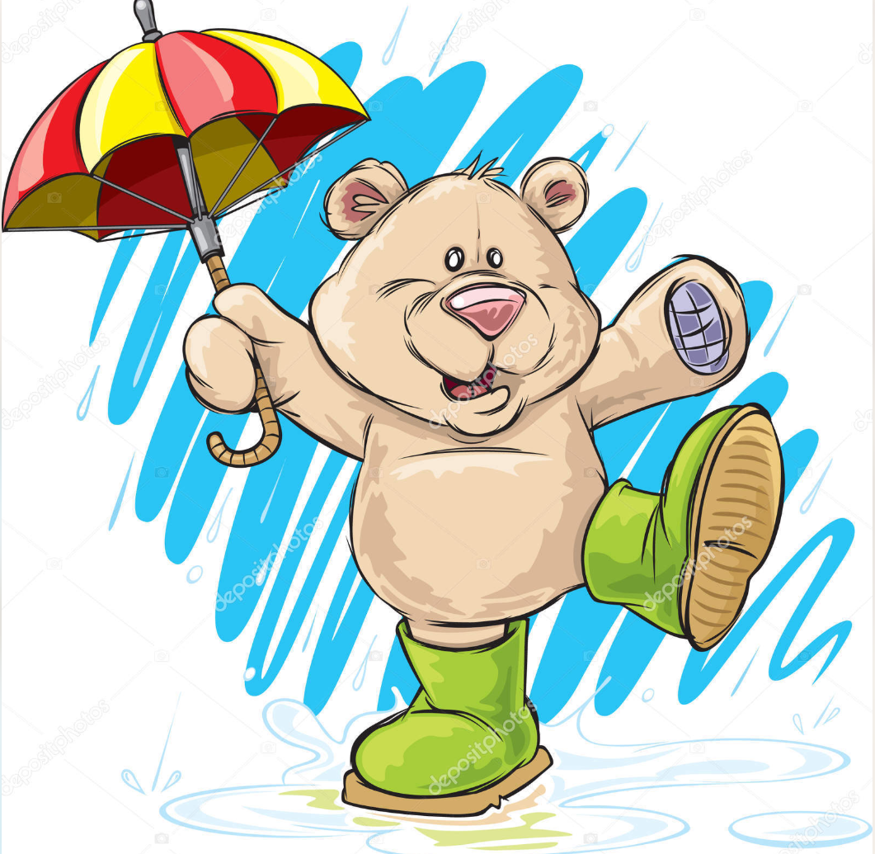
If only you had an umbrella Old Bear,
Then out into the rain you could go.
Splashing in the puddles Bear,
Just like long ago.

Slide 4

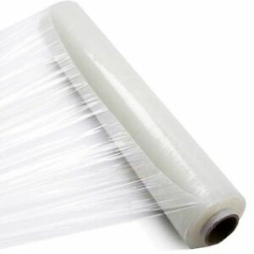
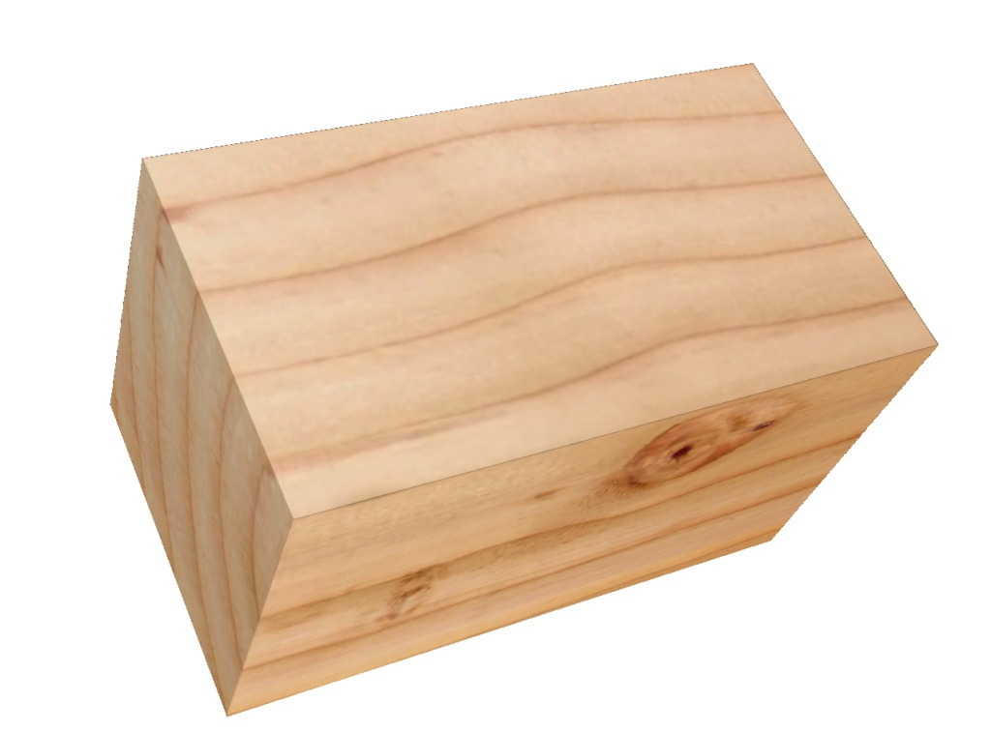
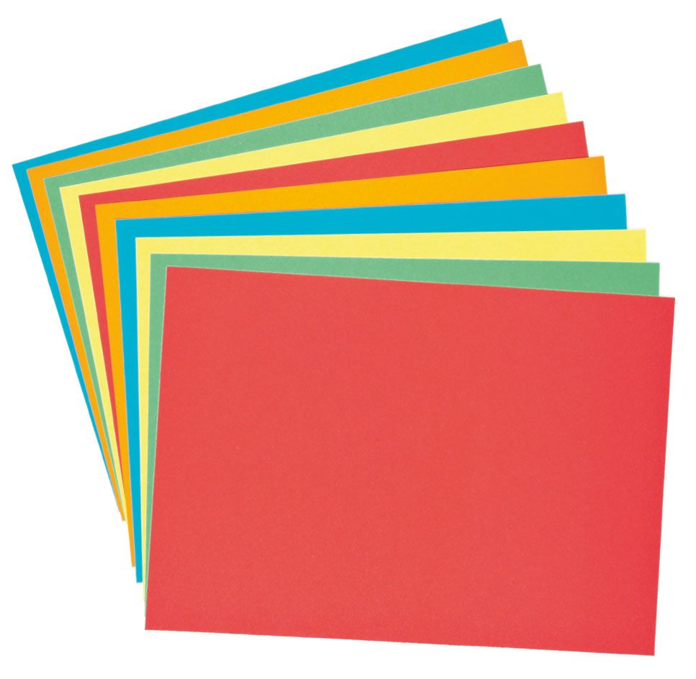
Maybe we could make an umbrella Bear,
What a good idea!
But what would we use to make it?
That could be tricky I fear…

Slide 5
Old Bear needs our help to design his umbrella.
To make it work, he needs a material that is WATERPROOF
This means that it will not let water through.
We need to TEST different materials to decide which ones
would make a good choice for Old Bear’s Umbrella.

Slide 6
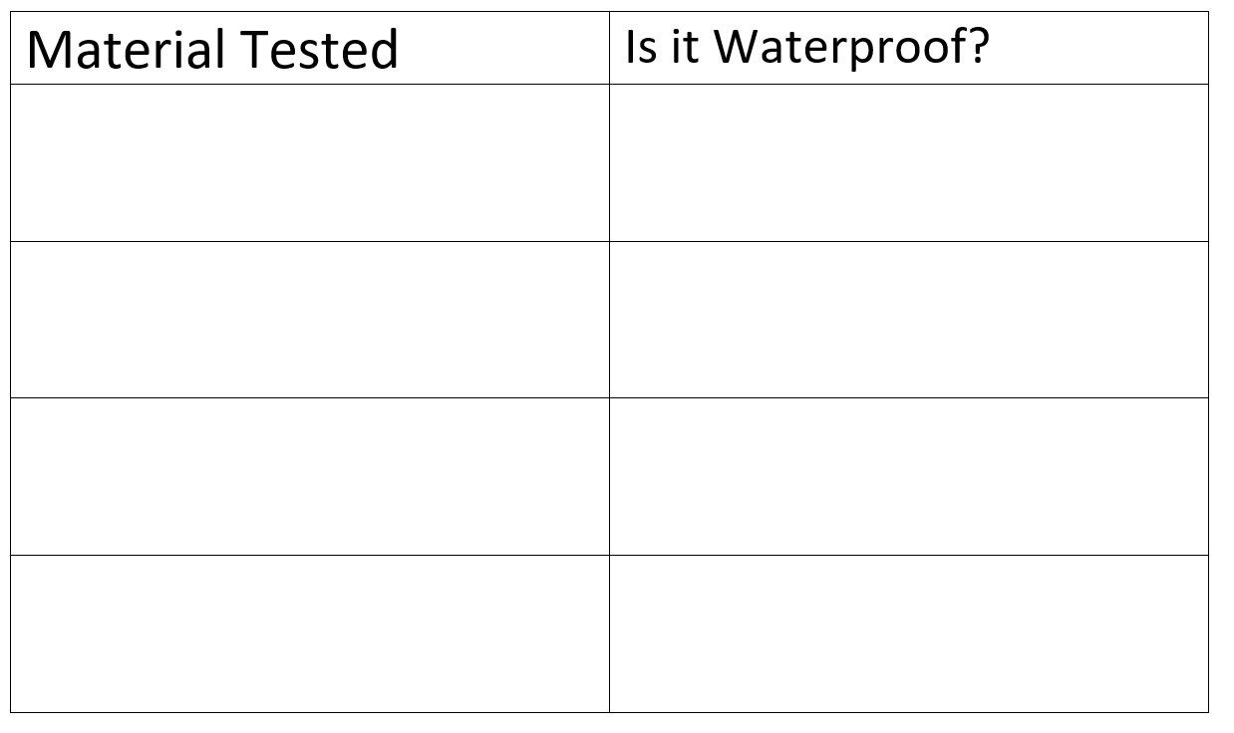
You could record your results like this

Slide 7
WHAT material do you think
Old Bear should use for his
Umbrella and WHY?

