Slide 1
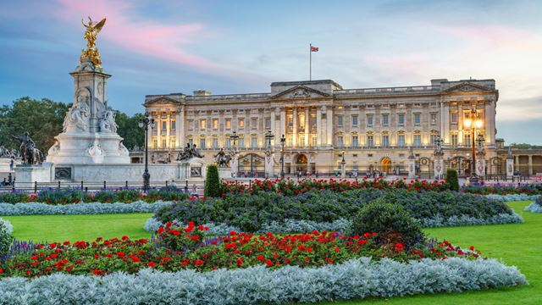
Palaces across the world
An Art activity for Class Attenborough

Slide 2
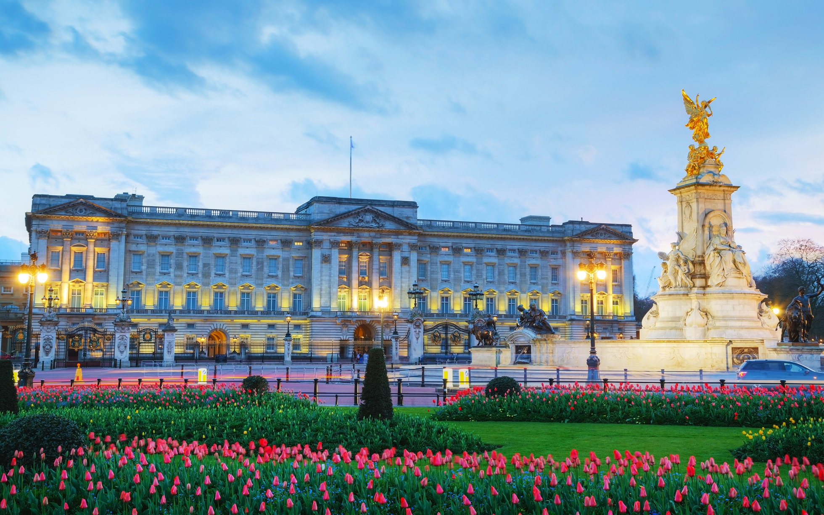
Hello Class Attenborough!
Today we will be looking at different palaces across
The world. A palace is a special home where
a King or Queen live.
Do you know the name of this palace?
Click to find out…
Buckingham Palace!
This palace is in London and is where Queen Elizabeth lives
But there are many palaces in the world…

Slide 3
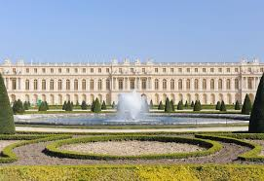
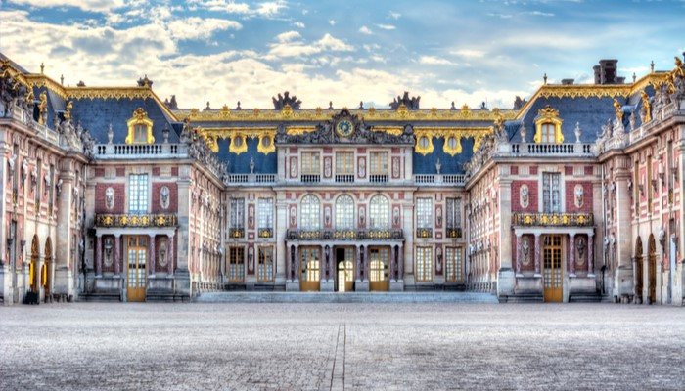
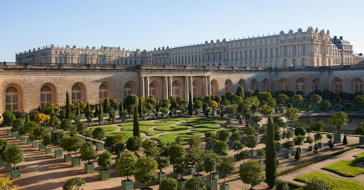
These are not pictures of three different palaces, but one enormous palace called the Palace of Versailles in France.
The French King used to live there, but they don’t have one anymore.

Slide 4
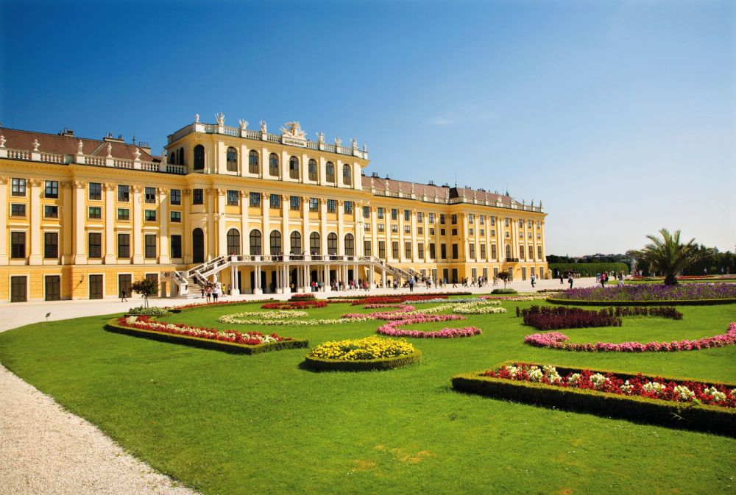
This is the Schonbrunn Palace in
Austria

Slide 5
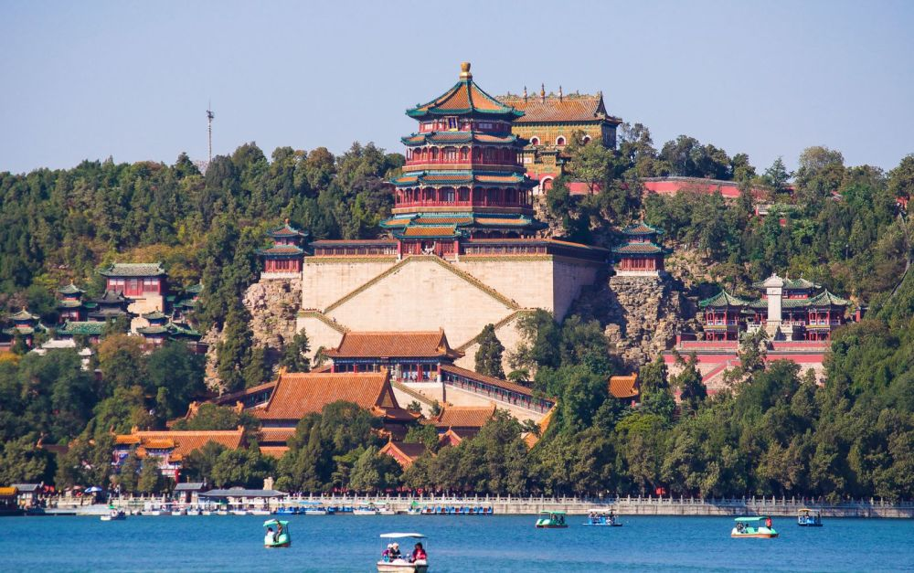
This is the Summer Palace in China

Slide 6
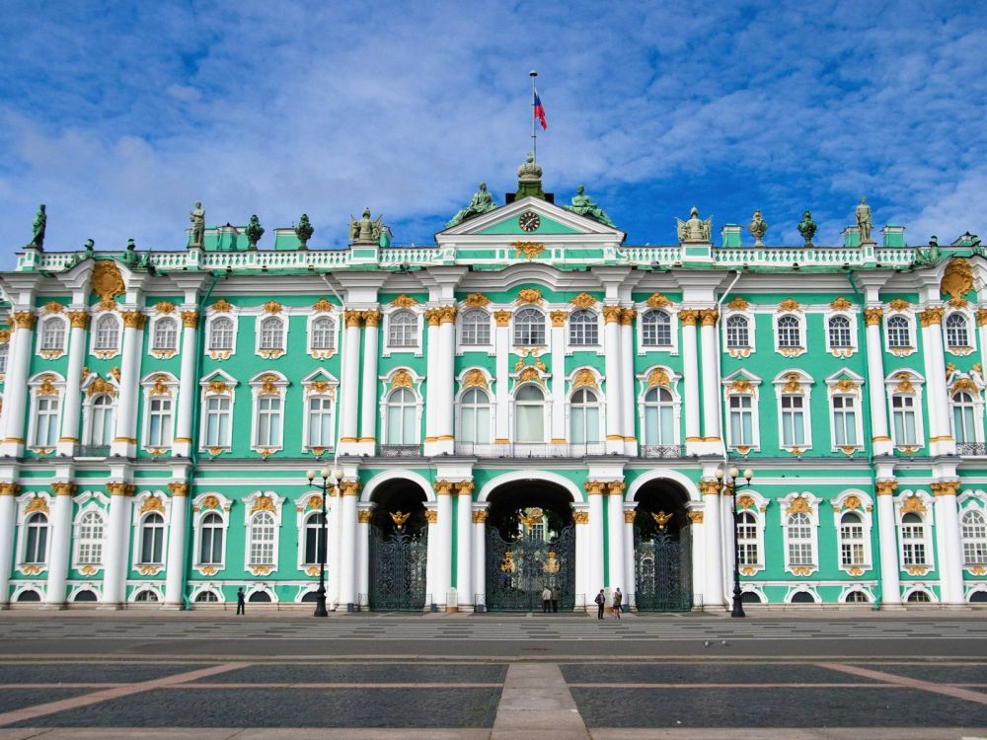
This is the Winter Palace in Russia!

Slide 7
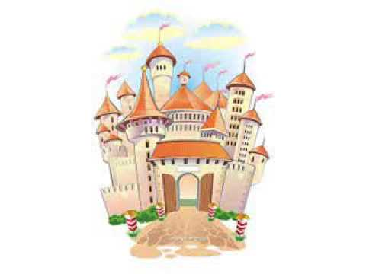
Your Challenge!
I would like you to design your own royal palace.
You can:
Draw a picture
Make a model out of boxes
Build with construction materials like Lego
Please email in a picture so we can put it on the website!

