Slide 1


The feeding of the 5000
A miracle
Blossoming Minds
Teaching Resources

Slide 2

Jesus had given his disciples the power to perform miracles and sent them out to preach God’s word.
Blossoming Minds
Teaching Resources

Slide 3
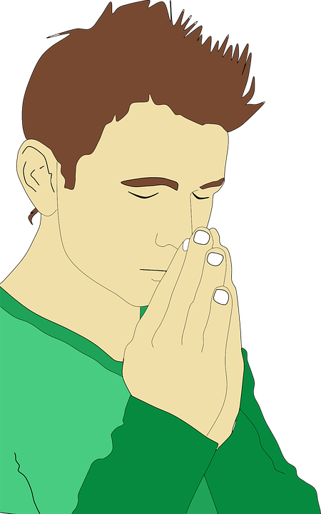

They had travelled far and wide into the country and had great success, gaining many supporters for Jesus, spreading love and healing sick people.
Blossoming Minds
Teaching Resources

Slide 4

When they returned, they were each keen to tell Jesus the tales of their journeys.
“What a journey!”
“Guess what I did!”
Blossoming Minds
Teaching Resources

Slide 5

But crowds of people followed the disciples. They thought that if they followed Jesus’ men, they might be able to meet Jesus himself.
Blossoming Minds
Teaching Resources

Slide 6
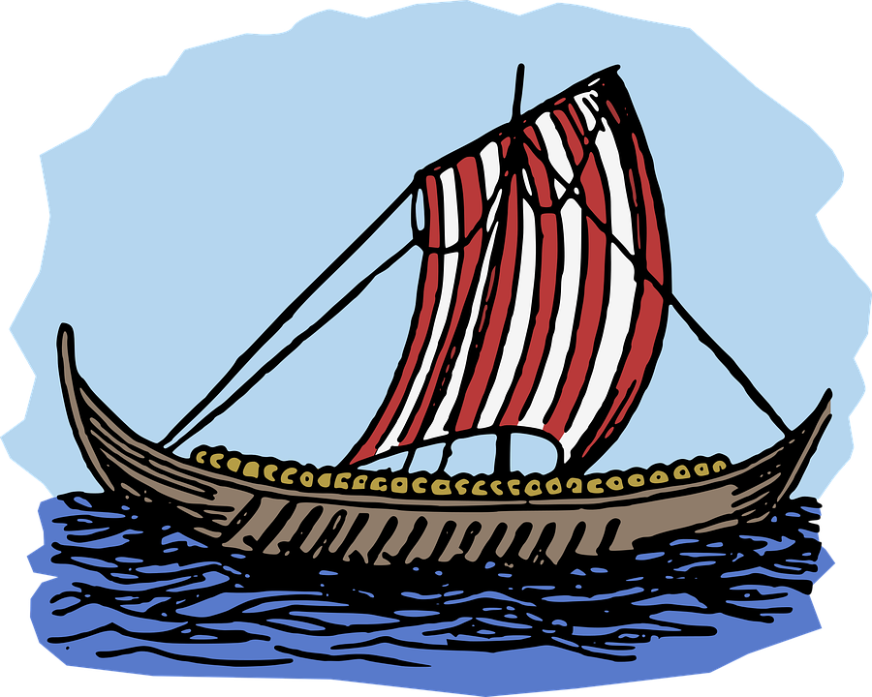
There were so many people, that it wasn’t possible to speak to Jesus properly.
Jesus said, “Come with me and we will find a quiet place to talk.”
They took a boat out on the lake, heading for the opposite bank.
Blossoming Minds
Teaching Resources

Slide 7

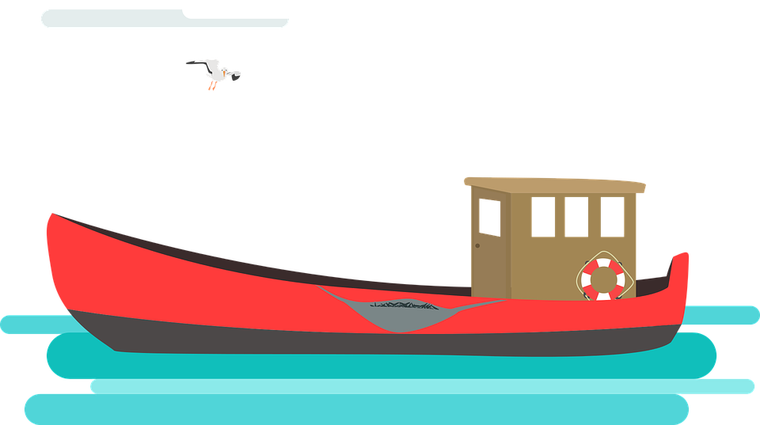
However, the crowd saw Jesus and the disciples leave and rushed around the shore to where the boat was heading.
When the boat moored, there were thousands of people waiting. It certainly wasn’t a quiet spot!
Blossoming Minds
Teaching Resources

Slide 8

Even though they had all hoped for some peace and quiet, Jesus found love in his heart for all these people who had come to see him. They just wanted to hear the word of God. He started teaching them about God’s love.
Blossoming Minds
Teaching Resources

Slide 9

It soon started to get dark. The disciples were worried about what all these people were going to eat for dinner.
Blossoming Minds
Teaching Resources

Slide 10

“We should send the crowds to the nearby village to buy some food,” they said to Jesus.
Blossoming Minds
Teaching Resources

Slide 11

But Jesus disagreed.
“You can feed them,” he said.
The disciples did not have much money. They were just fishermen and had families of their own to feed. They could not possibly afford to buy food for all these people too.
Blossoming Minds
Teaching Resources

Slide 12

“It would take us almost a year to earn enough to feed these crowds!” they protested.
While they were discussing the problem, one disciple noticed a small boy walking past with food. His basket contained 5 small loaves and 2 small fish.
Blossoming Minds
Teaching Resources

Slide 13
The disciple showed the food to Jesus, who held up the bread and broke it. He then passed the basket to his disciples, asking them to share the food among the crowd.
Blossoming Minds
Teaching Resources

Slide 14












They were, of course, confused about how Jesus thought such a small helping of food would feed this large crowd.
But the basket was passed around the 5000 people.
All 5000 had enough to eat!
Blossoming Minds
Teaching Resources

Slide 15

There was even some food left over. In fact, the disciples took 12 basketfuls of bread pieces back to Jesus.
Blossoming Minds
Teaching Resources

Slide 16

The crowd were overwhelmed by the miracle! They knew now that Jesus must have been sent from God.
Blossoming Minds
Teaching Resources

Slide 17
Beginning, middle or end?
There was enough food for all 5000 people. It was a miracle!
Blossoming Minds
Teaching Resources

Slide 18
Beginning, middle or end?
Jesus’s disciples had come back to Jerusalem to tell Him about their journeys.
Blossoming Minds
Teaching Resources

Slide 19
It soon started to get dark. The disciples were worried about what all these people were going to eat for dinner.
Beginning, middle or end?
Blossoming Minds
Teaching Resources

Slide 20
Questions to consider
Why did Jesus choose to feed all these people?
What did it show about Jesus?
What did it show about God?
How might people in the crowd have felt when they realised what Jesus had done?
Blossoming Minds
Teaching Resources

Slide 21

The End
For more information see: Matthew 14:13-21; Mark 6:30-44; Luke 9:10-17; John 6:1-15
Find more assembly and RE resources at https://www.tes.com/teaching-resources/shop/blossomingminds
Blossoming Minds
Teaching Resources
All pictures courtesy of pixabay.com available for commercial use

