Slide 1


Jesus calms the storm
A miracle
Blossoming Minds
Teaching Resources

Slide 2

Jesus and his disciples had been preaching all day.
Blossoming Minds
Teaching Resources

Slide 3
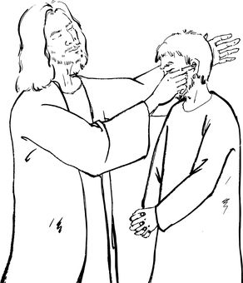
Jesus had performed miracles, healing the sick and injured and convincing people of God’s power and mercy.
Blossoming Minds
Teaching Resources

Slide 4

They had been followed by crowds all day, who were eager to see and hear Jesus, who was gaining in fame.
Look, it’s Jesus!
Blossoming Minds
Teaching Resources

Slide 5

But this had tired them all out. Jesus noticed the weary looks on his disciples’ faces.
I’m exhausted, Jesus!
Blossoming Minds
Teaching Resources

Slide 6
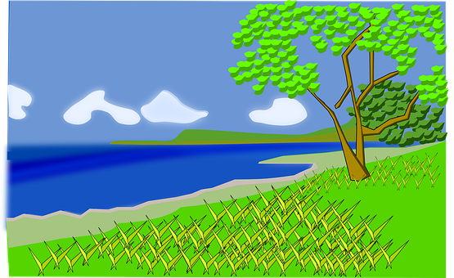
He realised that they needed to rest. “Why don’t we go to the opposite side of the lake to escape the crowds?” he asked.
Blossoming Minds
Teaching Resources

Slide 7
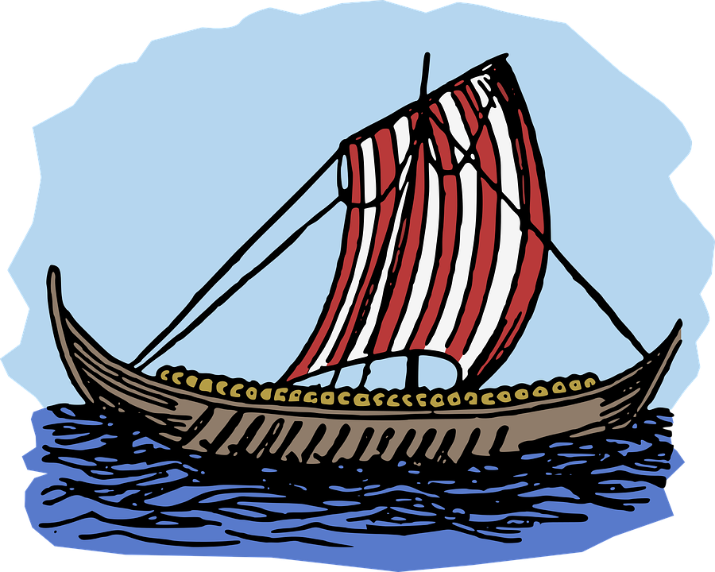
So they all clambered on a boat, ready to row to the other side.
Blossoming Minds
Teaching Resources

Slide 8

The disciples took up the oars, while Jesus went to the stern of the boat to rest.
Blossoming Minds
Teaching Resources

Slide 9

He lay out some cushions and was rocked into a deep slumber by the gentle lapping of the waves. It was very peaceful.
Blossoming Minds
Teaching Resources

Slide 10
But as they got further out into the lake, the waves started lapping more fiercely at the wooden vessel.
Blossoming Minds
Teaching Resources

Slide 11

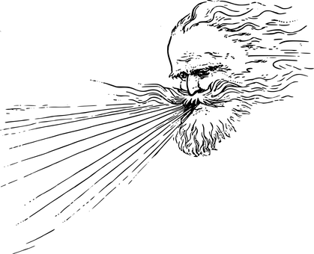
Dark, menacing clouds swept across the sky and a strong wind gusted blew around them.
Blossoming Minds
Teaching Resources

Slide 12
The boat started to pitch and rock from the ferocity of the wind and the waves.
Blossoming Minds
Teaching Resources

Slide 13

The disciples were feeling nervous by now. Rain was lashing at their faces and the occasional waves swept right over the boat.
Blossoming Minds
Teaching Resources

Slide 14

But still Jesus slept peacefully.
Blossoming Minds
Teaching Resources

Slide 15


As wave after wave engulfed the boat, the disciples started to scream and shout, fearing for their lives in this terrifying storm.
We’re going to drown!
Help us!
Blossoming Minds
Teaching Resources

Slide 16


One disciple decided to wake Jesus.
Shaking him roughly from his fear, the disciple pleaded “Master, don’t you care if we all drown?”
Don’t you care if we drown?
Blossoming Minds
Teaching Resources

Slide 17

Jesus listened to the howling gale and felt the stinging waves and rain on his skin.
Blossoming Minds
Teaching Resources

Slide 18

He observed His disciples running terrified across the deck of the boat, being rocked and thrown from side to side.
AAAAAHHH!
Blossoming Minds
Teaching Resources

Slide 19



He saw the fear in their faces.
Blossoming Minds
Teaching Resources

Slide 20
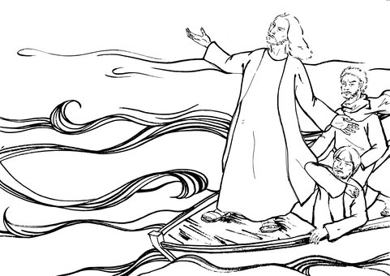
Calmly, He stood, stretched out His arms to the wind and the waves, and commanded: “Peace! Be still!”
Peace! Be still!
Blossoming Minds
Teaching Resources

Slide 21
And all at once the wind died down and the waves became completely calm.
Blossoming Minds
Teaching Resources

Slide 22
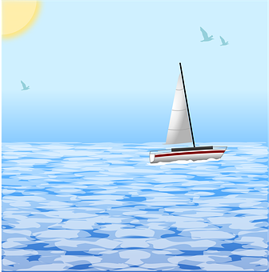
The storm had disappeared and the lake was once again lapping gently and peacefully against the lower decks of the boat.
Blossoming Minds
Teaching Resources

Slide 23
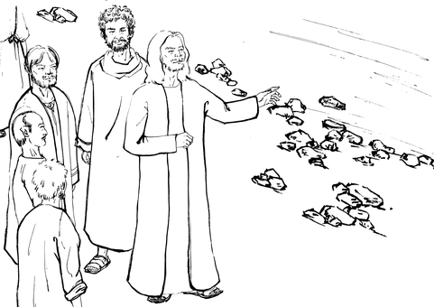
The disciples gazed in wonder at Jesus. They were once again in awe of this man who seemed to be have power over nature itself.
Wow! He’s so powerful!
Blossoming Minds
Teaching Resources

Slide 24
Then he asked the disciples: “Why are you so afraid? Where is your faith?”
Where is your faith?
Blossoming Minds
Teaching Resources

Slide 25
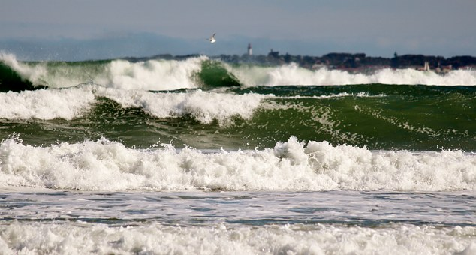
Blossoming Minds
Teaching Resources

Slide 26
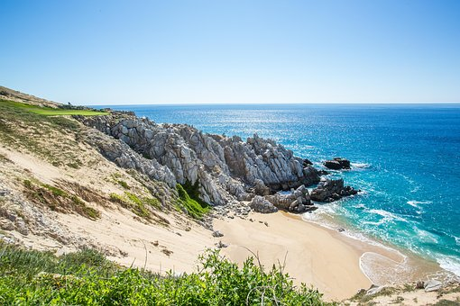
Blossoming Minds
Teaching Resources

Slide 27
The End
For more information see: Matthew 8:23-27; Mark 4:35-41
Find more assembly and RE resources at https://www.tes.com/teaching-resources/shop/blossomingminds
Blossoming Minds
Teaching Resources
All pictures courtesy of pixabay.com available for commercial use

