Slide 1
Monday 13th June 2020 Planning an explanation text

Slide 2
Hello Class Attenborough!
Last week we looked at explanation texts, and how to write them.
Today I want you to plan you own explanation text.
This text can be about….

Slide 3
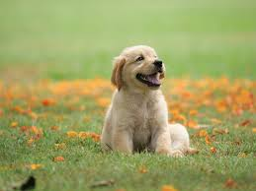
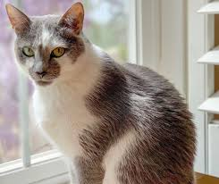
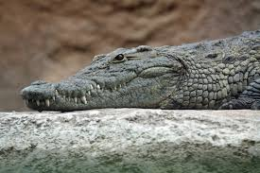
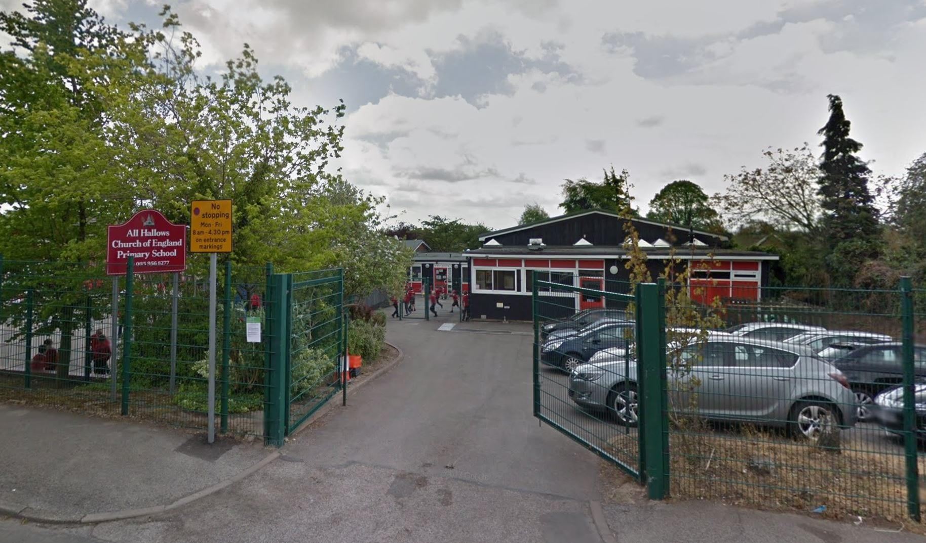
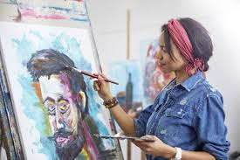
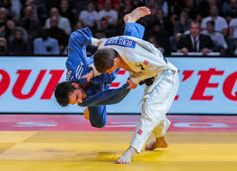
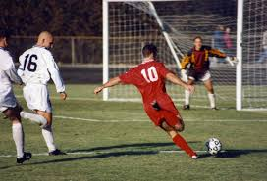
How to look after your pet
How to do well in school
How to do your favourite hobby
Anything else!

Slide 4
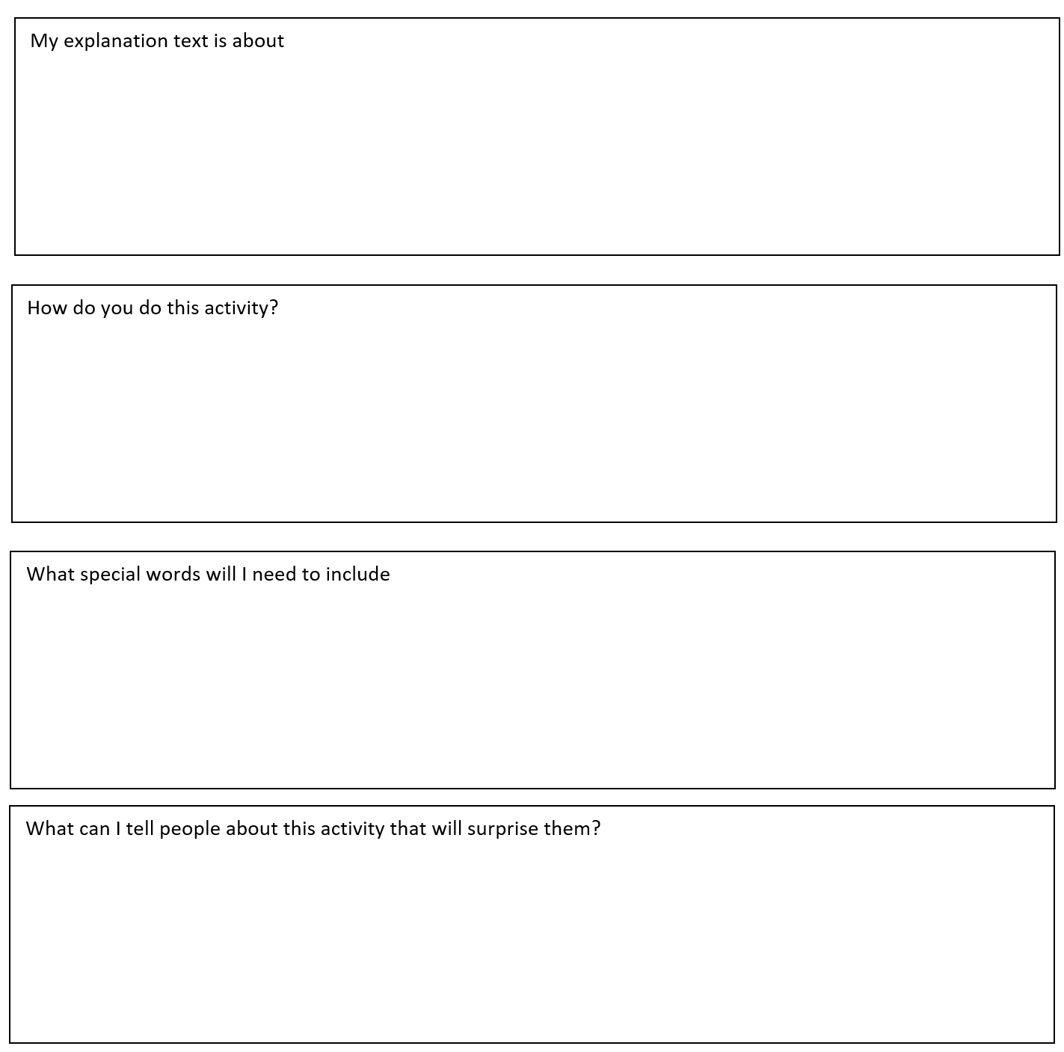
Download this sheet to help you
plan your explanation text

