Slide 1
Puppies
Puppies are very cute and fluffy if you want to see all types of puppies you have come to the right place.

Slide 2
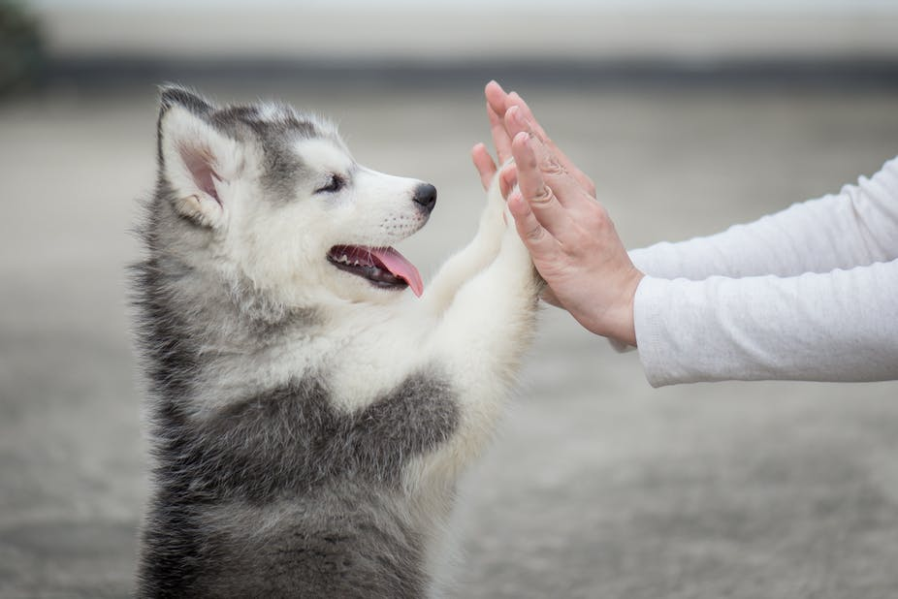
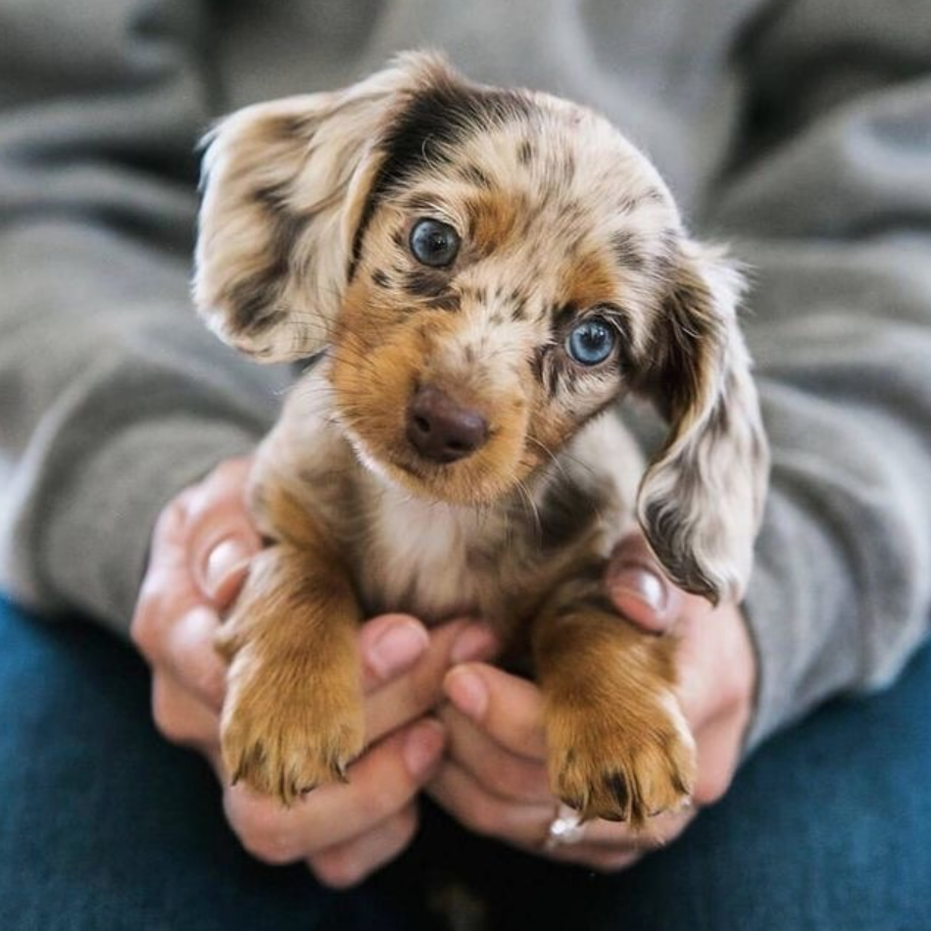
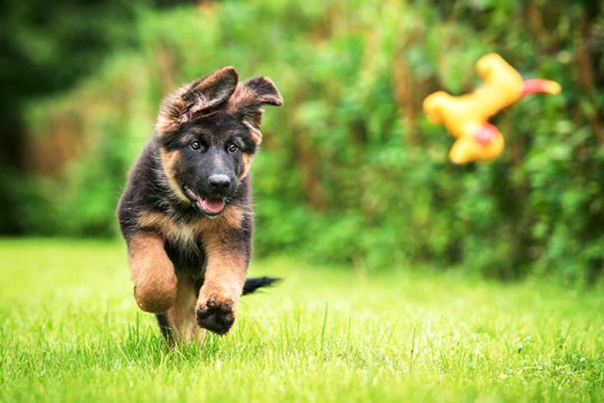
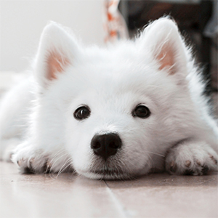
Here are some puppies there is a German Shepard, Huskie , Samoyed and Dachsond. They are very cute, just like every puppy.

Slide 3
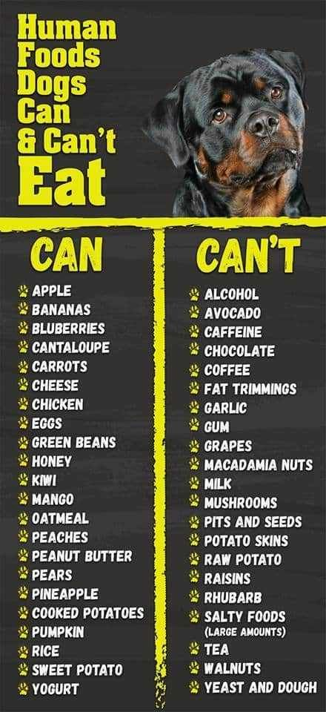
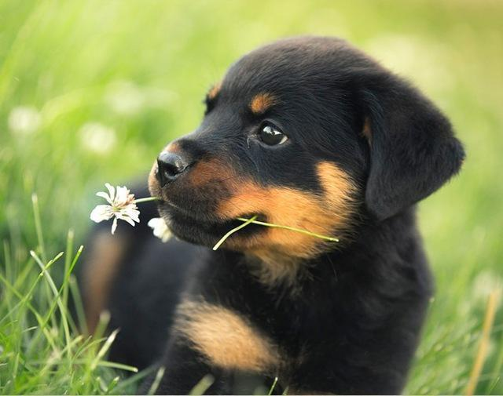
This is a Rottweiler. They are mostly used by the police for caching criminals, they are very cute though.

Slide 4
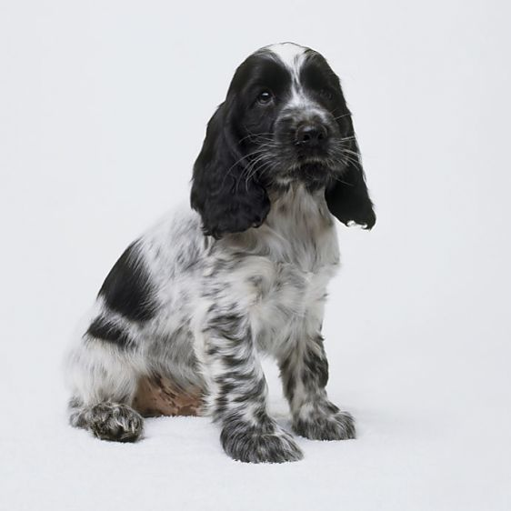
This is an English Cocker Spaniel black and white. They are very fluffy. They like lots of attention.
You can get a working cocker spaniel which likes to go on lots of walks.

Slide 5
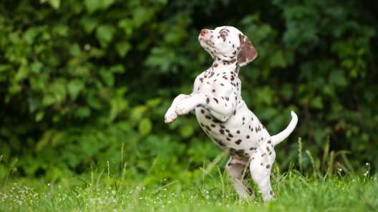
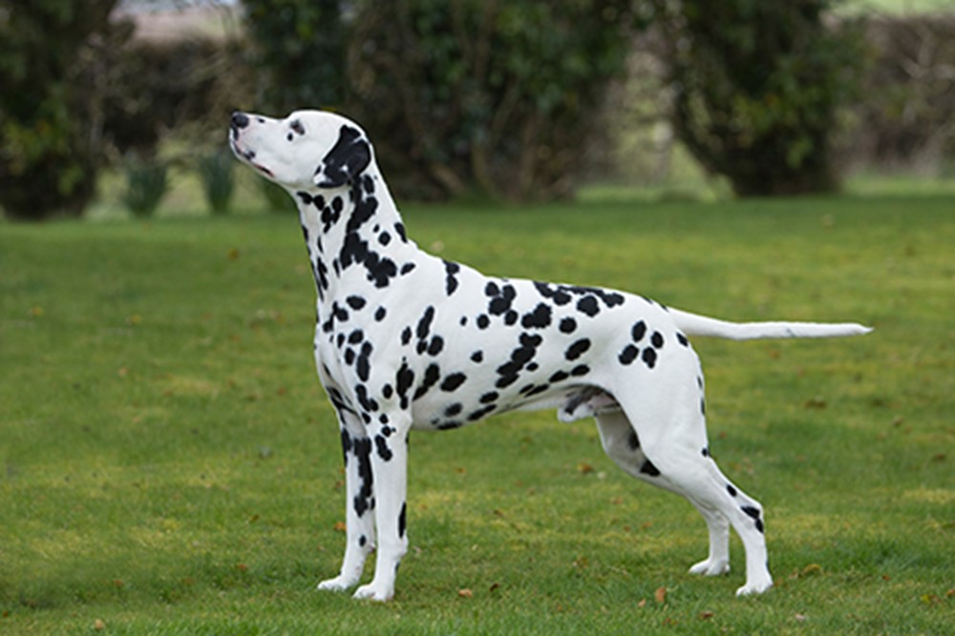
This is a Dalmatian puppy they are born without spots and about at 6 months old they grow spots.
This is what they look like when their older.

Slide 6
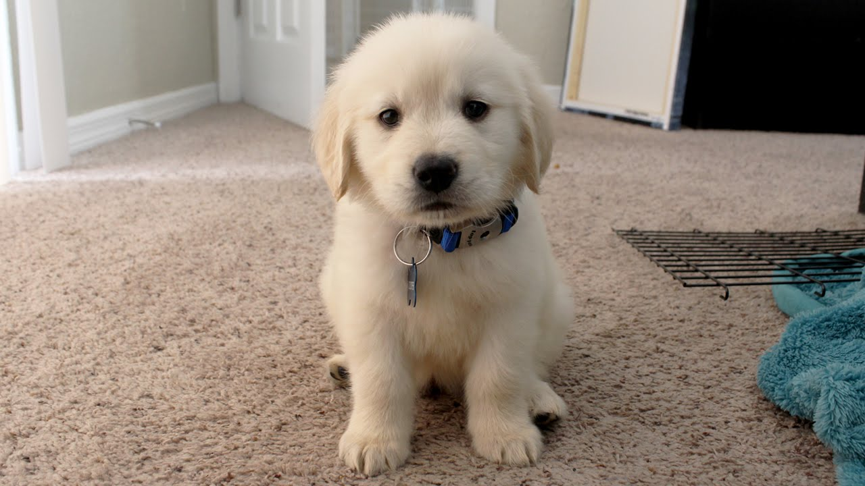
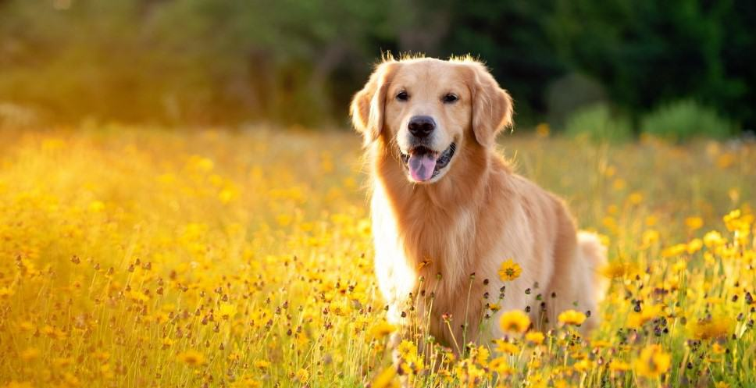
This is a Golden Retriever puppy they can grow very tall ,they are really fluffy!
This is what they look like when they are older.

Slide 7
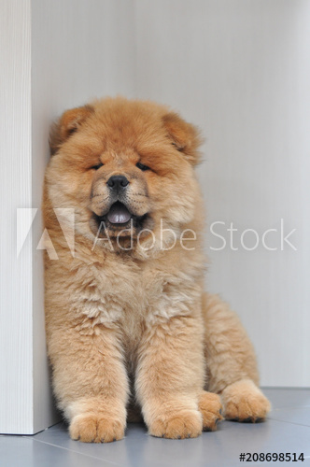
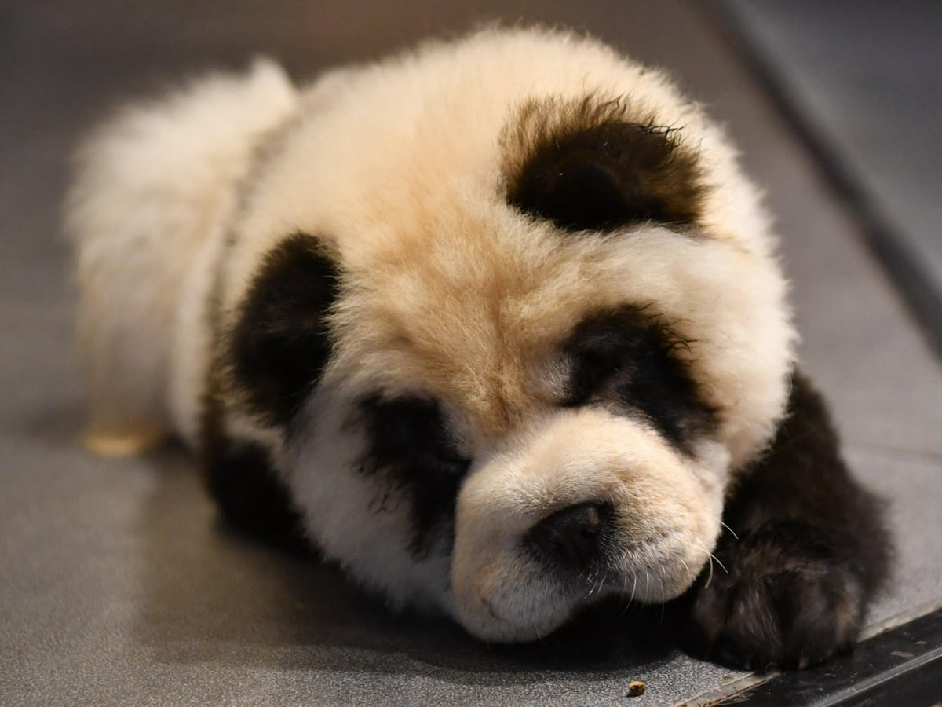
This a Chow Chow they are super fluffy.
They love having attention and love being fussed.

Slide 8
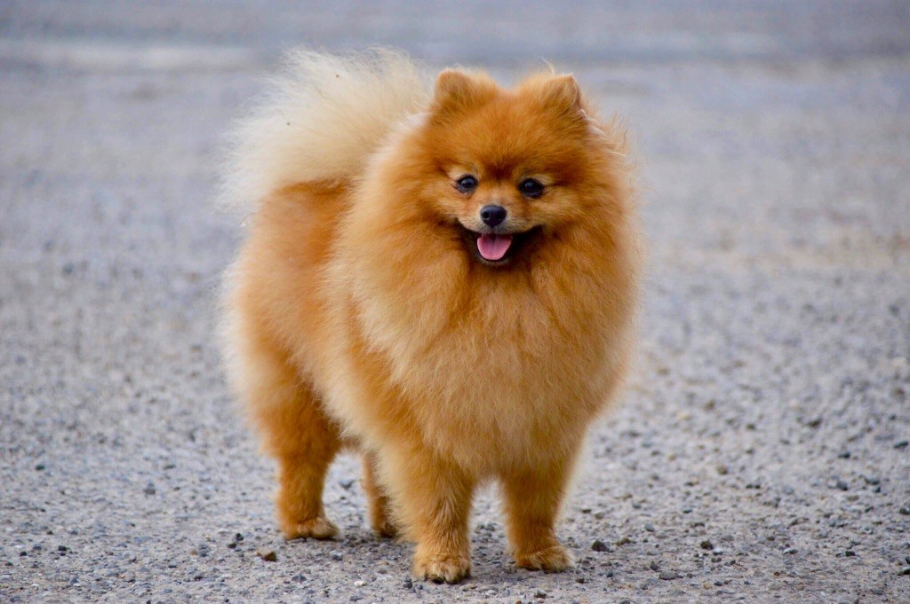
They weigh 7-10 pounds and come from big dogs!
This is a Pomeranian they are very fluffy and quite small.

Slide 9
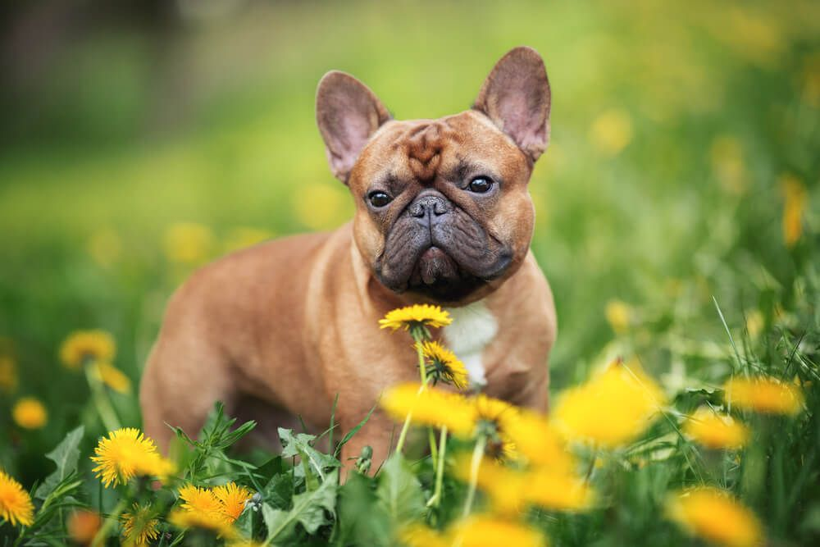
This is a French Bulldog they are quite small and love attention. They cannot swim because of their big heads.
Frenchie's have two different styles of ears.

Slide 10
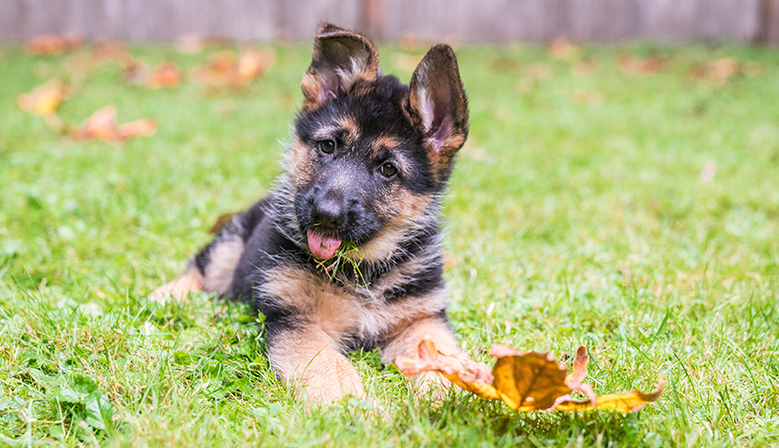
They are very very fluffy and are super cute!
This is a German Shepherd they make excellent guard and police dogs they will protect their owners at all costs.

Slide 11
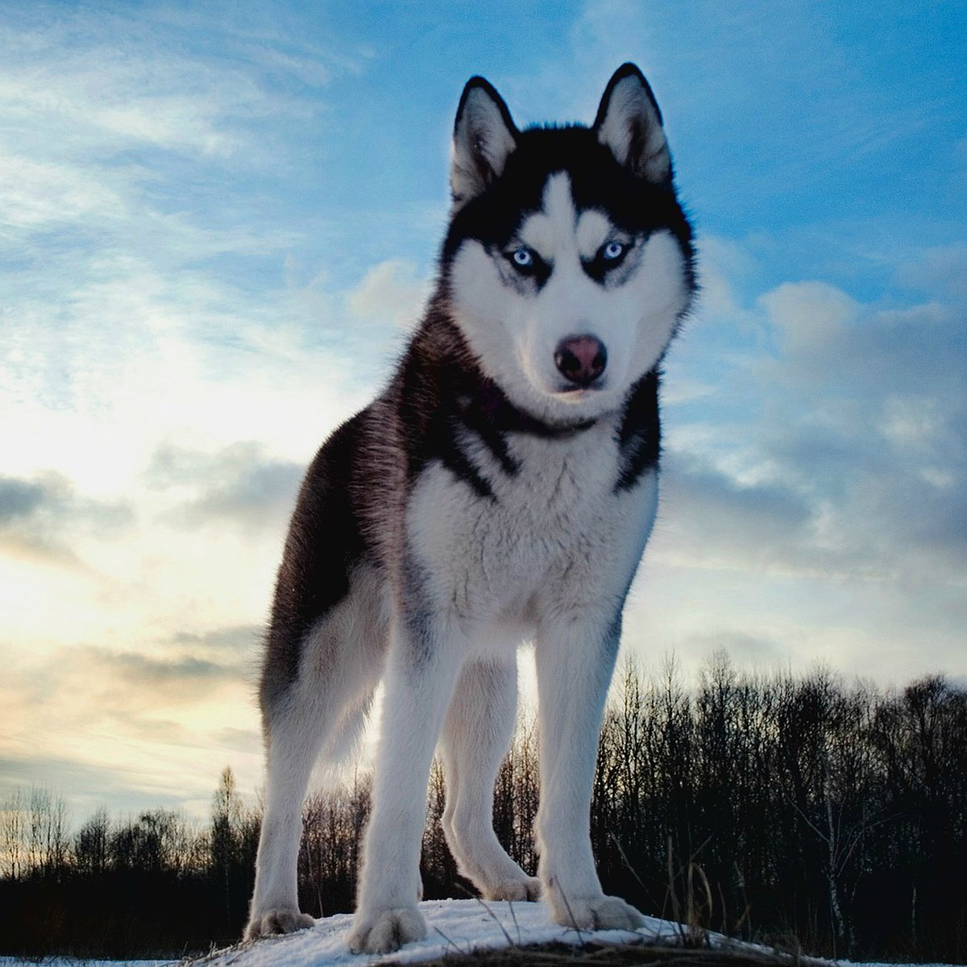
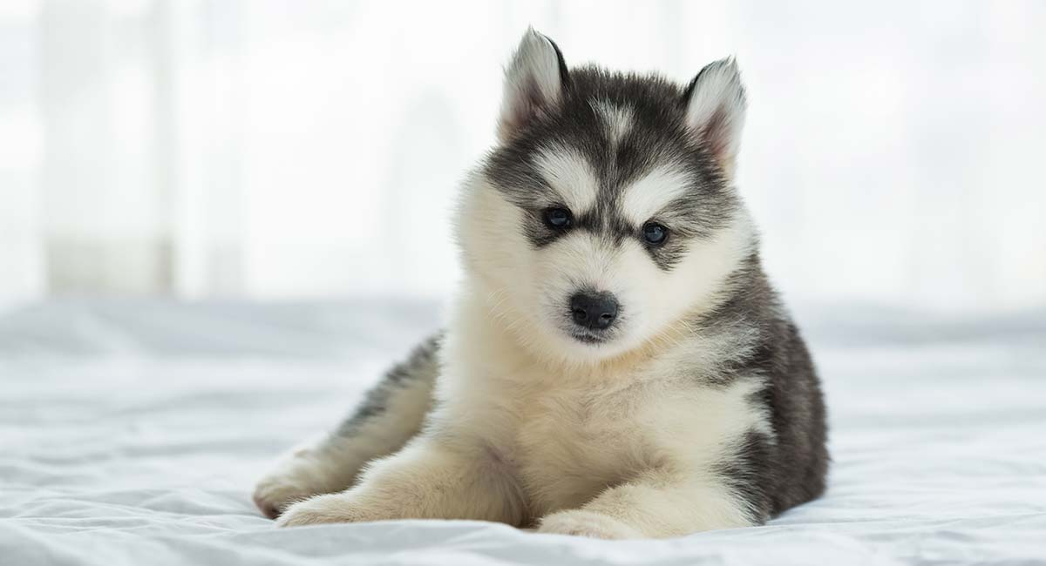
This is a Huskie they are descended from wolfs they have the same viciousness but different cuteness.
They look like this when they are older.

Slide 12
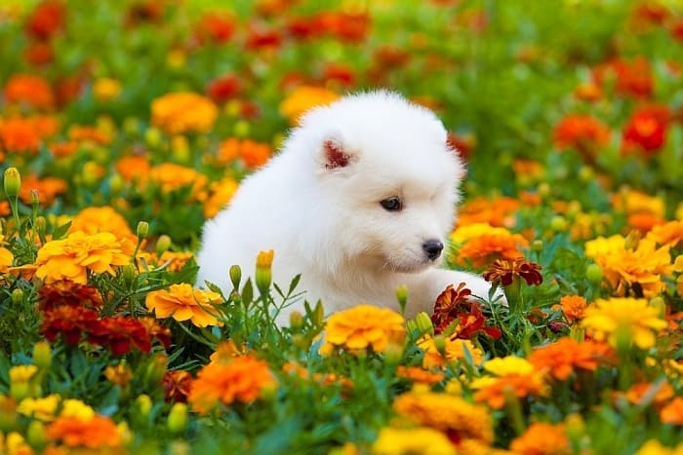
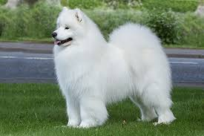
This is a Samoyed they are basically bigger versions of Pomeranians they can grow to the same size of a Golden Retriever witch is big!
This is what they look like when they are older.

Slide 13
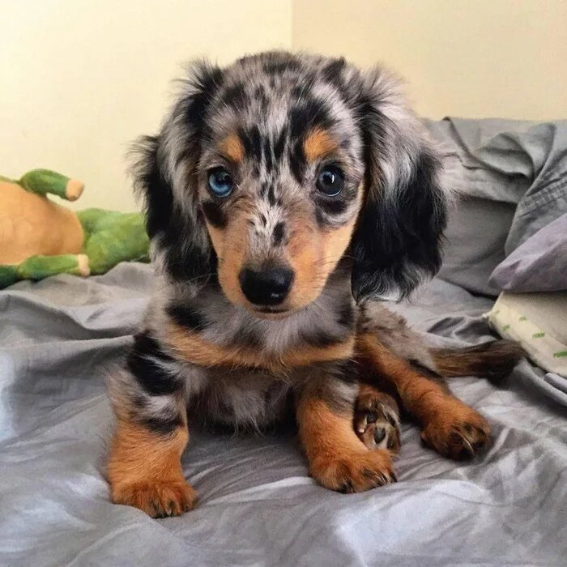
This is a Dachshund they are also known as sausage dogs, they have long bodies and are very cute. –just like all puppies-
There isn’t really a change when they get older except they grow a tiny bit.

Slide 14
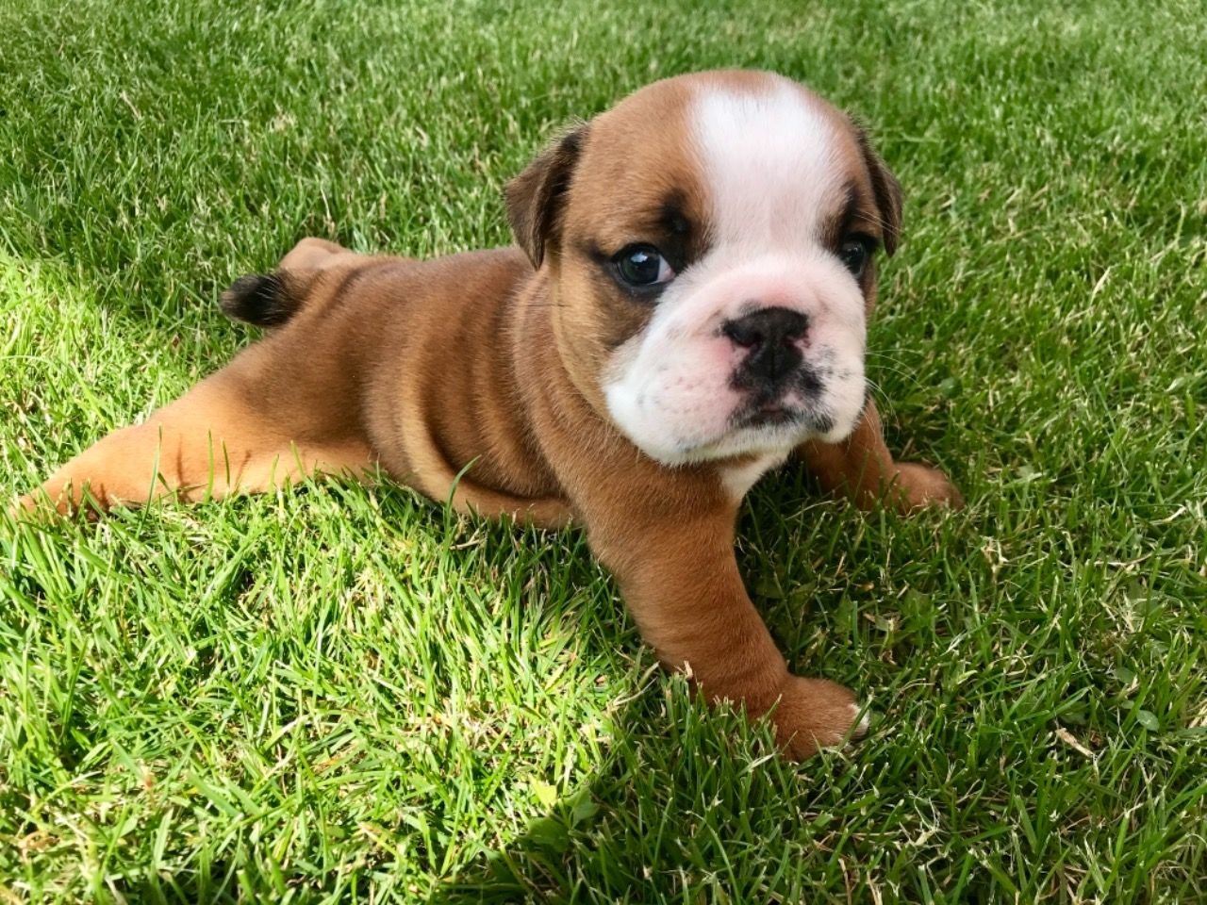
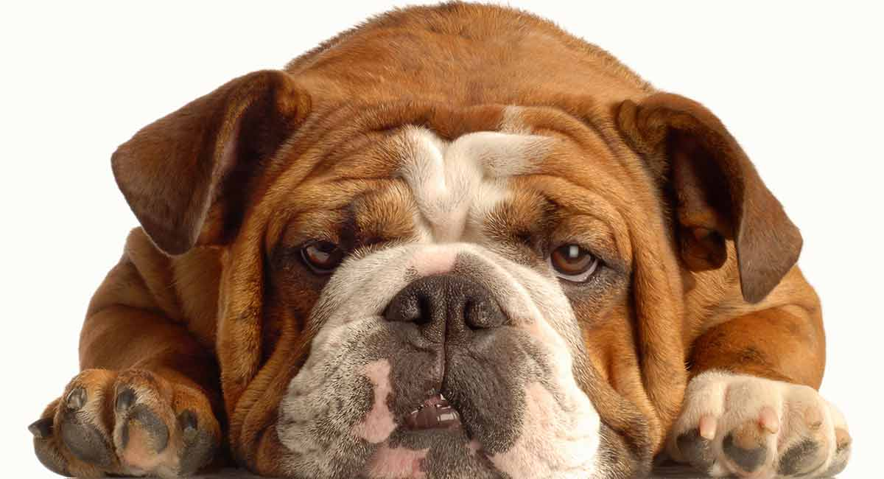
This is a English Bulldog they are quite lazy and funny.
They look like this when they are older.

Slide 15
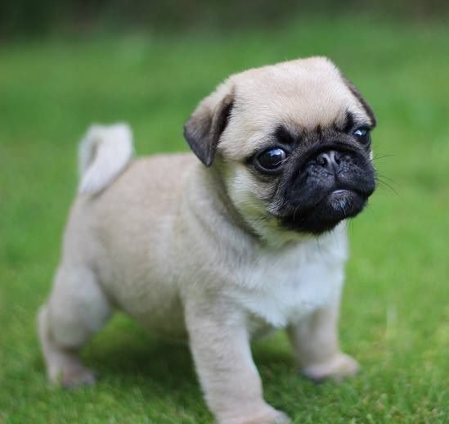
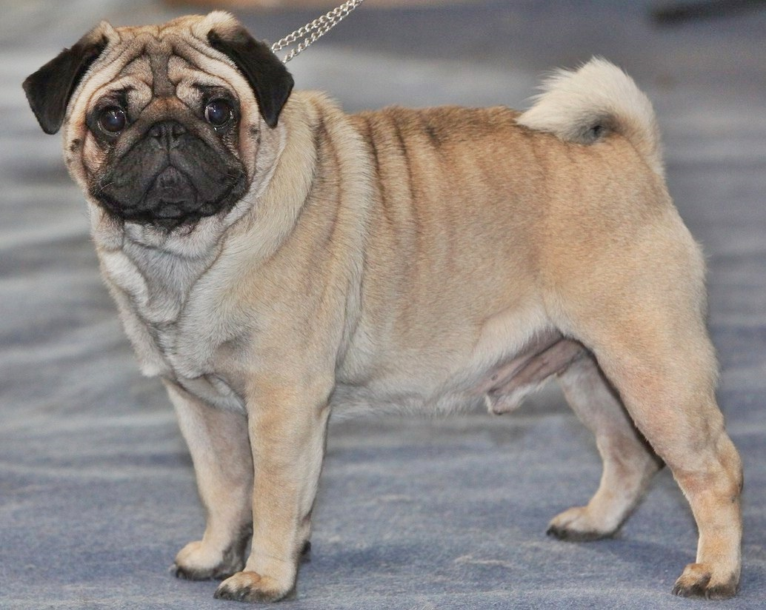
This is a Pug they fart a lot, but still are very cute they are small when they are older or younger.
This is when they are older do you see a difference?

Slide 16
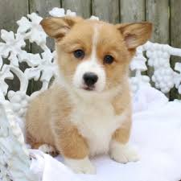
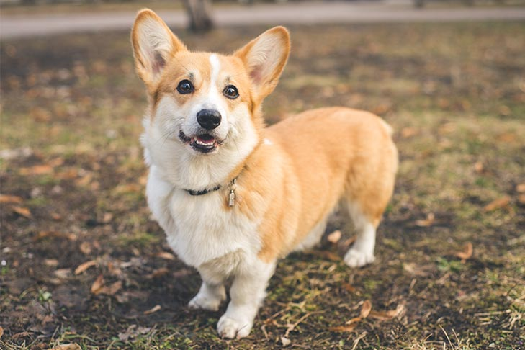
This is a Corgi they have been the royal family dog for ages.
This is when they are older.

Slide 17
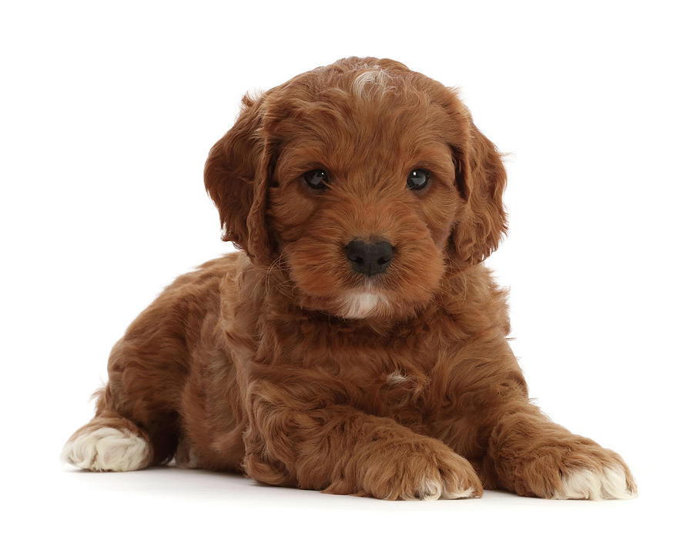
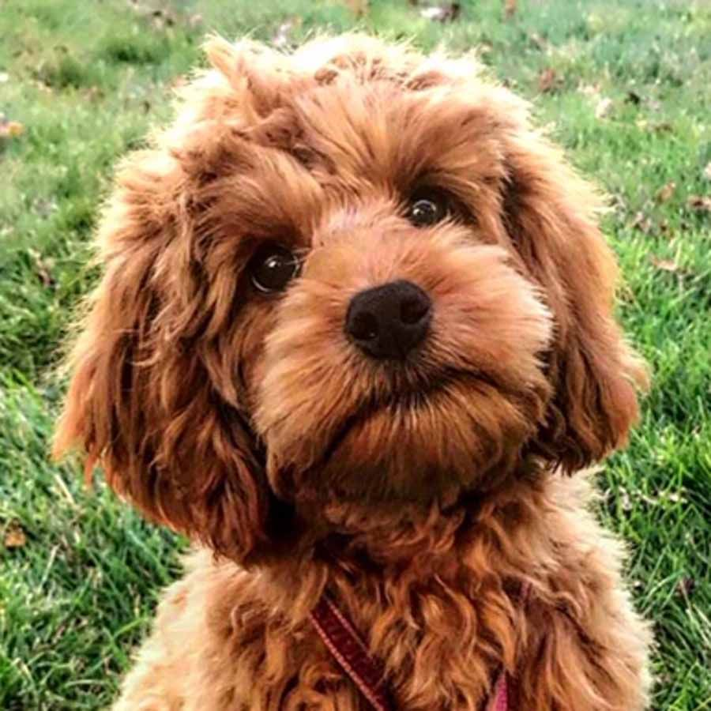
This is a Cocker Poo they are so cute and fluffy they weigh 5.4-11 kg.
This is when they are older.

Slide 18
By Eva
☺☺☺
Hope you have enjoyed sorry if I didn’t get all of the breeds.

