Slide 1
Fair trade

Slide 2


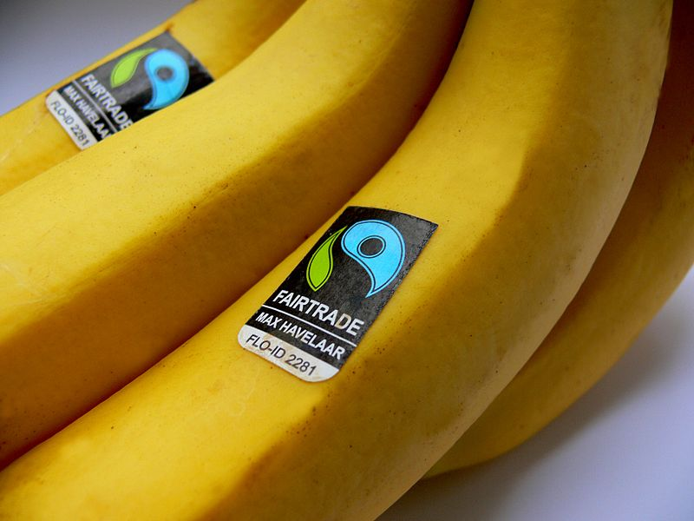
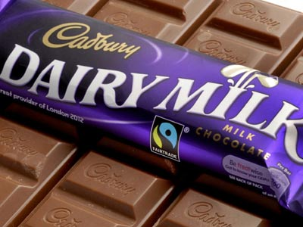
Fair trade products.

Slide 3


Fair trade logo
This is the fair trade logo make sure you look out for it when you go to the supermarket!!

Slide 4



Countries
The fair trade products come from different countries like india, ghana and Africa.

Slide 5

Fair trade is a charity that make sure people in poor countries get a fair wage. Please look out for the fairtrade logo!!!

