Slide 1
Fair Trade
by Sebastian

Slide 2

When you go to a supermarket and you want to buy some chocolate, we should try and buy the more expensive chocolate that is Fairtrade.
Fairtrade chocolate will help farmers and their families to build a better life for them selves.
Farmers in some countries barely get paid an the company get paid the most.

Slide 3
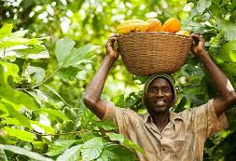
What is fair trade
The fair-trade program is a global movement made up of lots of different producers and companies putting people first.
By purchasing fair trade this helps farmers to be paid a fair wage helping them to look after their families.

Slide 4
We should all choose fair trade and make the right choices to help others.

