Slide 1



Fair Trade

Slide 2
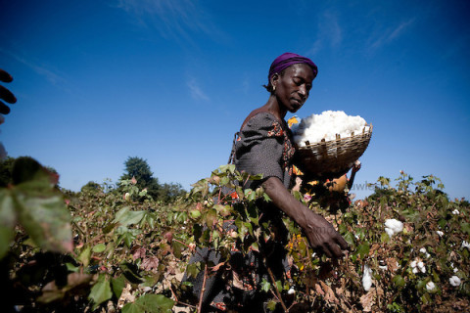
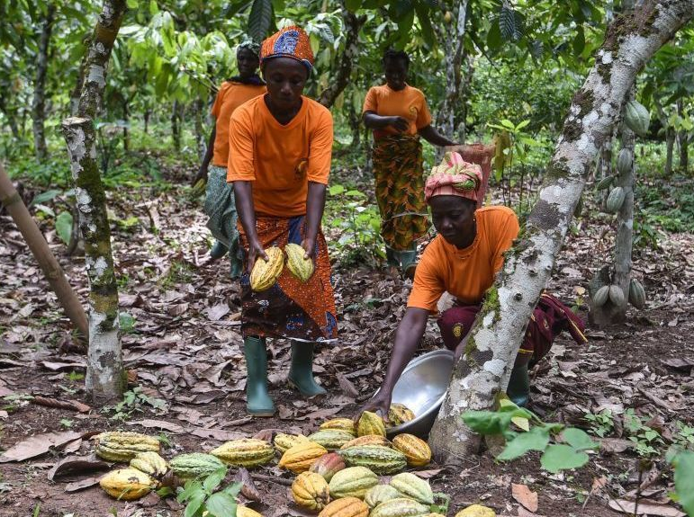
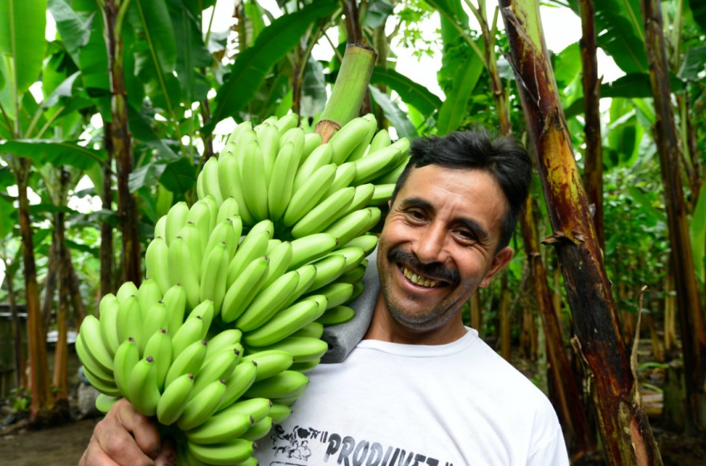
What is Fair-Trade
Fair-Trade is a company that gives better money to farmers across the world. The types of people they help are cocoa bean, coffee bean, sugar cane, cotton and many more types of farmers. The reason farmers need Fair-Trade is because they aren’t always paid enough money and go into poverty. So Fair-Trade pay the farmers enough money to survive.

Slide 3



How to Help
If you want to help, then look for the Fair-Trade logo below and that means people will have been paid the right amount of money to look after, farm and create the products you are buying. There are other charities doing this as well, like the Rainforest Alliance.

