Slide 1


Fair trade
This power point is all about Fair Trade, they make sure that all farmers have the right amount of pay. They have put logos on some food, for example chocolate and coffee.

Slide 2

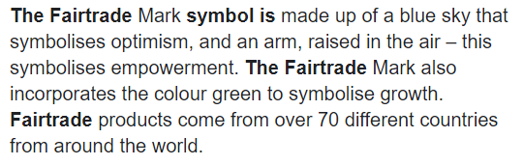
Have you ever wondered about what the Fair Trade logo means? Well think about that no more because I’ll tell you!
This is what the fair trade logo means in more detail.

Slide 3


What is Fair Trade?
What is Fair Trade? Fair Trade is about better prices, decent working conditions, local sustainability and fair terms for farms and workers in the developing world. By requiring companies to pay a fair amount of money over the market price for any goods. This gives farmers enough money to feed their family.

Slide 4


Why should we support Fair Trade?
We should support it because it’s the right thing to do. It makes sure that al the money is going to the right people.
Fair Trade helps us learn about who made and put the effort and time into the food we love and enjoy.

Slide 5

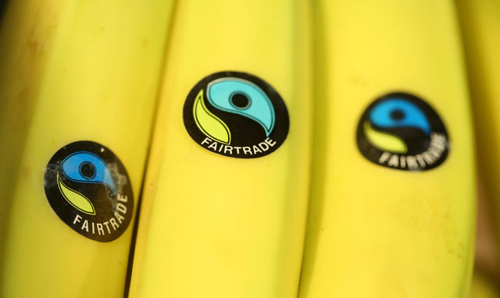
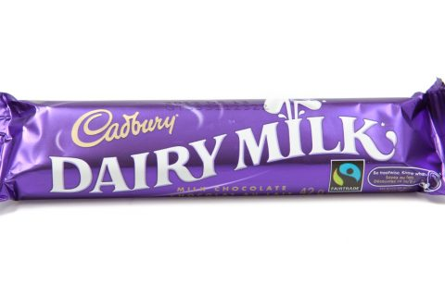

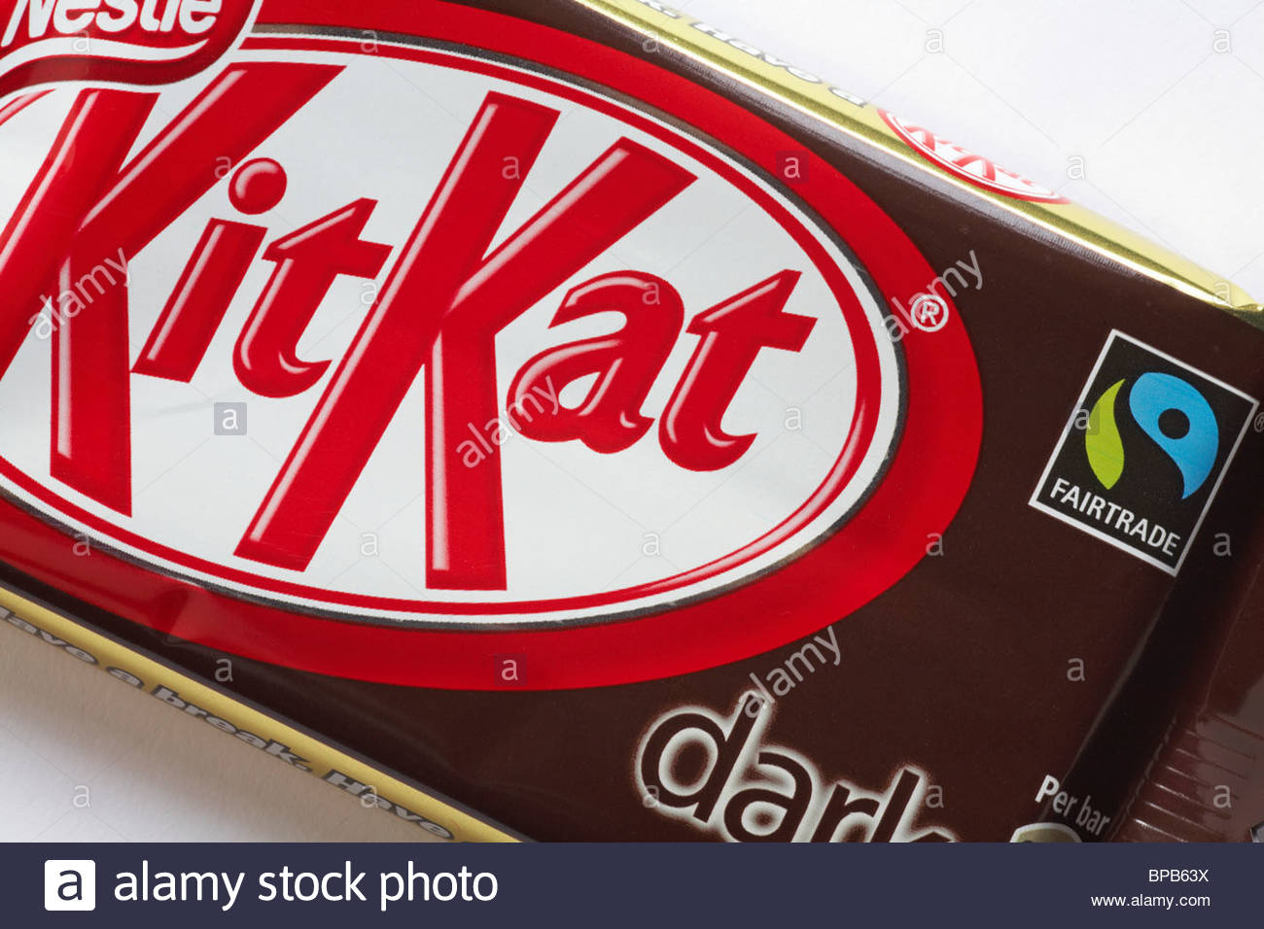
Where should you look for the Fair Trade logo on your food?
Try to find all of the Fair Trade logos
On most food there is a Fair Trade logo which you can look for it with either be on the front or back of the product.

Slide 6
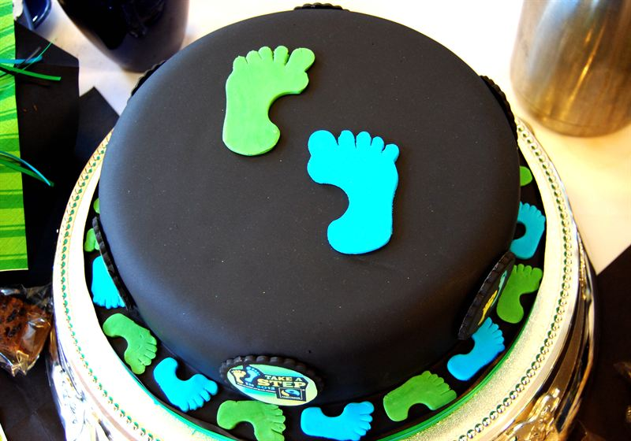

I hope you enjoyed this and will support Fair Trade ☺

