Slide 1
Rats
By Evie T

Slide 2
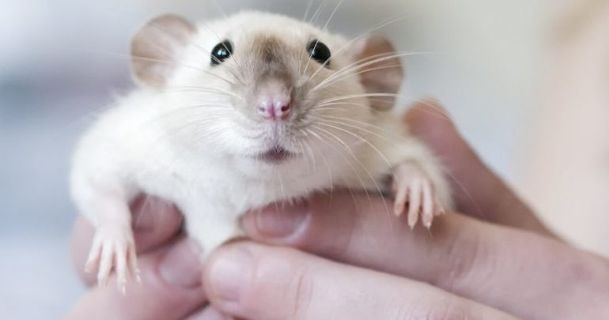
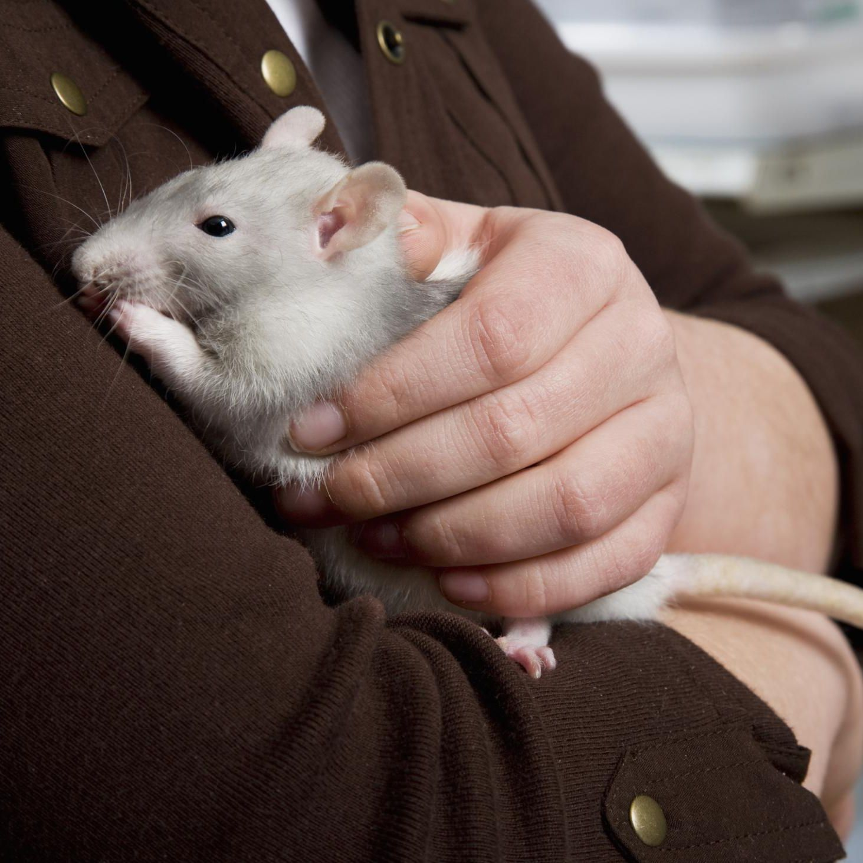
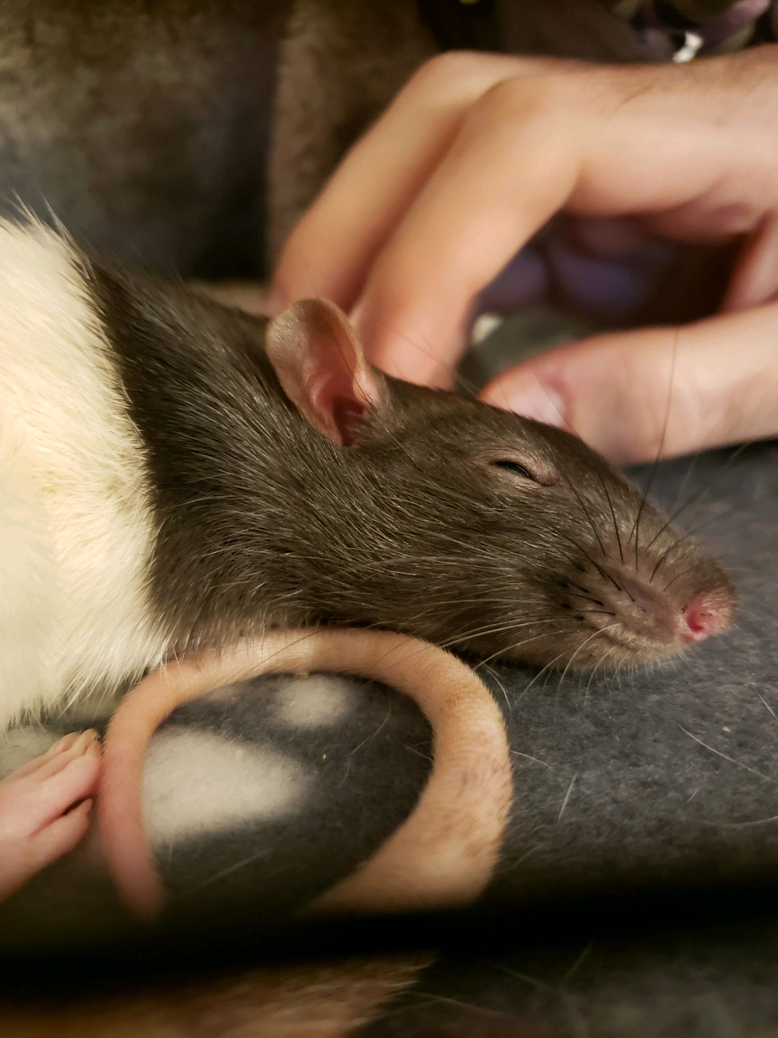
Rats are not just rodents that you find an the streets, they can be loving caring pets and they are very cute and cuddly.

Slide 3
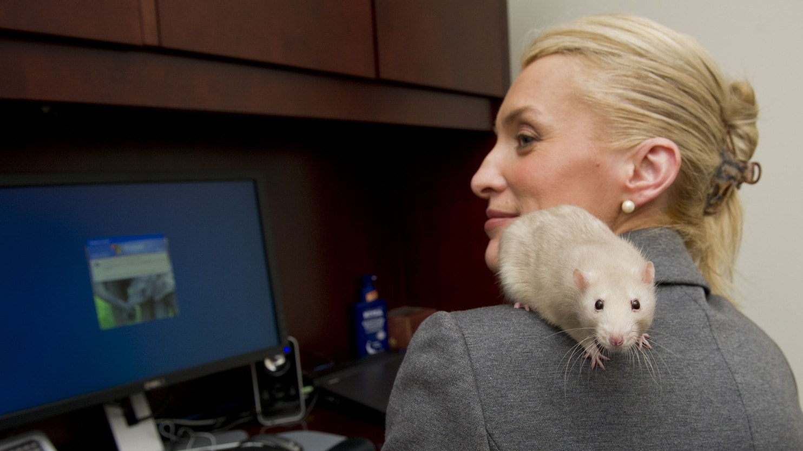
Rats can be trained to help you with your work and maybe even sleep with you.

Slide 4
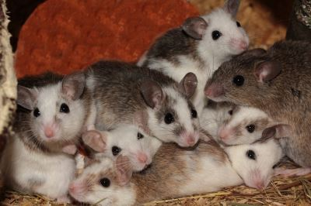
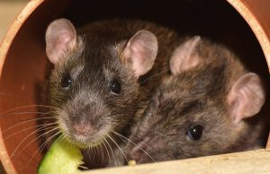
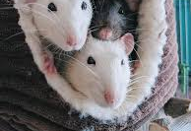
Rats can be learn to do all sorts of things like come, stand, lie-down and other cool tricks. But if they don’t have a friend or a relative they will be really sad and not want to play with you or anyone else.

Slide 5
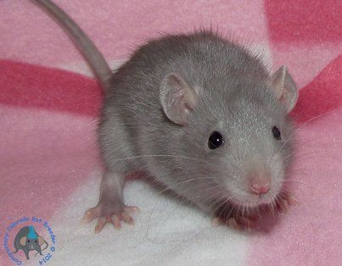
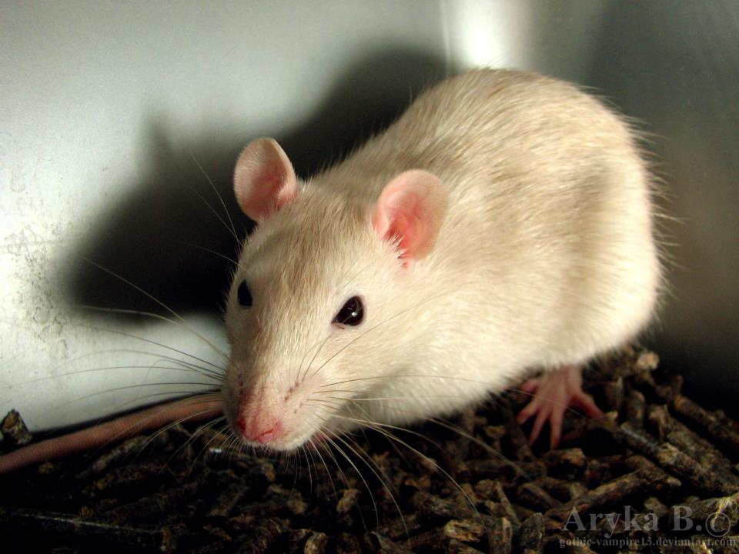
You can’t tell the difference between a male and a female rat because they look so alike. I bet you can’t tell which one is female and which is male.

Slide 6
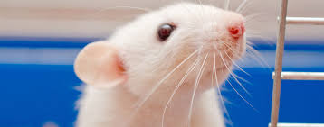
Male and female rats have different personalities a female is very playful and doesn’t fight, but a male is very lazy and fights a lot but that is not always the case.

Slide 7
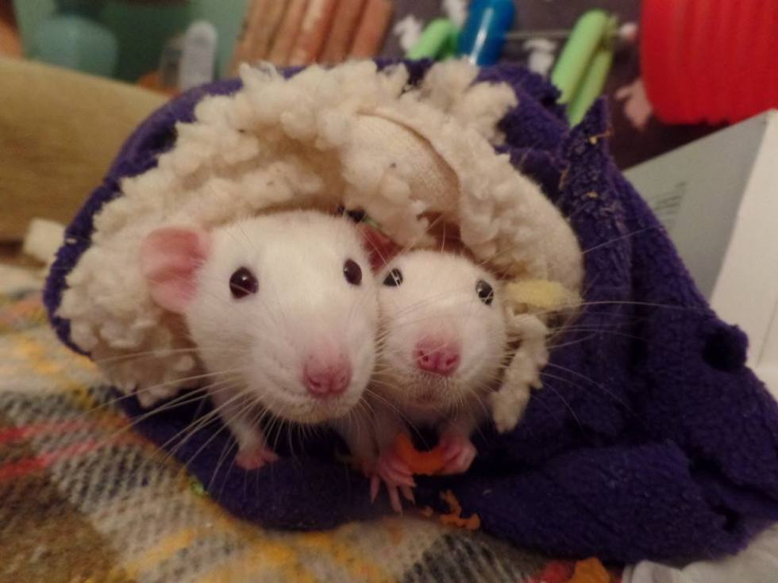
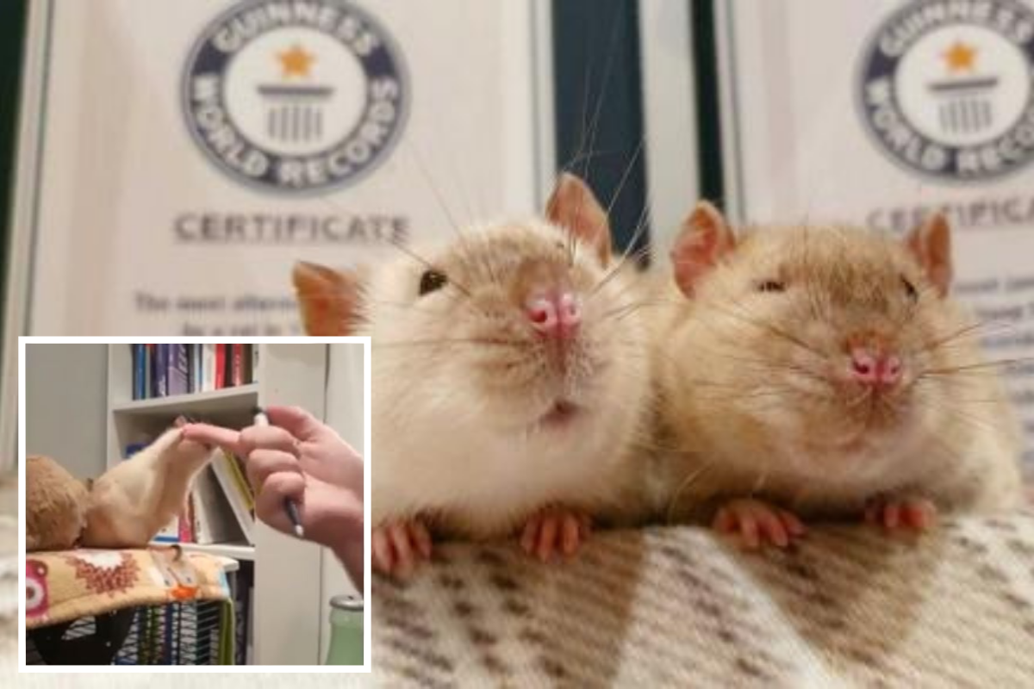
Rats lick you like dogs because they like you and want to put their scent on you. They play fight and it looks very aggressive but it is just like lion cubs they don’t hurt each other.

Slide 8
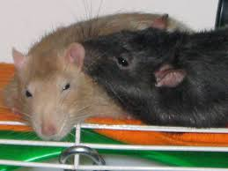
Rats need a big cage to eat sleep and drink in and lots of things to play with otherwise they get bored. You need to get them out about at least 1 hour every day so they don’t get fat.

Slide 9
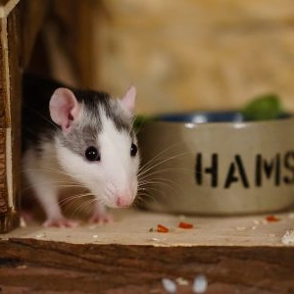
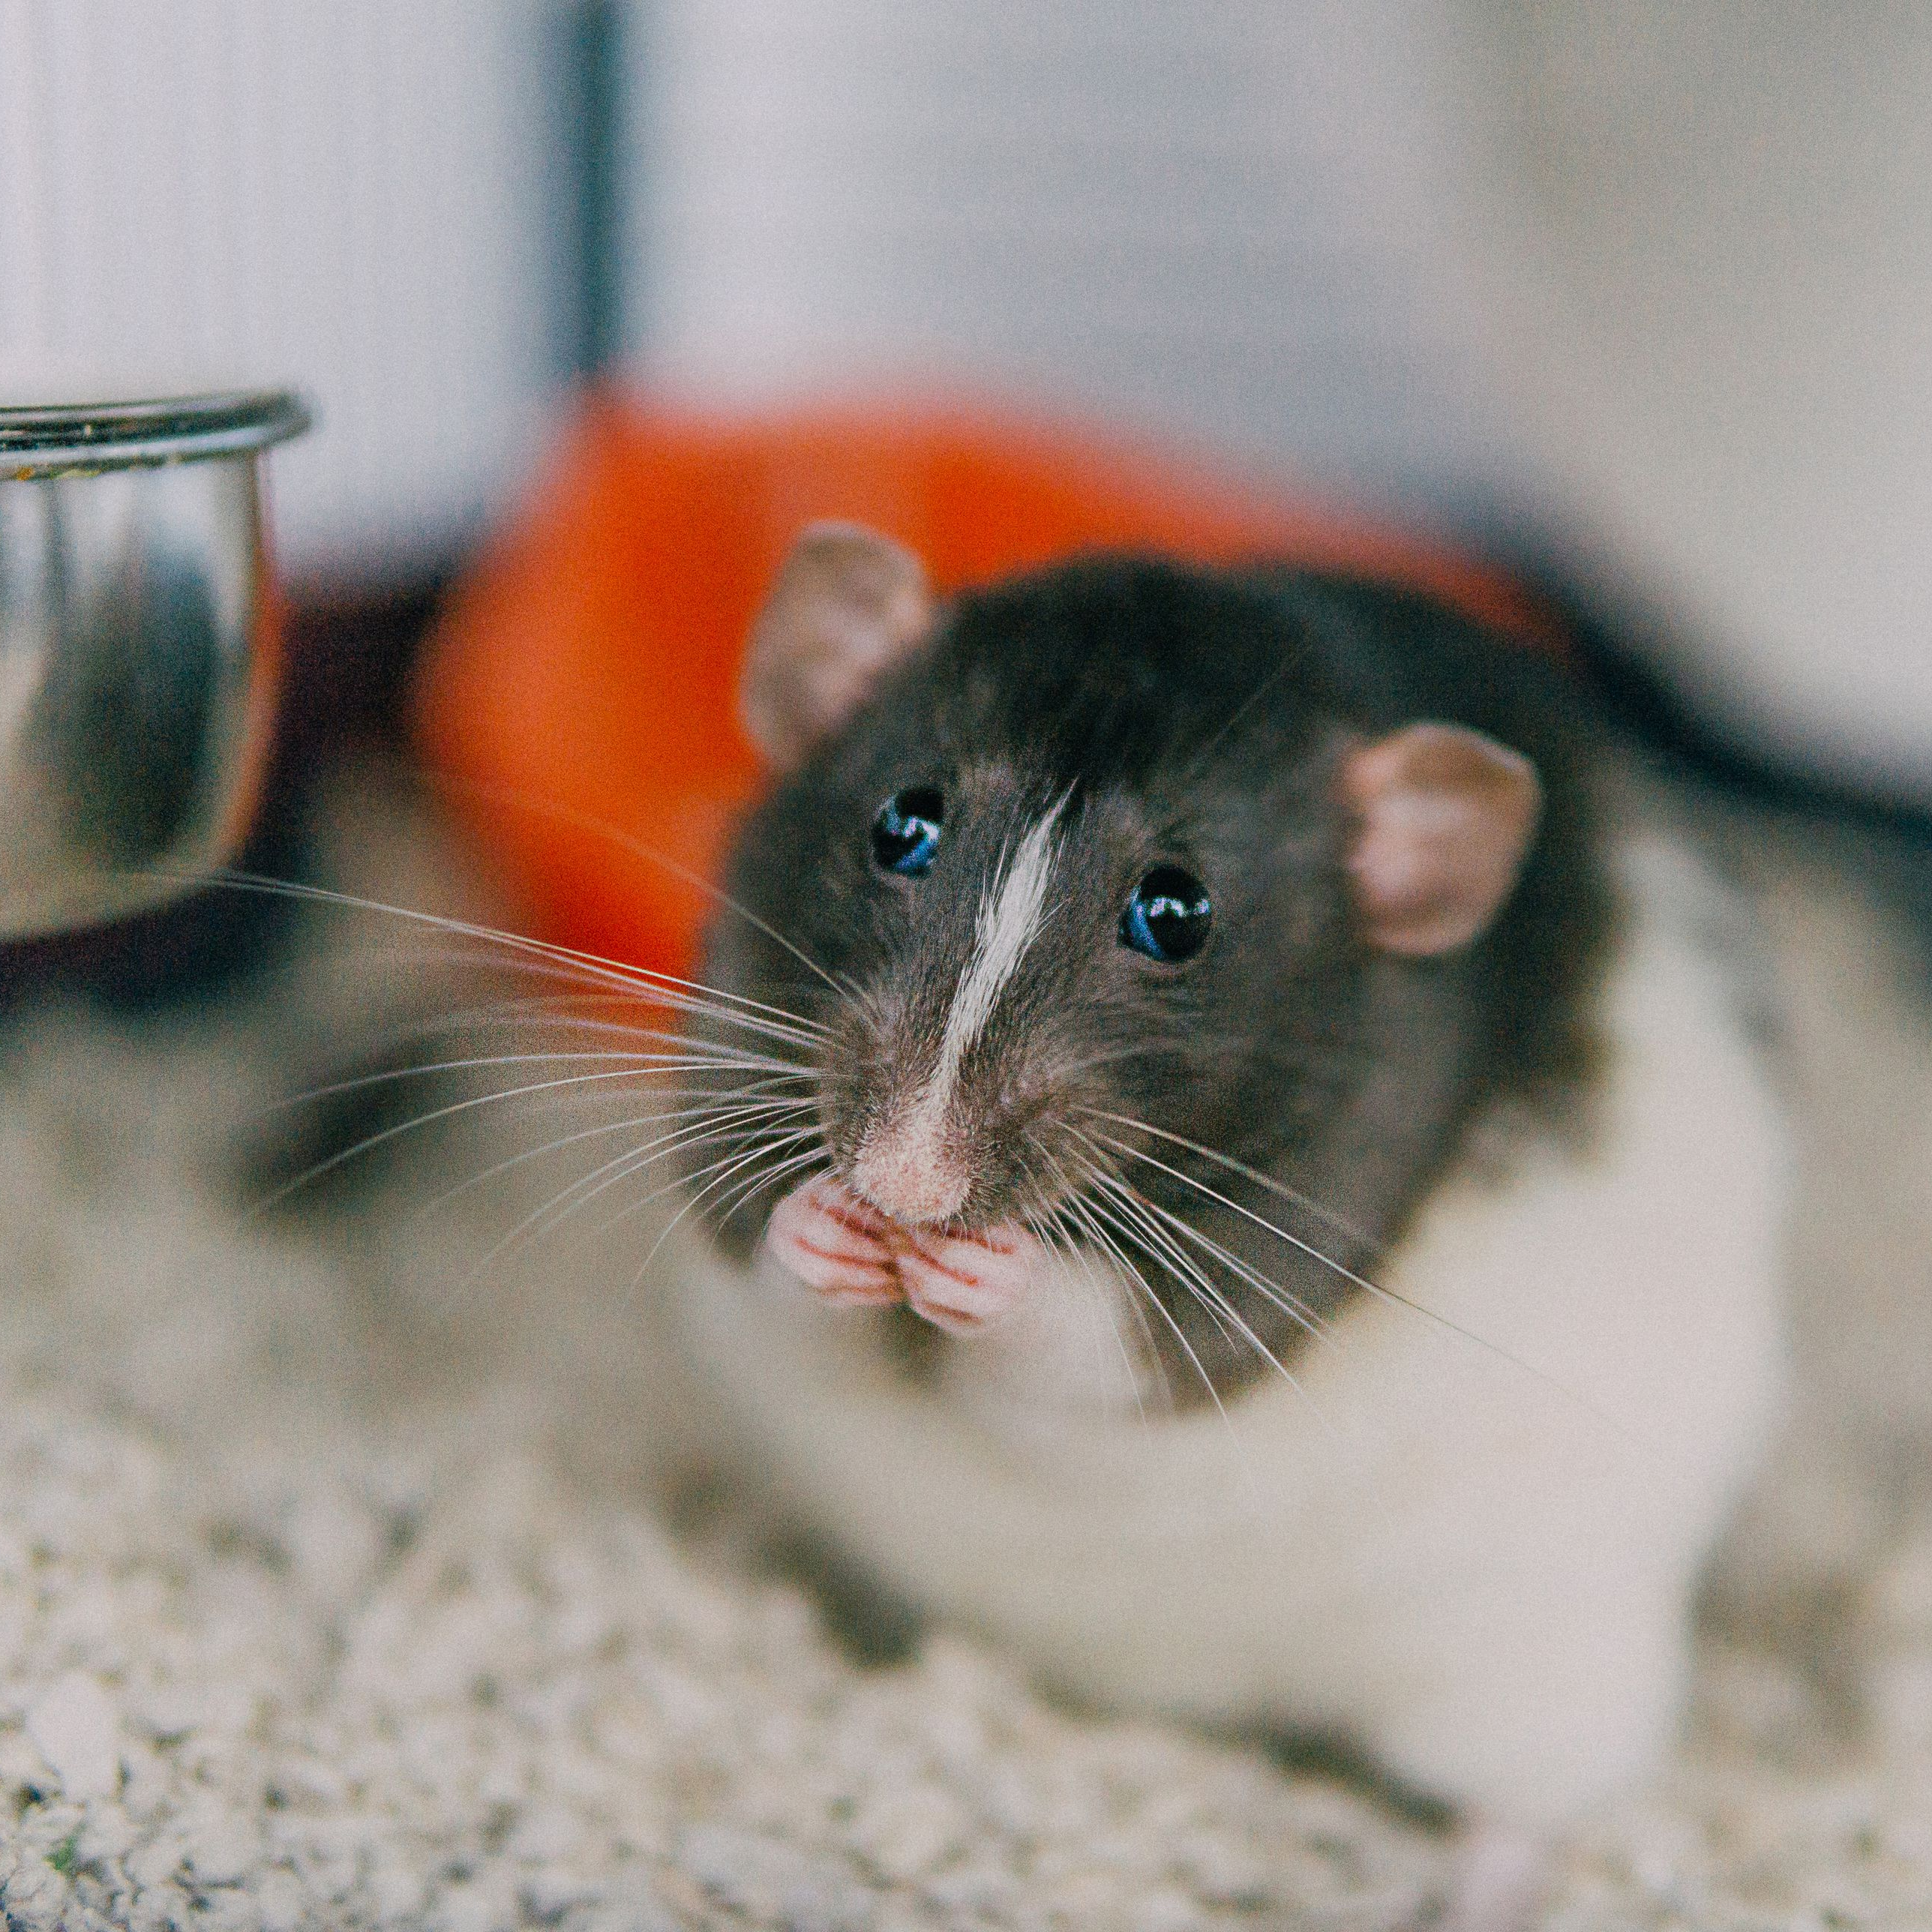
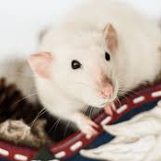
They eat fruit such as cherries, grapes, bananas, strawberries, melons, and plumbs. They eat vegetables as well like broccoli, potatoes, carrots, peas, sweet potato and other things like that. They need about 25g of food a day. If you have a hungry rat and need some food click this link. ratRations.co.uk Rat food, base mixes and herbs.

