Slide 1
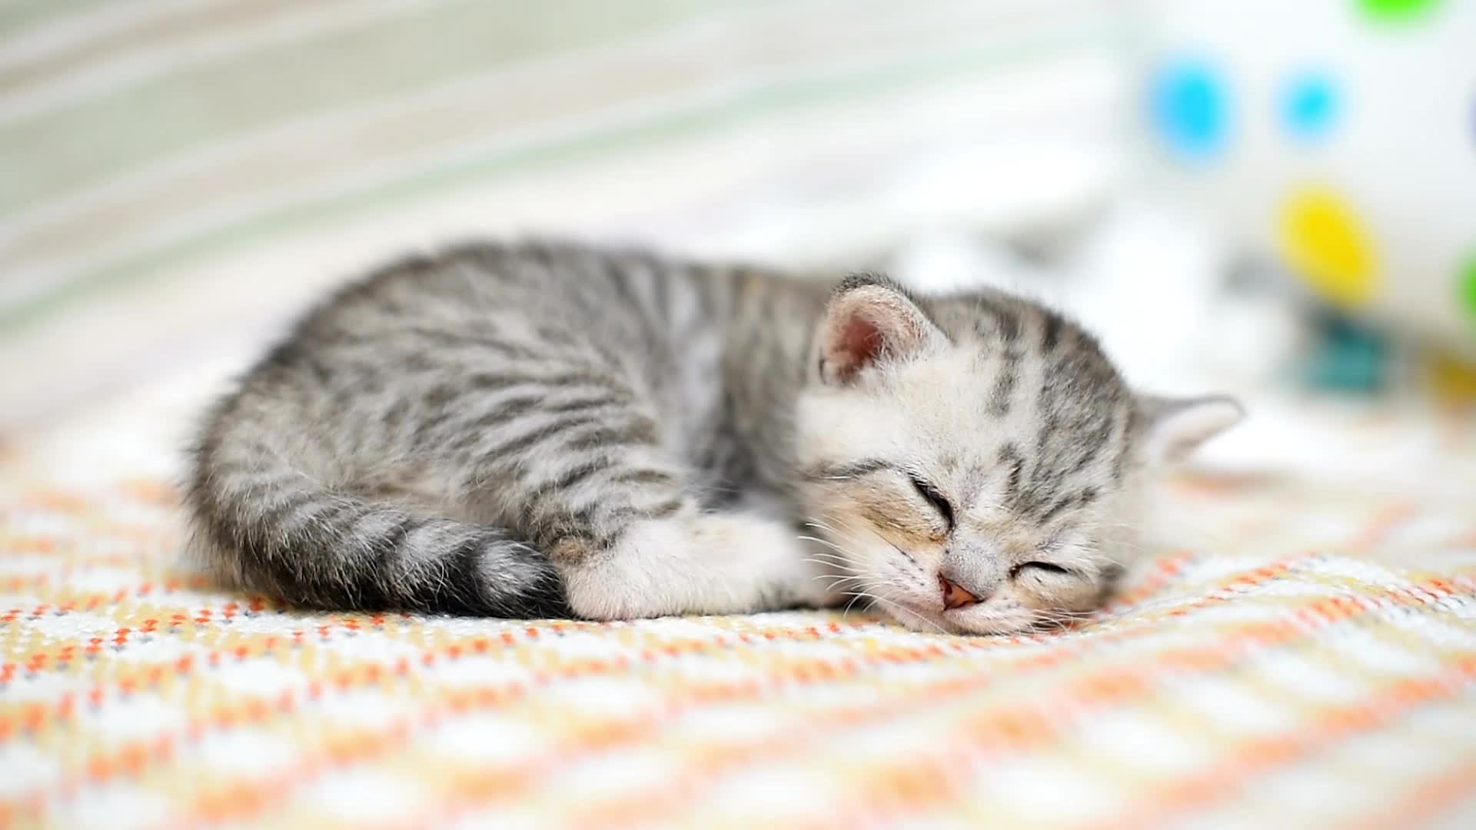
Cats and dogs

Slide 2
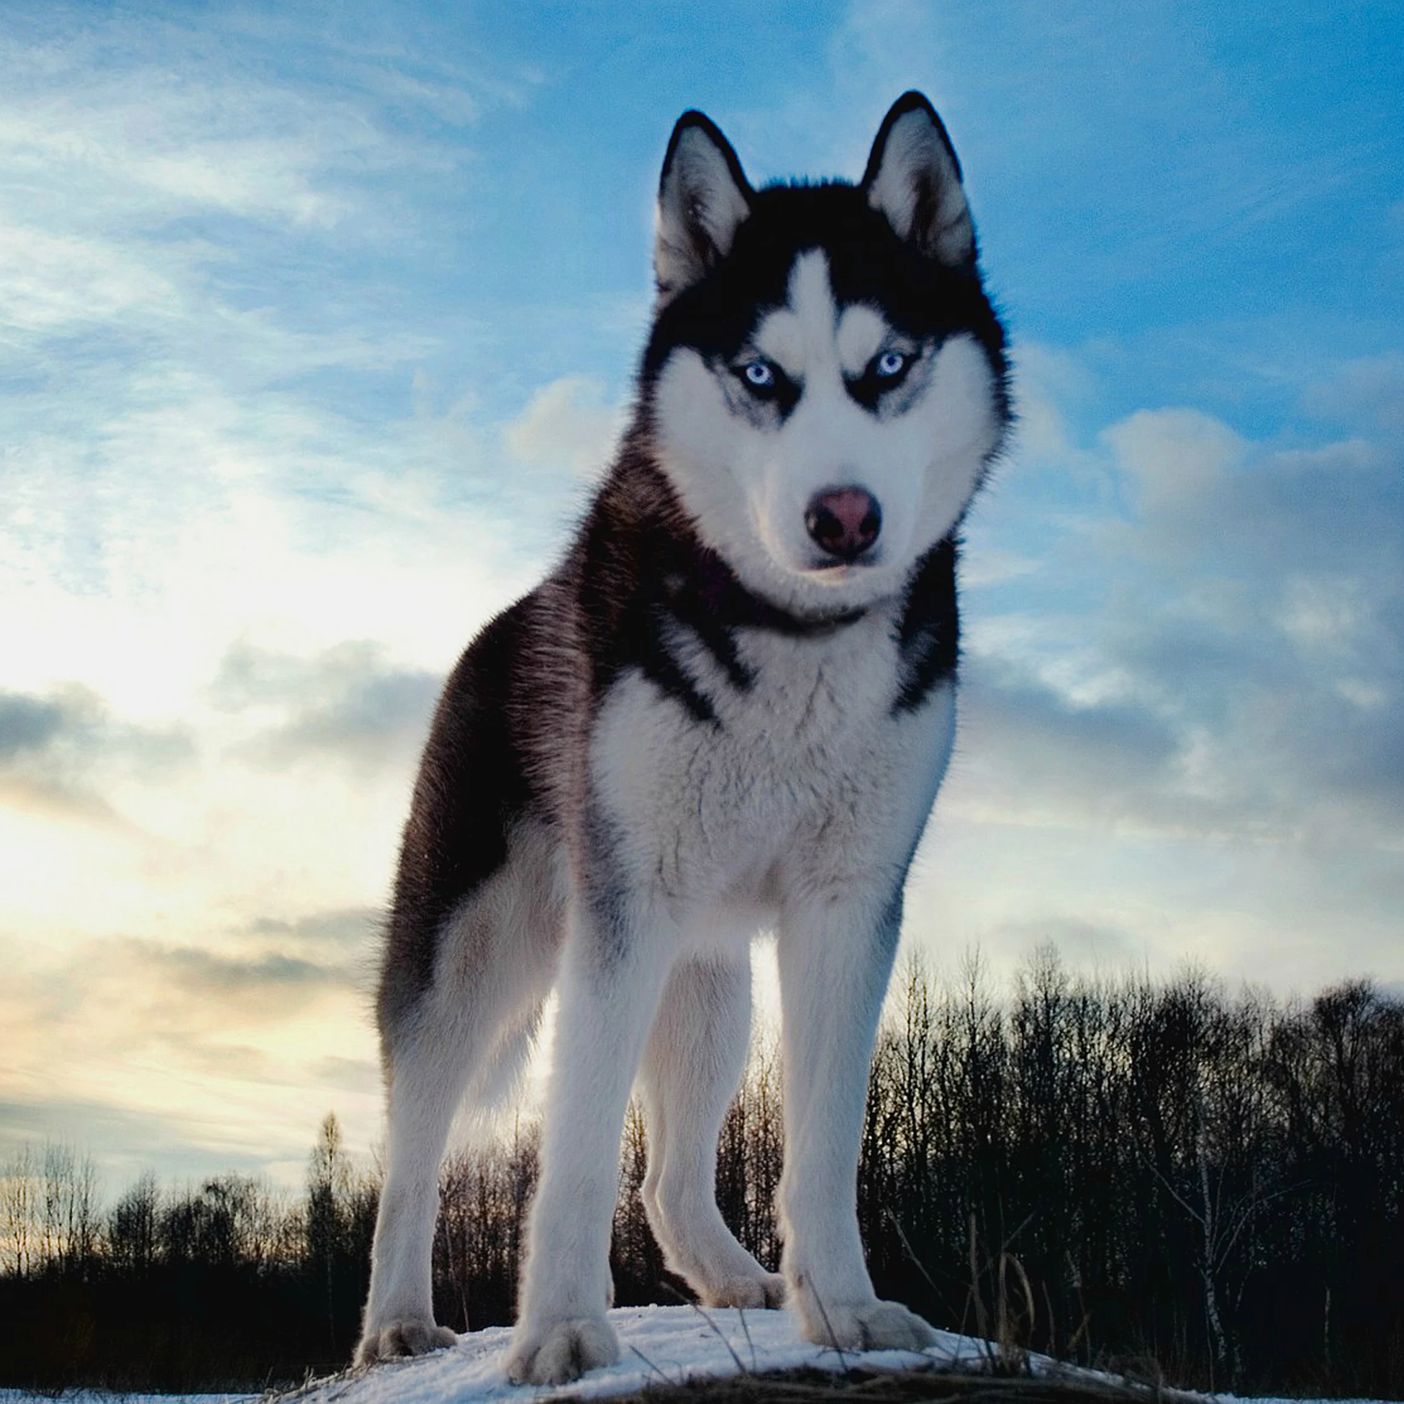
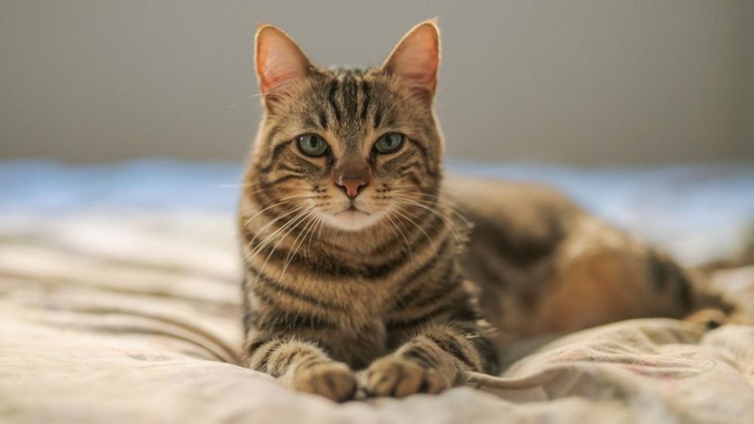

pictures
cat
dog

Slide 3
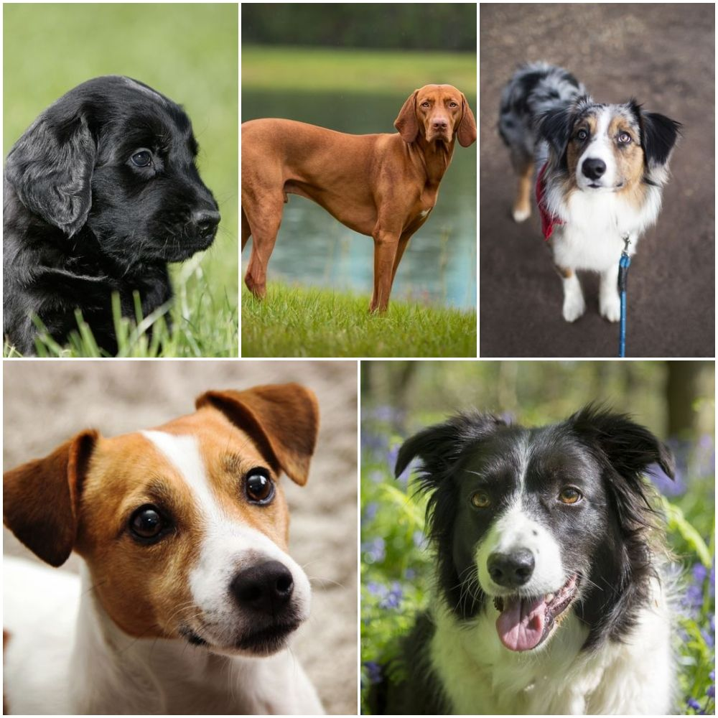
dogs

Slide 4
lockdown
People are getting dogs in lockdown thinking "oh this will be nice" but then they go back to work and they don’t have any time anymore and give them back. But they need to think before they do because dog shelters have had over 1000 calls to bring them back!
And people just get Puppy's not dogs, so now dogs they need homes.

Slide 5
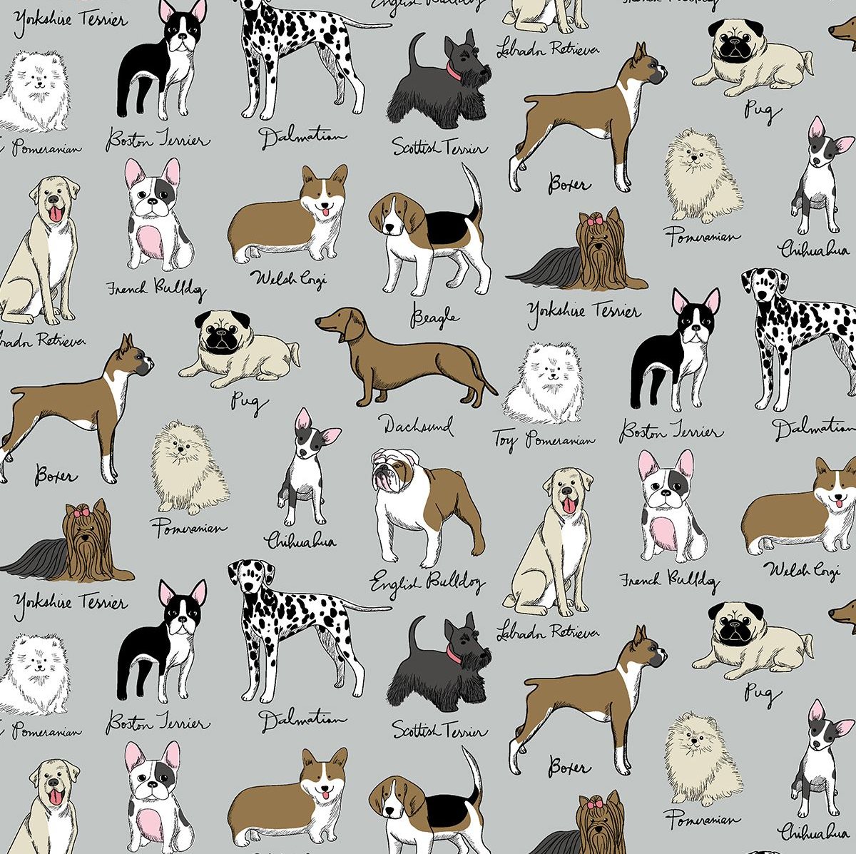
breeds
    There are hundreds of dog breeds in the world or more, so I'm going to tell you about some of the different types of dog.

Slide 6
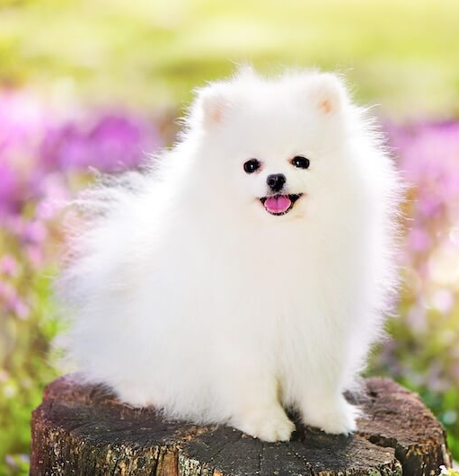
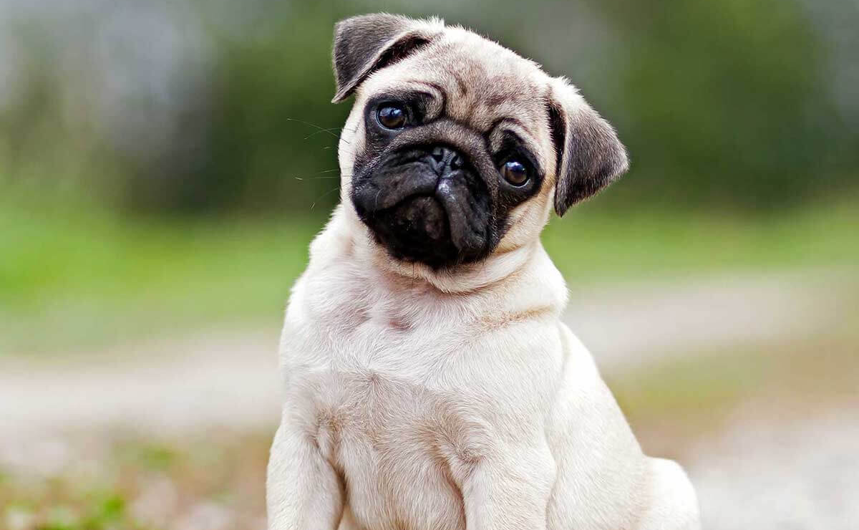
Pomeranians and pugs
The top one is a Pomeranian.
A pomeranians are aulso known as pom poms.
The bottem one is a pug.
A collective of pugs is called a grumble.
Pugs were breed to sit on the laps of Chinese Emperors.
Pugs sleep 14 hours a day.

Slide 7
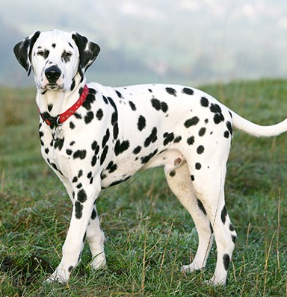
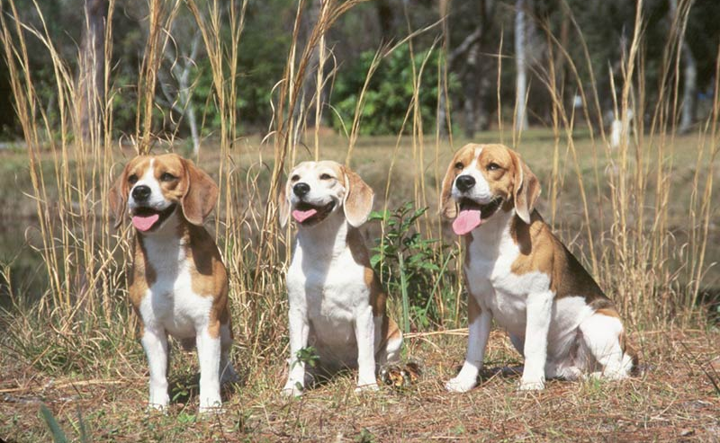
Dalmations and beagls.
The top one is a Dalmation.
Thay love horses.
They are born spotless.
The bottem one is a beagle.
Beagels were bred for hunting.
Beagles tails are like white flags.

Slide 8
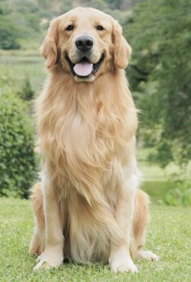
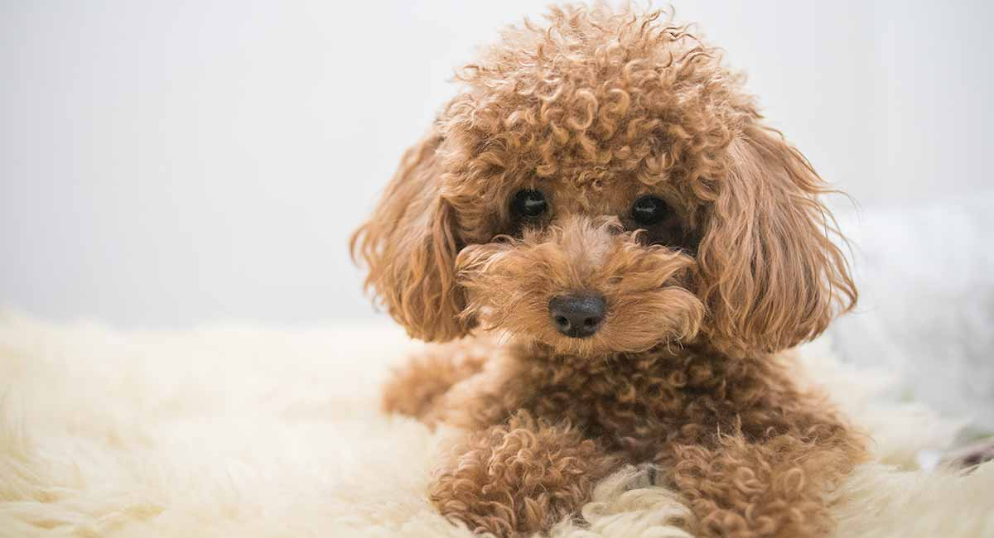
Poodles and golden retriever
The top one is a Golden Retiever.
There hard working breed.
They love to eat.
The bottom one is a poodle.
Poodles are great swimmers.
There from Germany.

Slide 9
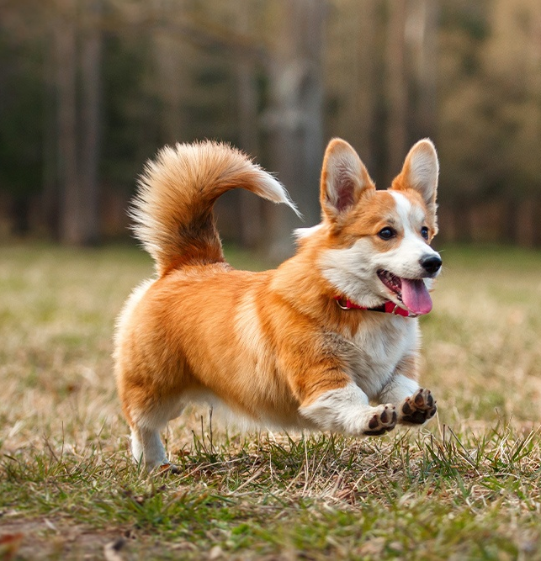
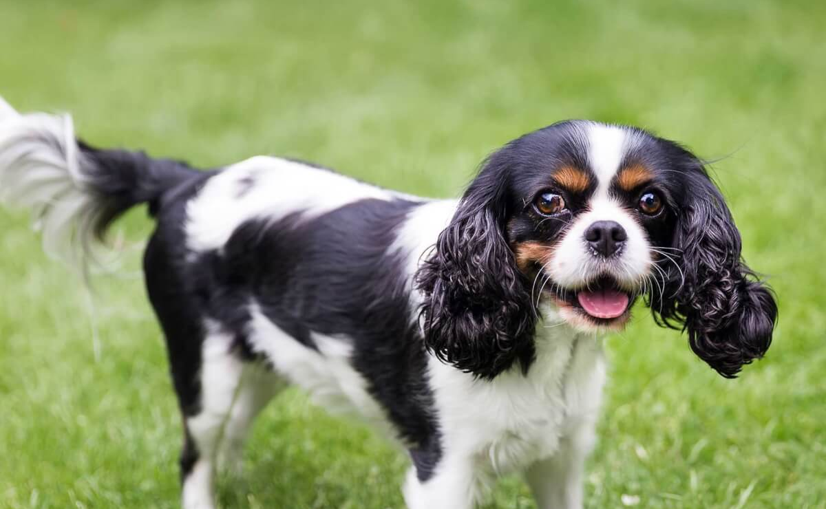
Spaniels and corgis
The top on is a Corgi.
Corgis are Royalty.
In welsh ''cor'' means dwarf and ''gi'' means dog.
The bottem one is a Spaniel.
They are gentel.
They live for about 9-14 years.

Slide 10
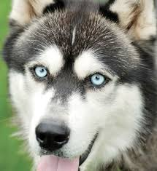
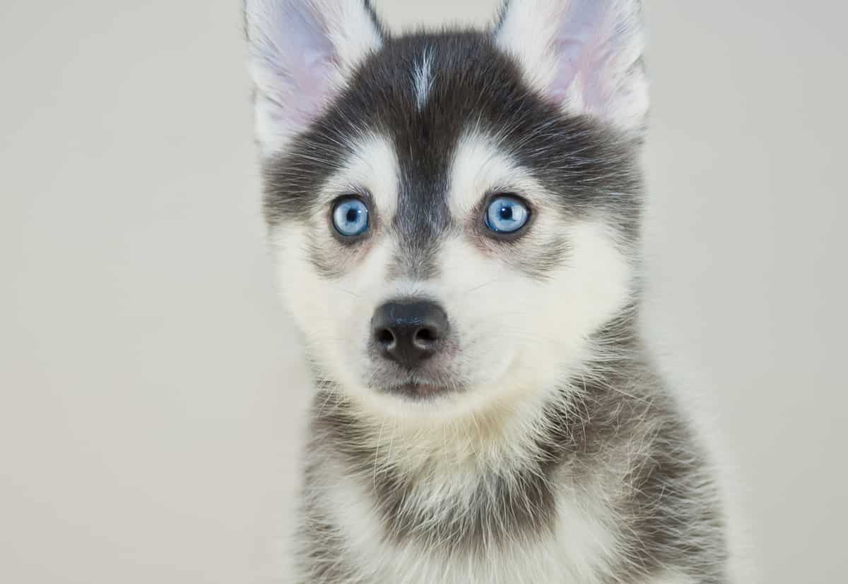
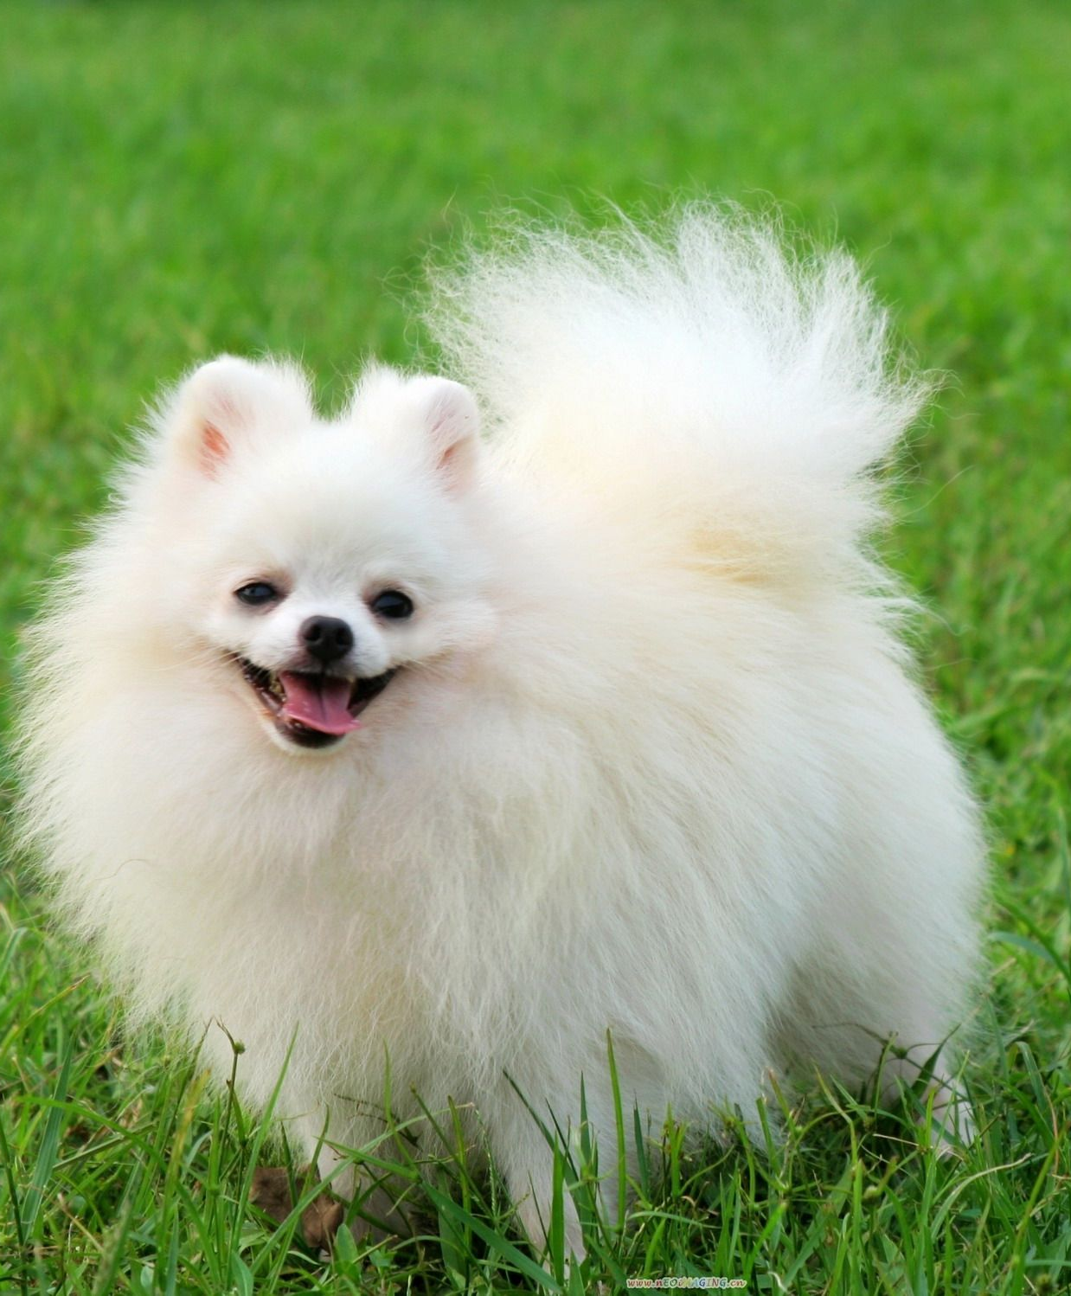
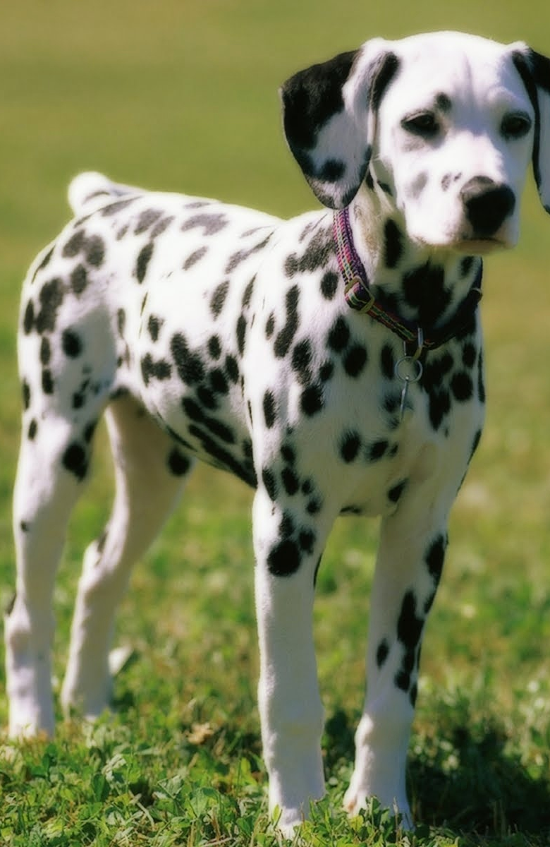
My favourite dogs
Top left husky.
Top right Pomsky (husky crossed between Pomeranian).
Bottom left Pomeranian.
Bottom right Dalmation.

Slide 11
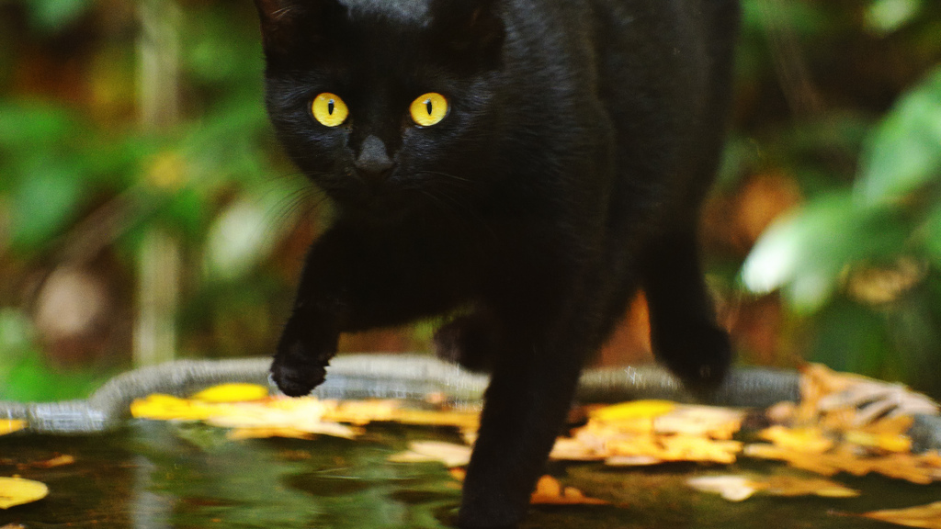
cats

Slide 12
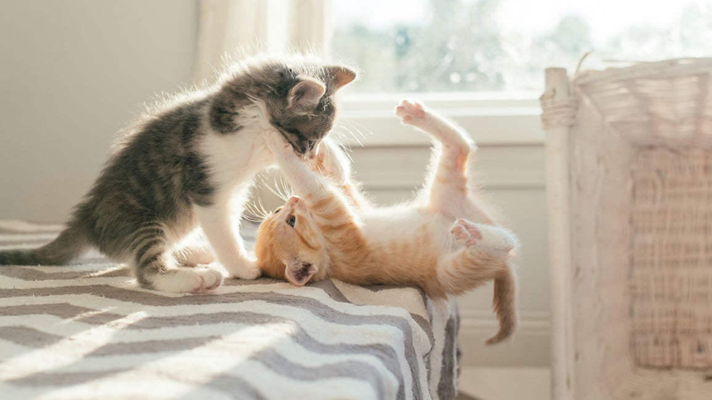
facts

Slide 13
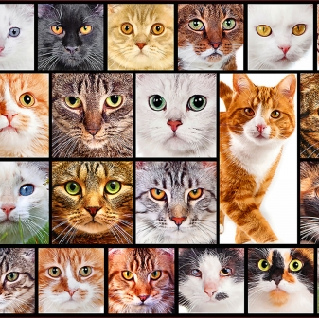
Facts about cats
1. Cats walk like Giraffe and Camels!
2. A house cat can reach speeds up to 30mph.
3. The oldest cat in the world was 38 years old.
4. In 1963 a cat went to space.
5. Cats spend 70% of their lives sleeping.
6. A cat was the Mayor of an Alaskn townfor 20 years!

Slide 14
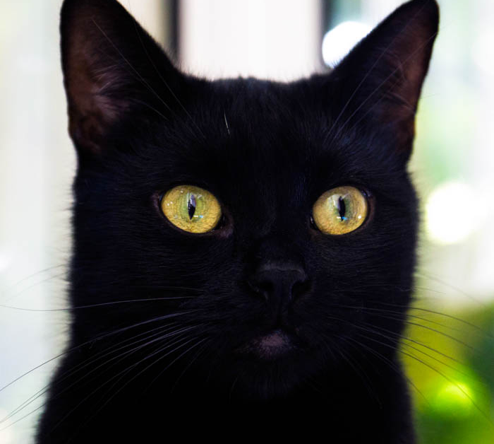
Cat racism
For some reason people don't want black cats because they are not good for Instagram pictures because they don't show up. And people think that they are witches cats.
Just because they are black doesn’t mean they are evil. think this is stupid and they are beautiful and the same as The rest of them I have one myself and she is my little baby girl her name is Pepper and she is very sweet.

Slide 15
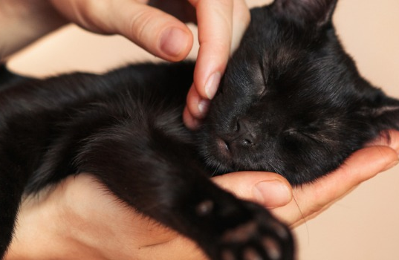
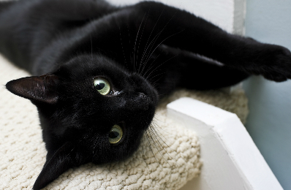
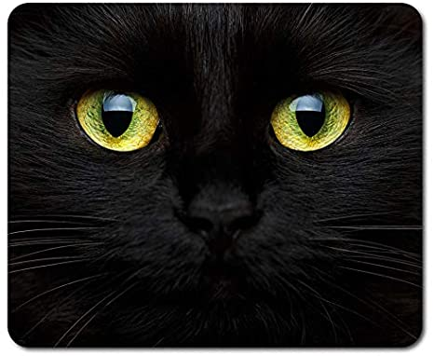
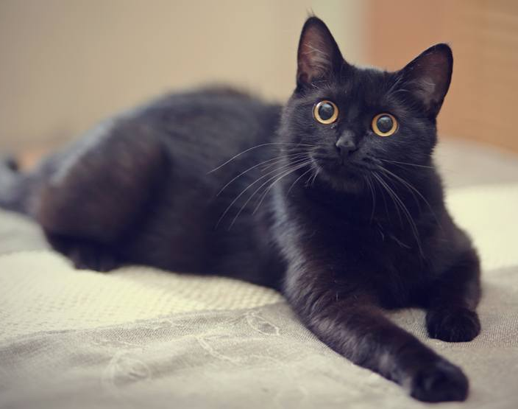
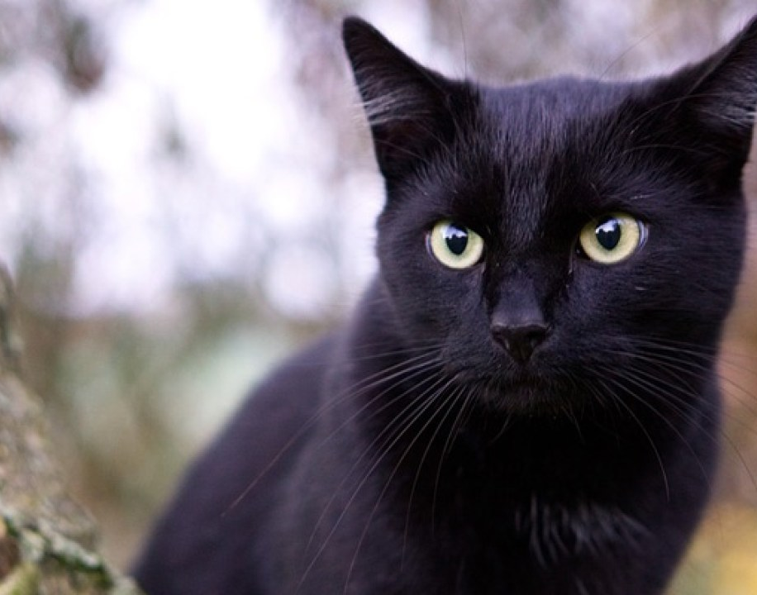

Slide 16
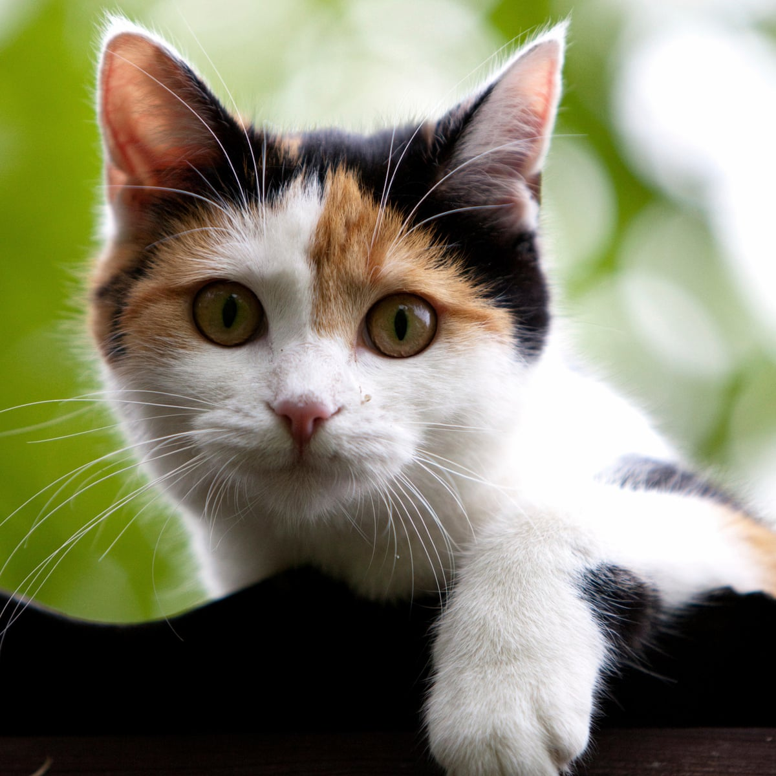
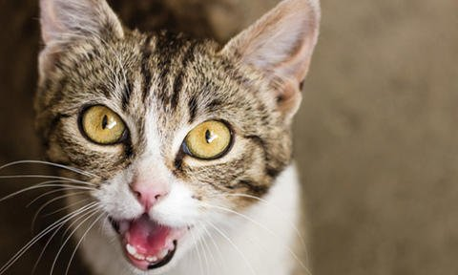
A cats favorite things
Cats love napping, and being groomed and grooming, they love their food, they like running water to drink from, they love to use their paws, they love play time, to sleep in the sun, climb and watch wildlife programs.

Slide 17
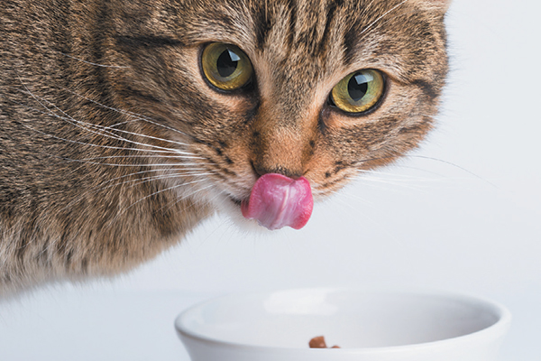
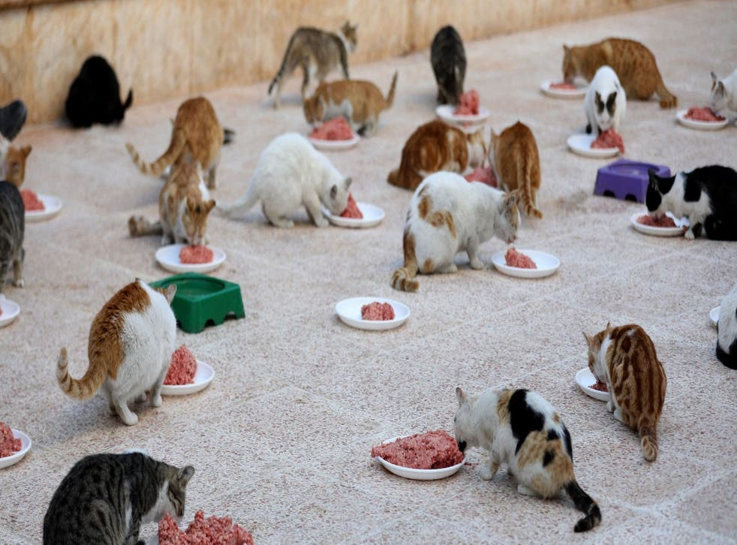
Diet
Cats are meat eaters, plain and simple. They have to have the protein from the meat.

Slide 18
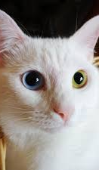
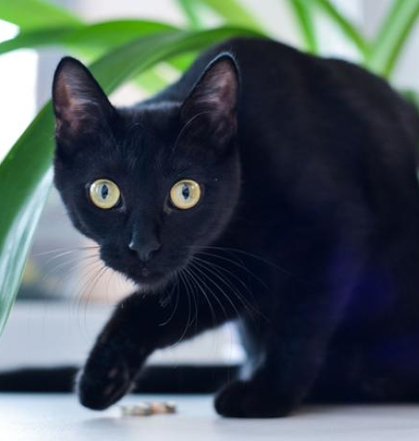
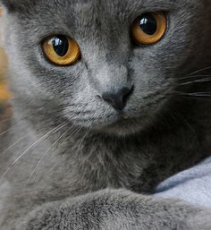
My favorite cats
I love all cats but these are some of my favorites the first one is a Black cat , the second one is a Russian Blue cat the last one is an Odd eyed cat.

Slide 19
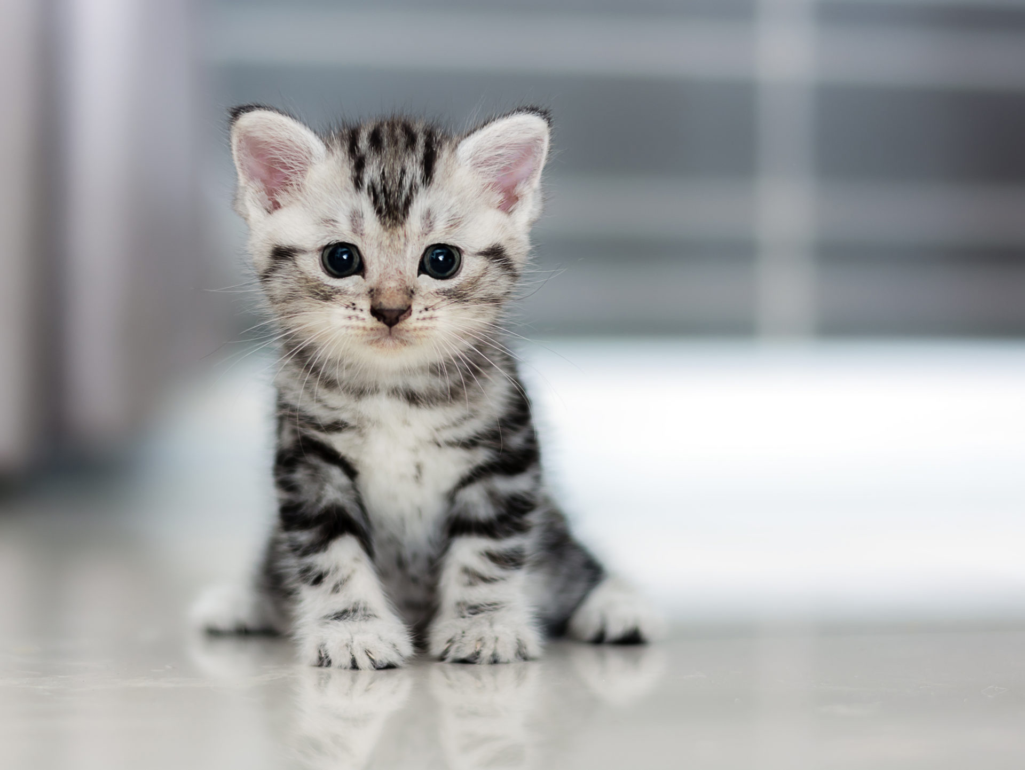
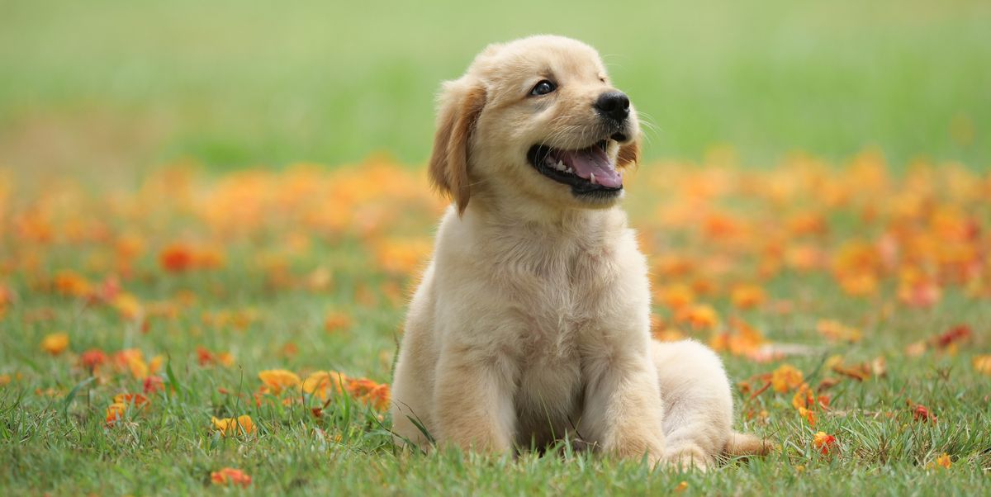
Which one?
Personally I love cats more because they are my Favorite animal ever I'm in love and obsessed.
cat
dog

Slide 20
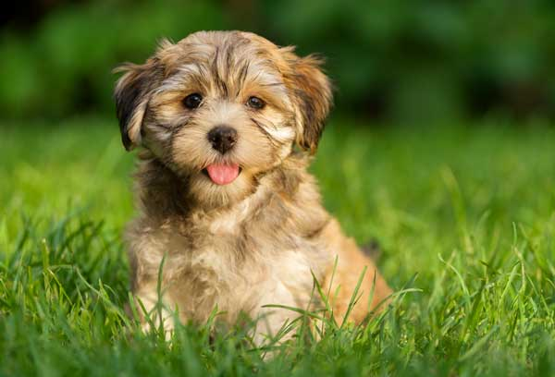
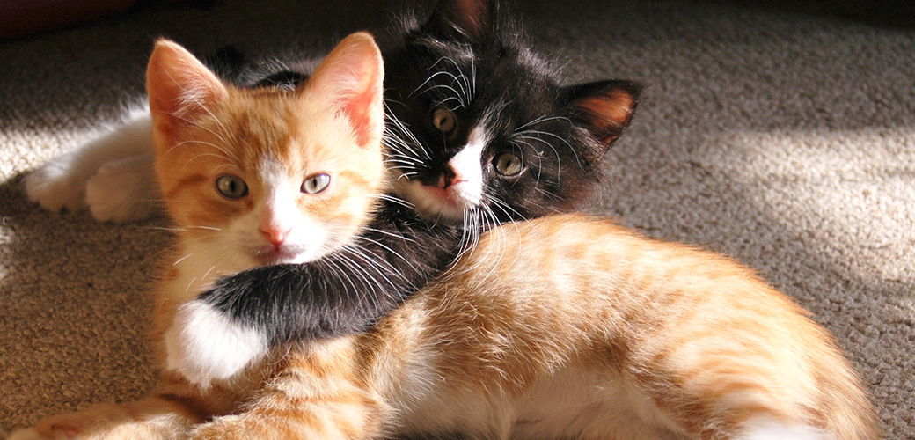
awww

