Slide 1


Slide 3



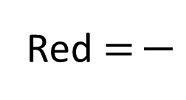

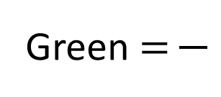
What fractions of the cubes are each colour?
Which of the fractions above are unit fractions?
Which of the fractions above are non-unit fractions?
Yellow $=$
Red $=$
Green $=$

Slide 4


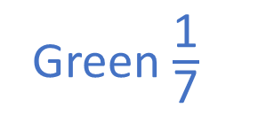
What fractions of the cubes are each colour?
Which of the fractions above are unit fractions?
Which of the fractions above are non-unit fractions?
4
2
1
Yellow $=$
Red $=$
Green $=$
7
7
7
Green $\frac{\text{1}}{\text{7}}$
Yellow $\frac{\text{4}}{\text{7}}$
Red $\frac{\text{2}}{\text{7}}$

Slide 6


What fraction is being represented?
Have a think
5
There are equal parts altogether.
out of equal parts is shaded.
of the shape is shaded.
This is a fraction.
1
5
$\frac{\text{1}}{\text{5}}$
unit

Slide 7

What fraction are shaded red?
Have a think
4
There are equal parts altogether.
out of equal parts are shaded red.
of the shapes are shaded red.
This is a fraction.
3
4
$\frac{\text{3}}{\text{4}}$
non-unit

Slide 8




Have a think
Which of these representations shows $\frac{\text{1}}{\text{4}}$? Why?

Slide 9
Have a go at questions
1 – 4 on the worksheet

Slide 10




0
1
2
3
4
5
$\frac{\text{1}}{\text{4}}$
$\frac{\text{2}}{\text{4}}$
$\frac{\text{3}}{\text{4}}$
0
1
$\frac{\text{4}}{\text{4}}$

Slide 11








Have a think
What fraction is the arrow pointing to?
$\frac{\text{3}}{\text{5}}$
0
1
Where would $\frac{\text{6}}{\text{7}}$ be on this number line?
$\frac{\text{1}}{\text{7}}$
$\frac{\text{2}}{\text{7}}$
$\frac{\text{3}}{\text{7}}$
$\frac{\text{4}}{\text{7}}$
$\frac{\text{5}}{\text{7}}$
$\frac{\text{6}}{\text{7}}$
0
1

Slide 12
Have a go at the rest of the worksheet

