Slide 1


Science
Animals Including Humans
Year One
Science | Year 4 | Animals Including Humans | Food Chains | Lesson 6

Slide 3
Aim
I can construct and interpret food chains
Success Criteria
I can order a simple food chain.
I can identify the producer, predator and prey.
I can interpret a variety of food chains.

Slide 4

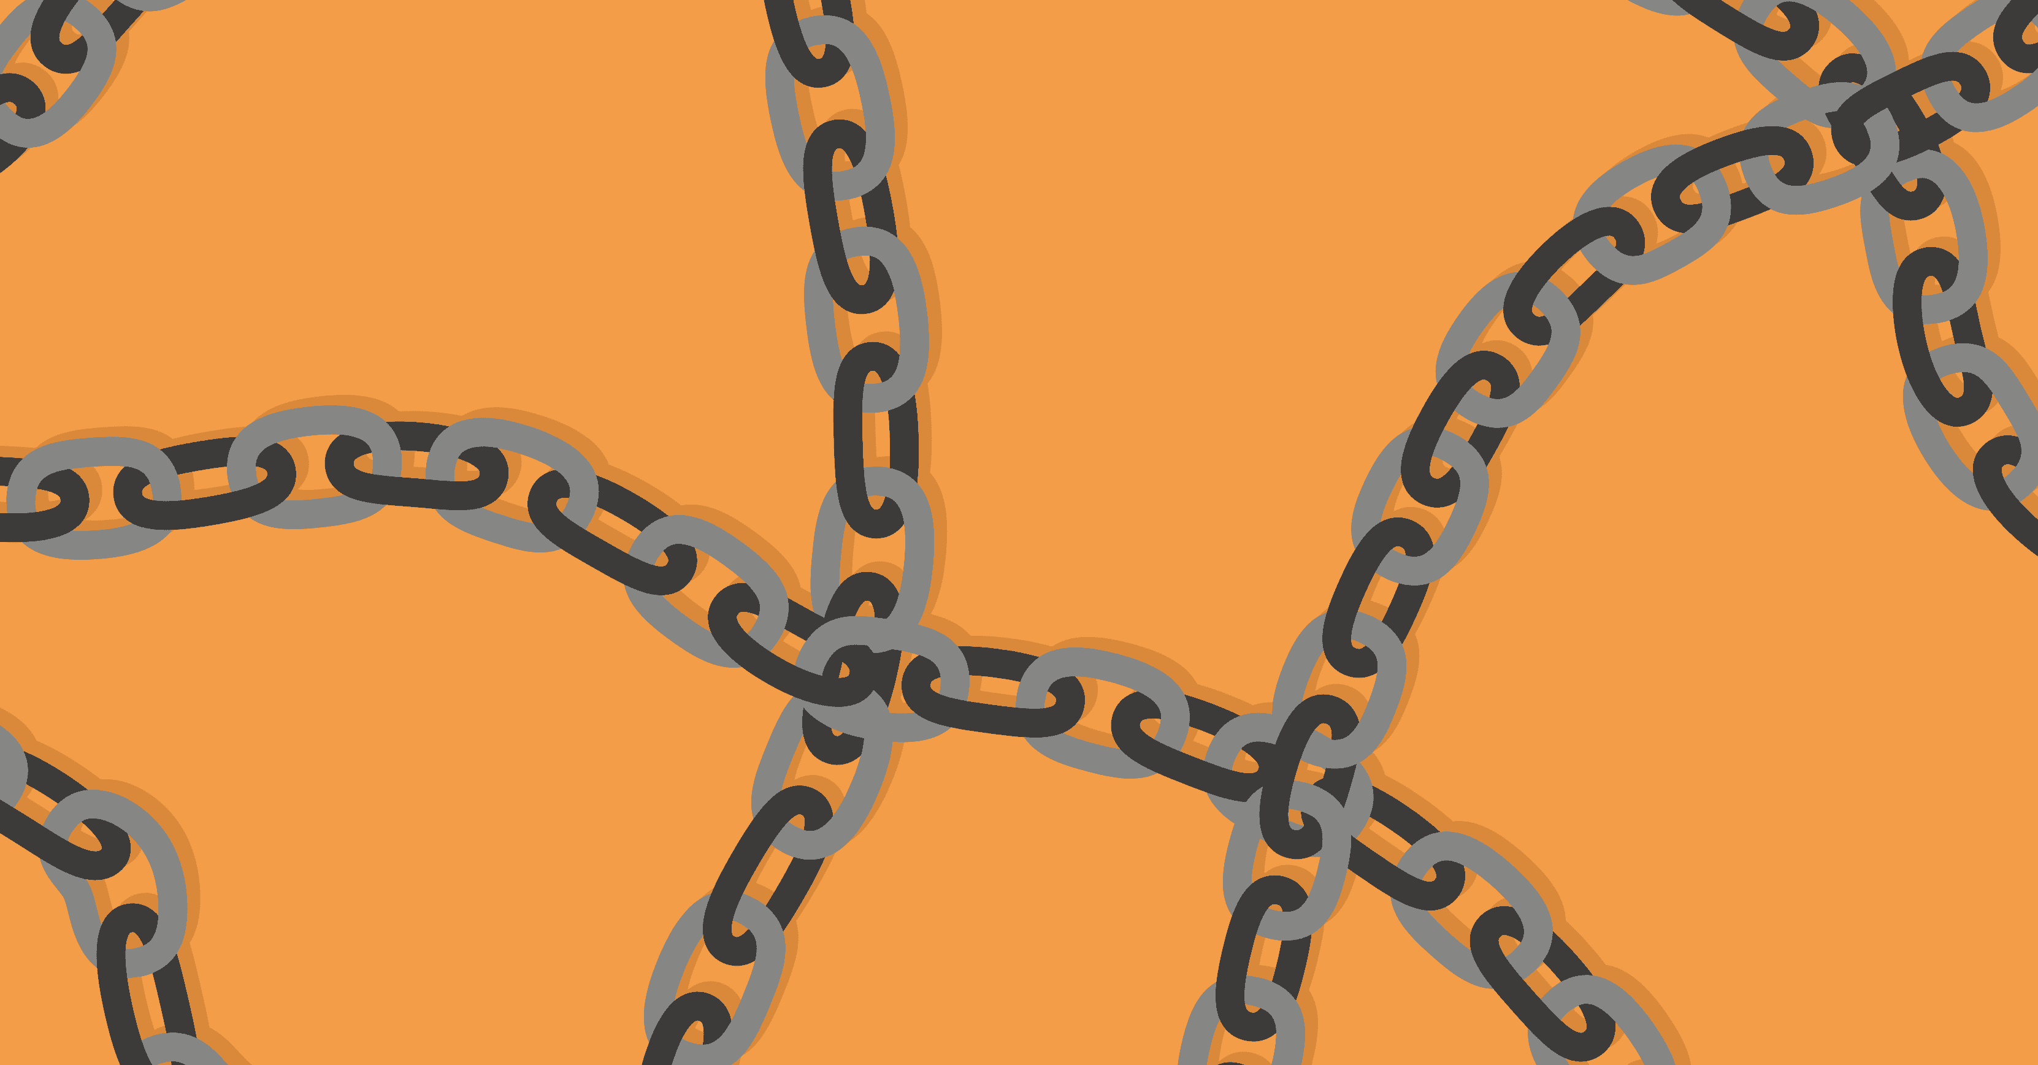
Food Chains
What is a food chain?
Now watch the following video clip and see if we can add to or refine our ideas.

Slide 5

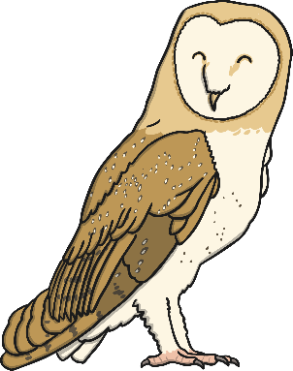
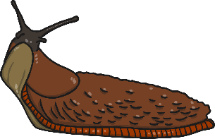
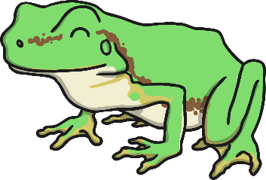
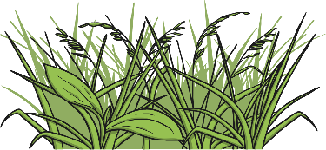
Interpreting Food Chains
How is this food chain constructed?
What do the arrows represent?
How should we label the different parts of the food chain?

Slide 6

Interpreting Food Chains
Match the words with their meanings.
Words | Meanings
Herbivores | An animal that eats plants.
Carnivores | An animal that eats other animals.
Omnivores | An animal that eats plants and animals.
Detritivores | An animal that eats decomposing plants and animals.
Producers/Autotrophs | Plants that produced their own food.
Consumers | Animals that eat plant or other animals.
Primary Consumer | An animal that eats plants.
Secondary Consumer | An animal that eats the primary consumer.
Tertiary Consumer | An animal that eats the secondary consumer.
Prey | An animal that is hunted for food.
Scavenger | An animal that eats dead animals.
Predators | An animal that kills for food.
Decomposer | An organism or bacteria that breaks down dead plants and animals into liquid for food.

Slide 7
Labelling Food Chains 1
Producer/Autotroph
Consumer
Consumer
Consumer
Primary Consumer
Secondary Consumer
Tertiary Consumer
Prey
Predator/Prey
Predator
Detritivore
Omnivore
Carnivore

Slide 8
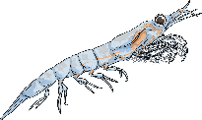
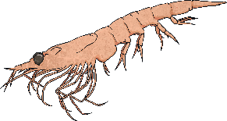
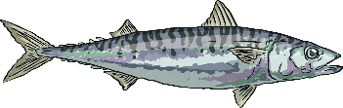
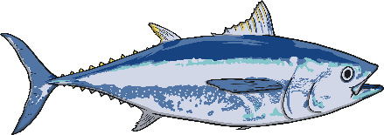
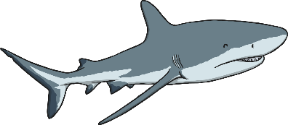
Labelling Food Chains 2
Here is a more complex example:
Producer/
Autotroph
Consumer
Consumer
Consumer
Consumer
Primary Consumer
Secondary Consumer
Tertiary Consumer
Quaternary Consumer
Prey
Predator/Prey
Predator/Prey
Predator/
Scavenger
Herbivore
Carnivore
Carnivore
Carnivore

Slide 9
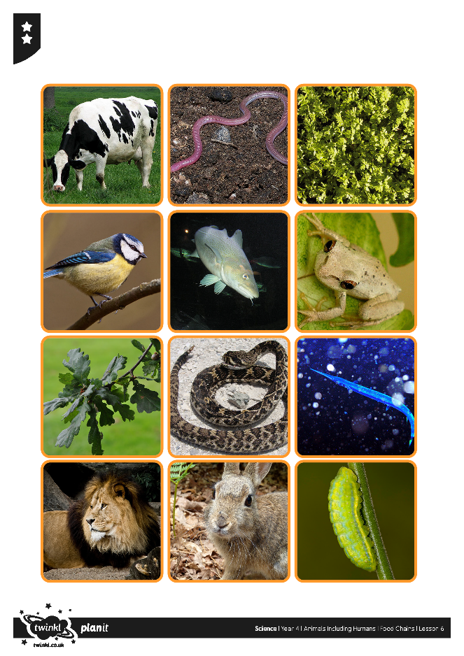
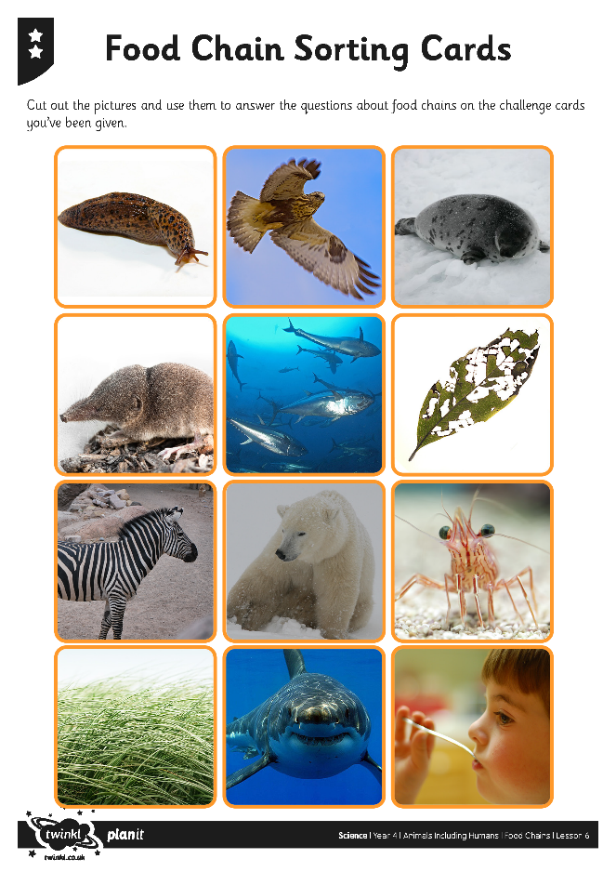
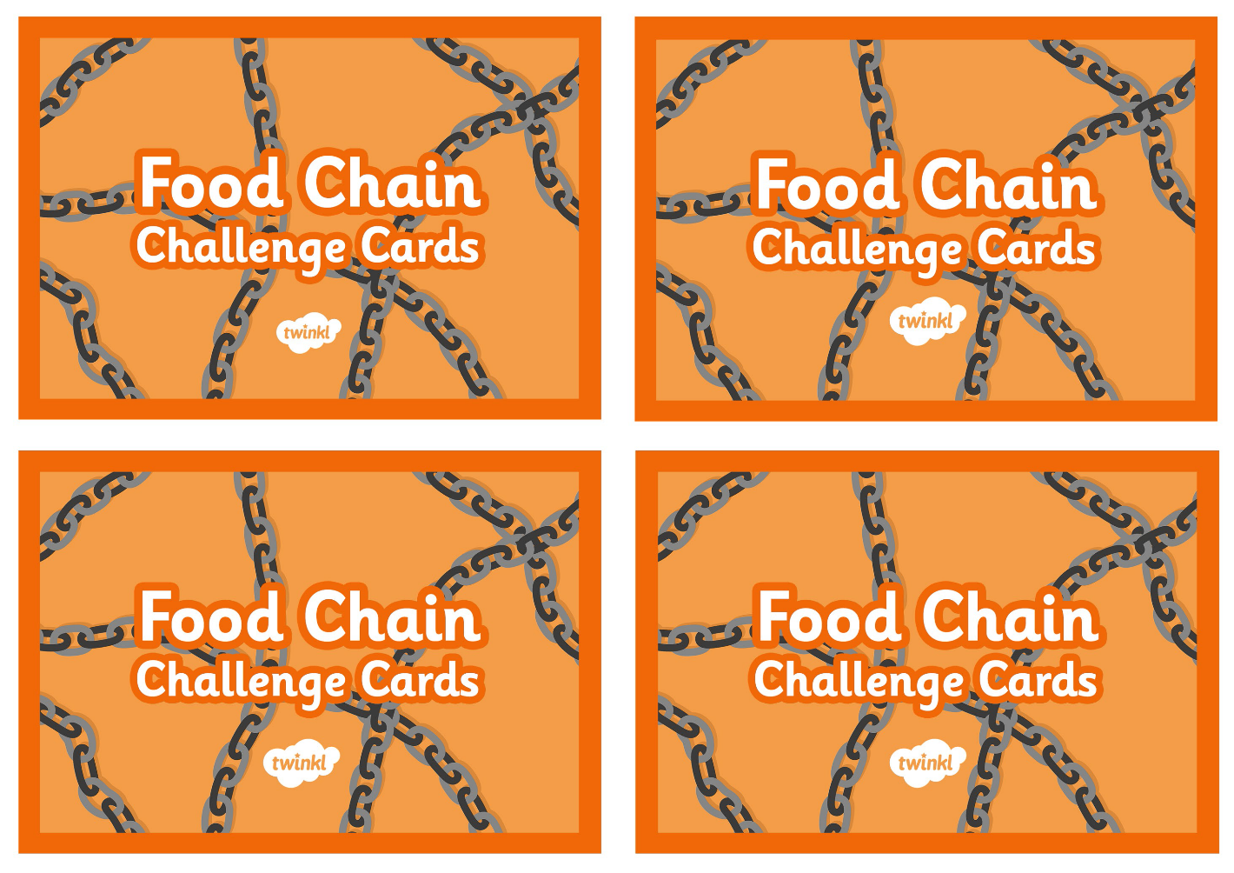
Food Chains Activity

Slide 10
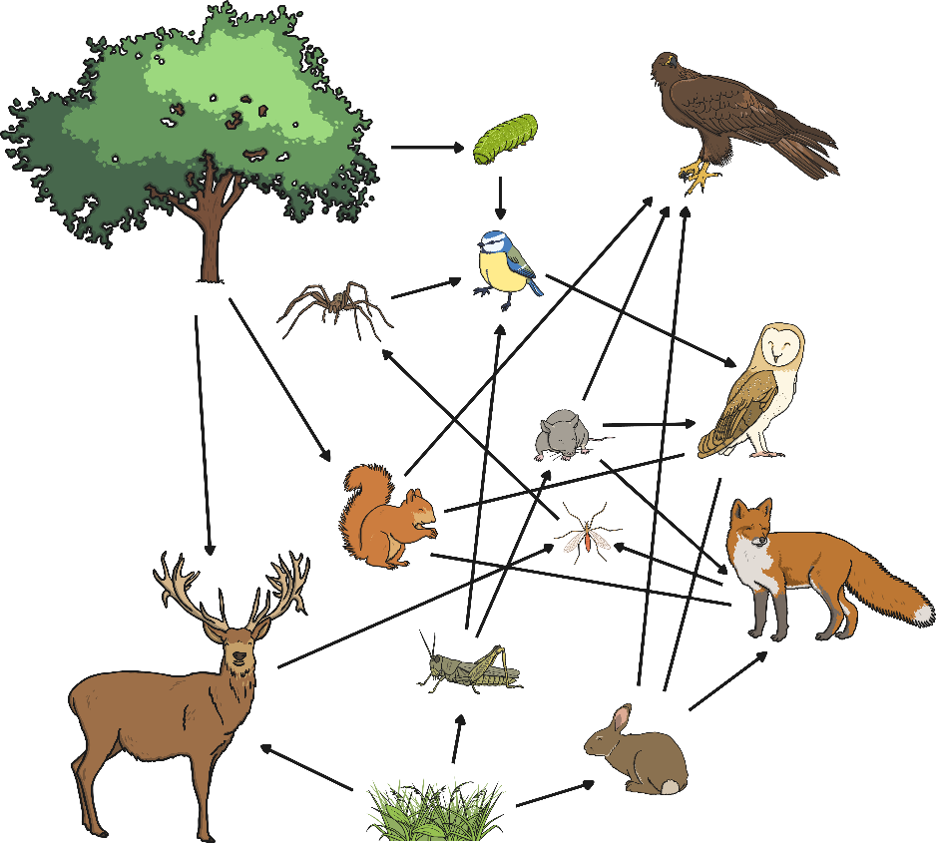




Interpreting Food Webs
How are food webs similar/different to
food chains?
When would it be better to
use a food chain?
When would a food
web be better?

Slide 11

Aim
I can construct and interpret food chains
Success Criteria
I can order a simple food chain.
I can identify the producer, predator and prey.
I can interpret a variety of food chains.

