Slide 1


Science
Animals Including Humans
Year One
Science | Year 4 | Animals Including Humans | Tooth Decay Enquiry Part 1 | Lesson 4

Slide 2
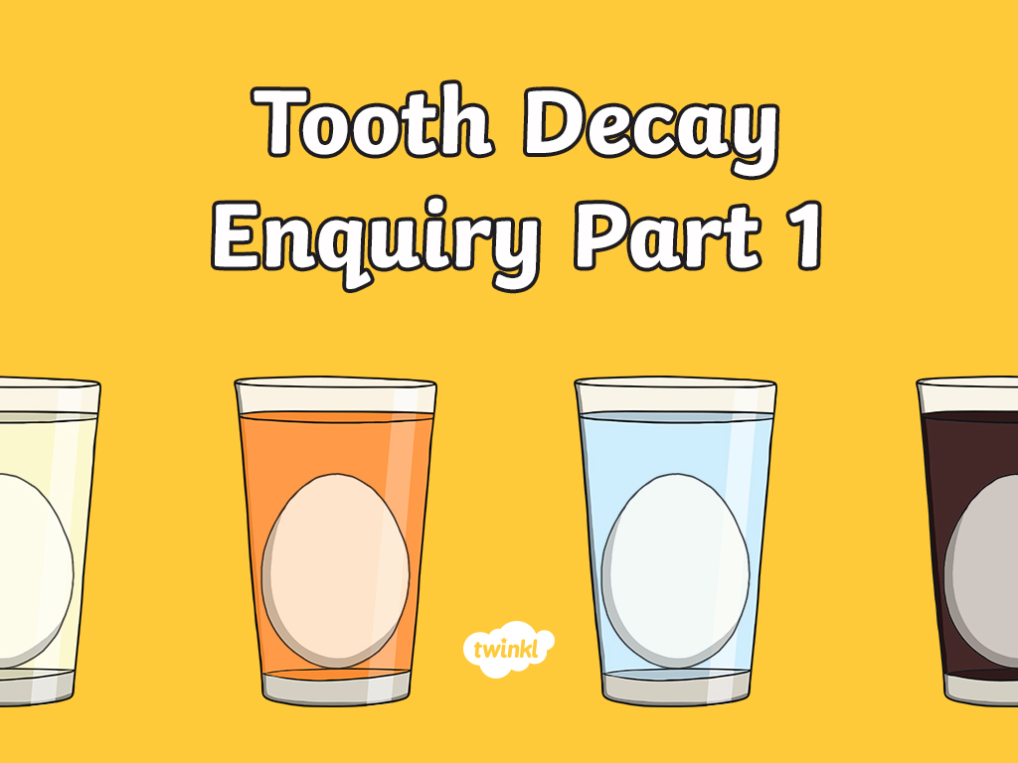

Slide 3
Aim
I can ask scientific questions and choose a scientific enquiry to answer them.
I can create an enquiry or test.
Success Criteria
I can generate questions.
I can generate relevant scientific questions.
I can suggest an appropriate type of scientific enquiry to answer
my question.
I can set up a simple enquiry with support.
I can make predictions and suggest equipment.
I can give clear instructions to perform a test.

Slide 4

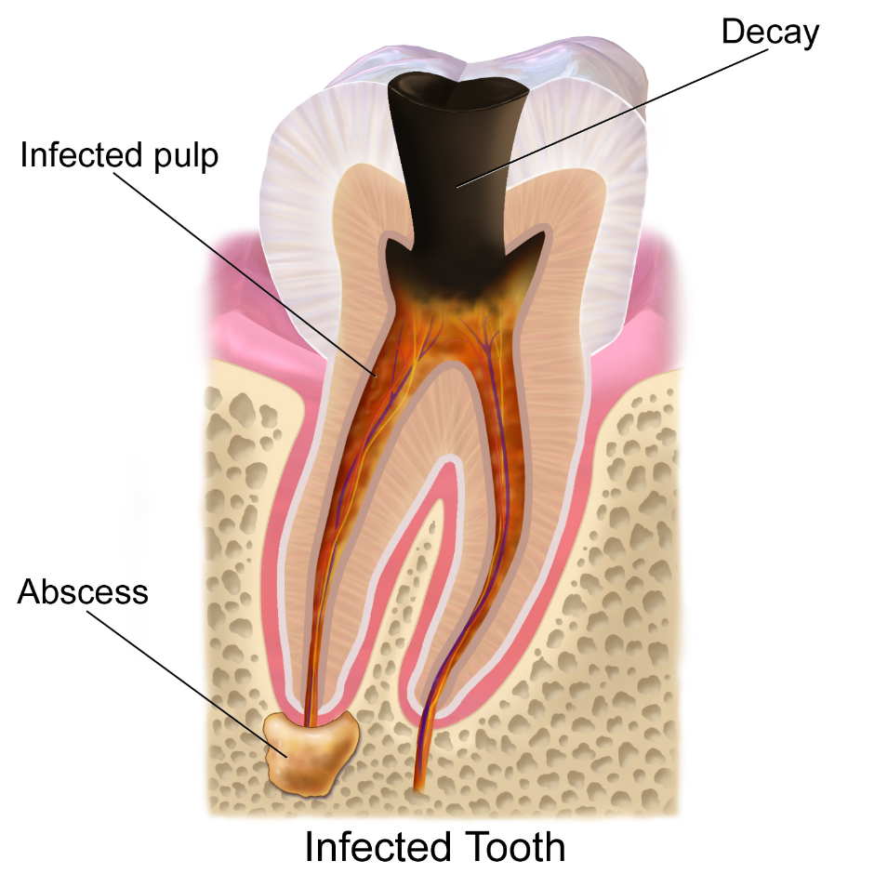
Tooth Decay
Try and answer the following questions:
What is
tooth decay?
What causes
tooth decay?
Image courtesy of BruceBlaus (@Wikipedia.com) - granted under creative commons licence – attribution

Slide 5

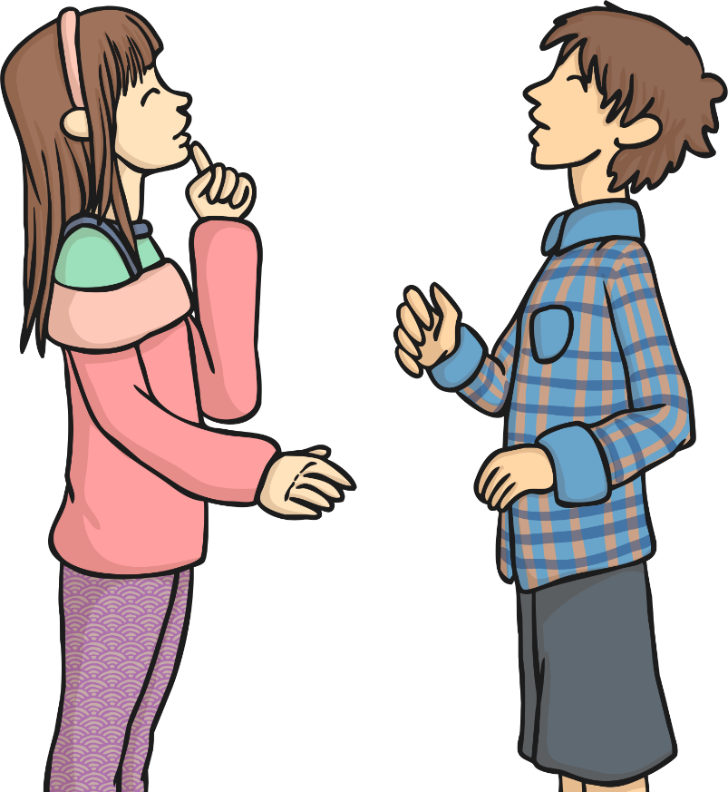
Questions!
Scientific Enquiry
Why do scientists
ask questions?
Why do they carry out enquiries and tests?

Slide 6
Scientific or Not?
Categorise the questions based on whether they are scientific questions that can be tested or whether they are non-scientific questions:
Scientific Questions | Non-Scientific Questions
Does eating fruit keep you healthy?
How much sleep do rabbits need?
What time is dinner?
Does water always boil when heated?
Can you open the lid?
When should I do my homework?
Does sound travel through walls?
Do plants need soil to grow?

Slide 7
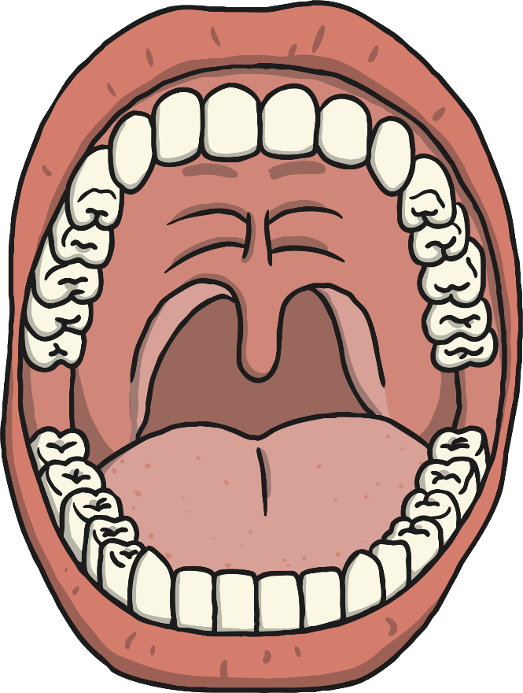
Creating Scientific Questions
The question we would like to find the answer to is:
Do different drinks affect our teeth?
Have a think about how you could create a scientific experiment to answer this question?
Write down your ideas for this experiment. What would you need? How would you carry it out? What would you predict?
?

Slide 8



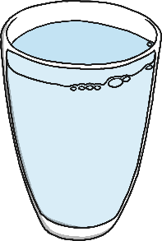
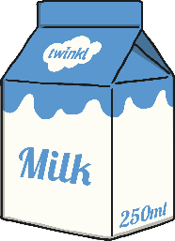
Experiment Time
You may want to carry out the experiment you have just planned or you may prefer to watch the following video https://www.arcticdental.com/tooth-decay-egg-experiment-for-kids/ to give you another idea (only watch Part 1).
Now it’s your turn…
Ask an adult at home if they could help you set up your own experiment. What drinks are you going to use? What are you going to use instead of real teeth. How long are you going to leave them for?

Slide 9

Aim
I can ask scientific questions and choose a scientific enquiry to answer them.
I can create an enquiry or test.
Success Criteria
I can generate questions.
I can generate relevant scientific questions.
I can suggest an appropriate type of scientific enquiry to answer my question.
I can set up a simple enquiry with support.
I can make predictions and suggest equipment.
I can give clear instructions to perform a test.

Slide 10


