Slide 1
English
Discussion Texts – A balanced argument
First of 3 lessons – to ensure mastery of the text type.

Slide 2
Discussion – A balanced argument
Be proud of your learning (Ambition).
Why is it so important to revisit prior learning (Last week’s focus)?
Post-it note challenge: You have 3 minutes to write down the features of a discussion text.
Feedback/Share class check list/Why do we need a writing check list?
The success of our writing will be judged against this.
Spiral teaching - In Yr5 you will write a one sided persuasive piece.
How is our text going to be organised?

Slide 3
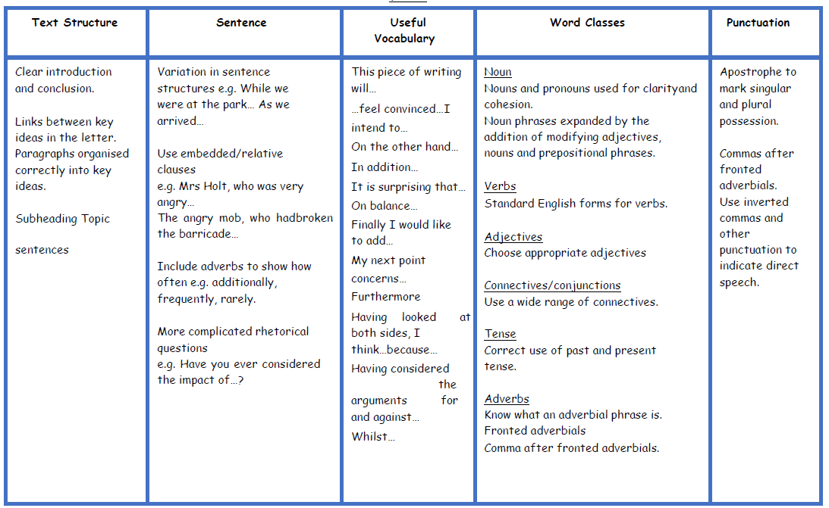

Slide 4
Discussion – a balanced argument
Your writing will be on the laptop and saved in a folder on student share titled School Swimming.
Writing title:
Should our school take children to learn how to swim?
Introductory paragraph should :
Tell the reader what swimming is.
Why it is an important activity but why it may not be a good activity to do at school.
This balanced argument will discuss if (relate to title)…
Include a rhetorical question.

Slide 5
Writing Portfolio objective
Peer assessment opportunity - To be able to suggest improvements.
Tell the reader what swimming is.
Why it is an important activity but why it may not be a good activity to do at school.
This balanced argument will discuss if (relate to title)…
Include a rhetorical question.
Grammar
Composition
Spellings

Slide 6
Discussion – a balanced argument
Thinking hats:
Positives
Negatives

Slide 7
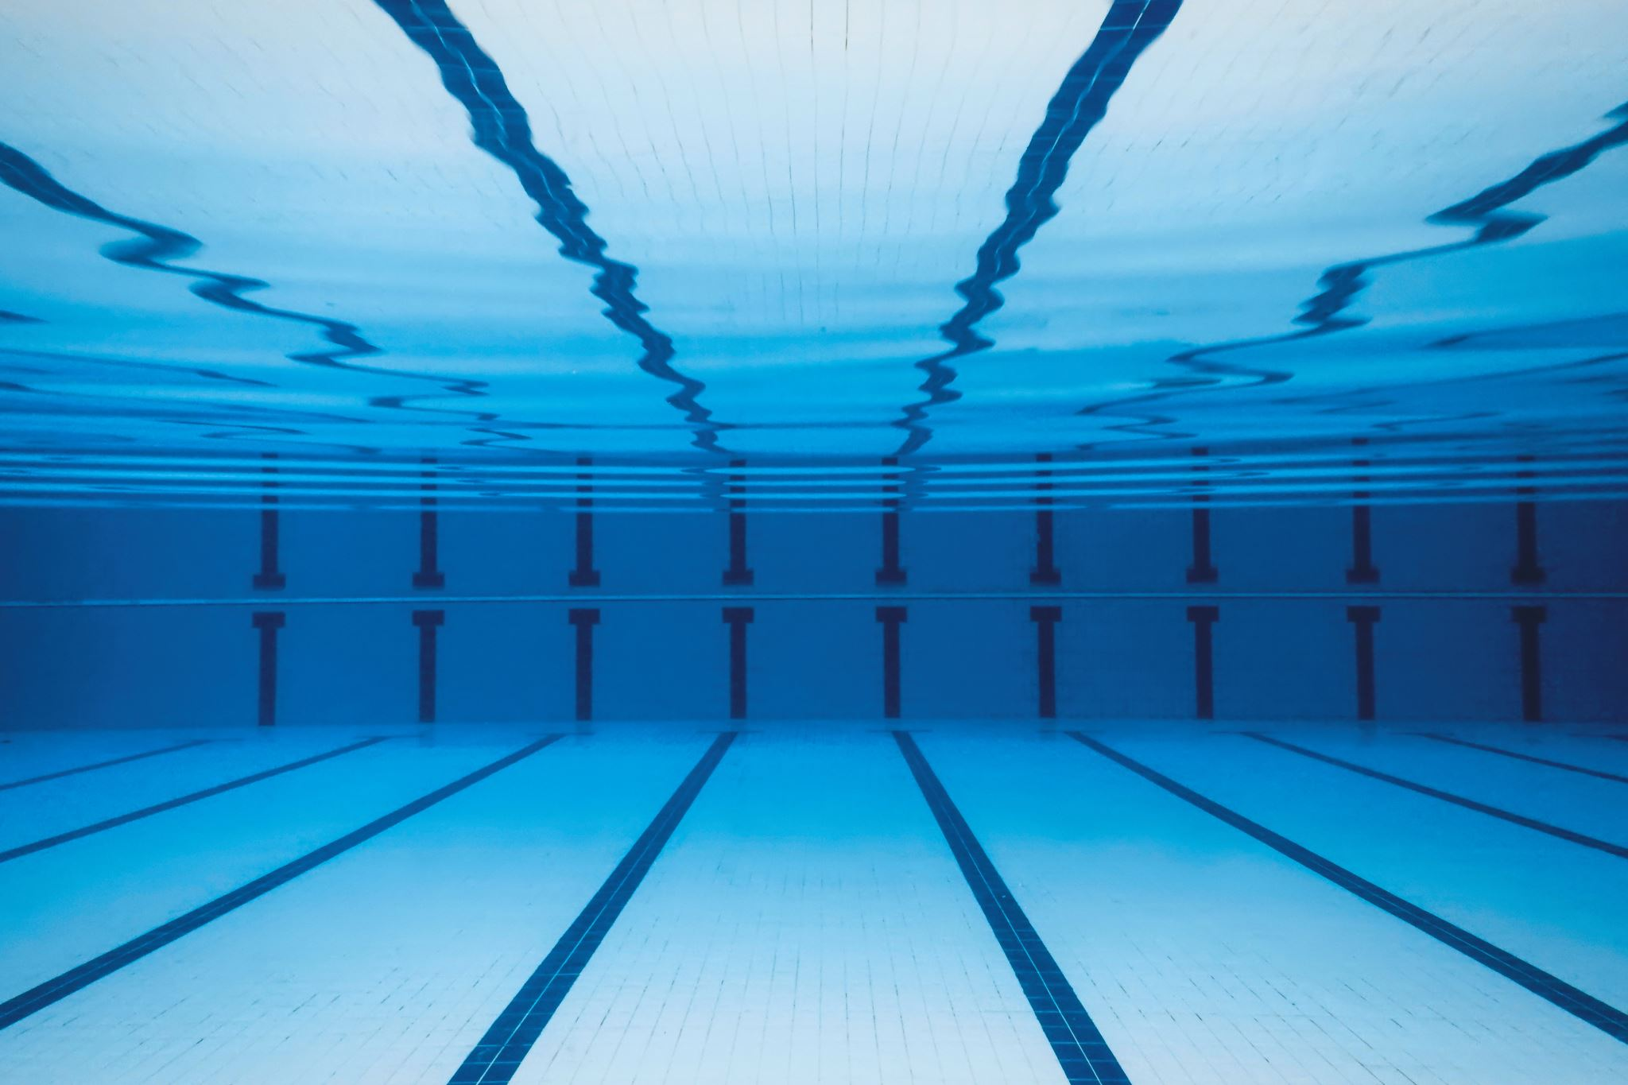
What are the positives connected to school swimming?

Slide 8
Quotes/Facts/Positives
Swimming is the only sport which can save your life.
The Institute of Swimming say, ‘23% of children leave primary school unable to swim 25m unaided. For some children, if they don’t learn to swim at school they may never learn.’
Child A, ‘ We can’t always afford to go swimming so I feel really lucky that I get to go with my school.’
Parent A, ‘We find it difficult to find the time to take out children swimming so it’s great that they get to go with school.’
Swimming lessons don’t just teach kids water safety skills, they can also boost their physical and mental wellbeing, as well as allow them to socialise and build their confidence, both in and out of the water.

Slide 9
Write 1 or 2 Paragraphs
Sentence openers (P1)– One of the main arguments for school swimming is…
Some people think that …
It is a fact that …
Evidence suggests that …
Sentence openers – Adverbials (P2)- Additionally,
Moreover,
Furthermore,

Slide 10
What are the negatives connected to school swimming?

Slide 11
Quotes/Facts/Negatives
Children miss out on having a playtime.
Children miss other subject learning time.
Children may have increased anxiety at school prior to going swimming.
Child B, ‘I don’t like the pool we swim at with school as the chlorine hurts my eyes.’
Some children find school swimming challenging because it can be noisy at the pool.

Slide 12
Write 1 or 2 Paragraphs
Sentence openers (P1)– One of the main arguments against school swimming is…
Some people think that …
It is a fact that …
Evidence suggests that …
Sentence openers (P2)- Additionally,
Moreover,
Furthermore,

Slide 13
Day 2/3
Continue with your balanced argument.
On completion peer assess and against writing genre criteria.

Slide 14
What is your personal opinion?
In your final paragraph what will you leave the reader to thinks about?

