Slide 1
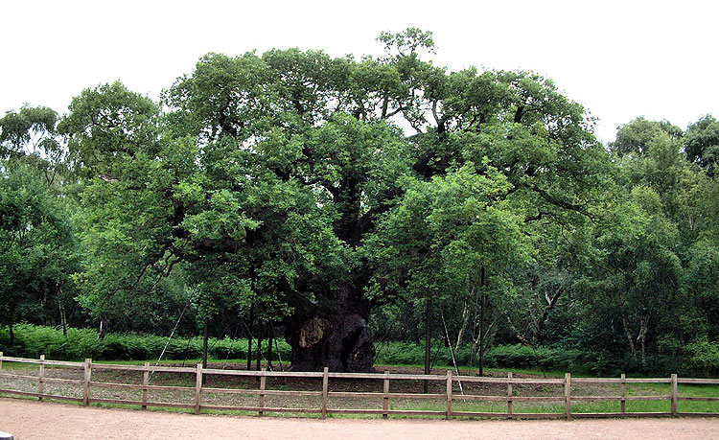
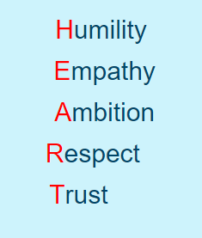
Welcome to Class Sherwood
Achievement for all

Slide 2
Class Organisation
Mr. Gillett (Class Teacher/PP/Assessment/Maths/Computing)
Mrs. Somerville classroom T.A and P.P.A. cover – Weds afternoon.
Daily routines virtually identical to Year 3 so ease of transition. Key stage 2 as two journeys – Lower and Upper.
Water and healthy snacks (nut free) allowed (try to encourage fruit and veg).
Communication links – Parent Mail and School Web –Page and email.
Thank you certificate assembly on a Friday (Parent Mail sent out on a Thursday evening).

Slide 3
Behaviour
Strong systems already in place – high expectations of all.
All Hallows’ Values HEART – Humility, Empathy, Ambition, Respect and Trust. Potential to move pictures up and earn 5 house points – Pmail home + reward sessions.
Restorative questioning at playtime, yellow, red cards as outlined in the organiser.

Slide 4
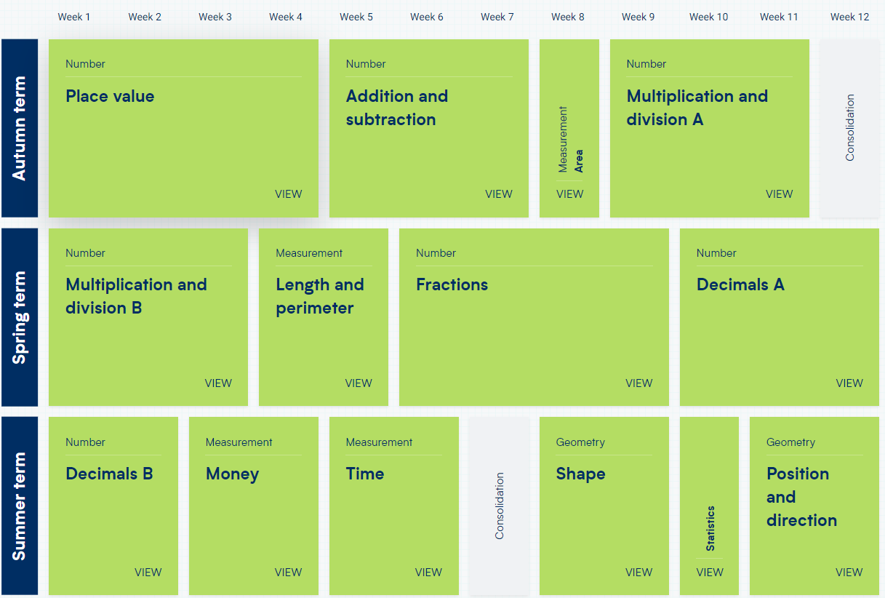
Maths
Shown below is a broad coverage plan for the whole of year 4.

Slide 5
Number - number and place value
Pupils should be taught to:
count in multiples of 6, 7, 9, 25 and 1,000
find 1,000 more or less than a given number
count backwards through 0 to include negative numbers
recognise the place value of each digit in a four-digit number (1,000s, 100s, 10s, and 1s)
order and compare numbers beyond 1,000
identify, represent and estimate numbers using different representations
round any number to the nearest 10, 100 or 1,000
solve number and practical problems that involve all of the above and with increasingly large positive numbers
read Roman numerals to 100 (I to C) and know that over time, the numeral system changed to include the concept of 0 and place value
New White Rose work books used alongside a Journal.

Slide 6
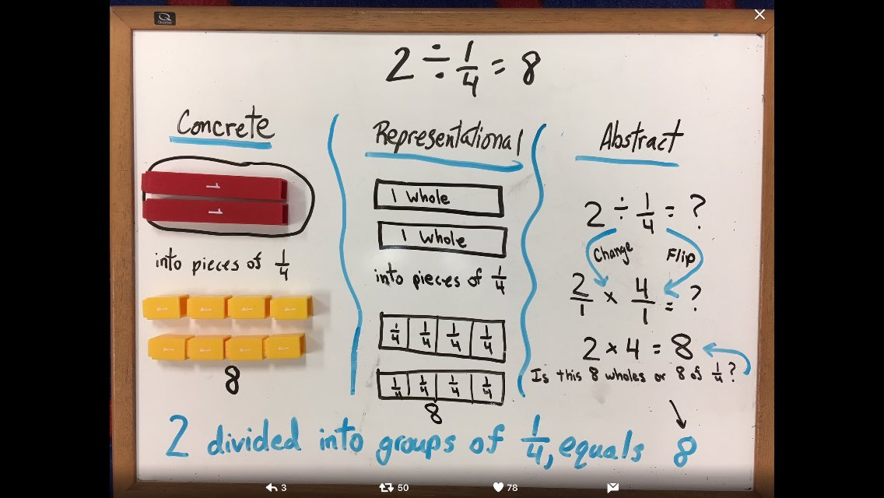
CPA – Concrete, Pictorial and Abstract

Slide 7
Maths : KIRFs (Key Instant Recall Facts)
Cognitive Load Theory
A new KIRF focus each half-term.
To help develop children’s fluency in mathematics, we ask them to learn Key Instant Recall Facts each half term. We expect children to practise their KIRFs at least 3 times a week.
Top tip: Little and often

Slide 8
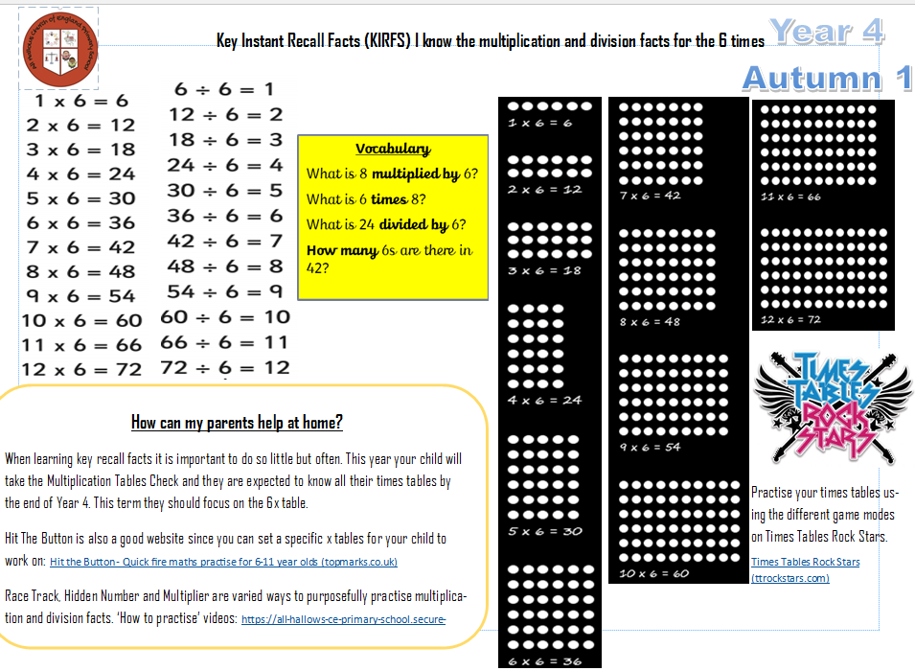
How can you help…

Slide 9
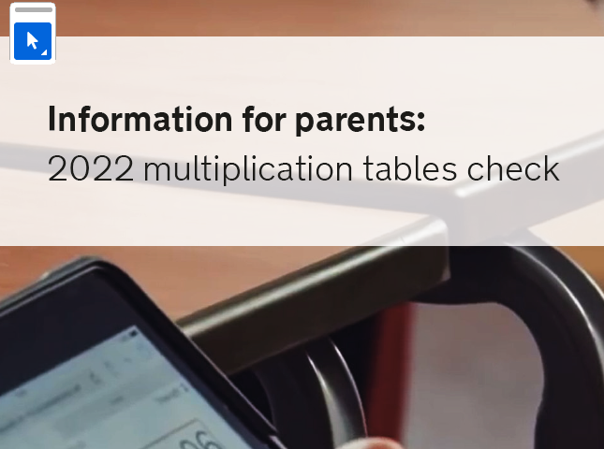
Maths MTC
The government have introduced an Multiplication Tables Checker (MTC) to be taken online and in school in June. The expectation is for rapid recall (within 6 seconds) any multiplication fact up to 12 x 12 = 144.
Please continue to use TT RockStar for continued practise.
Written methods (algorithms are more efficient than previous year) for the four operations will evolve.

Slide 10
English Reading
Reading is the rocket fuel for improving vocabulary.
Fluency, rate and understanding.
Reading in school takes the form of guided sessions, one to one and whole class.
Outside of school is so important.
Particularly important to discuss texts.
Library Cards – Bronze, Silver and Gold checked in school organiser on a Friday (Individua and Class Prizes). Reading to a sibling, listening to a story/podcast, find a series they enjoy.
Exposure to a range of text types is important. Not just books but newspapers, magazines, local library is a fantastic out of school resource.

Slide 11

Reading
Whole Book, extracts and short pieces.
Reciprocal Reading – Visualiser, Questioner, etc.
VIPERSS (Vocabulary, Inference, Prediction, Explanation, Retrieval, Sequencing and Summarise).

Slide 12




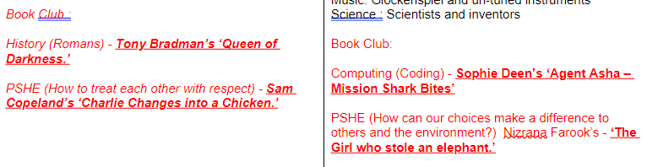
Reading
Introduction of Book Club
Obvious that the Class love stories

Slide 13
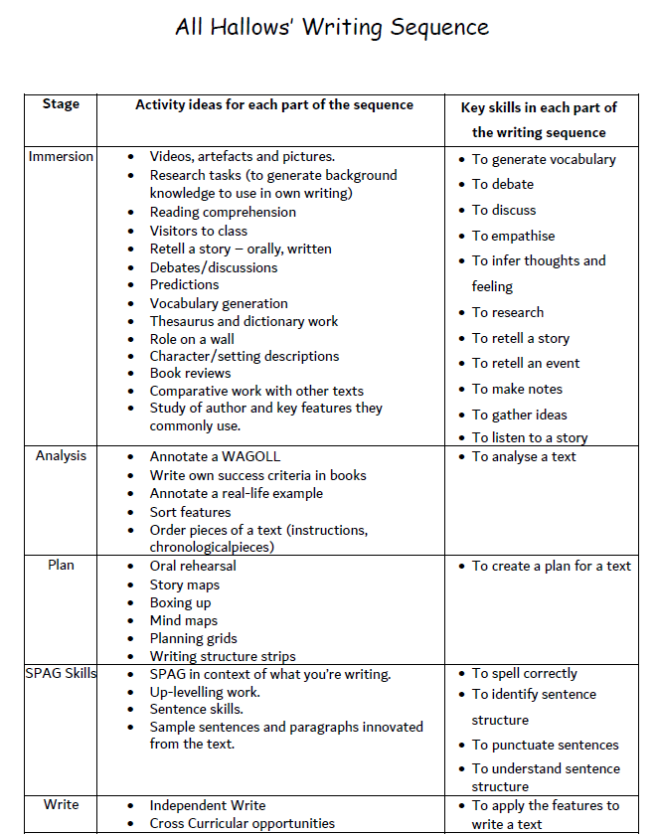

Slide 14
English: Writing
Assessment of writing skills focuses on 4 areas,
composition: purpose and audience,
grammar,
Punctuation,
transcription skills (handwriting and spelling).

Slide 15
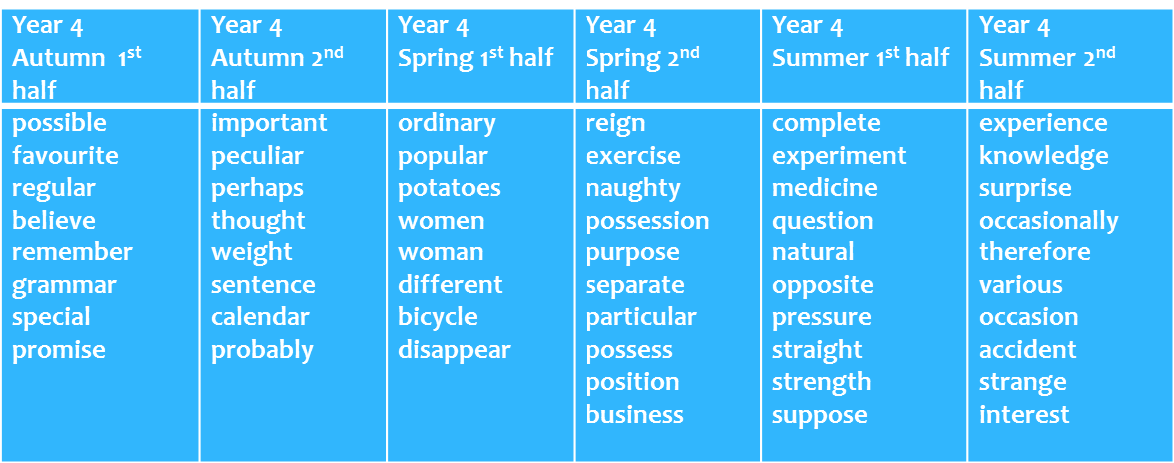
Word Lists
Statutory spellings each half term plus additional weekly spellings

Slide 16
Broader Curriculum
Website link
https://www.allhallowsprimary.co.uk/the-curriculum/
Trip – Southwell Minster Roman’s Day 24/9/2024
Swimming – Victoria Baths during the entire Summer Term
Residential – St Michaels in Hathersage 2 nights (9/7/2025 to 11/7/2025)

Slide 17
Home Learning –
Practise makes permanent
Word list practise (statutory/weekly spellings).
KIRF practise for Maths
Reading at least four times a week (listening to audiobooks is included) and recorded in organiser.
TT Rockstar practise (Prizes)
Plus periodic Home Learning activities

Slide 18
Questions?
If you do have any questions regarding Year 4 then please send me an email.

