Slide 1

Welcome To Thoresby

Slide 2
Meet the team
Year 5 curriculum
Reading
Home Learning
Expectations
Trips
Website
Questions

Slide 3
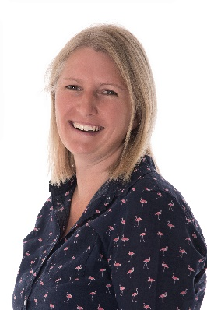
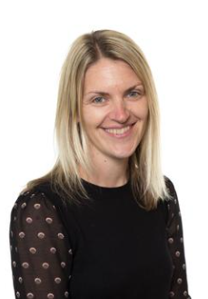
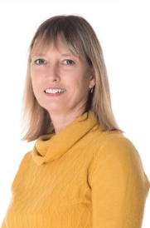
Meet the team
Miss Clark and Mrs Hally will be teaching Year 5 this year.
Miss Clark – Monday/Tuesday/ Wednesday
Mrs Hally - Thursday/Friday
Mrs Sarno will be in class to support Maths each day (although we will be flexible with this to best use the support).

Slide 4
Focus on reading
Again this year, we want to continue to encourage reading for both pleasure and as a life-skill. We have already started a class book related to our topic, we read regularly as part of our learning and encourage the children to read during their free time.
We even have our reading area in the classroom as a place to relax and read.
To help do this we have our library card system, where the children get a stamp every Monday if they have read at home (to/with an adult.) In year 5 we ask that they read 4 times for approx. 20 mins per week.
We want the children to read a range of texts:– magazines, comics, newspapers, online, audio books all count towards this.

Slide 5
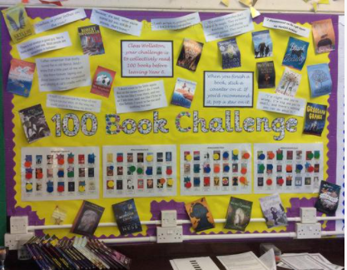
100 book challenge
In class we have a display showing the 100 recommended reads for years 5/6 children. The aim is for the class to have collectively read all 100 by the end of the year. Each time someone reads one of the books they mark this on the display.
If they would also recommend it to others, they star the book.

Slide 6
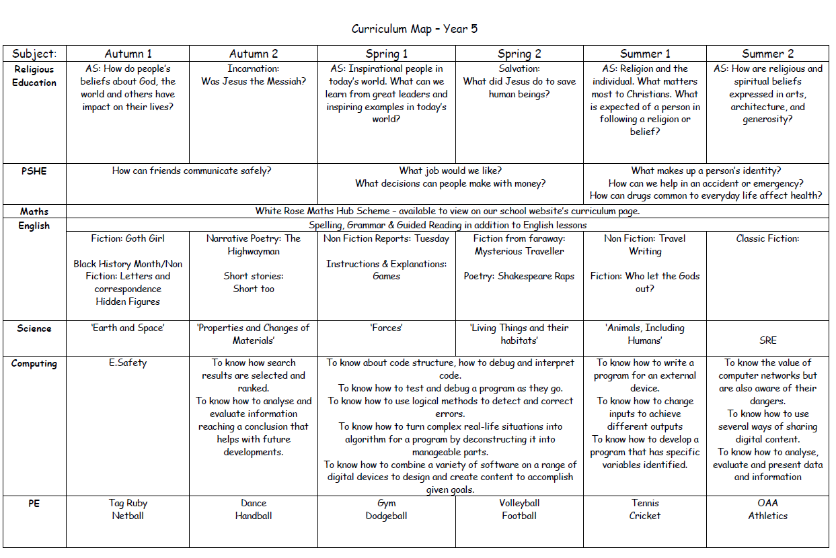
Year 5 Curriculum
Our curriculum map covers all subjects taught throughout the year and gives you a main heading/theme being covered. Some of the topics stretch across a term, whilst others we change every half term. With Maths and English in particular, the focus may be for a week or two.
For a closer look at the curriculum map for year 5 follow the link below to this section of the school's website.
Our curriculum | All Hallows CE Primary School (allhallowsprimary.co.uk)

Slide 7
Home Learning
Weekly vocab list can be found in their organisers. These are looked at on a Monday and used/practised as one of our early morning tasks through the week. Please help us by looking at these at home too.
Reading – 4 times a week. Please sign the organiser for Monday.
Year 5s will also receive home learning linked to our learning during the week. There may also be special pieces related to themed weeks/special events.
We now have a new home learning link to our French Scheme – Language Angels – with games and Karaoke for the children (and you, if you fancy learning some French.) Login (languageangels.com)
There’s always something to do every night – reading, vocab lists, handwriting, TT RockStars, Wordshark, Splashlearn and going over anything they weren’t sure about from the day’s learning.

Slide 8
Expectations
Children in Year 5 will be expected to work hard, putting in maximum effort and, being amongst the oldest children in school, set a good example to others with regard to behaviour and attitude.
These expectations apply to Home Learning: the children can expect us to prepare, give feedback and support them with their Home Learning; we expect them to complete it on-time and to a high standard.

Slide 9
Our behaviour system
Our crystal jar is a whole class reward system. If we earn a crystal it goes in the jar. Once we have collected all the crystals the whole class gets a reward.
We believe in a restorative approach to behaviour. We want the children to make good choices and to know that if we do make a poor choice, they can make amends for this. There are consequences both good and bad for the choices we make.
We use positive encouragement to help the children change a behaviour that may not be a good choice.
Our HEART system for recognising the values we try to encourage is central to our behaviour system in school.
If they move their heart up for ‘going above and beyond’ the expected and demonstrating one of our values, they will earn a treat. We also send a message home so you know they have earned this.
We also have a ‘Star of the week’ which we pick for all sorts of reasons. We have a small prize box for this too.

Slide 10
Trips
National Space Centre – already booked for this half term - details to follow shortly.
Young Voices.
Wollaton Hall.
We are always keen to try new places to enhance our curriculum. If you know of any we should visit please let us know.

Slide 11
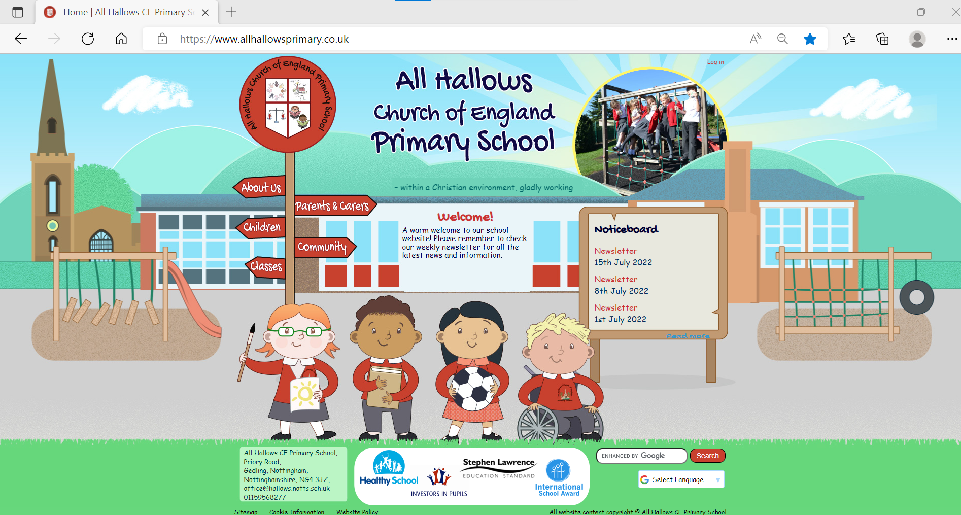
Our school website…

Slide 12
Questions
If you ever have any concerns/worries/information we may need please do get in touch. We are usually on the playground at the beginning and end of the day for quick messages.
Contacting us can be tricky during the school day, so if it is vital to get in contact please call the office. Otherwise, please feel free to send us an email on the following addresses:
bclark@hallows.notts.sch.uk
khally@hallows.notts.sch.uk
It does help us if any emails are sent to both of us so that we are both aware of any concerns/information etc.
One/or both of us will get back to you asap.

