Slide 1
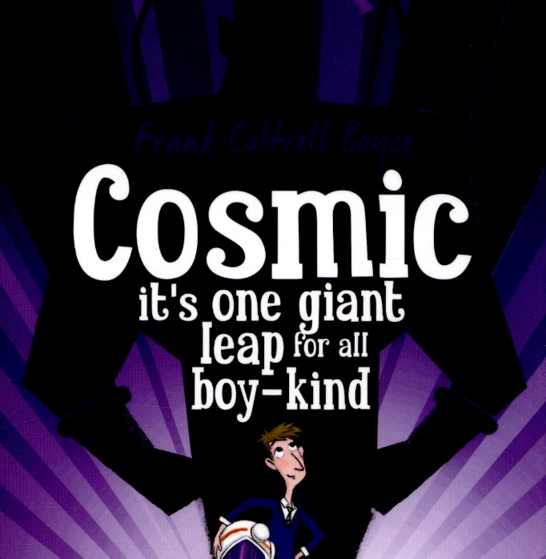
Week 3 Day 1

Slide 2
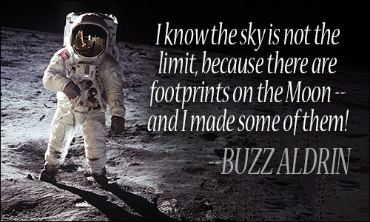
Starter
Who said this quotation and who do you think he is?
What do you think ‘the sky is the limit’ means when people say it?
What do you think Buzz Aldrin’s message is?

Slide 3
Read Chapter 15 – The ice-cream man of the Gobi Desert

Slide 4
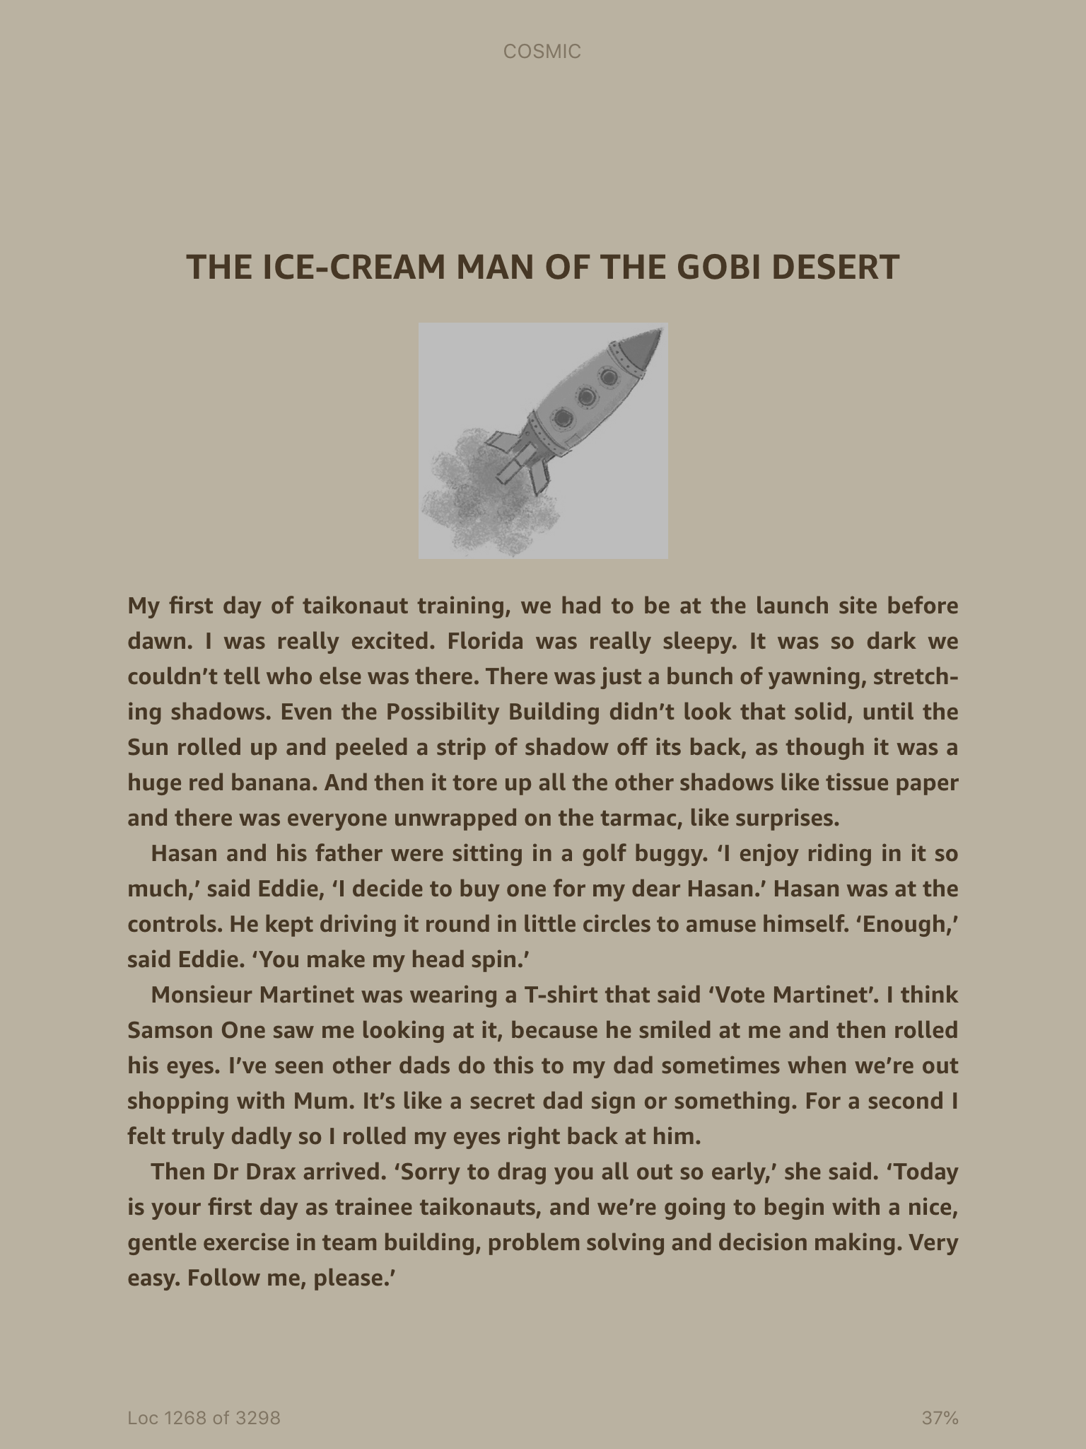

Slide 5
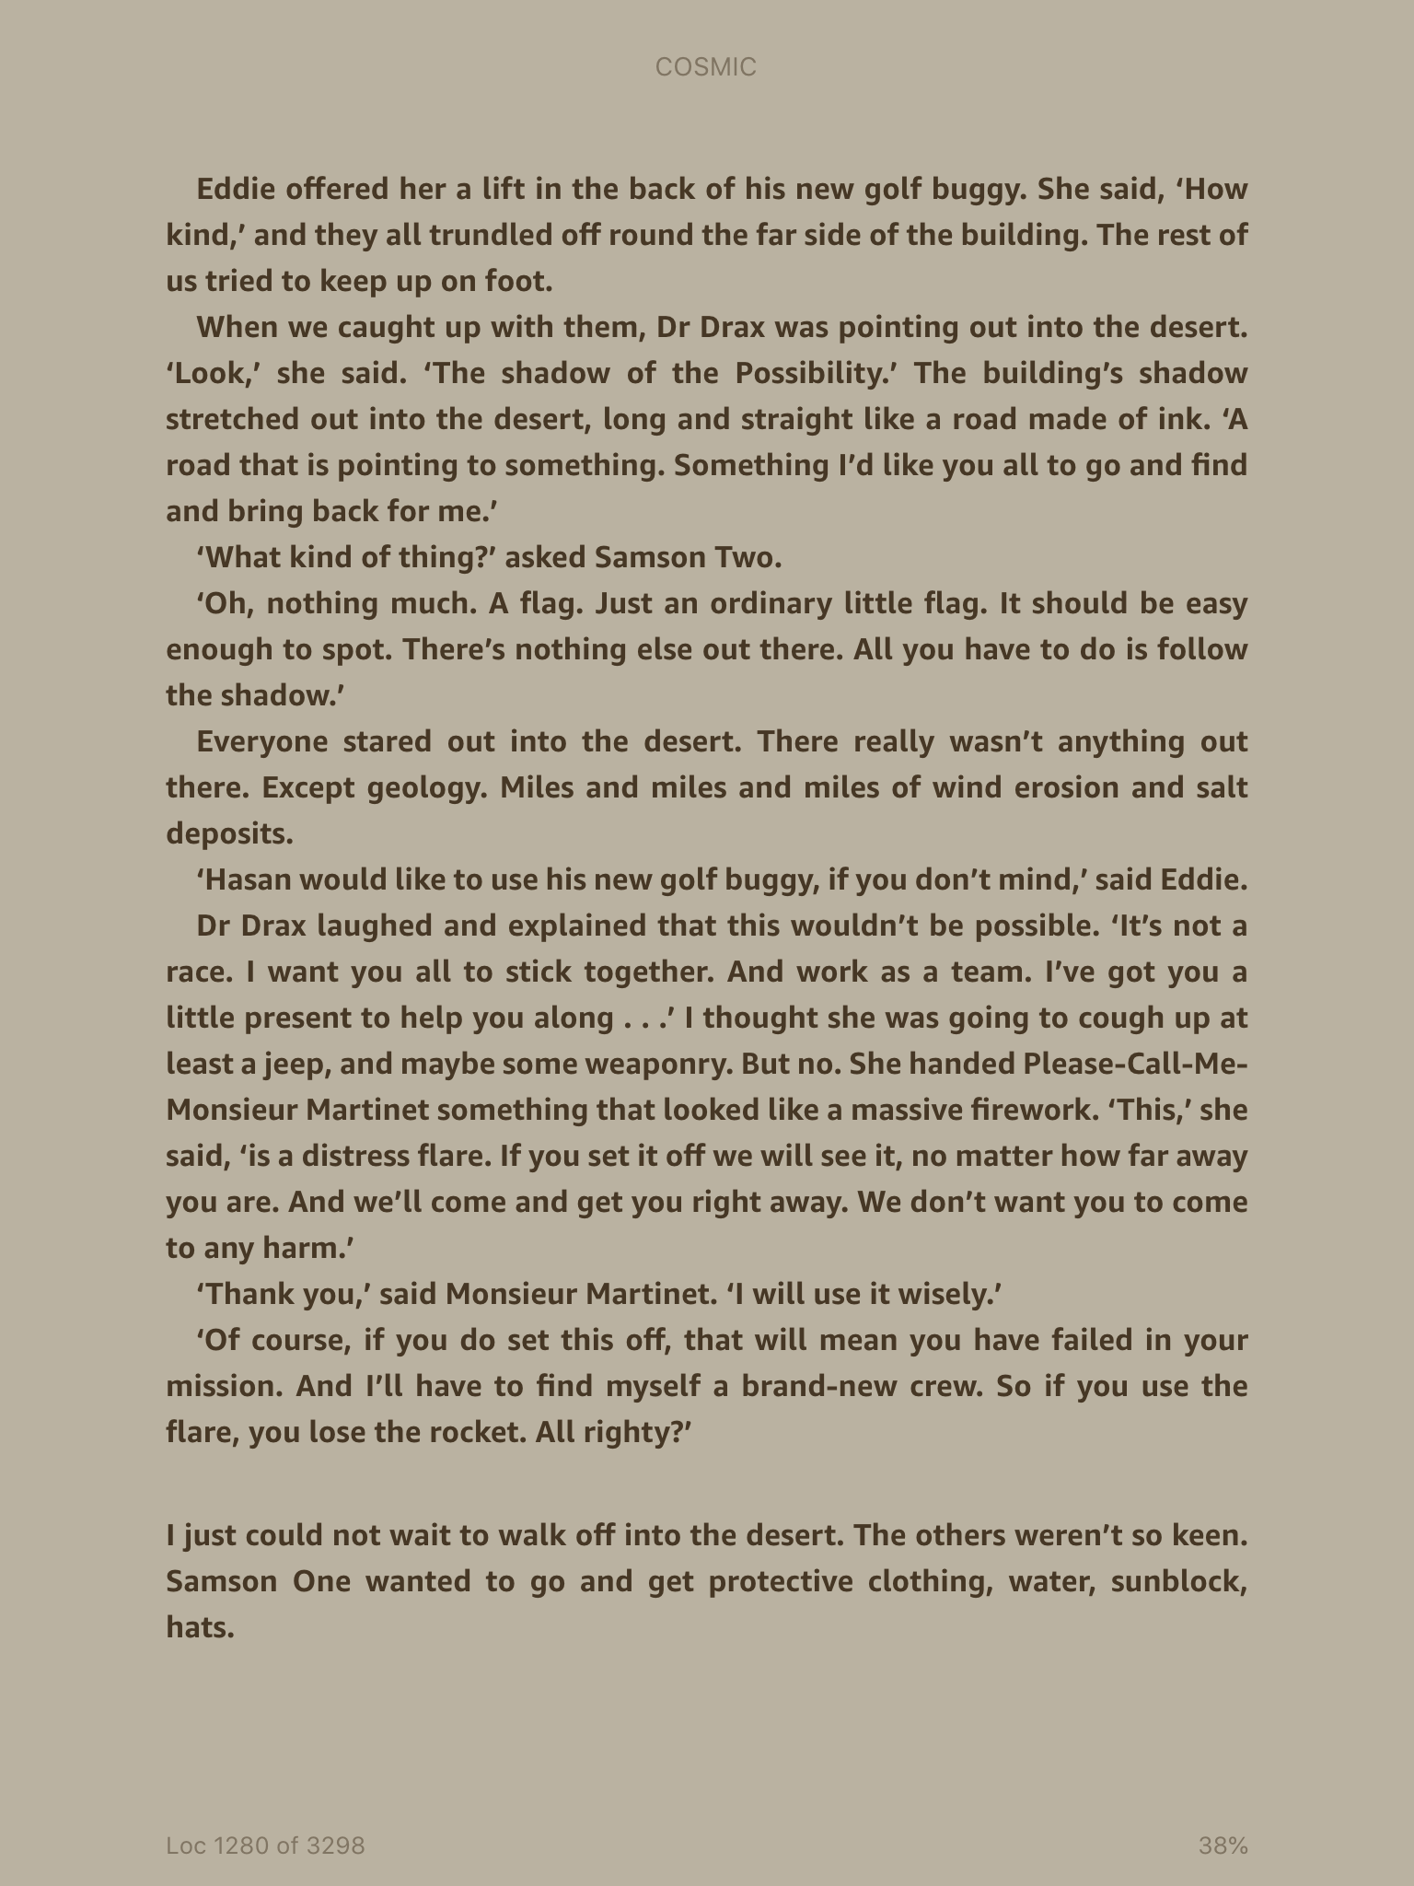

Slide 6
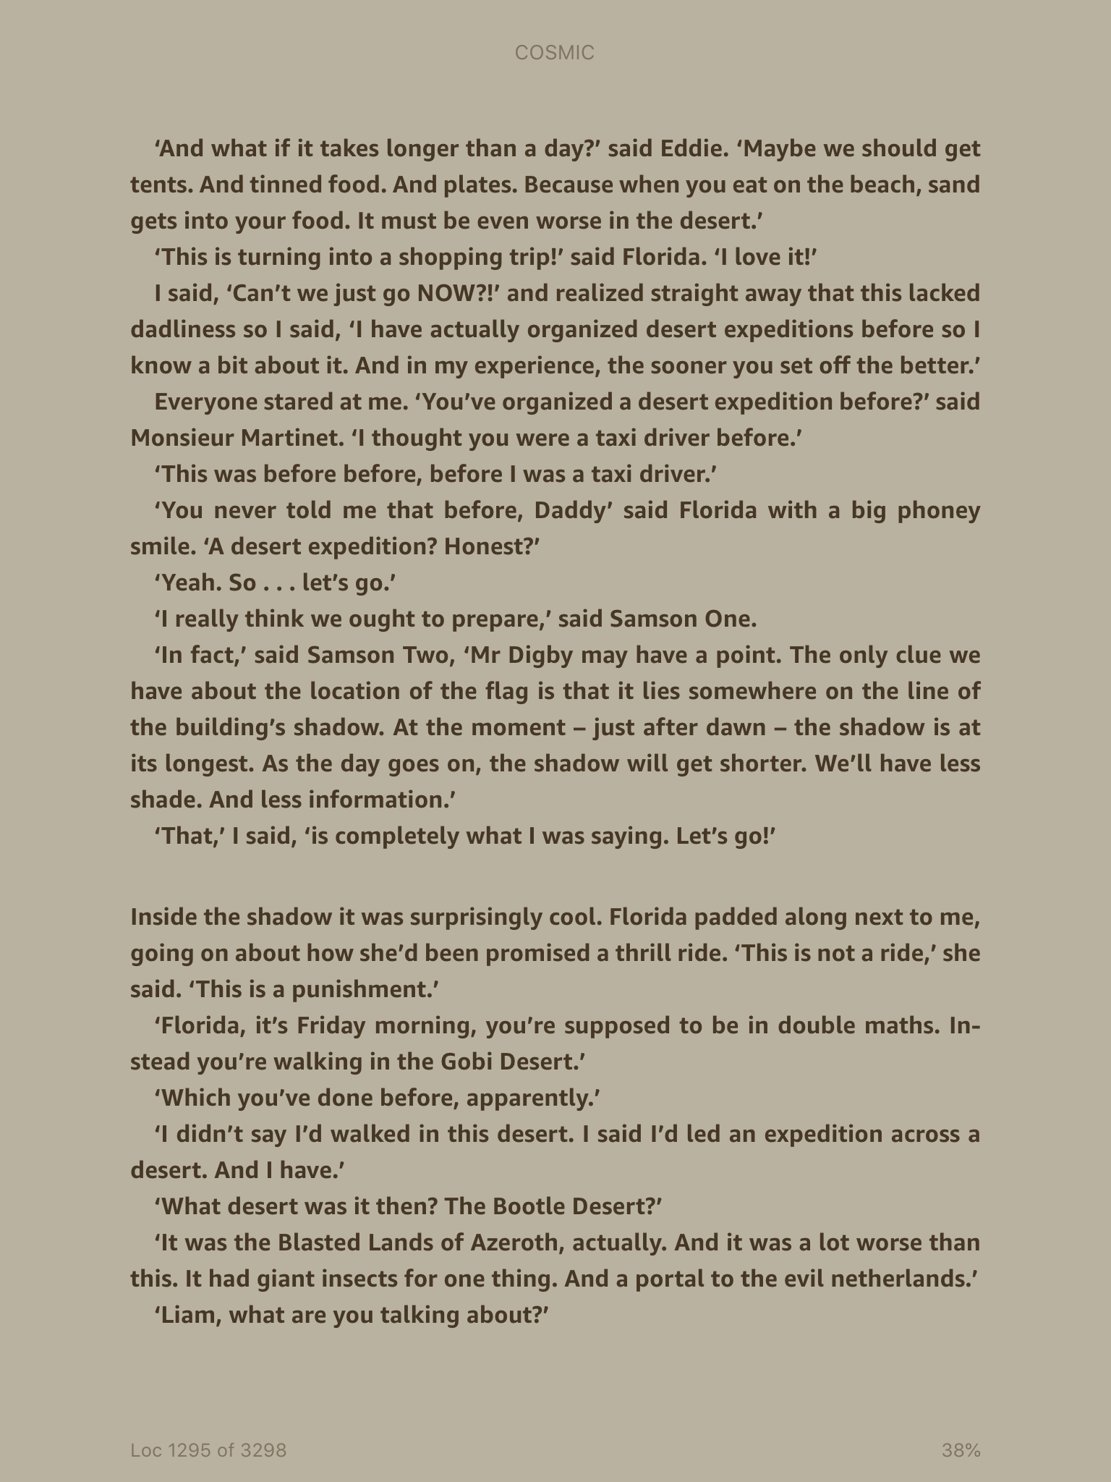

Slide 7
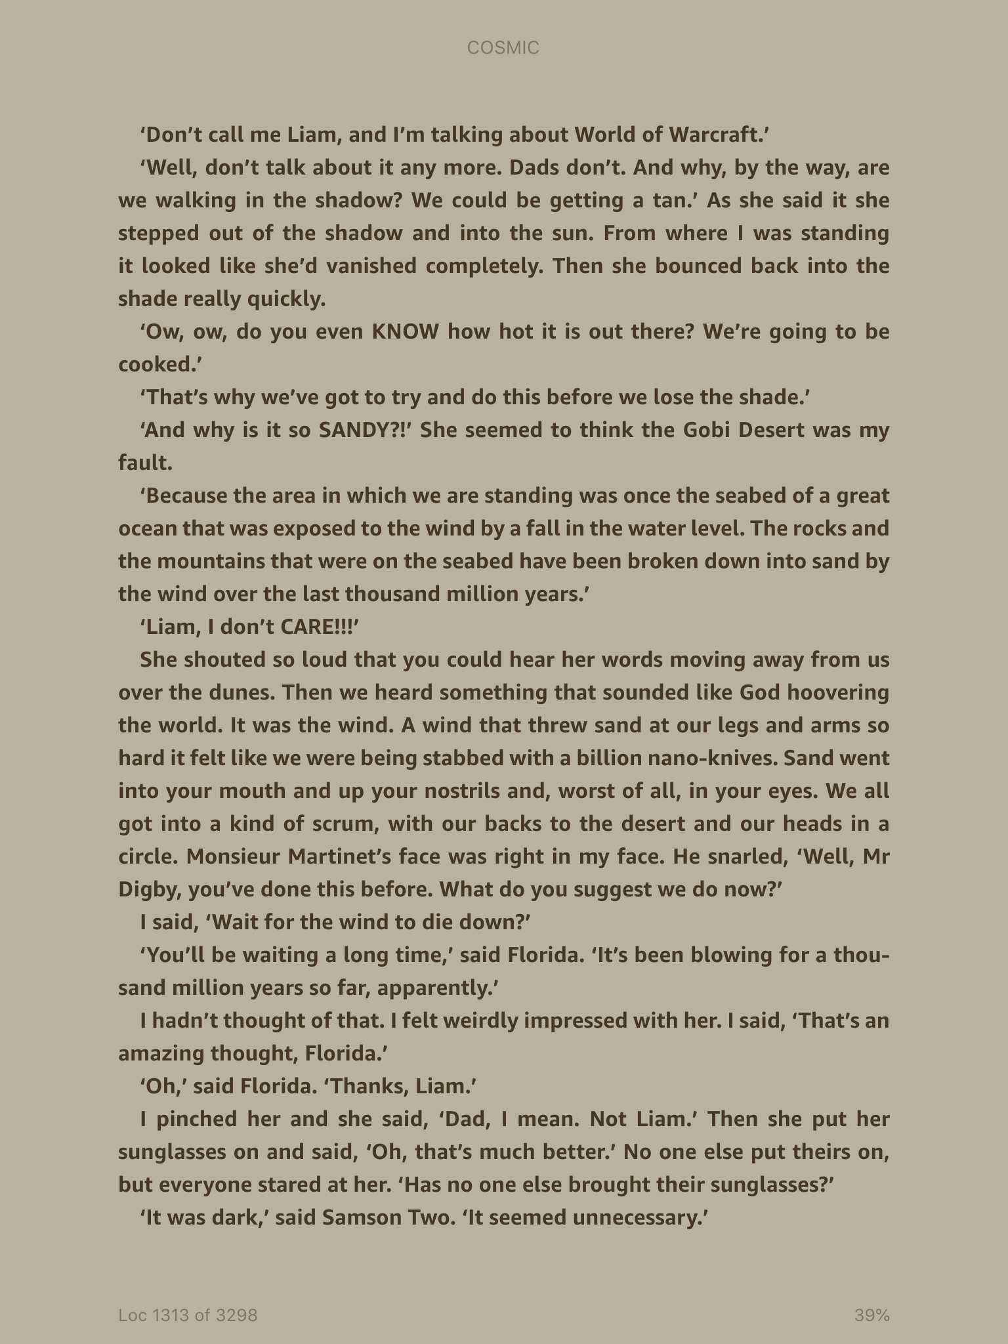

Slide 8
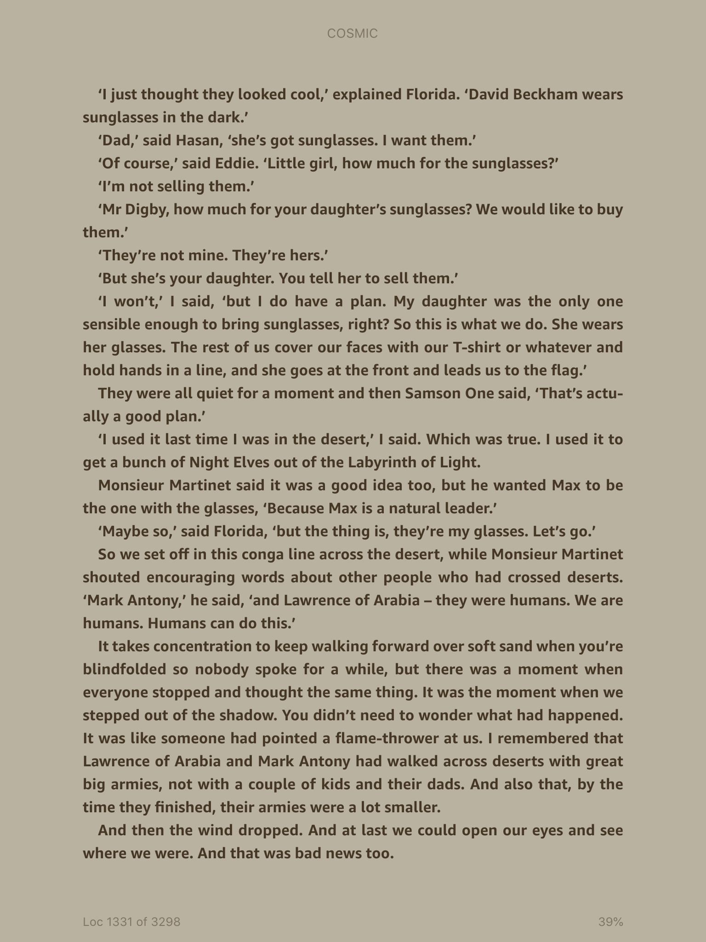

Slide 9
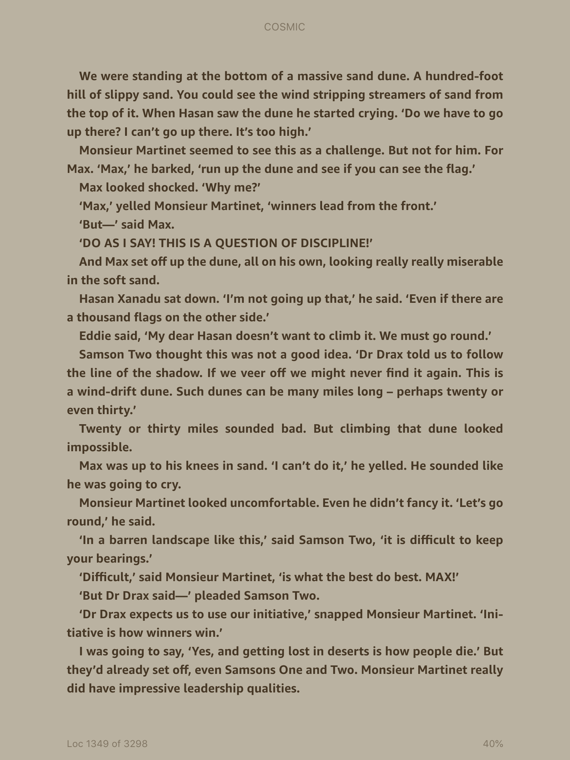

Slide 10
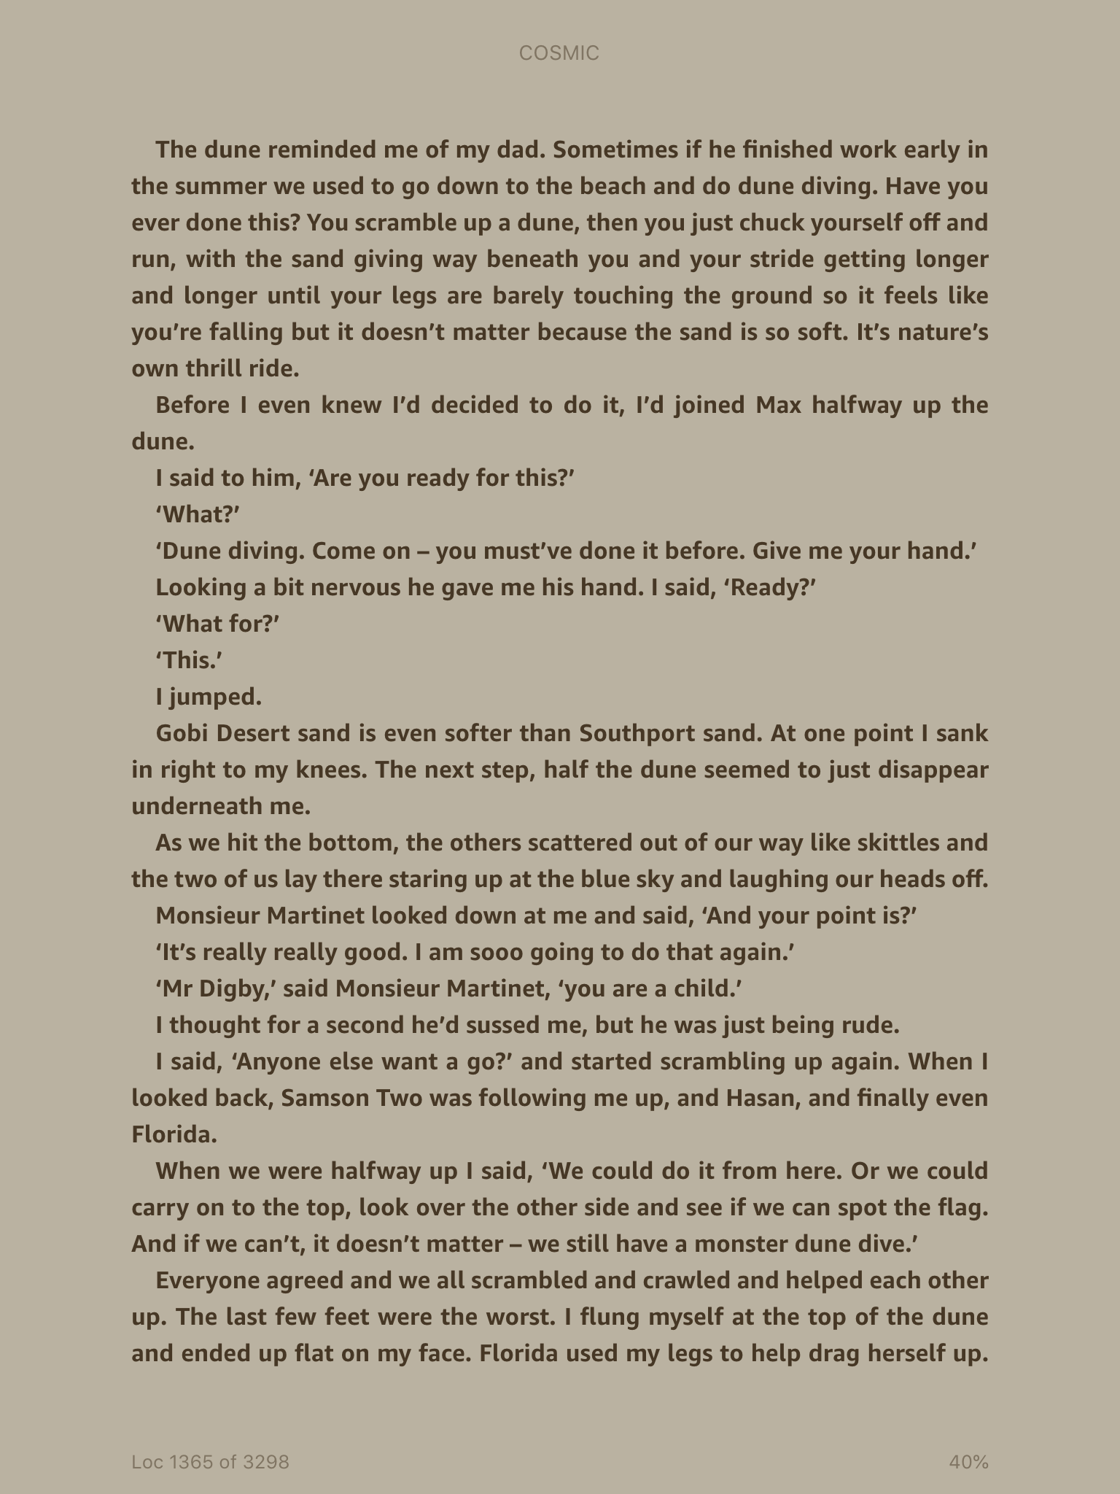

Slide 11
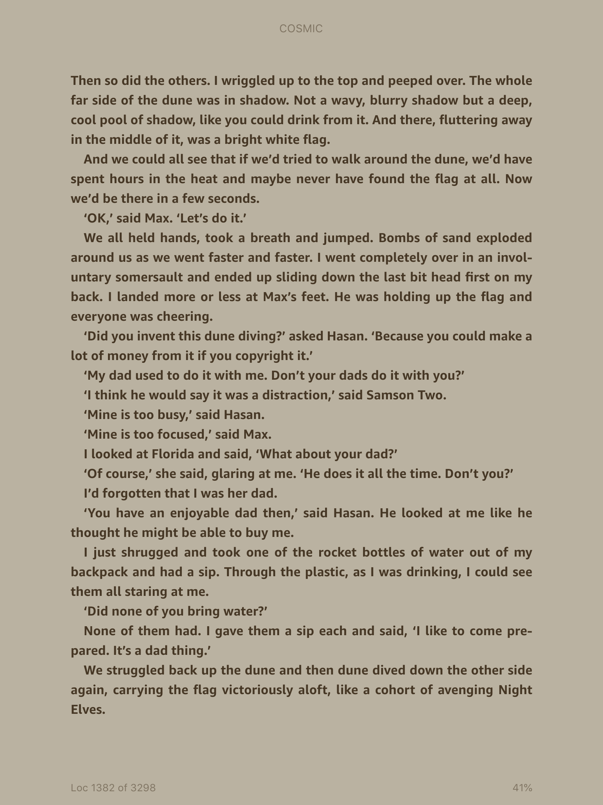

Slide 12
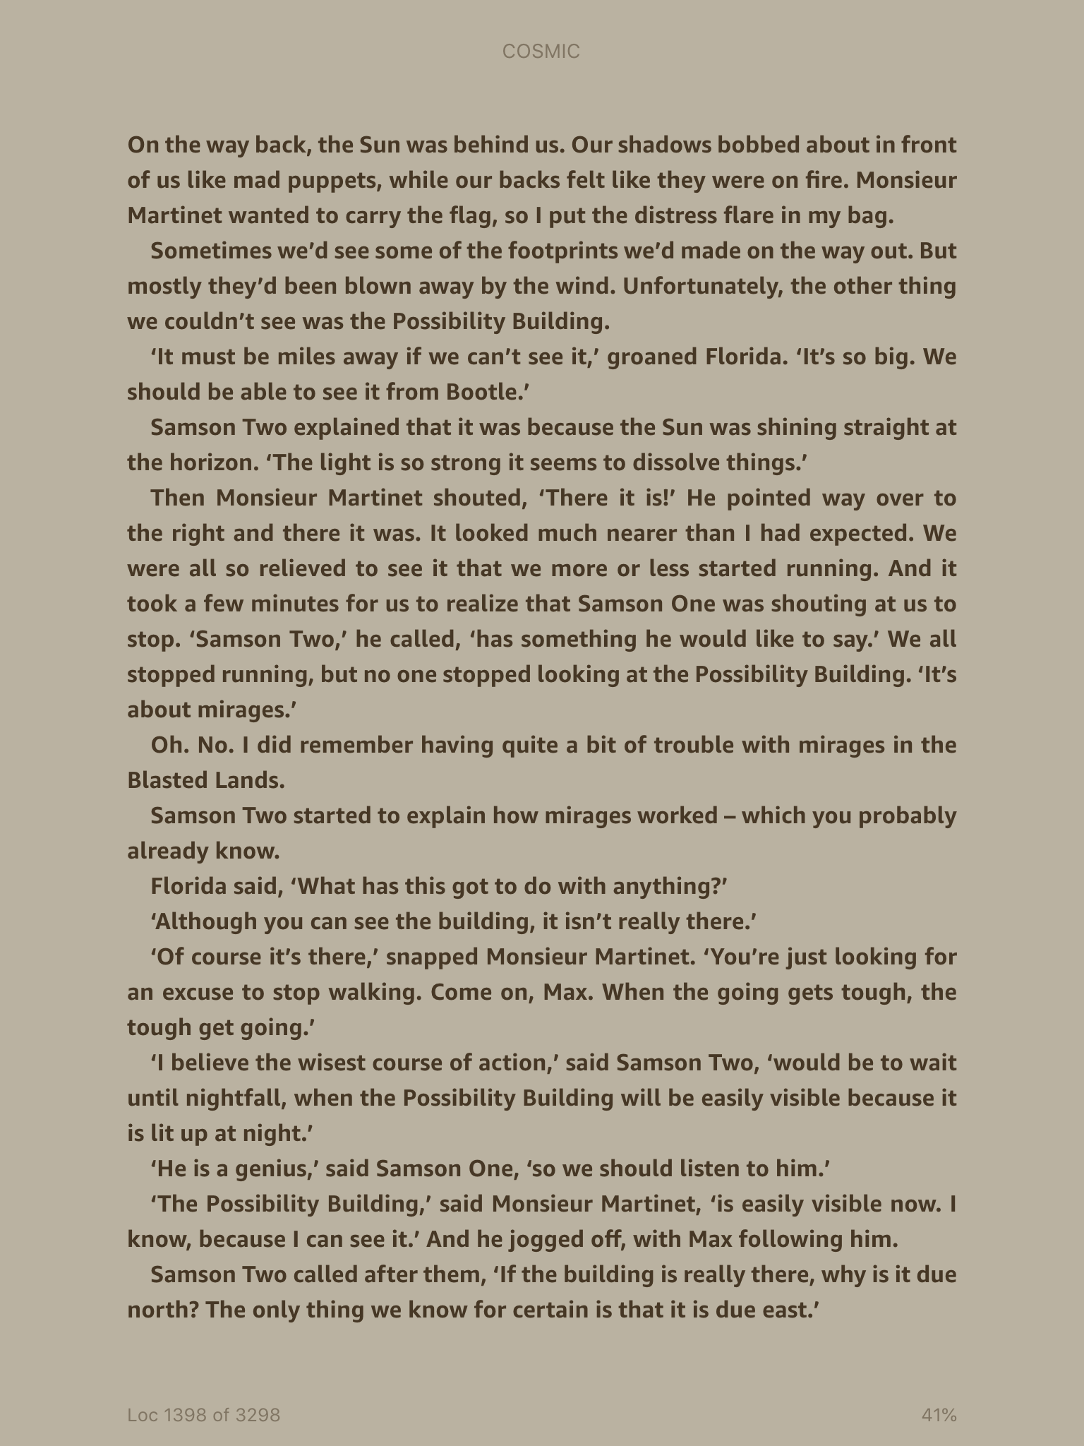

Slide 13
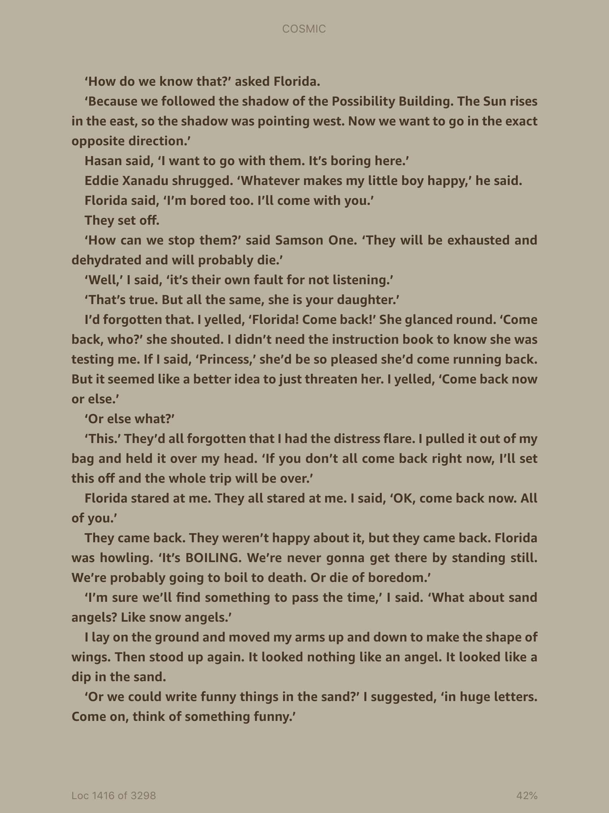

Slide 14
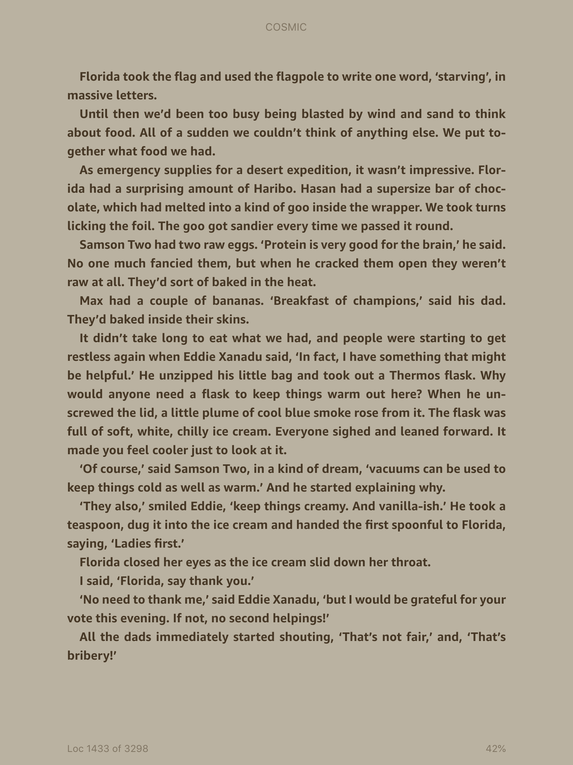

Slide 15
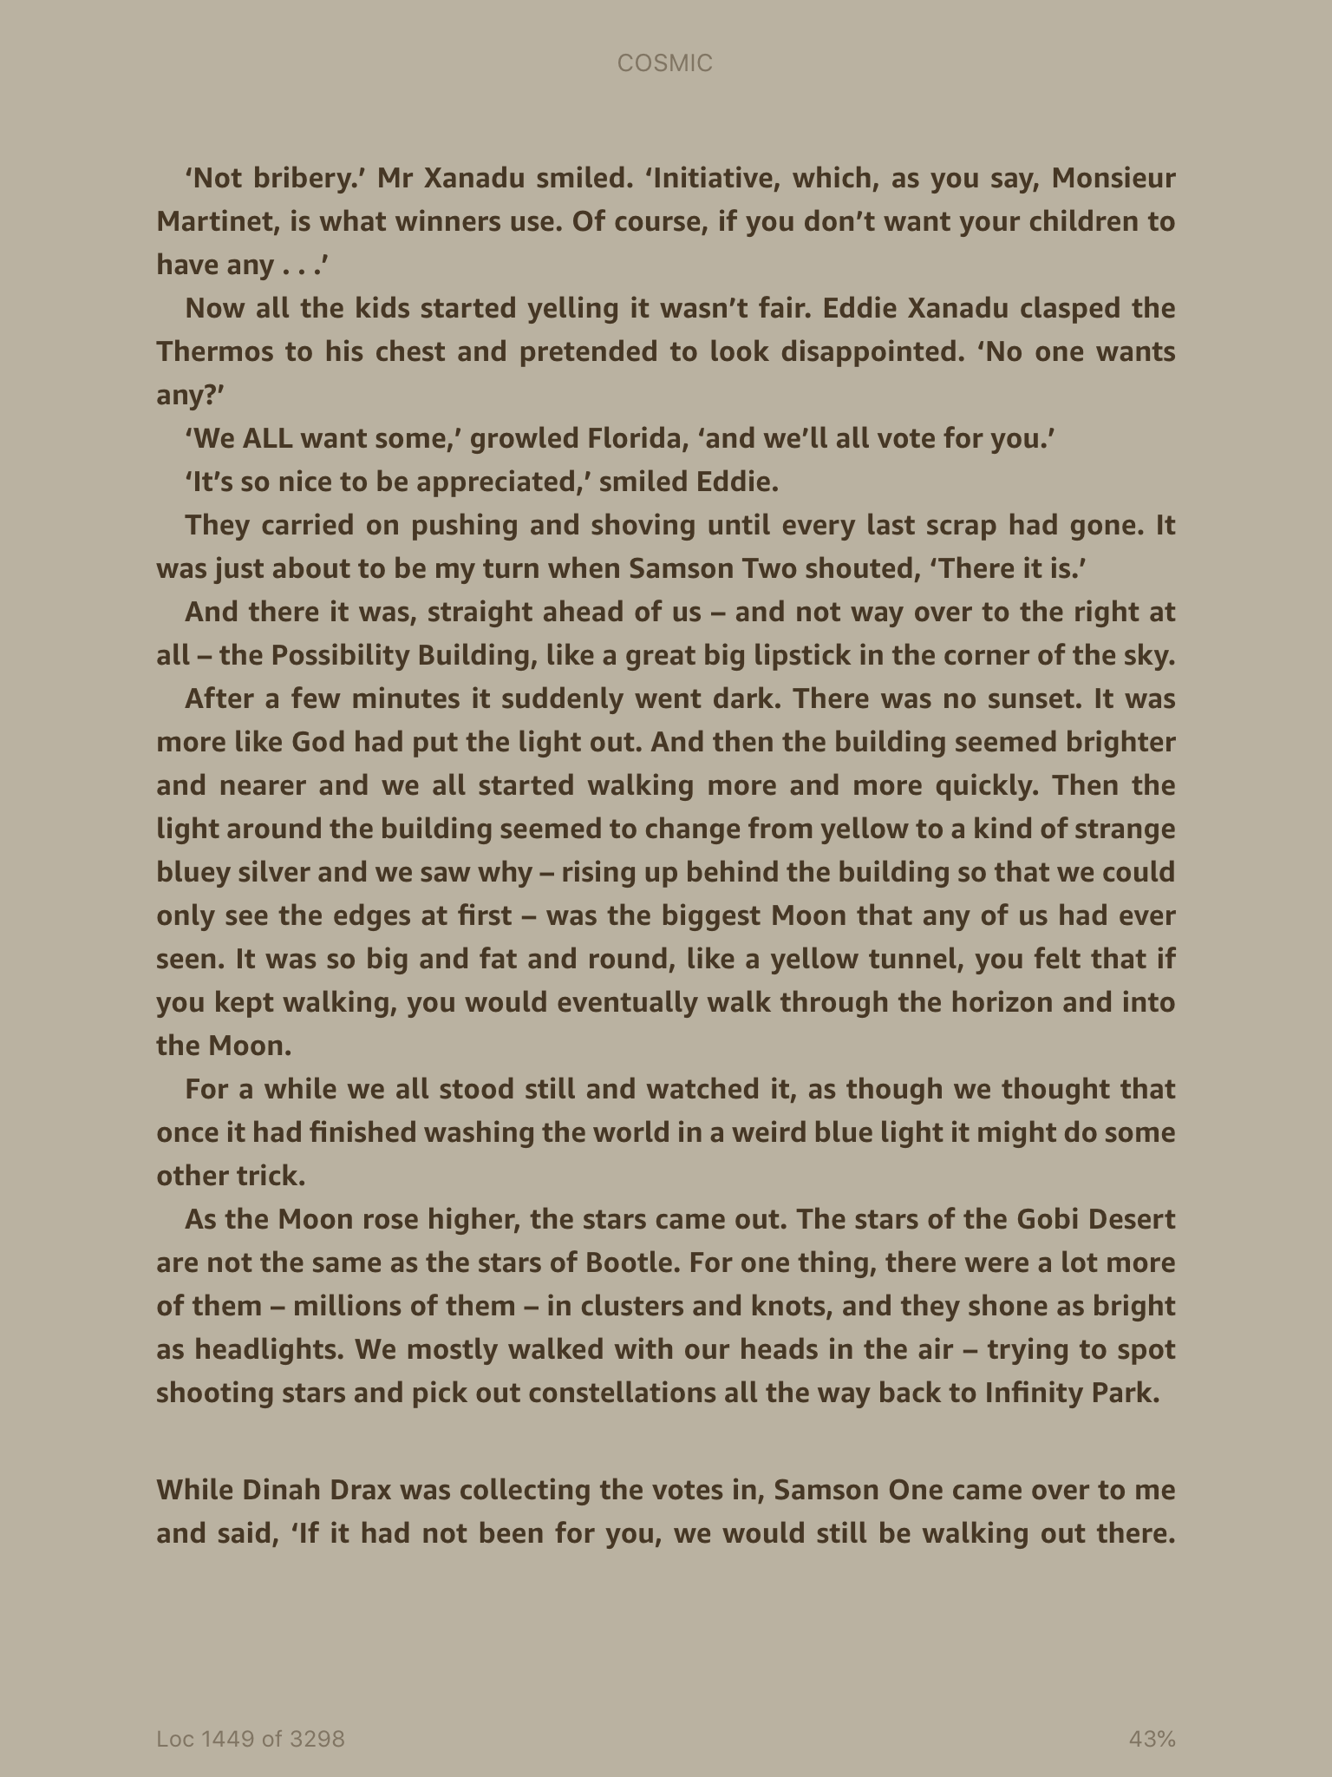

Slide 16
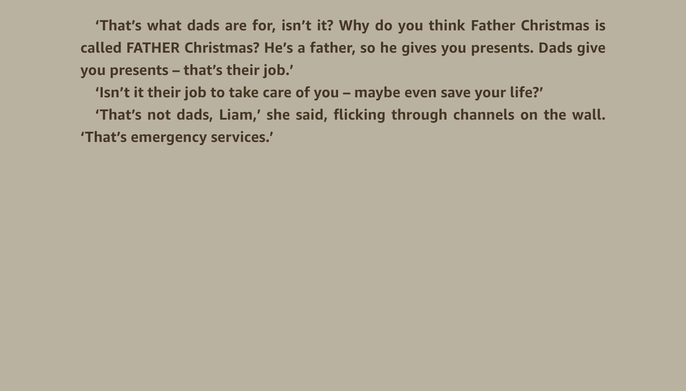

Slide 17
What did the group have to do in this chapter?
What item did Florida have that helped them? How did it help?
Does Liam have any skills? What are they?
Have any other members of the group been useful? Who and how?
What do you think of Eddie Xanadu’s tactic of bringing ice cream?
How did Liam save everybody on the trip?
How is his behaviour different from the other Dads?

Slide 18
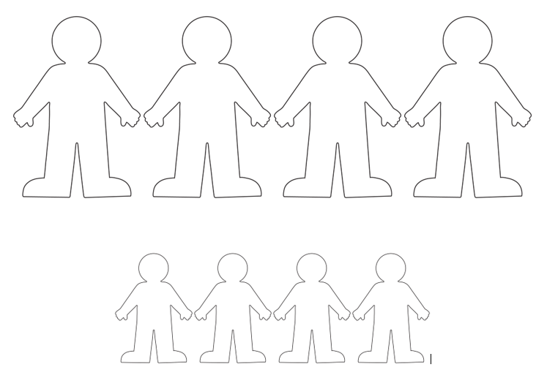
Main Task: Use the sheet to label who the 4 Dads and 4 children are on the desert challenge.
Annotate your sheet to add as much information about each character as you can
Label each character and annotate with as much information as possible. Then write which two characters appear to be the most similar and which two appear to be the most different

