Slide 1


Slide 2
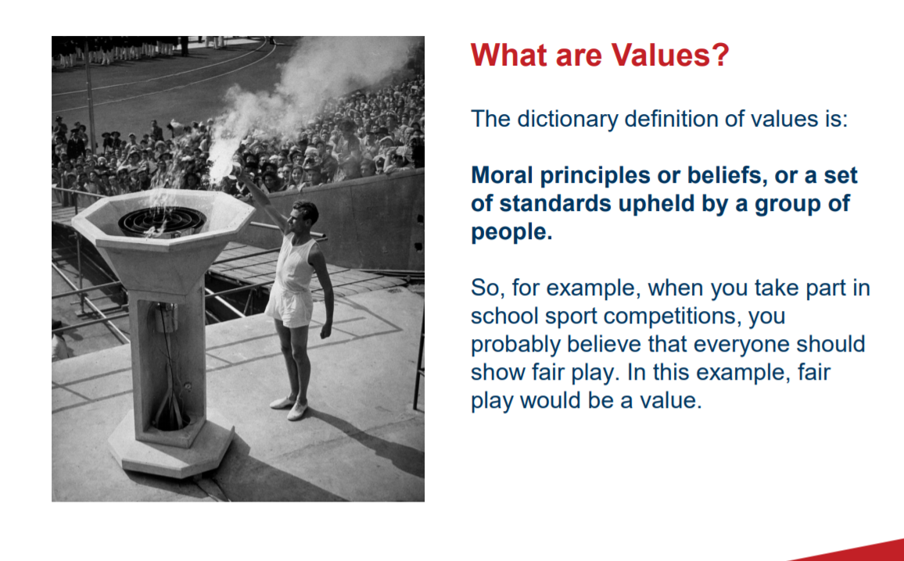

Slide 3


Slide 4
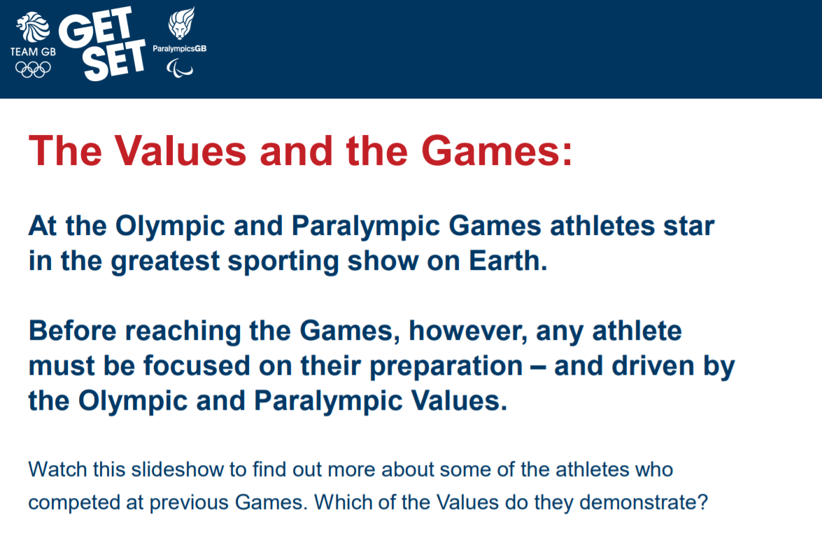

Slide 5


Slide 6
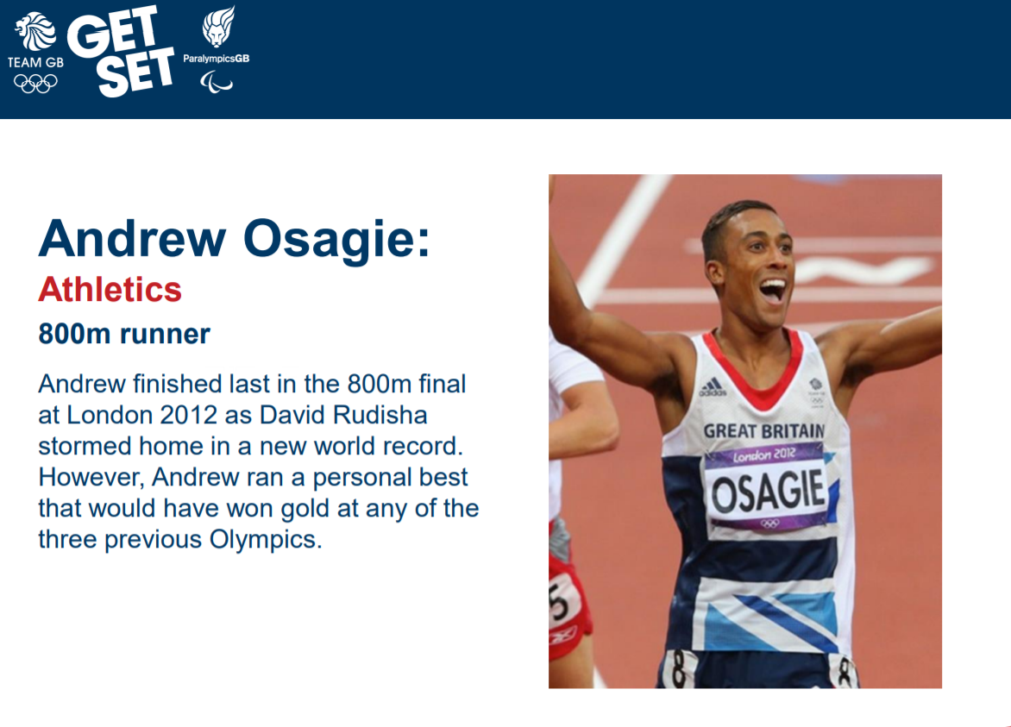

Slide 7
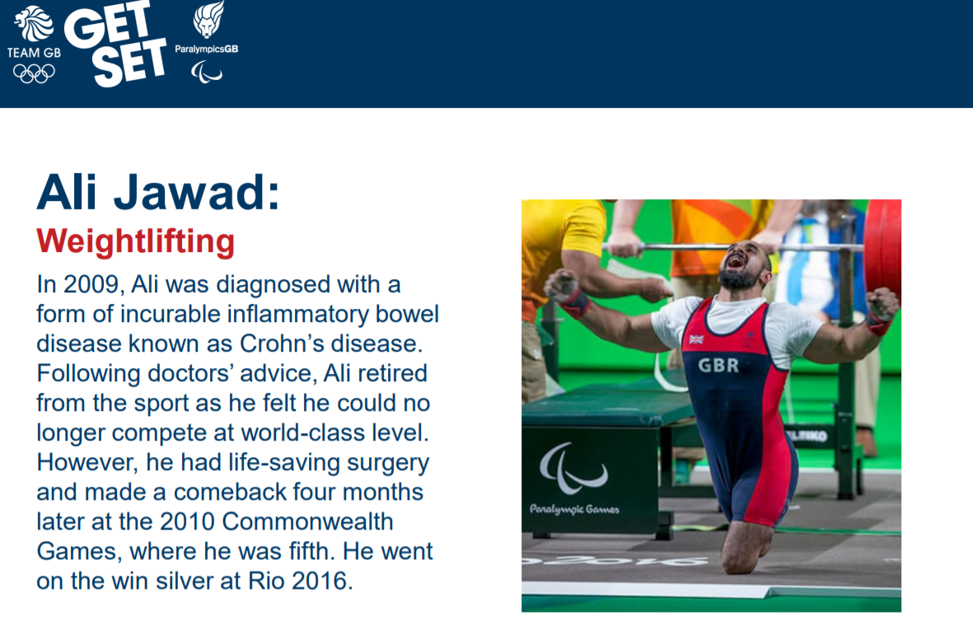

Slide 8


Slide 9


Slide 10
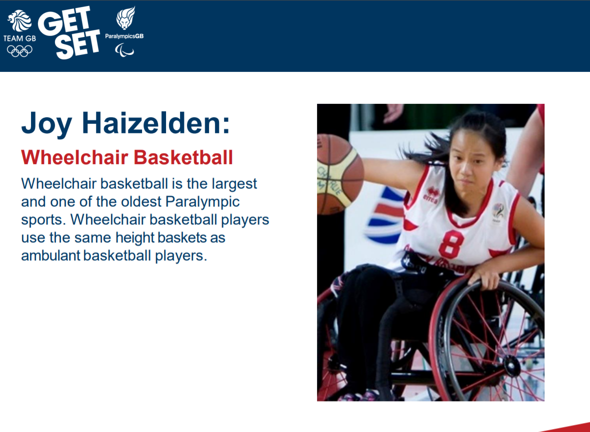

Slide 11


Slide 12
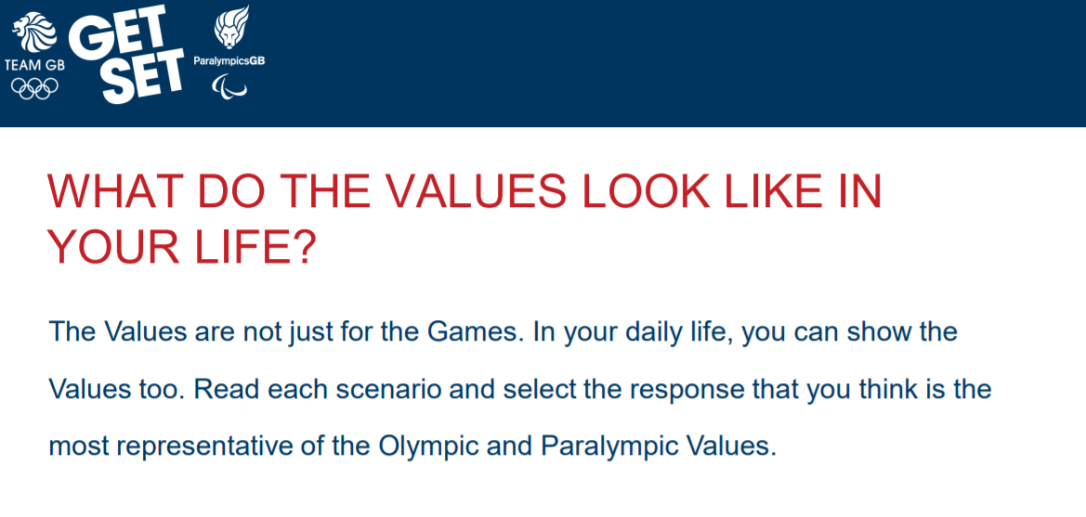

Slide 13


Slide 14
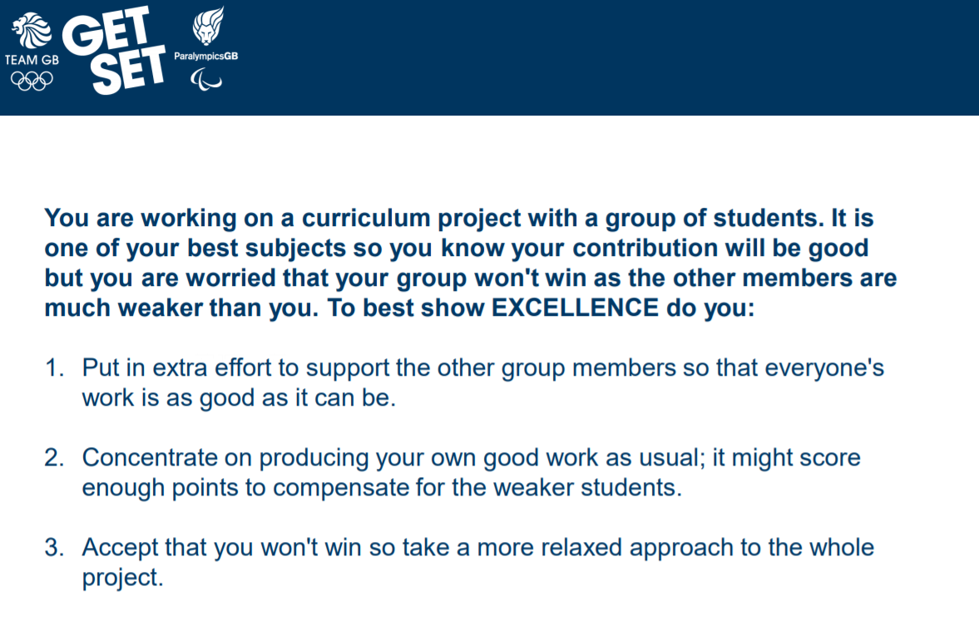

Slide 15


Slide 16


Slide 17
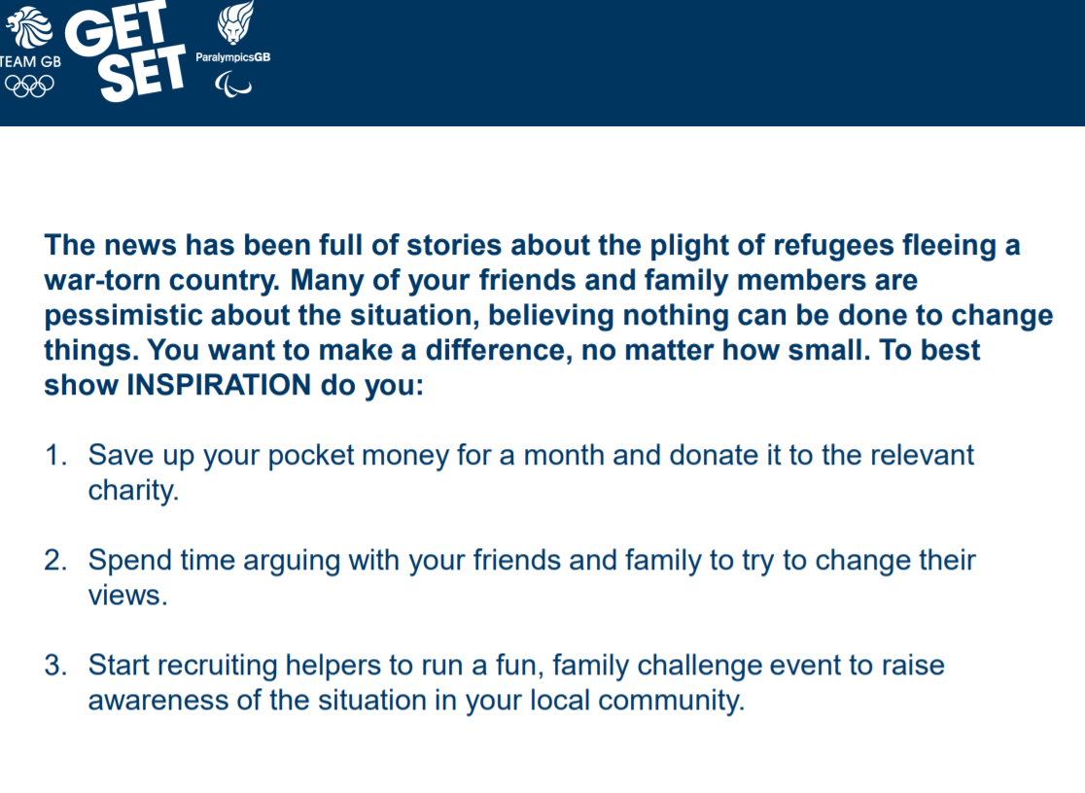

Slide 18
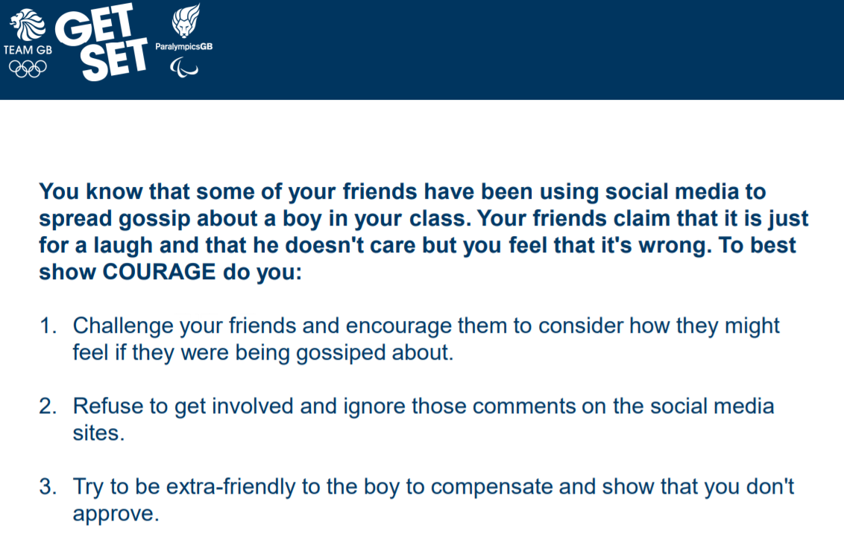

Slide 19
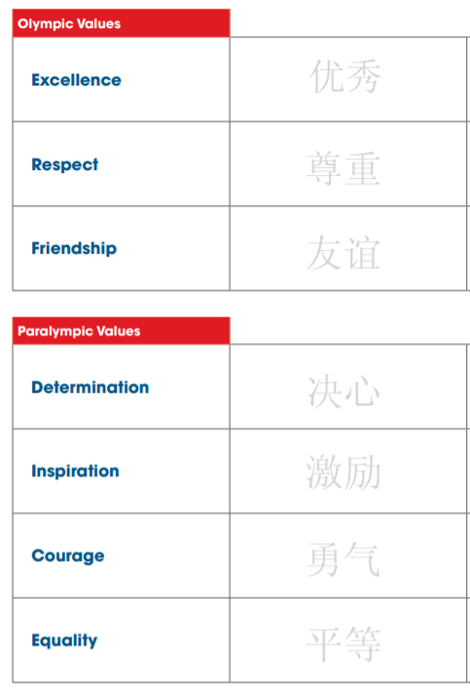
Have a go at drawing these Mandarin characters for the values words. The Chinese traditionally use a brush and ink to create their words. Why not have a go yourself on paper.

