Slide 1

Week 3 Day 2

Slide 2
Read Chapter 16 – I can’t work my trousers
In your opinion, what the funniest part of the chapter and why?
Which part did you enjoy the most and why?
Who do you think voted for Liam and why?

Slide 3
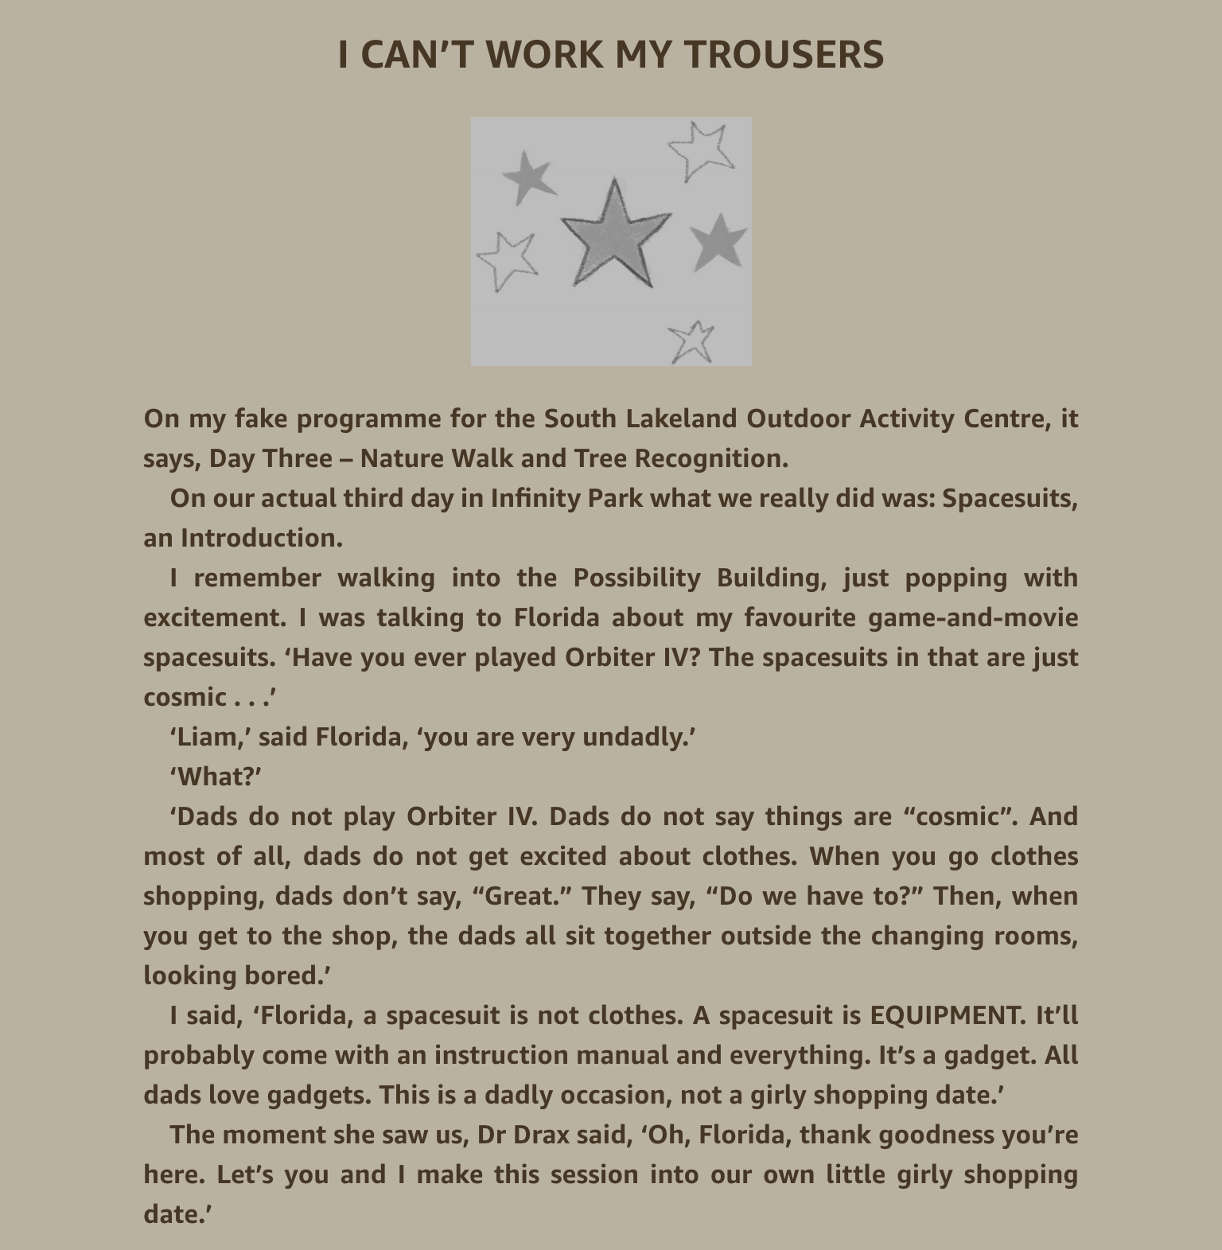

Slide 4
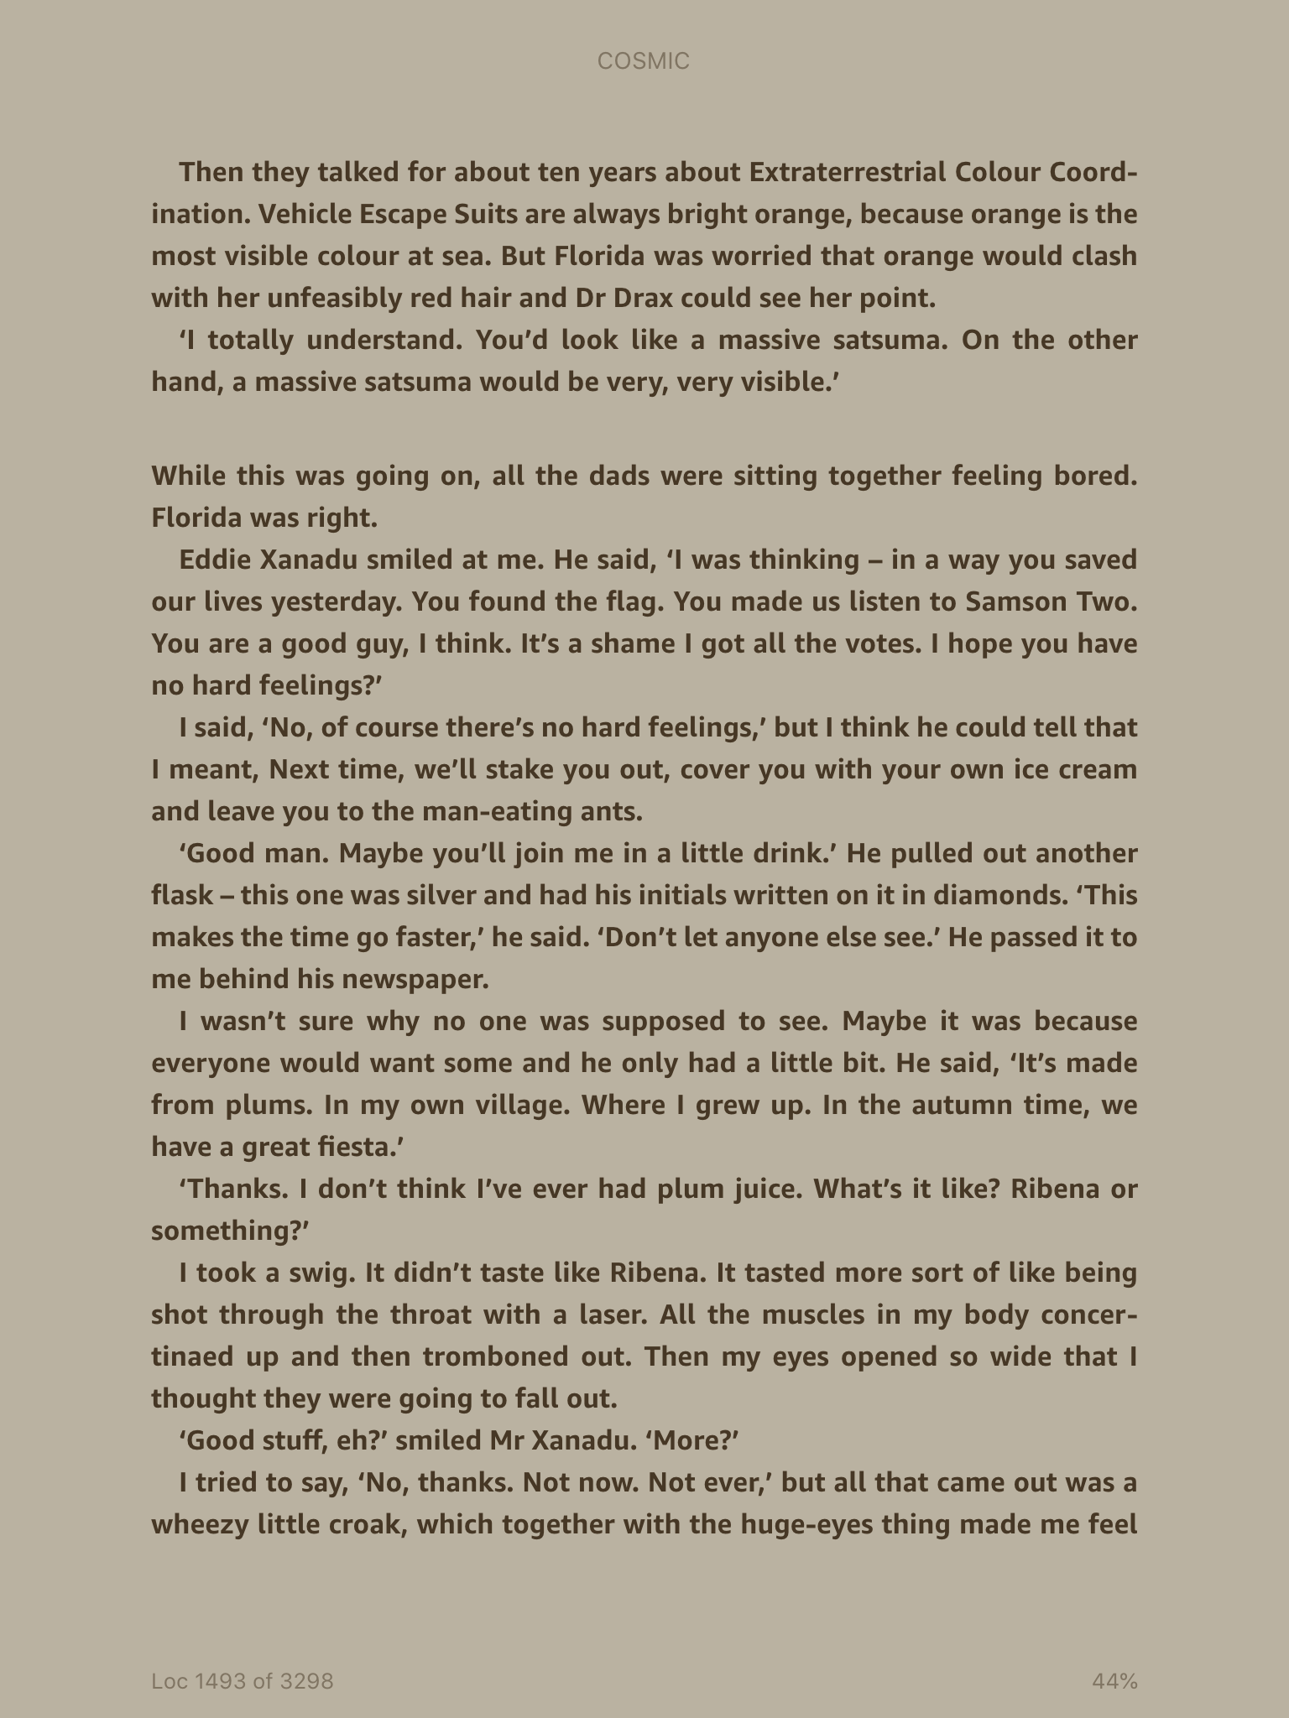

Slide 5
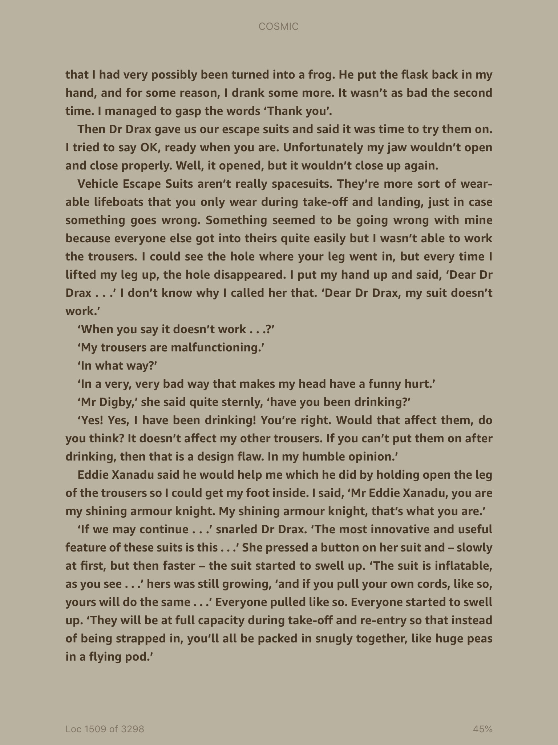

Slide 6
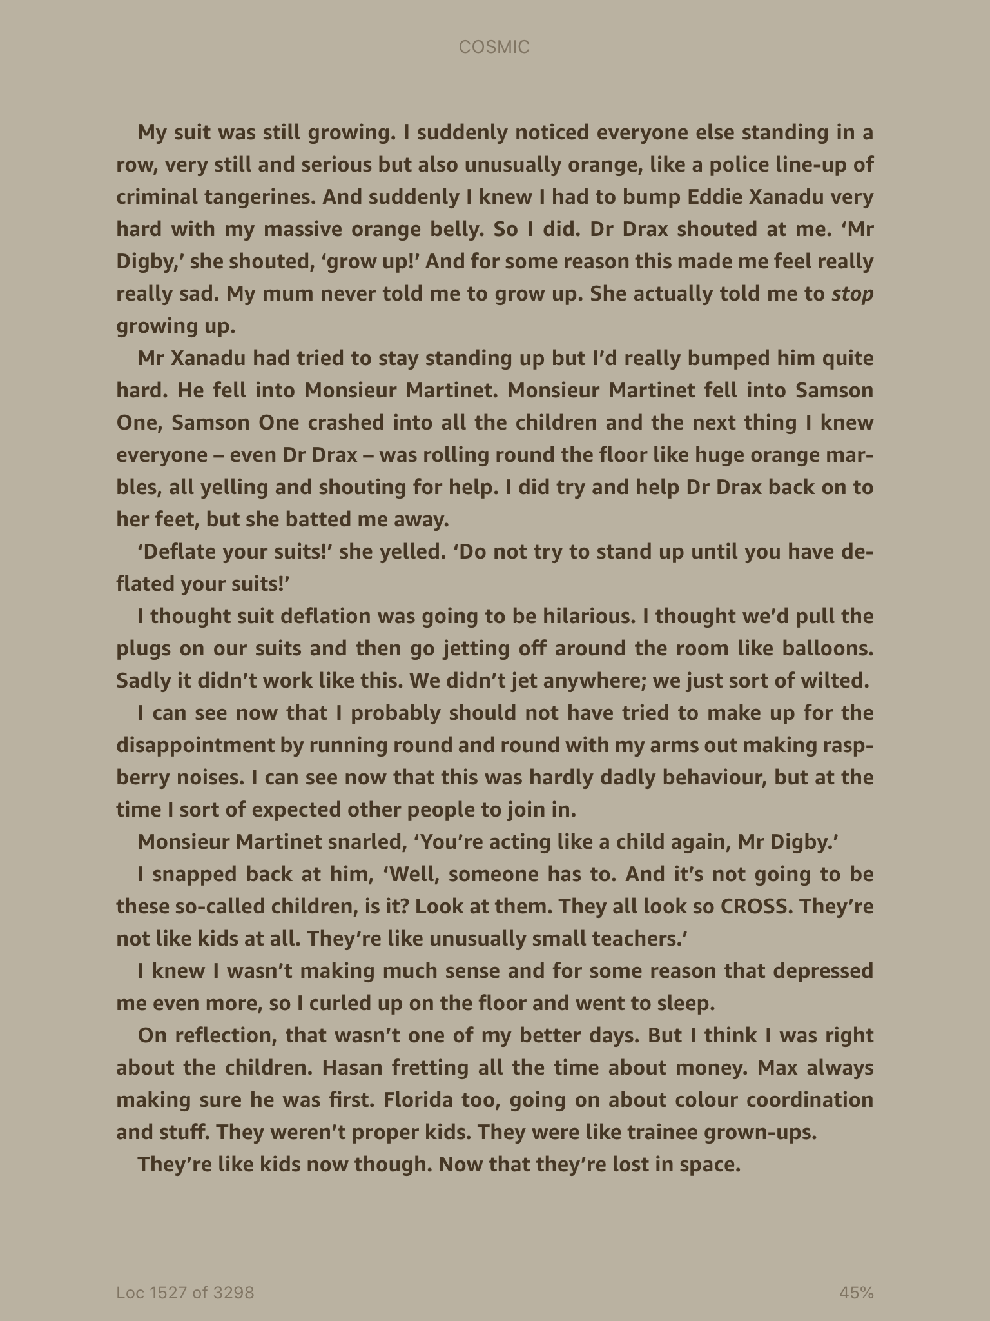

Slide 7
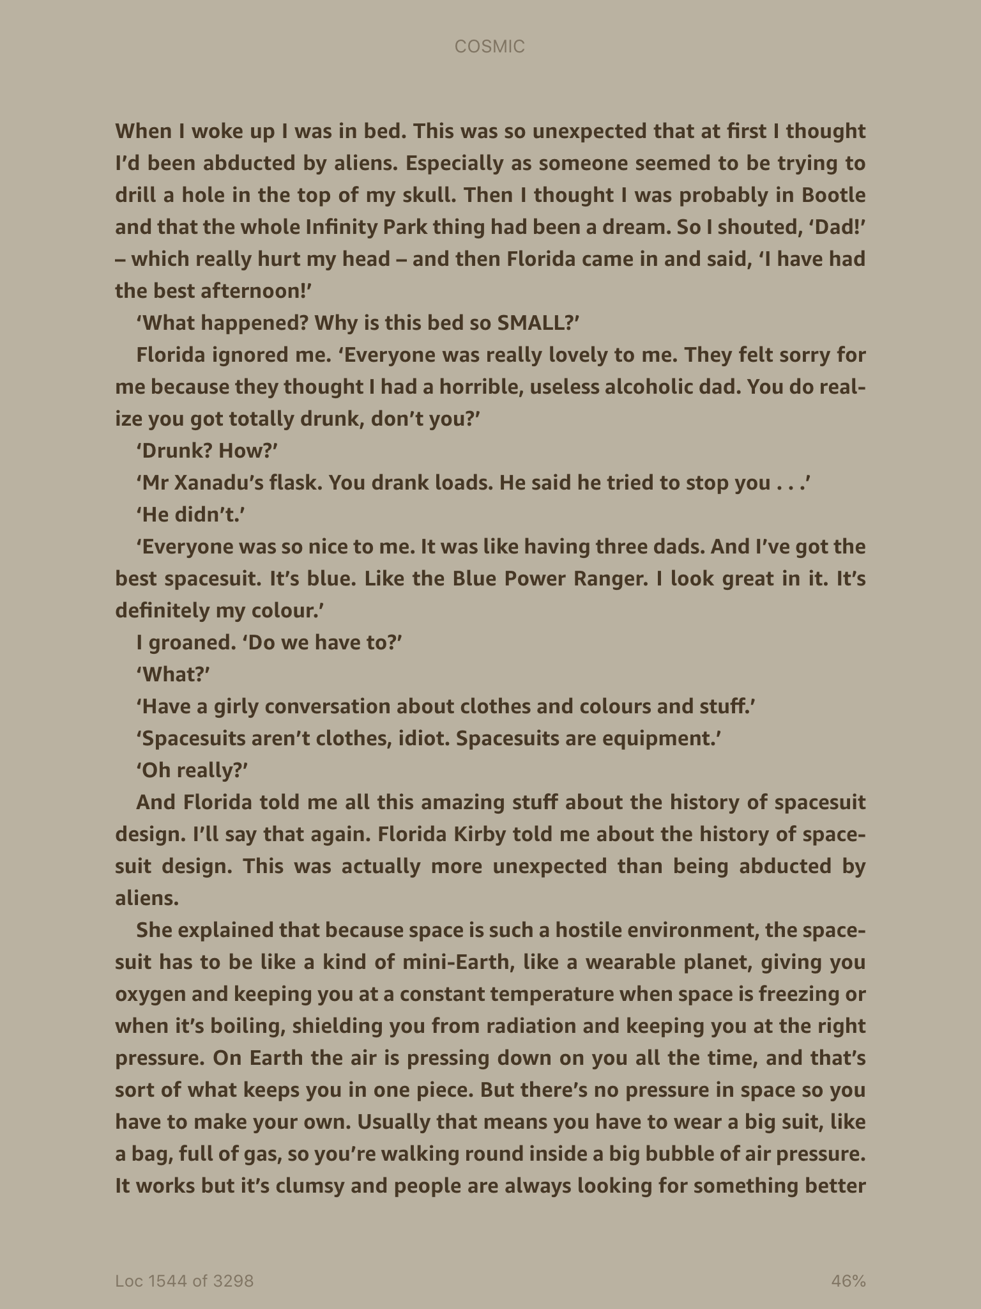

Slide 8
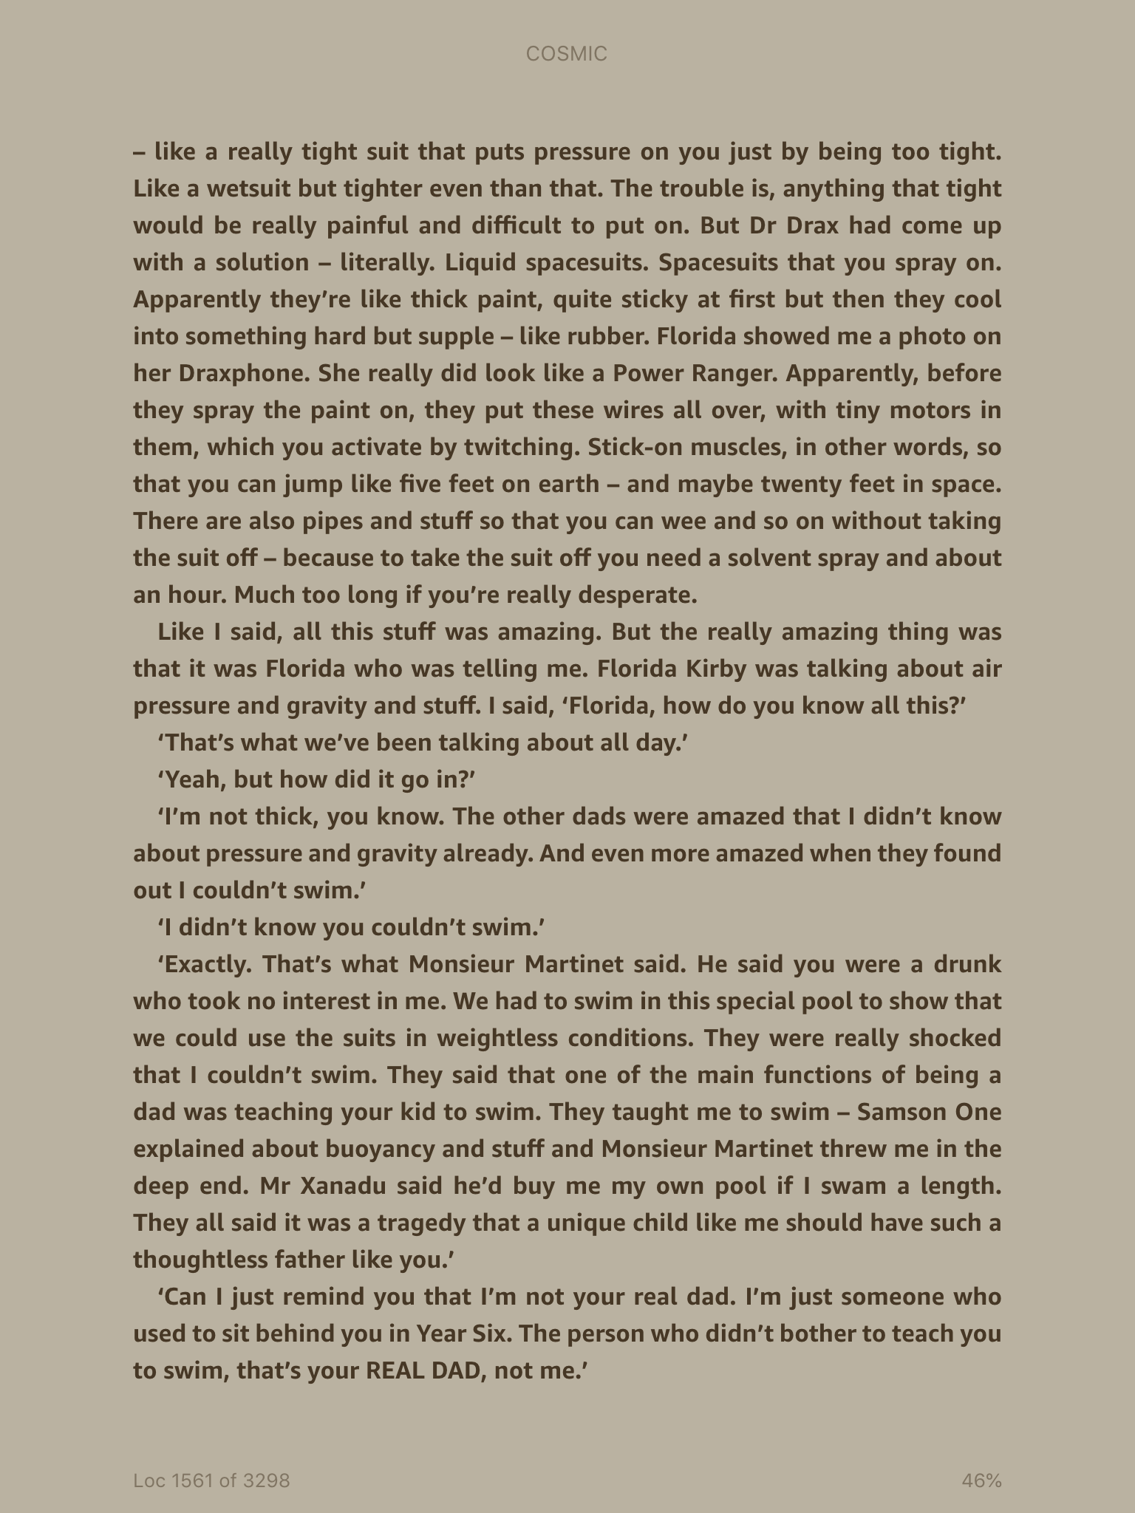

Slide 9
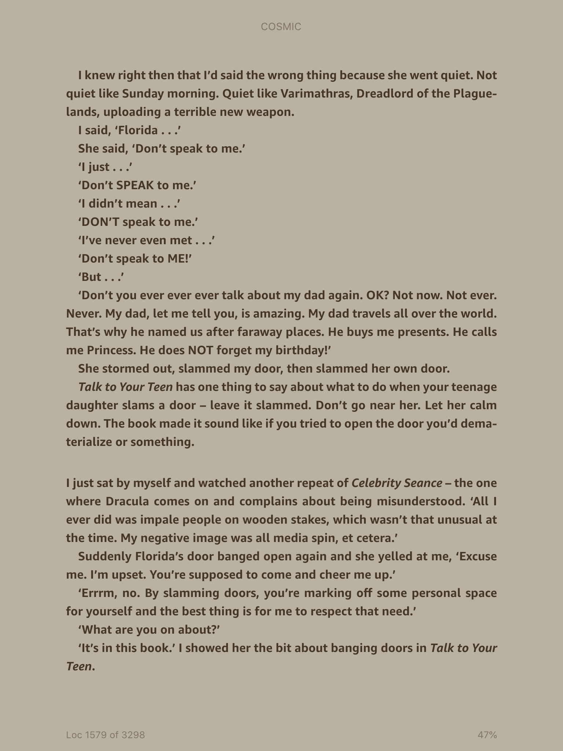

Slide 10
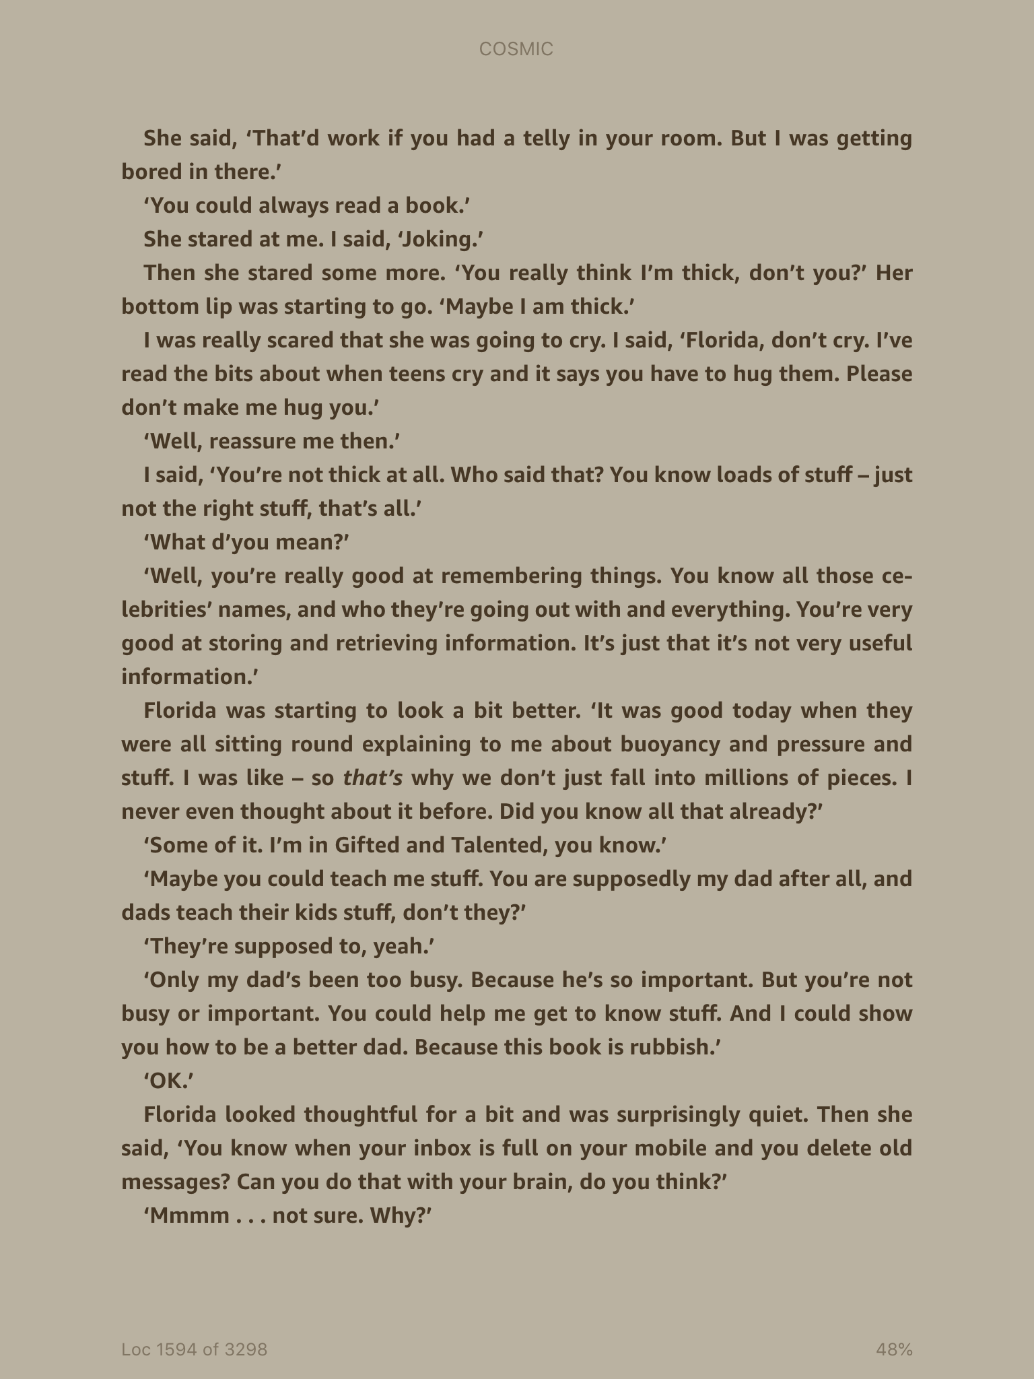

Slide 11
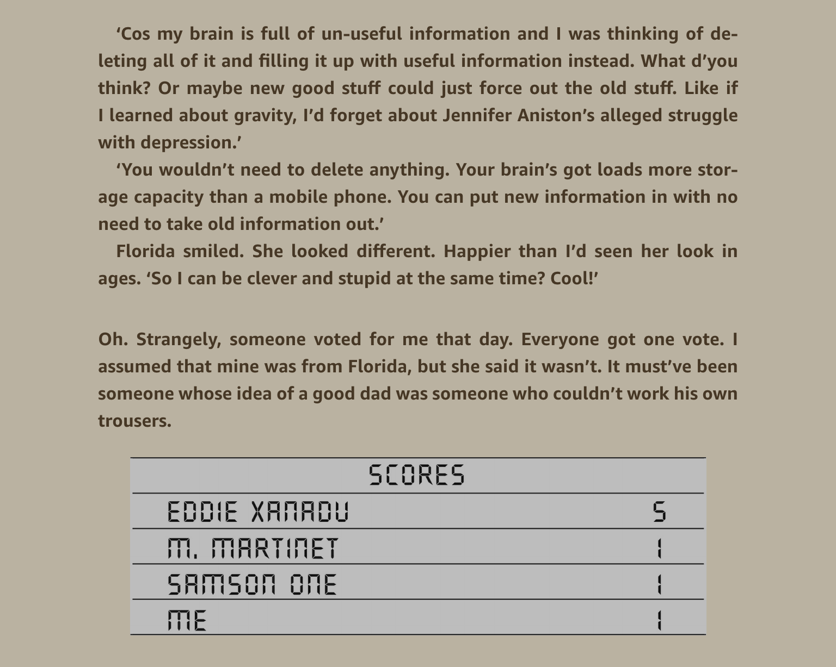

Slide 12

What pamphlet does Liam keep reading to help him manage Florida like a father would?
Who would this pamphlet be aimed at?
What sort of articles might it contain?

Slide 13
Main Task: We are pretending that ‘Talk to your Teen’ are starting a chat show, similar to Jeremy Kyle, to help parents deal with their difficult teenage children.
You will prepare advice on a given question. Think about the advice given in ‘Talk to your Teen’ and keep to the same style. You can choose one, several or all of them to answer.
My teenage daughter is obsessed with celebrities!
My father acts like a child!
My teenage daughter slams her door and won’t come out!
My daughter won’t speak to me!
How can I get my teenager to behave?

