Slide 1

TRAVEL TO TOKYO
GET READY!
KIT COLLECTOR PRESENTATION AND ACTIVITIES (KS2)
Notes:
TEACHER ONLY

Slide 2
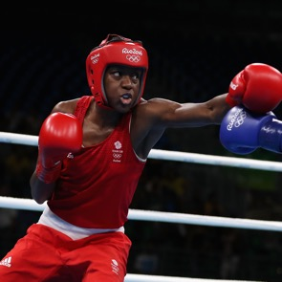
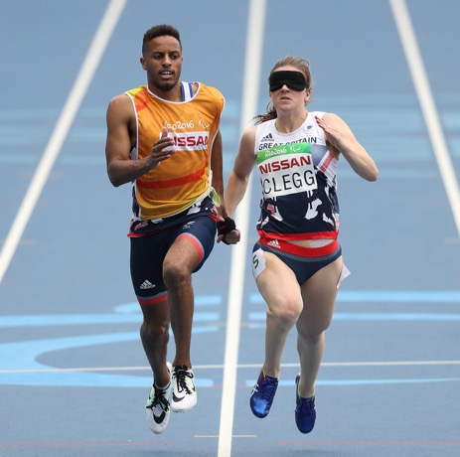
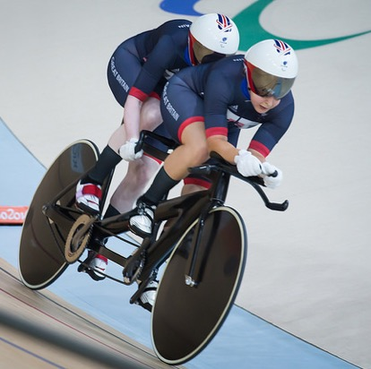
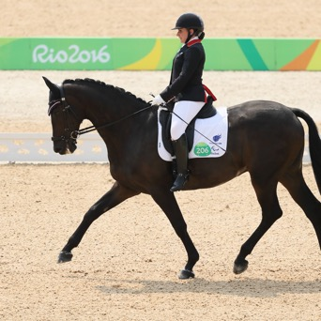
KITTED OUT: WHAT ATHLETES
NEED FOR TOKYO 2021
To take part in the Olympic and Paralympic Games, athletes need:
Kit – they wear special clothes to suit their sport.
Equipment – they use special equipment for their sport.
What kit and equipment can you see in the pictures?
Notes:
WITH PUPILS – INFORMATION
Use the slide to explain that athletes need specialist clothing (kit) and equipment to take part in the Olympic and Paralympic Games.
Part of the preparation for the Games involves athletes being given their team kit.
Ask pupils what different types of kit they wear for PE. Remind them they may wear different kit for different activities, e.g. swimming.
Ask them why they wear PE kit, e.g. safety, comfort, hygiene.
Explain that different sports need different kit and equipment.
Ask pupils to spot some of the kit and equipment shown in the photos. NB. Even horses need to be transported to the Games!
Use the quiz on the following slide to involve pupils in matching kit to sports.

Slide 3
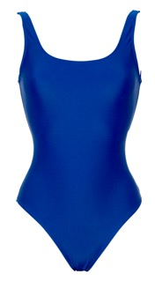
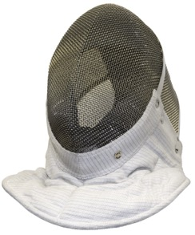
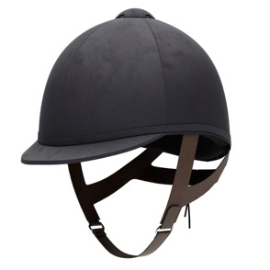
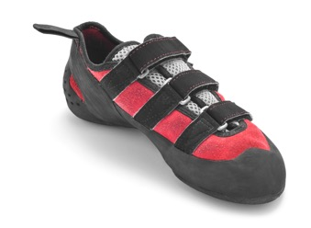
FOR WHICH SPORT WOULD YOU WEAR…?
A
B
C
D
A or B?
Swimming
Equestrian
Climbing
Fencing
Notes:
WITH PUPILS – ACTIVITY
Ask pupils to work in groups.
Show each item of kit and ask the groups to agree for which sport they would wear it.
Active learning option: ask each group to agree an action they will make to represent that sport, e.g. swimming might be a breaststroke movement. On ‘go’, ask the groups to make their actions as a way to give their answer.
Click to reveal the correct answer.

Slide 4
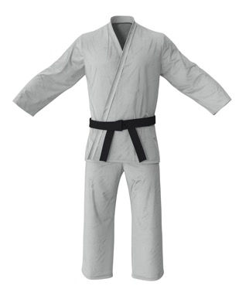
Traditional Japanese clothing influenced some modern sports.
Traditional Japanese kimono
きもの
Modern judogi (gi) for Judo
In which Olympic
or Paralympic
sports would
you wear
this type of kit?
A or B?
Notes:
WITH PUPILS – INFORMATION
Traditional Japanese dress – the kimono and obi (the belt) – influenced a number of modern sports.
Ask the pupils which Olympic or Paralympic sports these might include. If they need a hint, they are all martial arts.
Use the next slide to check their answers.

Slide 5
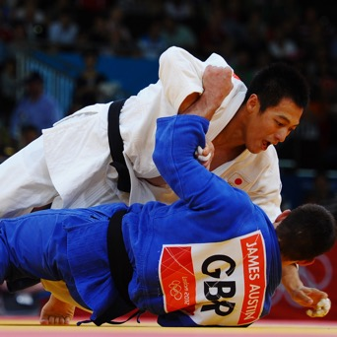
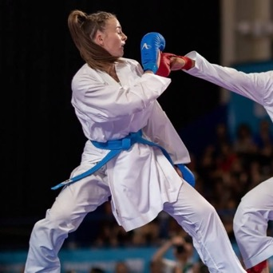
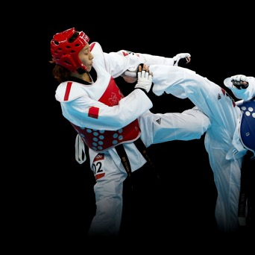
MODERN SPORTS INFLUENCED BY TRADITIONAL CLOTHING
Judo
Karate
Taekwondo
Notes:
WITH PUPILS – INFORMATION
Kit for the following modern sports (all martial arts) has been influenced by traditional Japanese clothing – even though not all of the martial arts are of Japanese origin. For example:
Judo – Olympics and Paralympics (Japanese origin sport)
Karate – Olympics – making its debut at Tokyo 2020 (Japanese origin sport)
Taekwondo – Olympics and Paralympics (Korean origin sport)
Pupils might also mention jujitsu (Japanese origin sport) but this is not an Olympic or Paralympic sport.

Slide 6
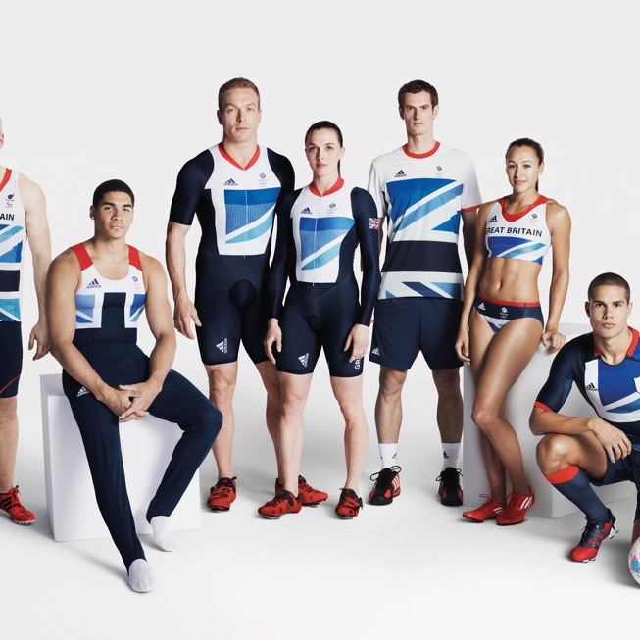
Looking the part: team kit
Athletes are given kit to wear for the Games.
A special design is created for each Games.
This shows athletes belong to Team GB or ParalympicsGB.
It makes athletes feel part of a team.
It shows they represent the UK.
Notes:
WITH PUPILS – INFORMATION
Explain that athletes are given specially designed kit when they go to the Games.
Although the actual kit is different for each sport, there is a consistent design across the team.
This shows the athletes represent the UK and helps them to feel part of a team.
This was the kit for Rio 2016 Olympic and Paralympic Games.

Slide 7
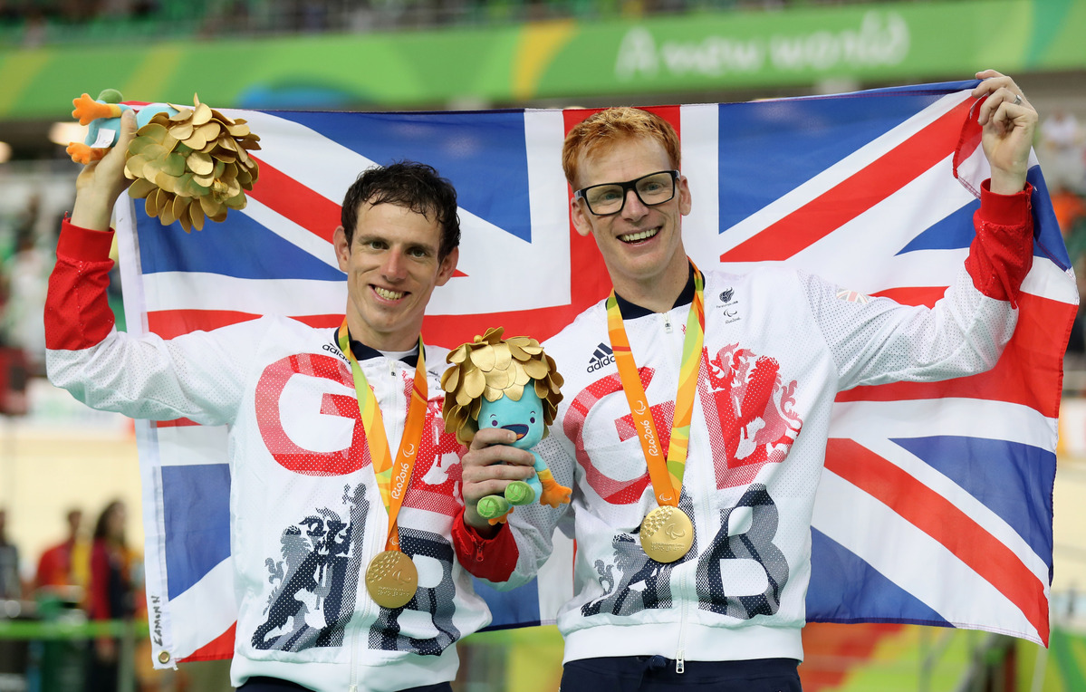


DESIGNED FOR THE UK
The Team GB and ParalympicsGB kit
GB Colours
red, white and blue
GB Shapes
lions
What will
you make?
Notes:
WITH PUPILS – ACTIVITY
Explain that the kit for Tokyo 2020 has not been revealed yet (likely to be revealed in June 2020).
Show the photo of the Rio 2016 kit: ask pupils what looks similar between the different items of kit?
Click again to reveal the answers:
Red, white and blue from the Union flag
Lions are symbols from the Royal Coat of Arms

Slide 8
DESIGNED FOR THE UK
Design your own team kit
?
GB Colours
red, white and blue
GB Shapes
lions
What colours will you use?
What shapes will you use?
Notes:
WITH PUPILS – ACTIVITY (Optional)
Explain that the kit for Tokyo 2020 has not been revealed yet (likely to be revealed in June 2020).
Show the photo of the Rio 2016 tracksuit.
Ask pupils to design a tracksuit, either for Team GB and ParalympicsGB (UK teams) or for their school/class.
CROSS-CURRICULAR OPPORTUNITY:
Geography: pupils research the climate in Tokyo – what will the weather be like in July/August?
Science and/or Design and Technology – pupils explore materials and identify what will be needed to help the athletes in Tokyo. (For example, keeping athletes cool was a priority during Rio 2016 due to high Brazilian temperatures.)

Slide 9
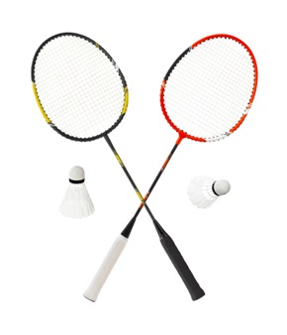
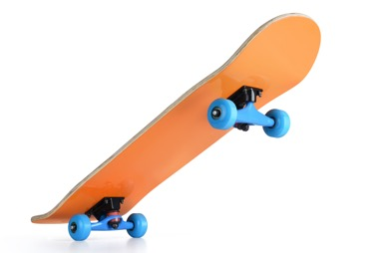
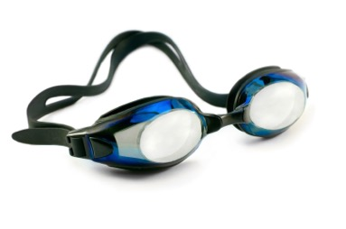
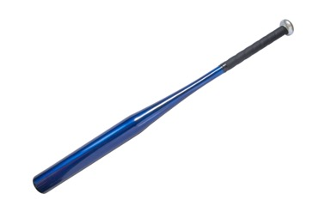
ATHLETES ALSO NEED SPECIAL EQUIPMENT
Match the equipment to the sport
A
B
C
D
Skateboarding
Swimming
Baseball
Badminton
Notes:
WITH PUPILS – ACTIVITY
As well as clothing, some athletes need specialist equipment for their sport.
Run the activity as a small group task:
Ask pupils to work in small groups (or pairs), as appropriate.
Show the items of equipment.
Ask pupils to agree in which sports the equipment is used.
Click again to reveal the answers.
Optional: ask pupils what equipment they use for sports and physical activities they do (in school or at home).

Slide 10
ATHLETES ALSO NEED SPECIAL EQUIPMENT
Match the equipment to the sport
A
B
C
D
Badminton
Skateboarding
Swimming
Baseball
Notes:
WITH PUPILS – INFORMATION
Answers are:
Badminton - A
Skateboarding - B
Swimming - C
Baseball - D
Optional: ask pupils what equipment they use for sports and physical activities they do (in school or at home).

Slide 11
SMALL CHANGES LEAD TO PERSONAL BESTS
+
=
Best kit
Best equipment
Better chance
of good result
Athletes make small changes to give themselves the best chance to improve and do well.
Notes:
WITH PUPILS – INFORMATION
Use the slide to introduce the idea of small changes leading to improved performance, leading to personal bests.
The following slide provides an example.

Slide 12
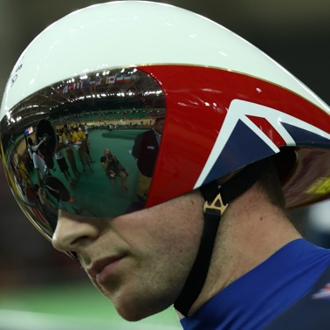
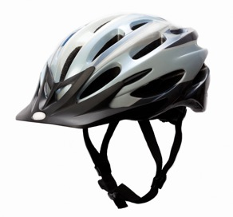
SMALL CHANGES = BETTER RESULTS IN SPORT
What has changed?
Lighter + more aerodynamic = faster
Notes:
WITH PUPILS – ACTIVITY
Use the slide to show an example of some changes that have been made to sports equipment to help improve athletes’ performances.
Working in pairs/groups, ask the pupils to identify:
What changes have been made?
How do those changes help athletes to perform better?
Encourage pupils to think about materials and shape.
Click to reveal answer.

Slide 13
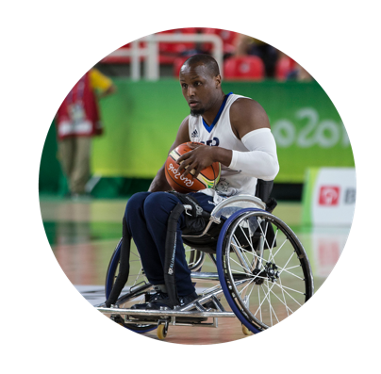
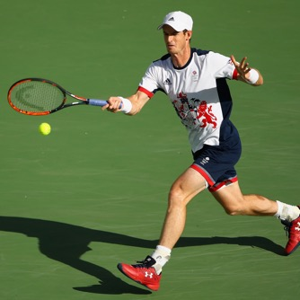
SMALL CHANGES = BETTER RESULTS IN SPORT
Wheelchair basketball players’ chairs have special wheels so they are less likely to tip over.
Tennis players can make their racket strings tighter or slacker to suit the weather.
Notes:
WITH PUPILS – INFORMATION
Use the slide to illustrate some changes that have been made to sports equipment to help improve athletes’ performances.
NB. The Active Challenge ‘Sports Technology’ suggests a cross-curricular activity for involving pupils in designing and improving a piece of sports equipment (links science, design and technology, and PE). Download it here: https://www.getset.co.uk/resources/travel-to-tokyo/ttt-teacher-resources

Slide 14
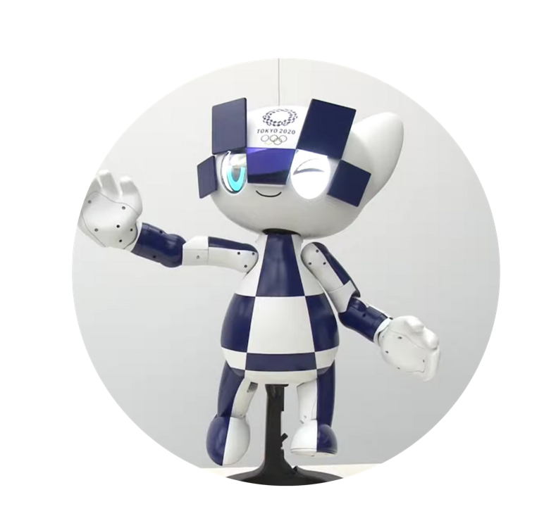
SMALL CHANGES =
BETTER RESULTS AT WORK
In Japan, workers:
Pay attention to details.
Think about their mistakes.
Make small changes to make things better.
This is called kaizen 改善
Japanese robots update their skills
as they learn!
These robots will
help at the Tokyo 2020 Games.
Notes:
WITH PUPILS – INFORMATION
Use the slide to share the Japanese work ethic with pupils, i.e. Japanese workers are always seeking to improve by examining the details of ‘failures’ or ‘mistakes’ and asking themselves how they can make something better.
In Japan, workers don’t hide their mistakes, as they know they can learn from them.
The Japanese word for improvement or betterment is kaizen.
This work ethic helps Japan to be a leader in the world of technology and Artificial Intelligence (AI).
Use the BBC clip to share a video of the Tokyo 2020 robots – an example of Japan leading the way in AI. https://www.bbc.co.uk/news/av/newsbeat-49070831/tokyo-2020-meet-the-olympic-and-paralympic-robots

