Slide 1

Week 4 Day 3

Slide 2
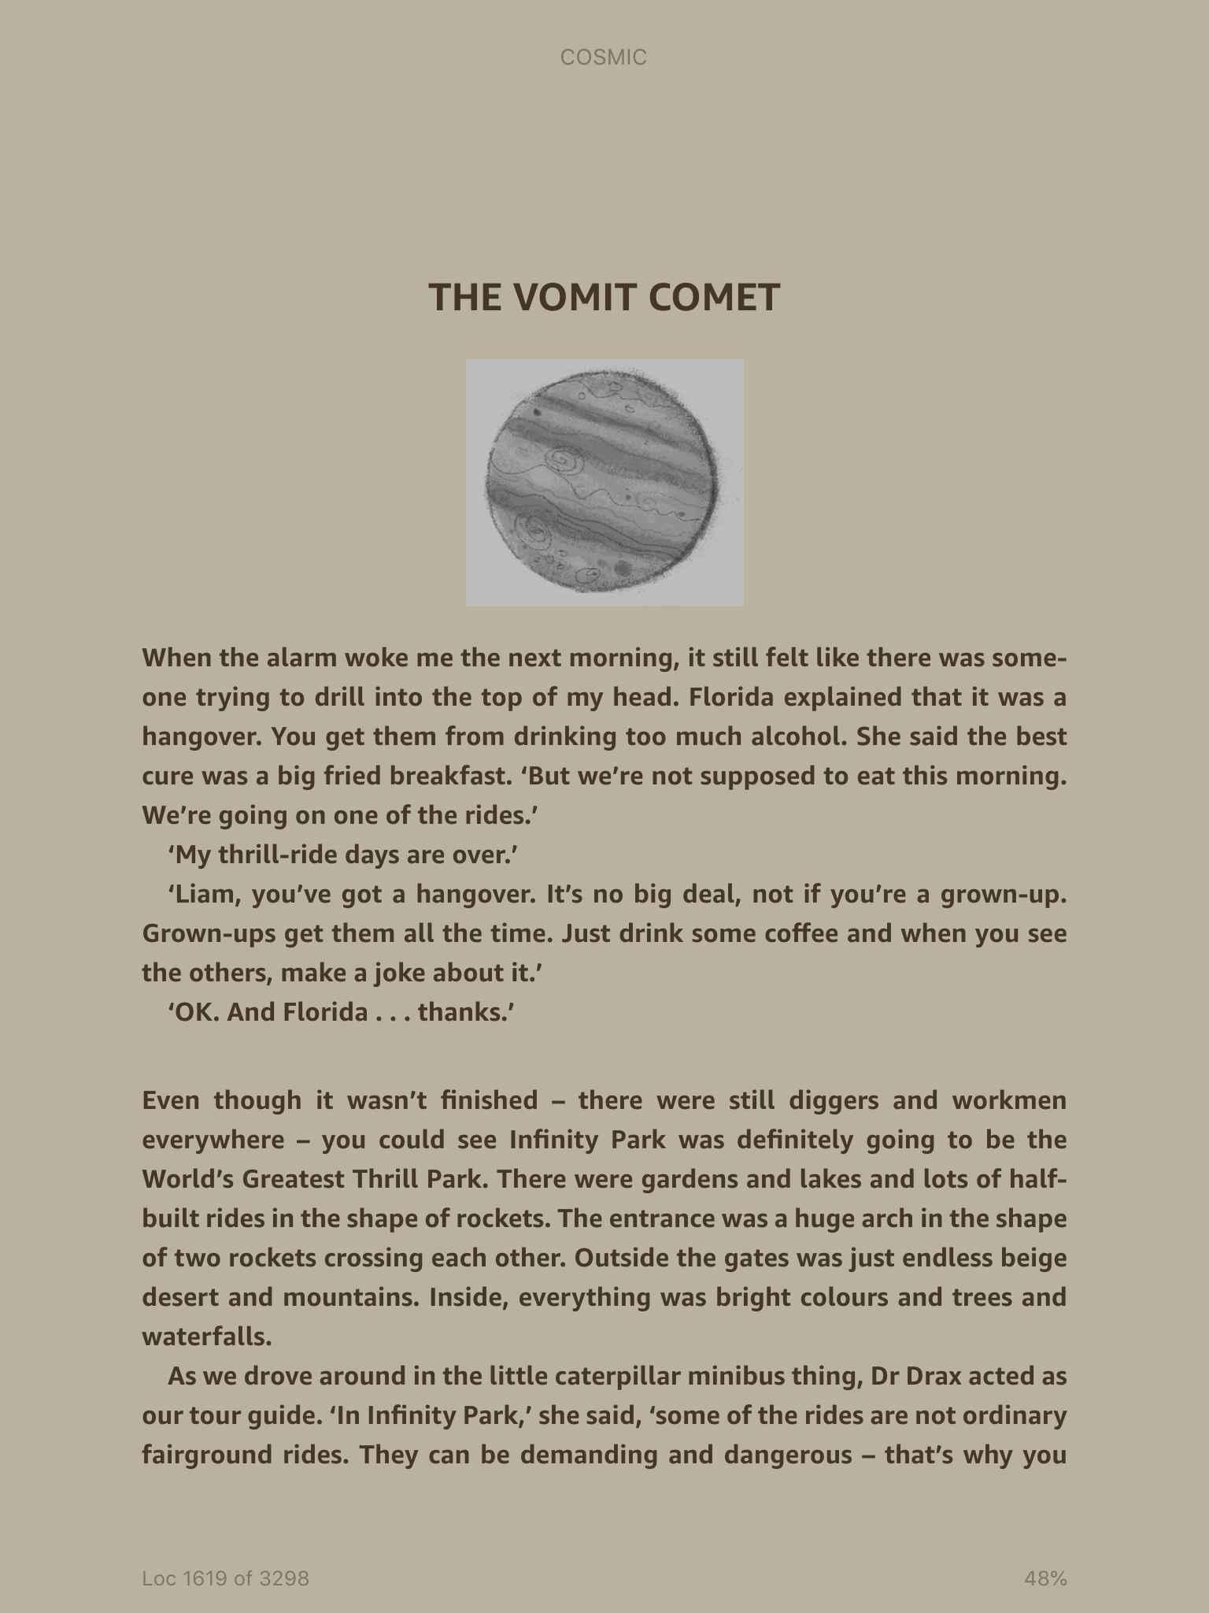
Read Chapter 17 – The Vomit Comet

Slide 3
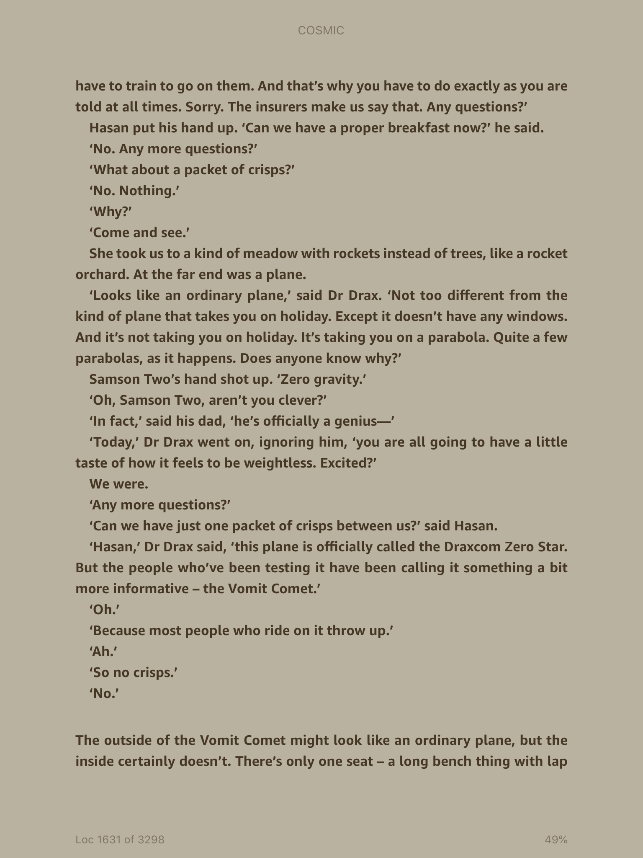

Slide 4
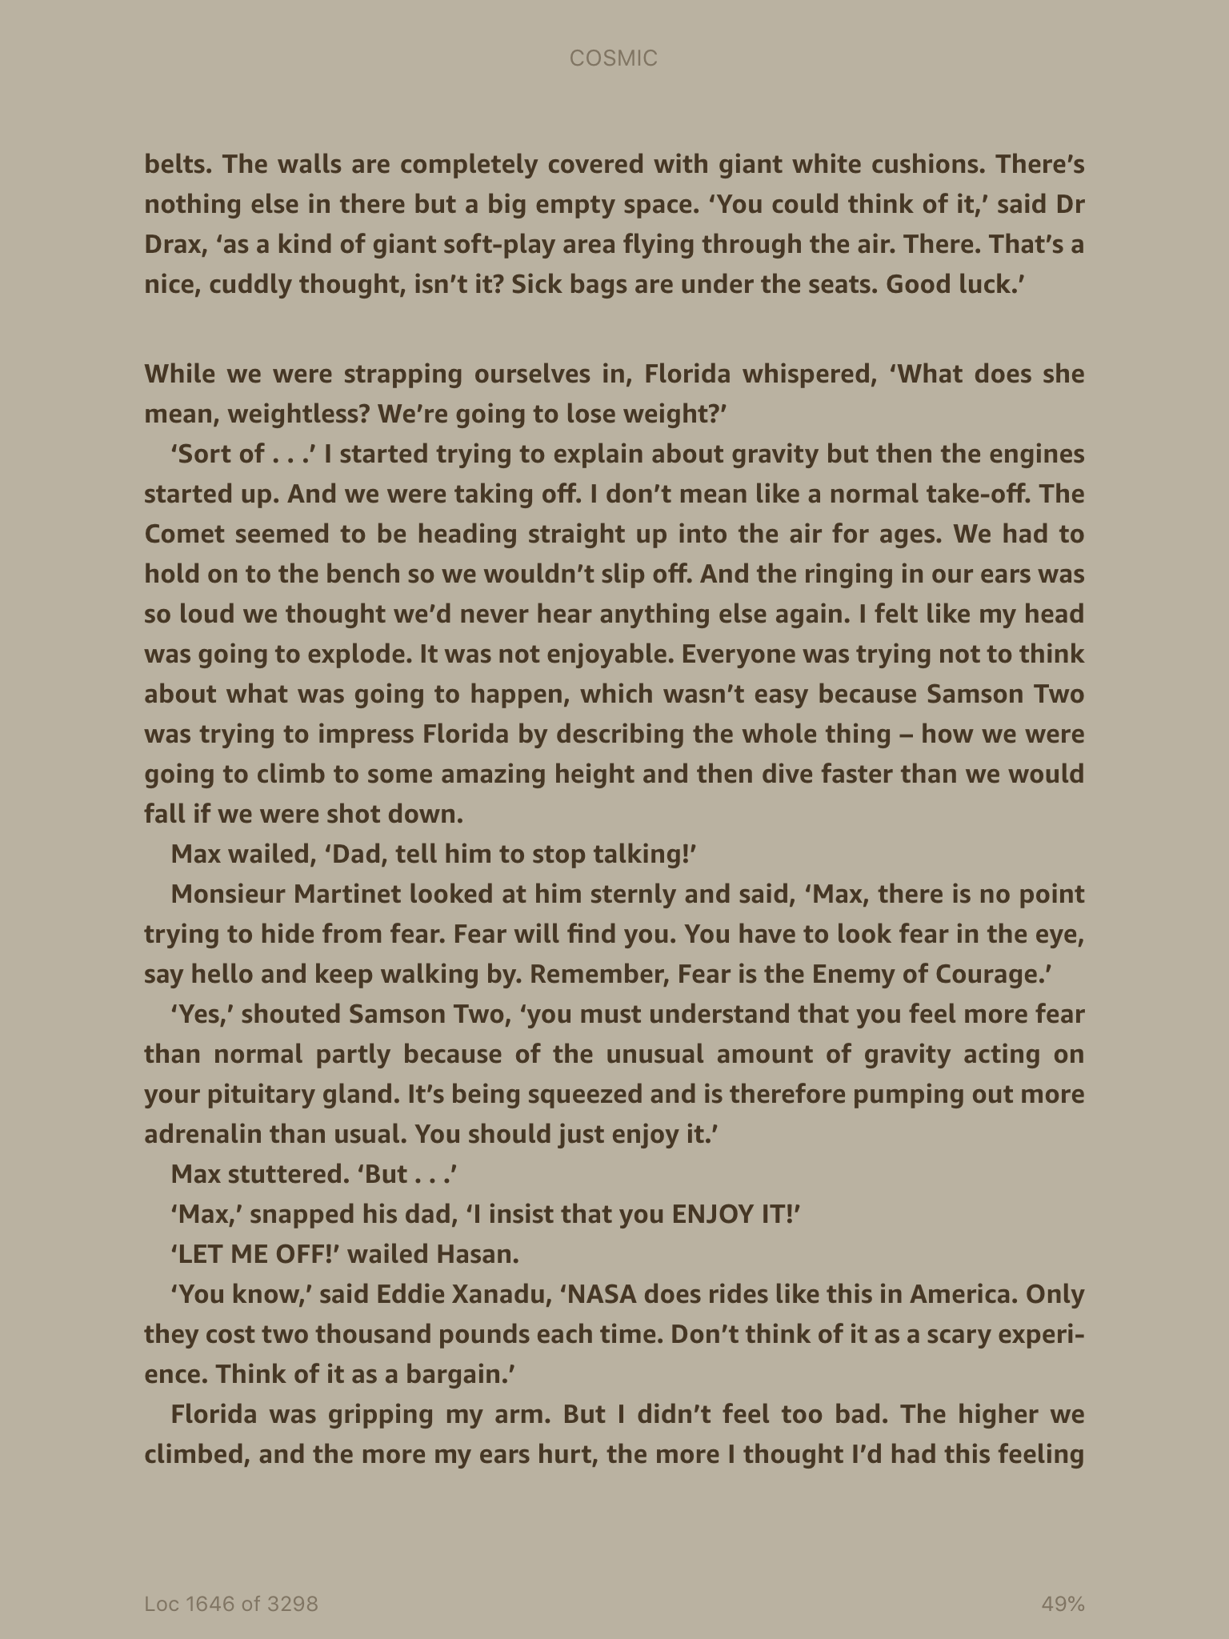

Slide 5
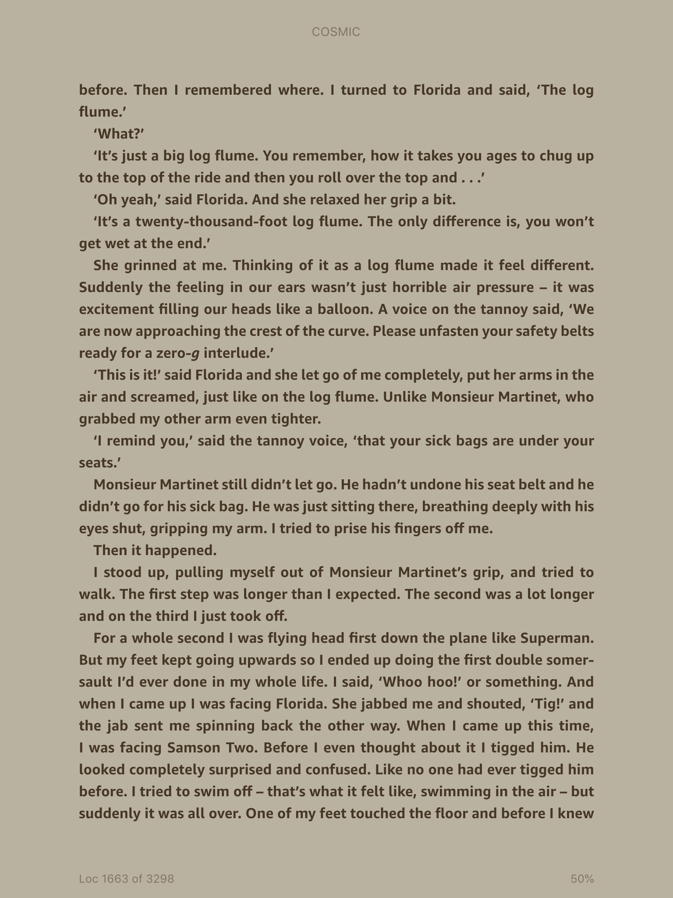

Slide 6
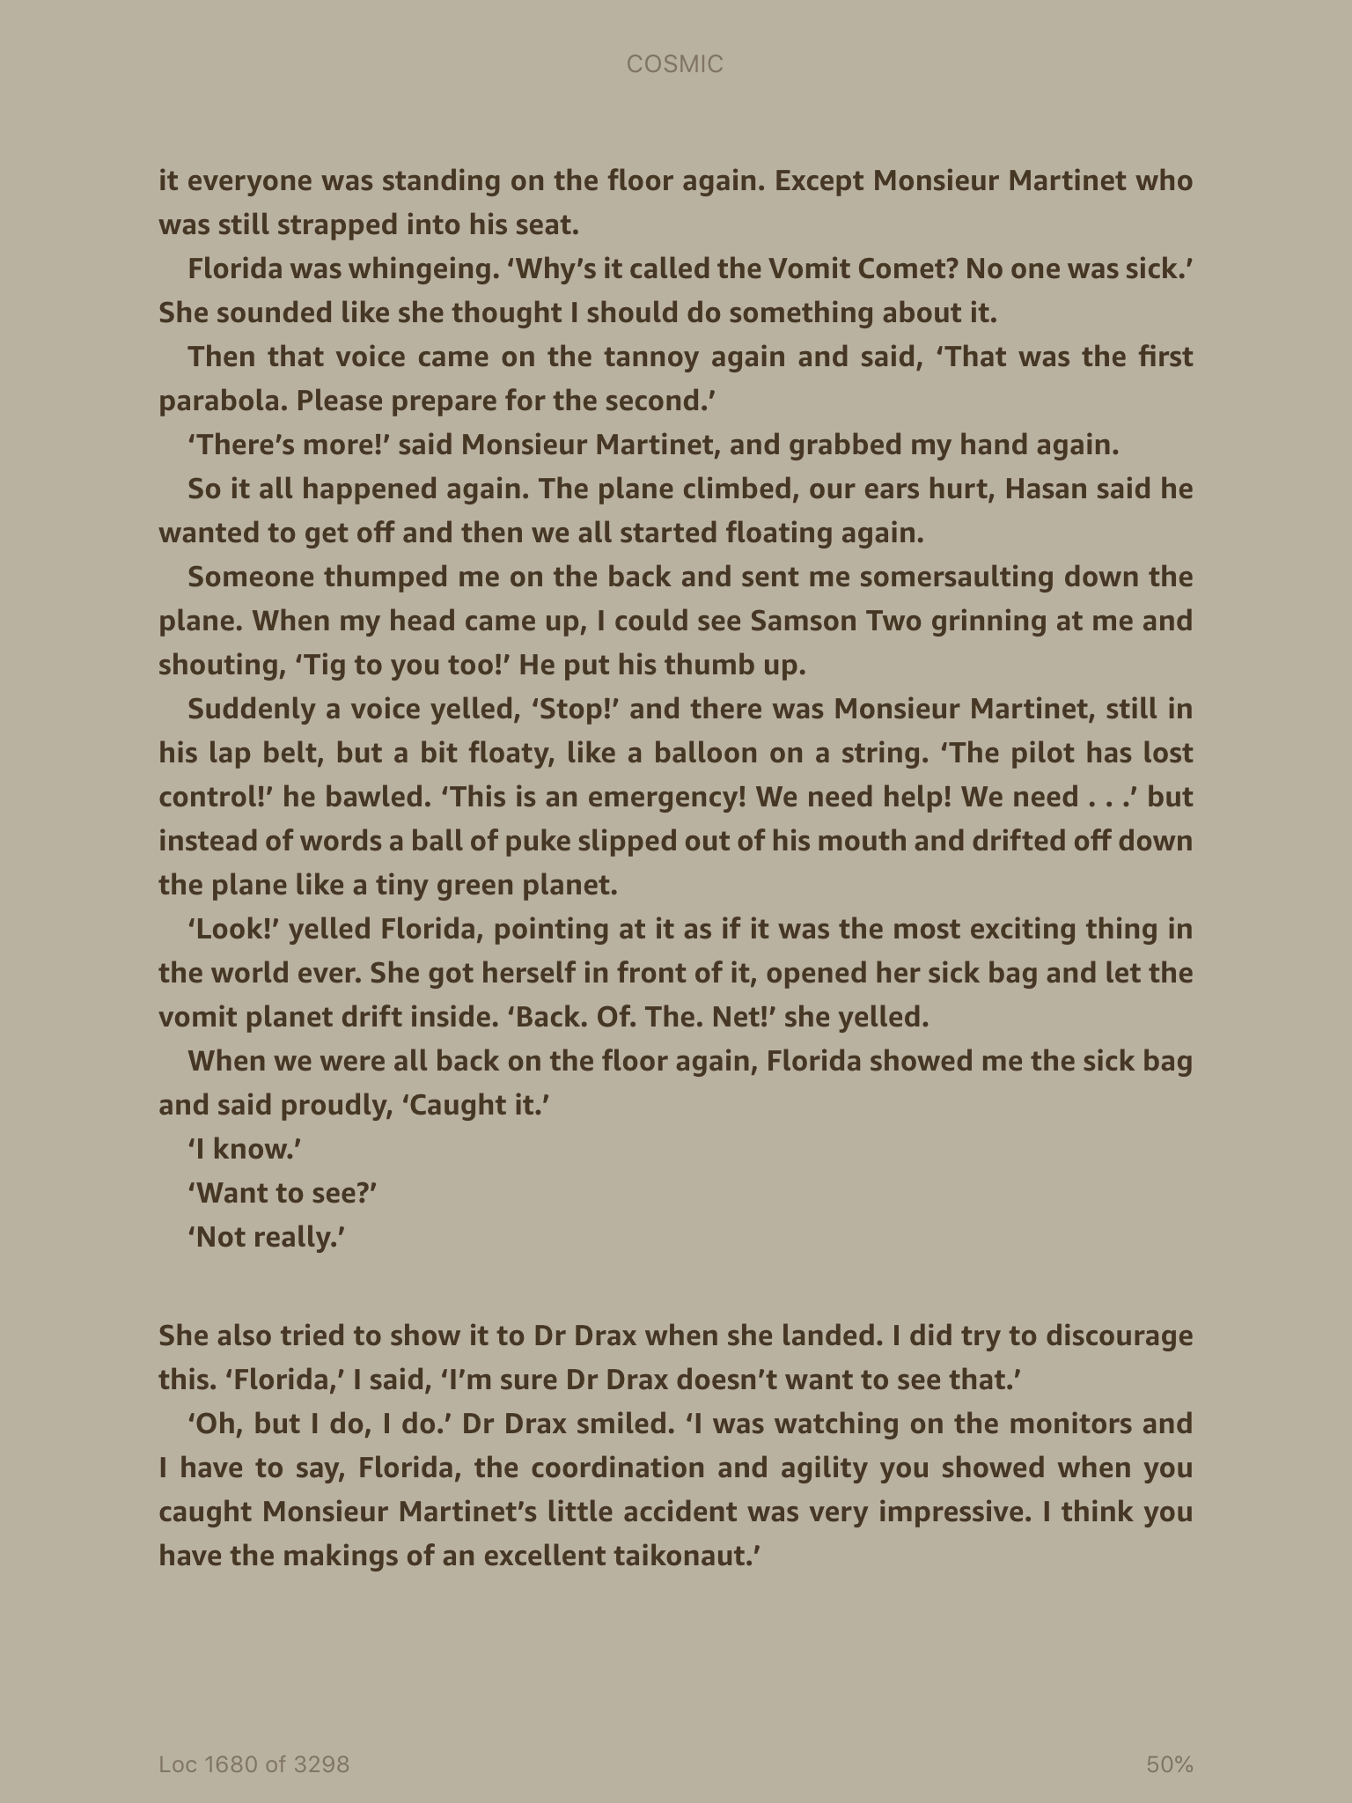

Slide 7
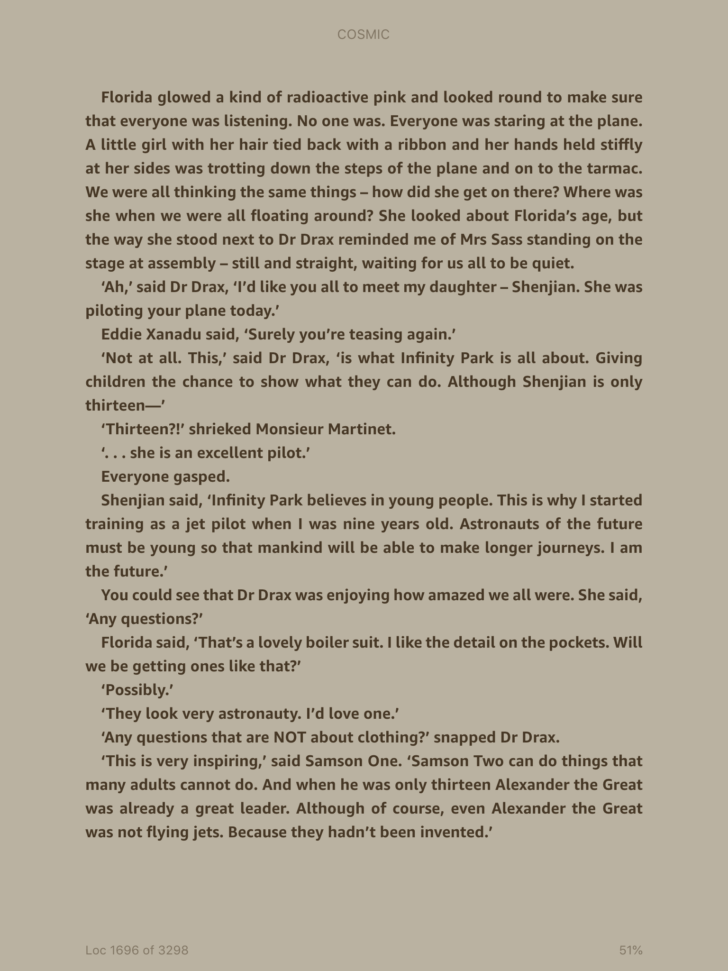

Slide 8
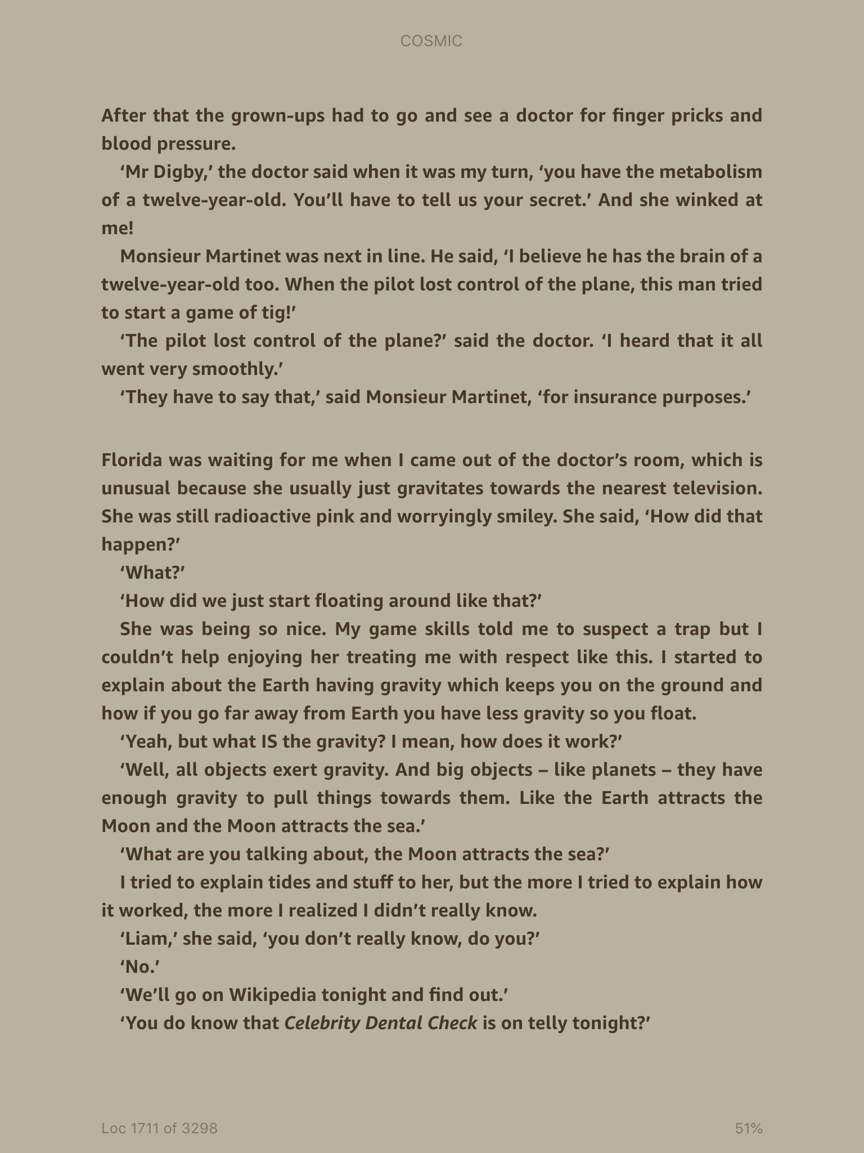

Slide 9
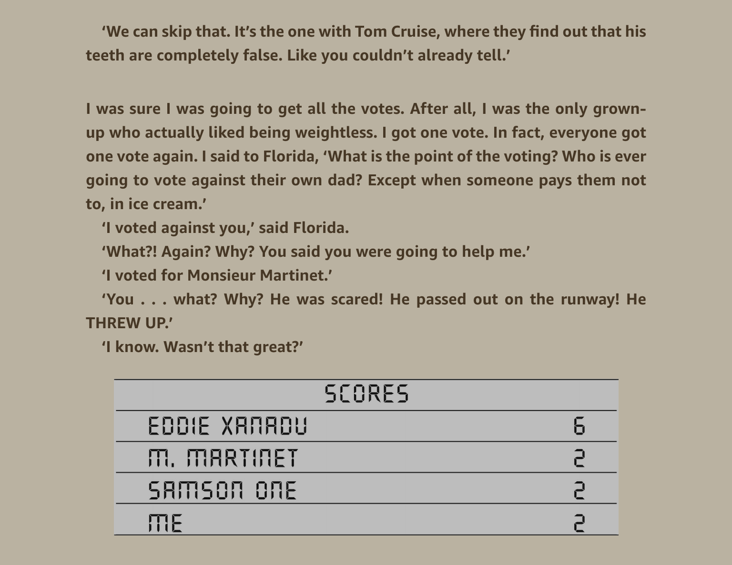

Slide 10
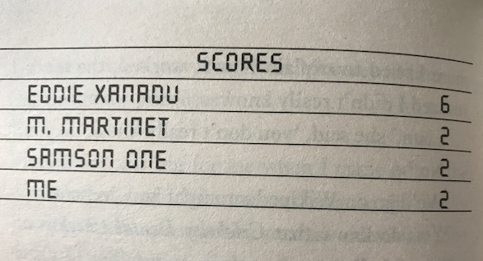
Main Task: You need to explain who has been voting for Liam. Use your knowledge of the characters and story so far to come to your conclusion. (written answer in books)
Now that you have read the chapter look at this image:
Somebody has voted for Liam again. Who could it be and why?
The choices are:
Florida, Hassan, Max, Samson 2 or… someone else?

